Slide 1
Introduction to Object-Oriented Programming (OOP)

Slide 2
So far, we have learned
Circuits and basic hardware components in a computer
Assembly programming language
Python
Recursion
Lists
Functions and parameters
Loops
The Python elements we learned can be used to accomplish some programming tasks as we have seen.

Slide 3
However, it is more natural to represent things in the real world as objects in a programming language!
For example,
A car that has an engine, a transmission, … that can move under some instructions …
A dog that can walk and bark …
A bird that can fly …
A book that has chapters and sections, and can be flipped through (read) …

Slide 4
Think, for example, if you are asked to build a program to maintain the information about a collection of books that contains title, author, publisher, date of publishing, and others, how would you do it?

Slide 5
One approach would be to use multiple lists or arrays
titles
authors
publishing_dates
To reference the 4th book in the collection, one would use titles[3], authors[3], publishing_dates[3]
Another approach would be to define a list (or an array) of book objects, each of which has an author field, a title field, a publishing_date field. When referring to a book, one would use book[3].author, book[3].title, …

Slide 6
Object Oriented Programming
An OOP language allows you to create your own types
A class is a type
An object is a particular instance of that type
There can be one instance
Or many instances
There can be operations (functions, a.k.a., methods) that apply to the object.

Slide 7
Everything in Python is an object!
Its capabilities depend on its class.
functions
class
"methods"
by the way, you can build your own...

Slide 8
Objects
An object is a structure - like a list - except
(1) Its data elements have names chosen by the programmer.
(2) An object contains its own functions that it can call (use)!
usually called "fields", "attributes"
usually called "methods" instead of functions:
__init__
__str__
the constructor
the string representation
(for printing)

Slide 9
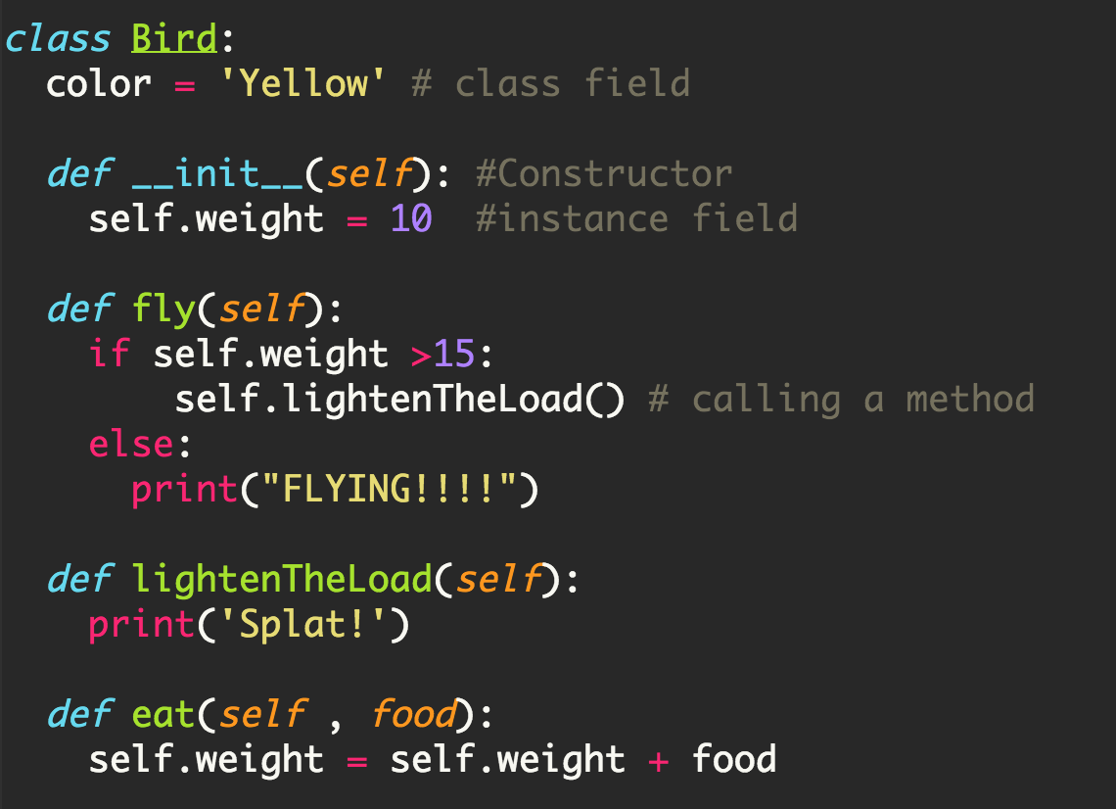
Here’s what a class may look like (Python syntax)
bigBird = Bird()
bigBird.fly()
bigBird.eat(20)
bigBird.fly()

Slide 10
Compared to what we know already …
The use of “Bird” class
The use of “String” class
sparrow = Bird()
print( sparrow)
sparrow.fly()
sparrow.eat( 20 )
sparrow.fly()
myString = “Hello World!”
capital = myString.caplitalize()
words = myString.split()
print( capital )
letterO = words[0].endswith(‘o’)
print( letterO )

Slide 11
Date
This is a class. It is a user-defined datatype (that you'll build in Lab!)
>>> d = Date(3,30,2011)
>>> print(d)
03/30/2011
this calls a CONSTRUCTOR …
this is an object of type Date
the representation of a particular object of type Date
>>> d.is_leap_year()
False
the isLeapYear method returns True or False. How does it know what year to check?
>>> d2 = Date(1,1,2012)
>>> print(d2)
01/01/2012
>>> d2.is_leap_year()
True
Another object of type Date - again, from the constructor.
How does it know to return True, instead of False in this case ??

Slide 12
class Date:
""" a blueprint (class) for objects
that represent calendar days
"""
def __init__( self, mo, dy, yr ):
""" the Date constructor """
self.month = mo
self.day = dy
self.year = yr
def __str__( self ):
""" used for printing Dates """
s = "{:02d}/{:02d}/{:04d}".format(self.month,self.day,self.year)
return s
def is_leap_year( self ):
""" anyone know the rule? """
The Date class
C/C++ printf style string formatting. See Python string documentation
Notes:
Take time to show this in IDLE, and then create some objects.

Slide 13
self
is the specific OBJECT THAT CALLS A METHOD
>>> d = Date(11,8,2011)
>>> print(d)
11/08/2011
These methods need access to the object that calls them
>>> d.is_leap_year()
False
>>> d2 = Date(1,1,2012)
>>> print(d2)
01/01/2012
>>> d2.is_leap_year()
True
These methods need access to the object that calls them

Slide 14
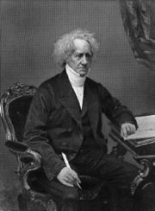
a Leap of faith….
class Date:
def __init__( self, mo, dy, yr ): (constructor)
def __str__( self ): (for printing)
def is_leap_year( self ):
if self.year%400 == 0:
return True
if self.year%100 == 0:
return False
return self.year % 4 == 0
John Herschel

Slide 15
Classes – DIY data
Class: a user-defined datatype
Object: data or a variable whose type is a class
constructor
object
d = Date( 11, 11, 2011 )
d.tomorrow()
print(d)
method
d would be named self inside the Date class...
uses str
Method: a function defined in a class called by an object
self: in a class, the name of the object calling a method
Constructor: the __init__ function for creating a new object
str: the __str__ function returning a string to print
data members: the data in self: self.day, self.month, self.year

Slide 16
Date ids
>>> d = Date(11,8,2011)
>>> print(d)
11/08/2011
>>> d2 = Date(11,9,2011)
>>> print(d2)
11/09/2011
this creates a different Date object!
>>> d2.yesterday()
>>> d == d2
False
>>> d == d2
False
Notes:
Take a moment to show how they have different memory locations by using the id() function
Point out that yesterday() is a function they will need to work on in Lab

Slide 17
Date ids
What date is on your id?
What id is on your Date?
UFO license
Area 51, CA
>>> d = Date(11,8,2011)
>>> print(d)
11/08/2011
>>> d2 = Date(11,9,2011)
>>> print(d2)
11/09/2011
this initializes a different Date!
Python objects are handled by reference!
How can this still be a different date?
>>> d2.yesterday()
>>> d == d2
False
>>> d == d2
False

Slide 18
Date ids
>>> d = Date(11,8,2011)
>>> print(d)
11/08/2011
>>> d2 = Date(11,9,2011)
>>> print(d2)
11/09/2011
this initializes a different Date!
Need an equals method to check if their VALUES are equal, not their MEMORY ADDRESSES
>>> d2.yesterday()
>>> d.equals(d2)
True
>>> d == d2
False

Slide 19
equals
class Date:
def __init__( self, mo, dy, yr ):
def __str__(self):
def isLeapYear(self):
def equals(self, d2):
""" returns True if they represent
the same date; False otherwise
"””
Notes:
def equals(self, d2):
return self.month == d2.month and self.day == d2.day and self.year == d2.year

Slide 20
References
>>> d = Date(11,8,2011)
>>> print(d)
11/08/2011
>>> d2 = d
>>> print(d2)
11/08/2011
>>> d.yesterday()
>>> print(d2)
11/07/2011
These refer to the same object!
We need a way to make a copy of an object! Simple assignment will not work!

Slide 21
copy
class Date:
def __init__( self, mo, dy, yr ):
def __str__(self):
def is_leap_year(self):
def equals(self):
def copy(self):
""" returns a DIFFERENT object w/SAME date value! """
return Date(self.month, self.day, self.year)
Whenever you want to create a brand-new object, use the appropriate CONSTRUCTOR
Notes:
def copy(self):
return Date(self.month,self.day,self.year)

Slide 22
What's wrong?
d = Date(1,1,2012)
d2 = Date(11,8,2011)
d.is_before( d2 )
True
class Date:
def is_before(self, d2):
""" if self is before d2, this should
return True; else False """
if self.month < d2.month:
return True
if self.day < d2.day:
return True
if self.year < d2.year:
return True
return False
Notes:
def isBefore(self, d2):
""" if self is before d2, this should
return True; else False """
if self.year < d2.year:
return True
if self.month < d2.month and self.year == d2.year:
return True
if self.day < d2.day and self.month == d2.month:
return True
return False

Slide 23
Better
d = Date(1,1,2012)
d2 = Date(11,8,2011)
d.is_before( d2 )
False
class Date:
def is_before(self, d2):
""" if self is before d2, this should
return True; else False """
if self.year < d2.year:
return True
if self.month < d2.month and self.year == d2.year:
return True
if self.day < d2.day and self.month == d2.month:
return True
return False
Notes:
def isBefore(self, d2):
""" if self is before d2, this should
return True; else False """
if self.year < d2.year:
return True
if self.month < d2.month and self.year == d2.year:
return True
if self.day < d2.day and self.month == d2.month:
return True
return False

Slide 24
tomorrow()
class Date:
def tomorrow(self):
""" moves the date that calls it ahead 1 day """
monthLen = [0,31,28,31,30,31,30,31,31,30,31,30,31]
Write this tomorrow method.
first, add 1 to self.day
then, adjust month and year, if needed
Notes:
Ignore the leap year the first time through it… give a chance to work on this.
if self.isLeapYear() and self.month == 2:
monthLen[2] = 29
self.day += 1
if self.day > monthLen[self.month]:
self.day = 1
self.month += 1
if self.month == 13:
self.month = 1
self.year += 1

Slide 25
Classes – DIY data
design-it-yourself!
Class: a user-defined datatype
Object: data or a variable whose type is a class
constructor
object
d = Date( 11, 11, 2011 )
d.tomorrow()
print(d)
method
d would be named self inside the Date class...
uses str
Method: a function defined in a class called by an object
self: in a class, the name of the object calling a method
Constructor: the __init__ function for creating a new object
str: the __str__ function returning a string to print
data members: the data in self: self.day, self.month, self.year

Slide 26
Operator Overload
If we define a class of objects, we may be able to or need to reuse some common operators
For example, to compare two date objects, can we say something like ‘d1 > d2’ if d1 is AFTER d2?
Or for two objects in a rational number class, can we say something like ‘r1 > r2’?
Python and any other modern programming languages allow ‘operator overload,’ that is, re-define the meaning of a common operator.

Slide 27
The example of the Rational class
From our text book
r1 = 1/3, r2 = 2/5, how to do operations such as r1 + r1, or comparisons such as if r1 == r2, or if r1 > r2?
We need overload the operators such as < or ==
How to do it?
Define specially named methods, __add__(), __eq__(), __ge__(), __gt__()
Show Rational.py

