Slide 1
Stacks
Revised based on textbook author’s notes.

Slide 2
Stacks
A restricted access container that stores a linear collection.
Very common for solving problems in computer science.
Provides a last-in first-out (LIFO) protocol.

Slide 3
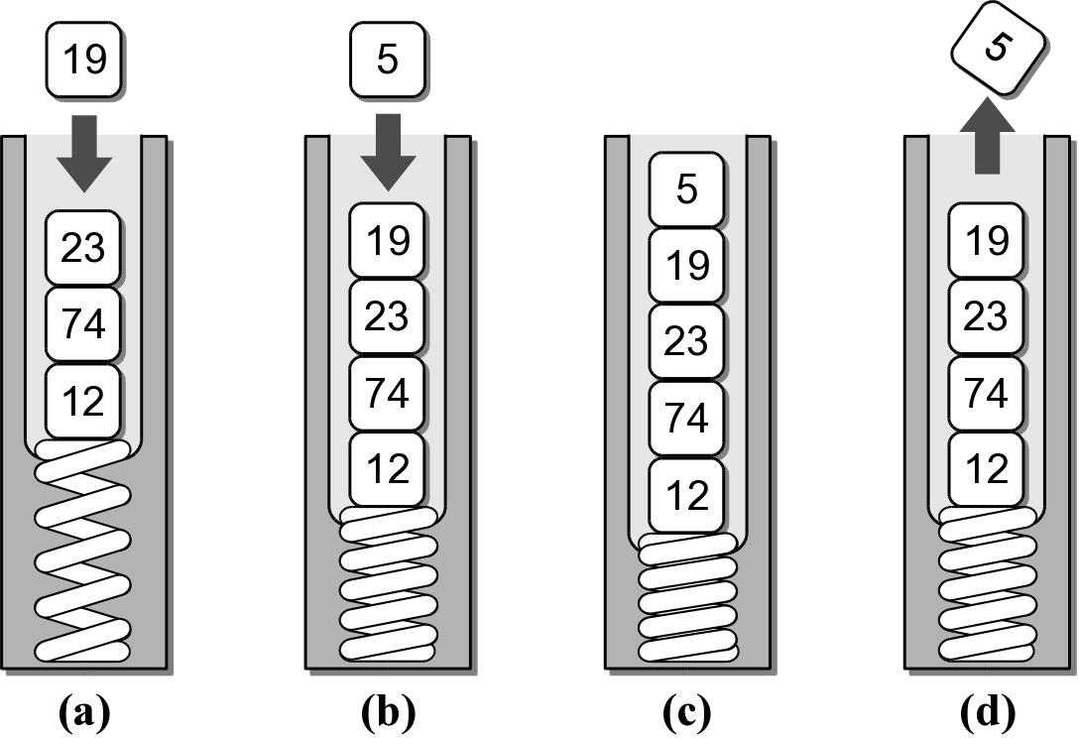
The Stack
New items are added and existing items are removed from the top of the stack.

Slide 4
Why stacks are useful?
Many computer science problems (and real life problems) are solved using stacks.
We’ll touch a few here.
Example: determine if a string is a palindrome
Here is a list of palindrome
http://www.palindromelist.net/
A Toyota’s a Toyota.
Civic
Go dog.
Tell a ballet.

Slide 5
We can solve the palindrome problem in recursion

Slide 6
We can also solve the problem using stacks
Given a string s, put the sting into a stack, then take the one on stack out in order (LIFO). If the two are the same, it is a palindrome!
Original string
In-stack
Output
civic
civic
civic
godog
godog
godog
hello
olleh
olleh

Slide 7
The Stack ADT
A stack stores a linear collection of items with access limited to a last-in first-out order.
Adding and removing items is restricted to the top of the stack.
Stack() is_empty() len() pop() peek() push( item )

Slide 8
Stack Example
reverse.py
# Extracts a collection of integer values from the user
# and prints them in reverse order.
PROMPT = "Enter an int value (<0 to end): "
my_stack = Stack()
# Extract the values and push them onto a stack.
value = int(input( PROMPT ))
while value >= 0 :
my_stack.push( value )
value = int(input( PROMPT ))
# Pop the values from the stack and print each.
while not my_stack.is_empty() :
value = my_stack.pop()
print( value )

Slide 9
Stack Implementation
Several common ways to implement a stack:
Python list
easiest to implement
Linked list
better choice when a large number of push and pop operations are performed.

Slide 10
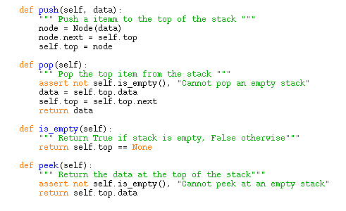
Linked list implementation

Slide 11
Stack Applications
Many applications encountered in computer science requires the use of a stack.
Balanced delimiters
Postfix expressions

Slide 12
Balanced Delimiters
Many applications use delimiters to group strings of text or simple data into subparts.
mathematical expressions
programming languages
HTML markup

Slide 13
Source Code Example
Consider the following C++ source code:
int sumList( int theList[], int size )
{
int sum = 0;
int i = 0;
while( i < size ) {
sum += theList[ i ];
i += 1;
}
return sum;
}

Slide 14
Source Code Example
The delimiters must be paired and balanced.
We can design and implement an algorithm to:
scan a C++ source file, and
determine if the delimiters are properly paired.

Slide 15
Valid C++ Source?
from lliststack import Stack
def isValidSource( srcfile ):
s = Stack()
for line in srcfile :
for token in line :
if token in "{[(" :
s.push( token )
elif token in "}])" :
if s.isEmpty() :
return False
else :
left = s.pop()
if (token == "}" and left != "{") or \
(token == "]" and left != "[") or \
(token == ")" and left != "(") :
return False
return s.isEmpty()

Slide 16
Mathematical Expressions
We work with mathematical expressions on a regular basis.
Easy to determine the order of evaluation.
Easy to calculate.
But the task is more difficult in computer programs.
A program cannot visualize the expression to determine the order of evaluation.
Must examine one token at a time.

Slide 17
Types of Expressions
Three different notations can be used:
infix: A + B * C
prefix: + A * B C
postfix: A B C * +

Slide 18
Infix to Postfix
Infix expressions can be easily converted by hand to postfix notation.
1. Fully parenthesize the expression.
2. For each set of (), move operator to the end of the closing parenthesis.
A * B + C / D
((A * B) + (C / D))
((A B *) (C D /) +)

Slide 19
Infix to Postfix (cont)
The expression at the end of step 2:
3. Remove all of the parentheses.
Which results in the postfix version.
((A B *) (C D /) +)
A B * C D / +

Slide 20
Evaluating Postfix Expressions
We can evaluate a valid postfix expression using a stack structure.
For each token:
If the current token is an operand, push its value onto the stack.
If the current token is an operator:
pop the top two operands off the stack.
perform the operation (top value is RHS operand).
push the result of the operation back on the stack.
The final result will be the last value on the stack.

Slide 21
Postfix Evaluation Examples
To illustrate the use of the algorithm, assume
the existence of an empty stack, and
the following variable assignments
Evaluate the valid expression:
A = 8 C = 3
B = 2 D = 4
A B C + * D /

Slide 22
Postfix Example #1
Token | Alg Step | Stack | Description
ABC+*D/ | 1 | 8 | push value of A
ABC+*D/ | 1 | 8 2 | push value of B
ABC+*D/ | 1 | 8 2 3 | push value of C
ABC+*D/ | 2(a) | 8 | pop top two values: y = 3, x = 2
 | 2(b) | 8 | compute z = x + y or z = 2 + 3
 | 2(c) | 8 5 | push result (5) of the addition
ABC+*D/ | 2(a) |  | pop top two values: y = 5, x = 8
 | 2(b) |  | compute z = x * y or z = 8 * 5
 | 2(c) | 40 | push result (40) of the multiplication
ABC+*D/ | 1 | 40 4 | push value of D
ABC+*D/ | 2(a) |  | pop top two values: y = 4, x = 40
 | 2(b) |  | compute z = x / y or z = 40 / 4
 | 2(c) | 10 | push result (10) of the division

Slide 23
Postfix Example #2
What happens if the expression is invalid?
A B * C D +
Token | Alg Step | Stack | Description
AB*CD+ | 1 | 8 | push value of A
AB*CD+ | 1 | 8 2 | push value of B
AB*CD+ | 2(a) |  | pop top two values: y = 2, x = 8
 | 2(b) |  | compute z = x * y or z = 8 * 2
 | 2(c) | 16 | push result (16) of the multiplication
AB*CD+ | 1 | 16 3 | push value of C
AB*CD+ | 1 | 16 3 4 | push value of D
AB*CD+ | 2(a) | 16 | pop top two values: y = 4, x = 3
 | 2(b) | 16 | compute z = x + y or z = 3 + 4
 | 2(c) | 16 7 | push result (7) of the addition
Error | xxxxxx | xxxxxx | Too many values left on the stack.

Slide 24
Postfix Example #3
What happens if there are too many operators for the given number of operands?
A B * + C /
Token | Alg Step | Stack | Description
AB*+C/ | 1 | 8 | push value of A
AB*+C/ | 1 | 8 2 | push value of B
AB*+C/ | 2(a) |  | pop top two values: y = 2, x = 8
 | 2(b) |  | compute z = x * y or z = 8 * 2
 | 2(c) | 16 | push result (16) of the multiplication
AB*+C/ | 2(a) |  | pop top two values: y = 16, x = ?
Error | xxxxxx | xxxxxx | Only one value on stack, two needed.

