Slide 1
Binary Tree Application Operations in Heaps
Revised based on textbook author’s notes.

Slide 2
Heap Operations
The heap is a specialized structure with limited operations.
Insert an element into the heap.
Remove the element from root node.

Slide 3
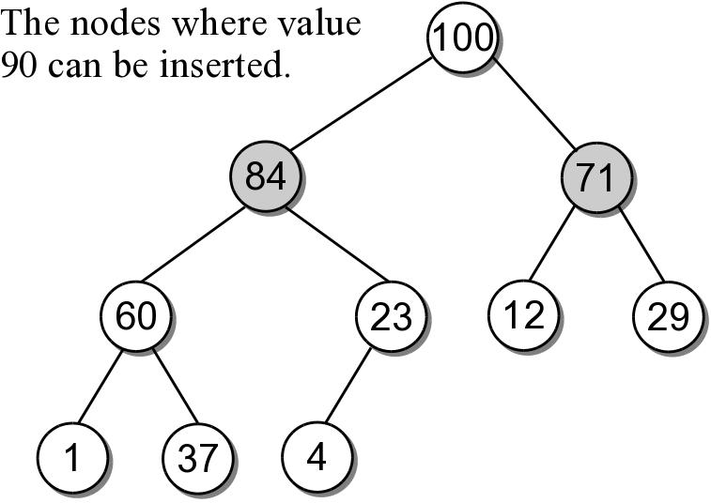
Heap Insertions
When an element is inserted into a heap, both properties must be maintained.
Example: add 90 to the max-heap.
There are only 2 places where 90 can be inserted.

Slide 4
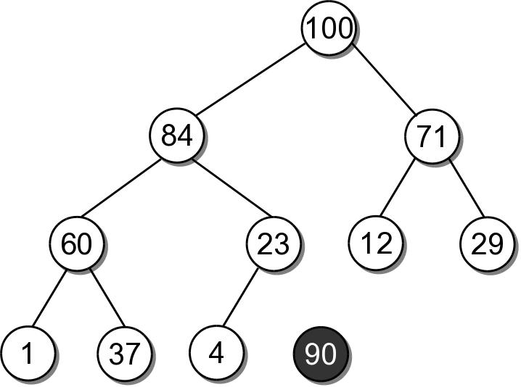
Heap Insertions
To properly insert an element into a heap involves several steps.
Create a new node for value.

Slide 5
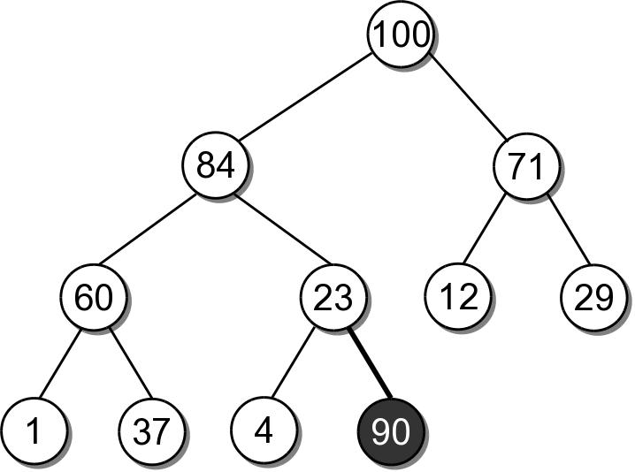
Heap Insertions
Link the node in as the last child in the complete tree.

Slide 6
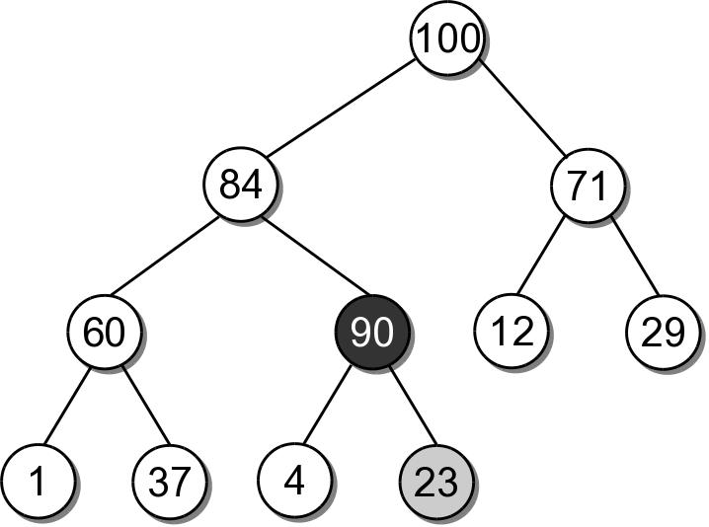
Heap Insertions
To restore the heap property, the new element has to move up along its path:
the data is swapped with its parent's data.
sift-up

Slide 7
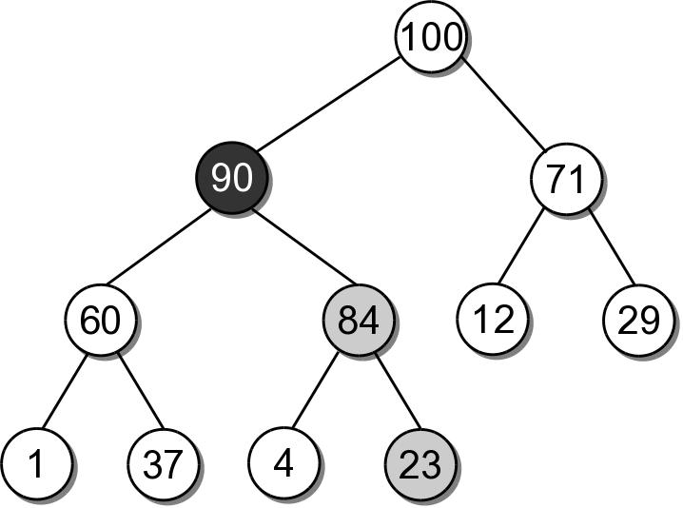
Heap Insertions
90 must move up another level since 84 is smaller.
After which, it is in it's correct position.

Slide 8
Heap Insert Example
Insert 41 into the heap from the previous slide.

Slide 9
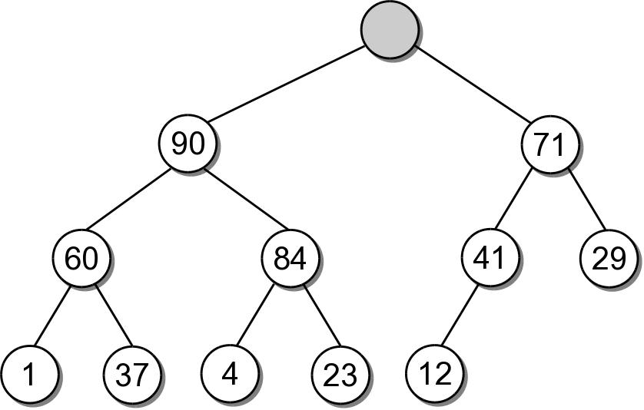
Heap Extractions
When an element is extracted from the heap, it can only come from the root node.
Both heap properties must be maintained.

Slide 10
Heap Extractions
To restore the tree to a heap:
another value will have to take the place of the extracted value in the root node.
a node has to be removed from the tree.

Slide 11
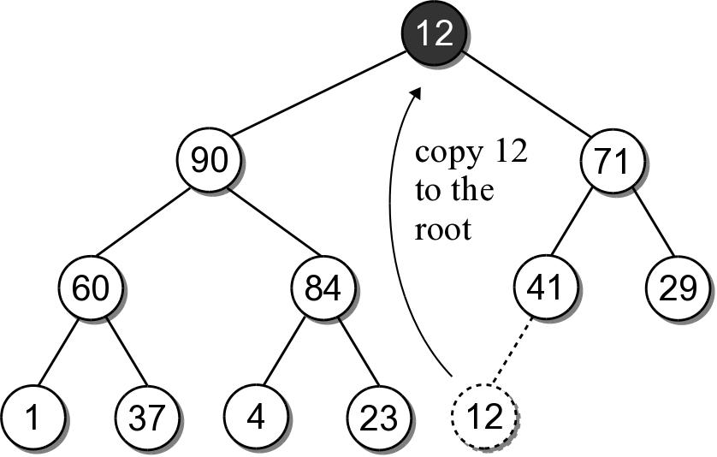
Heap Extractions
There is only one node that can be removed and still maintain the heap shape property.
Copy the data from the last child node to the root.
Delete the last child node.

Slide 12
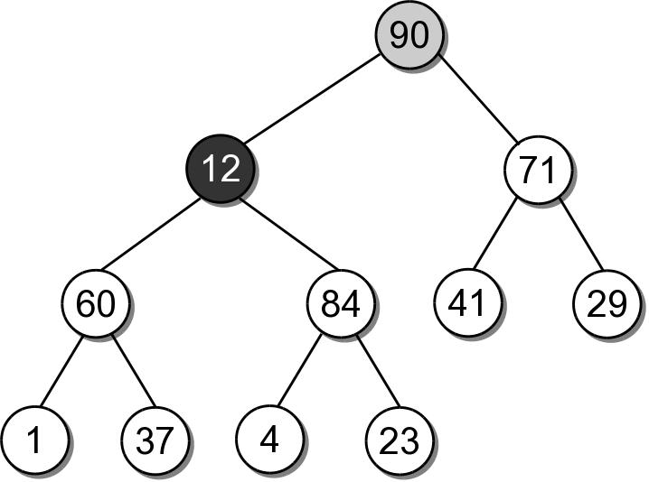
Heap Extractions
To maintain the heap order property, the new root value has to be sifted-down.

Slide 13
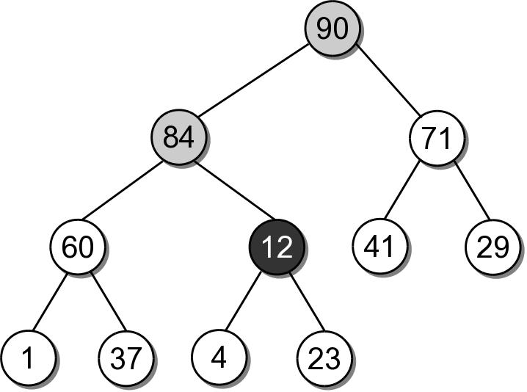
Heap Extractions
The shifting continues until the value is placed into a leaf node, or it is larger than its children.

Slide 14
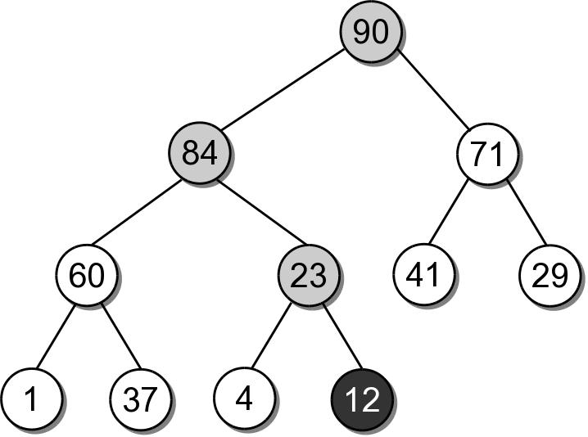
Heap Extractions
After being swapped with 23, value 12 will be in a node that maintains the heap order property.

Slide 15
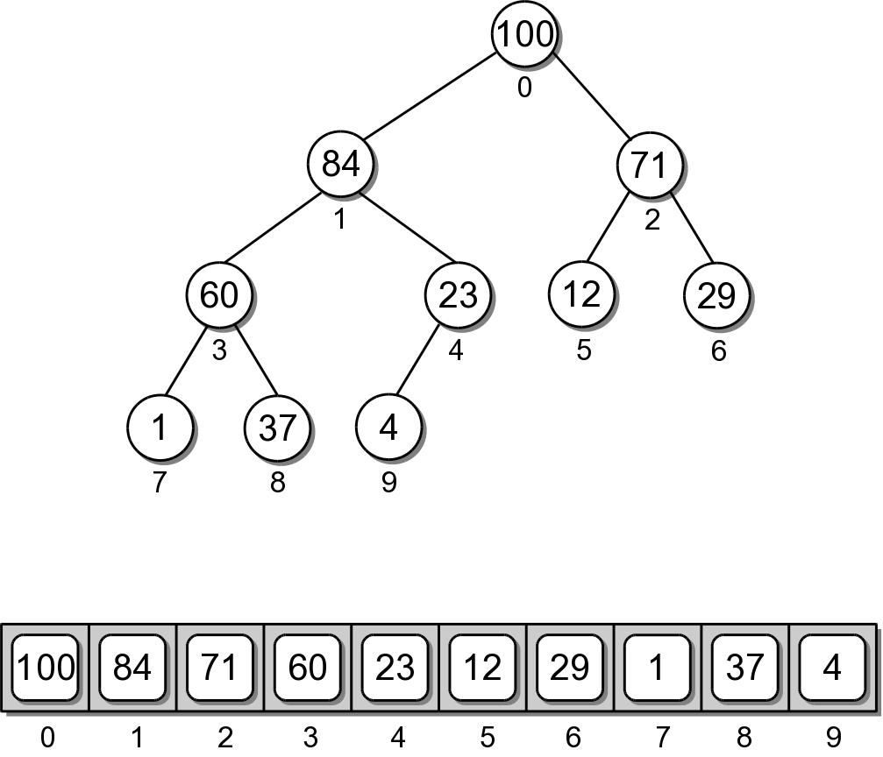
Heap Implementation
While a heap is a binary tree, it's seldom implemented as a dynamically linked structure.
Use a sequence to physically store the nodes.

Slide 16
Heap – Node Access
The complete tree will never contain “holes”.
The root will always be at position 0.
Its two children will always occupy positions 1 and 2.
The children of any node will always occupy the same position.

Slide 17
Heap – Node Access
Given the array index i
parent = (i-1) // 2
left = 2 * i + 1
right = 2 * i + 2
A child link is null if the index is out of range.

Slide 18
Heap – Class Definition
arrayheap.py
class MaxHeap :
def __init__( self, maxSize ):
self._elements = Array( maxSize )
self._count = 0
def __len__( self ):
return self._count
def capacity( self ):
return len( self._elements )
# ...

Slide 19
Heap – Class Definition
arrayheap.py
class MaxHeap :
# ...
def add( self, value ):
assert self._count < self.capacity(),
"Cannot add to a full heap."
# Add the new value to the end of the list.
self._elements[ self._count ] = value
self._count += 1
# Sift the new value up the tree.
self._sift_up( self._count - 1 )
def _sift_up( self, ndx ):
if ndx > 0 :
parent = ndx // 2
if self._elements[ndx] > self._elements[parent] :
tmp = self._elements[ndx]
self._elements[ndx] = self._elements[parent]
self._elements[parent] = tmp
self._sift_up( parent )

Slide 20
Heap – Class Definition
arrayheap.py
class MaxHeap :
# ...
def extract( self ):
assert self._count > 0,
"Cannot extract from an empty heap."
value = self._elements[0]
self._count -= 1
self._elements[0] = self._elements[ self._count ]
self._sift_down( 0 )
return value

Slide 21
Your Exercise
Following the pattern of function sift-up(), write the function sift-down() when the top (root) item is removed.

Slide 22
Heap – Class Definition
arrayheap.py
class MaxHeap :
# ...
def _sift_down( self, ndx ):
left = 2 * ndx + 1
right = 2 * ndx + 2
largest = ndx
if left < self._count and \
self._elements[left] >= self._elements[largest] :
largest = left
elif right < self._count and \
self._elements[right] >= self._elements[largest]:
largest = right
if largest != ndx :
self.swap( self._elements[ndx], self._elements[largest] )
self._sift_down( largest )

Slide 23
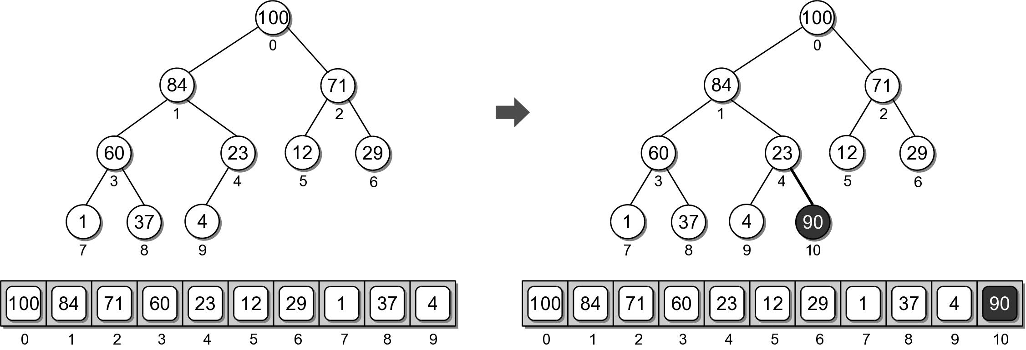
Heap Example
Physical view of adding value 90.

Slide 24
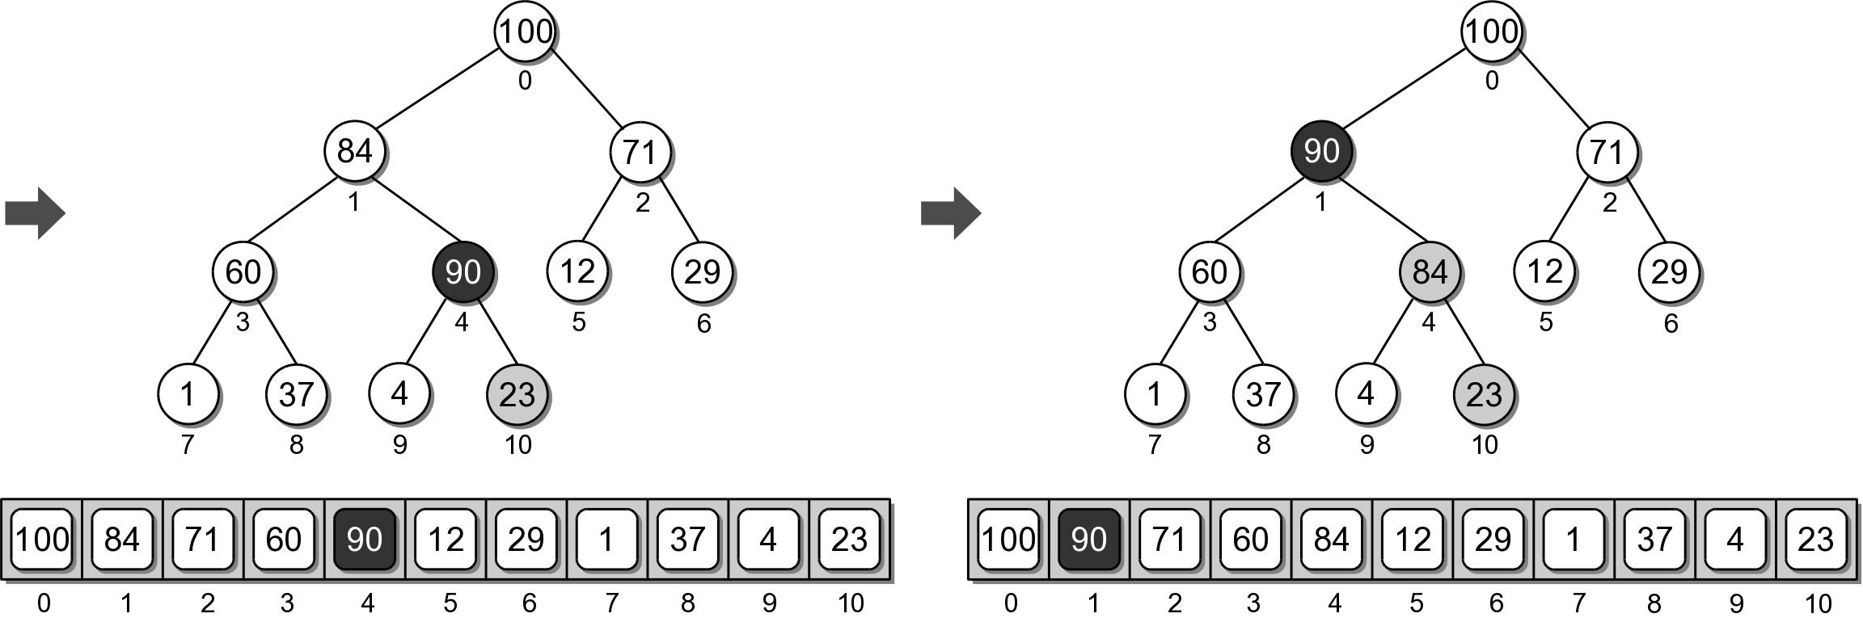
Heap Example
Physical view of adding value 90.

Slide 25
Heap Analysis
Assume a heap containing n elements:
Insertion: O(log n)
Extraction: O(log n)

Slide 26
The Heapsort
The simplicity and efficiency of the heap structure can be applied to the sorting problem.
Build a heap from a sequence of unsorted keys.
Extract the keys from the heap to create a sorted sequence.
Very efficient: O(n log n)

Slide 27
Heapsort Implementation
A simple implementation is provided below.
def simple_heap_sort( the_seq ):
# Create an array-based max-heap.
n = len(the_seq)
heap = MaxHeap( n )
# Build a max-heap from the list of values.
for item in the_seq :
heap.add( item )
# Extract each value from the heap and store
# them back into the list.
for i in range( n-1, -1, -1 ) : # small to large
# for I in range( n ) : # large to small
theSeq[i] = heap.extract()

