Slide 1
Binary Search Tree
Revised based on textbook author’s notes.

Slide 2
Search Trees
The tree structure can be used for searching.
Each node contains a search key as part of its data or payload.
Nodes are organized based on the relationship between the keys.
Search trees can be used to implement various types of containers.
Most common use is with the Map ADT.

Slide 3
Binary Search Tree (BST)
A binary tree in which each node contains a search key and the tree is structured such that for each interior node V:
All keys less than the key in node V are stored in the left subtree of V.
All keys greater than the key in node V are stored in the right subtree of V.

Slide 4
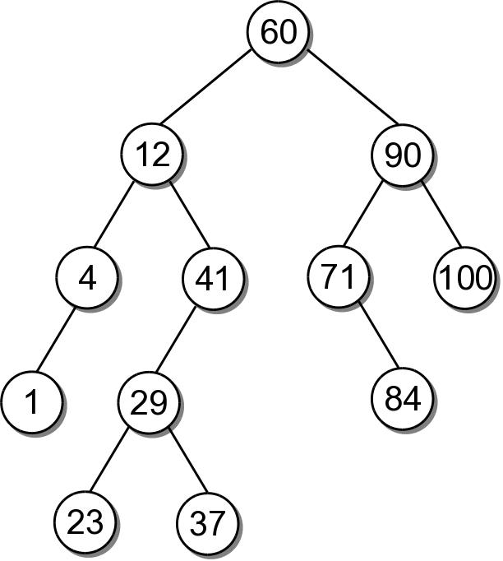
BST Example
Consider the example tree

Slide 5
BST – ADT
bst.py
# We use an unique name to distinguish this version
# from others in the chapter.
class BST :
def __init__( self ):
self._root = None
self._size = 0
def __len__( self ):
return self._size
def __iter__( self ):
return _BSTreeIterator( self._root )
# ...
# Storage class for the binary search tree nodes.
class _BSTNode :
def __init__( self, key, data ):
self.key = key
self.data = data
self.left = None
self.right = None

Slide 6
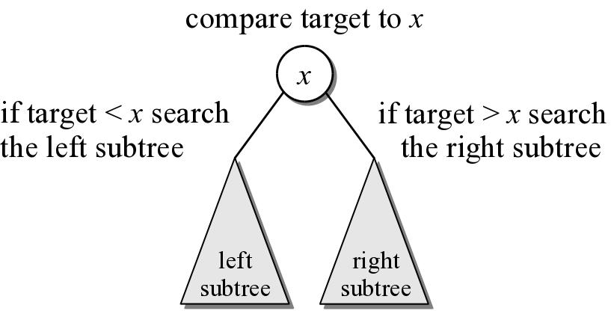
BST – Searching
A search begins at the root node.
The target is compared to the key at each node.
The path depends on the relationship between the target and the key in the node.

Slide 7
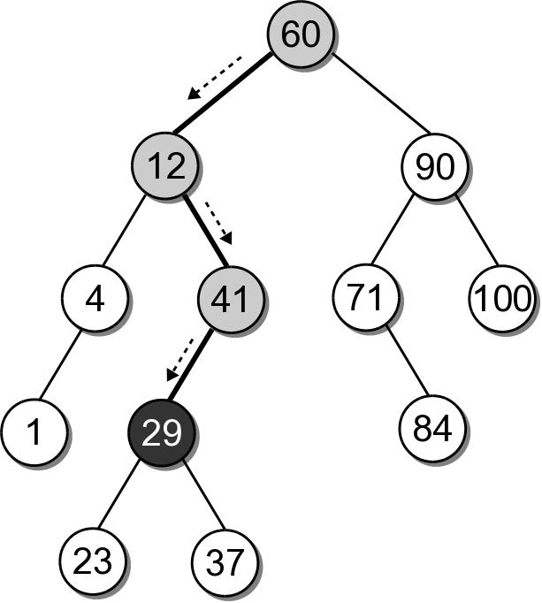
BST – Search Example
Suppose we want to search for 29 in our BST.

Slide 8
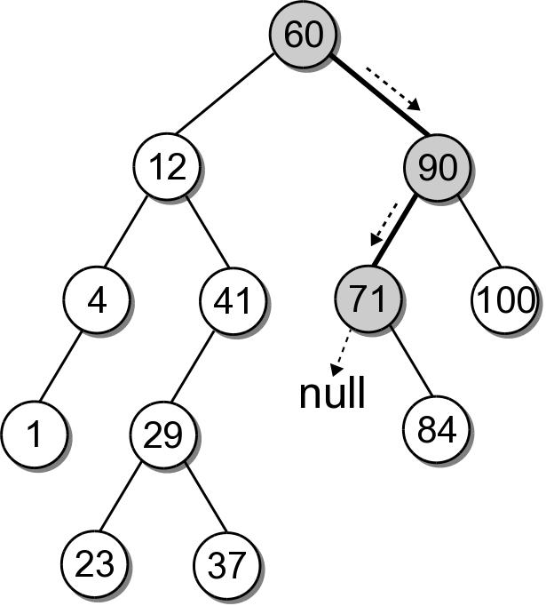
BST – Search Example
What if the key is not in the tree? Search for key 68 in our BST.

Slide 9
BST – Search Implementation
bst.py
class BST :
# ...
def __contains__( self, key ):
return self._bstSearch( self._root, key ) is not None
def valueOf( self, key ):
node = self._bstSearch( self._root, key )
assert node is not None, "Invalid map key."
return node.value
def _bstSearch( self, subtree, target ):
if subtree is None :
return None
elif target < subtree.key :
return self._bstSearch( subtree.left )
elif target > subtree.key :
return self._bstSearch( subtree.right )
else :
return subtree

Slide 10
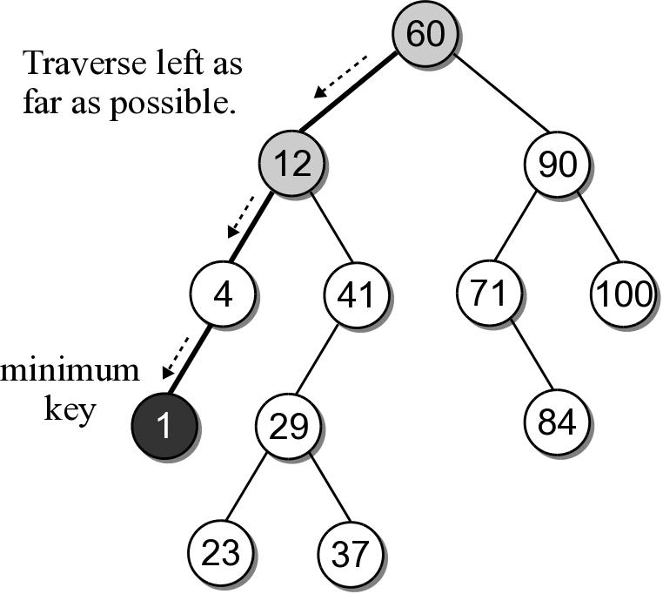
BST – Min or Max Key
Finding the minimum or maximum key within a BST is similar to the general search.
Where might the smallest key be located?
Where might the largest key be located?

Slide 11
BST – Min or Max Key
The helper method below finds the node containing the minimum key.
class BST :
# ...
def _bstMinumum( self, subtree ):
if subtree is None :
return None
elif subtree.left is None :
return subtree
else :
return self._bstMinimum( subtree.left )

Slide 12
BST – Insertions
When a BST is constructed, the keys are added one at a time. As keys are inserted
A new node is created for each key.
The node is linked into its proper position within the tree.
The search tree property must be maintained.

Slide 13
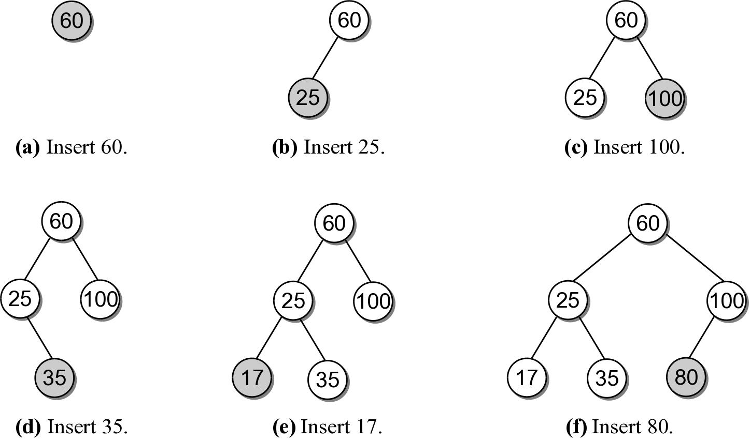
Building a BST
Suppose we want to build a BST from the key list
60 25 100 35 17 80

Slide 14
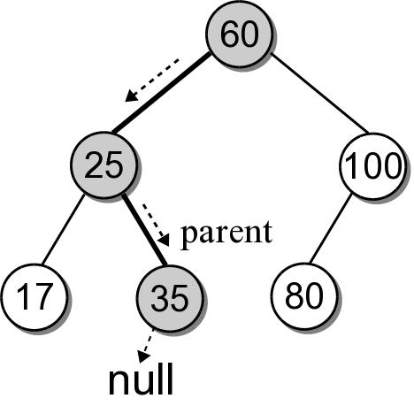
BST – Insertion
Building a BST by hand is easy. How do we insert an entry in program code?
What happens if we use the search method from earlier to search for key 30?

Slide 15
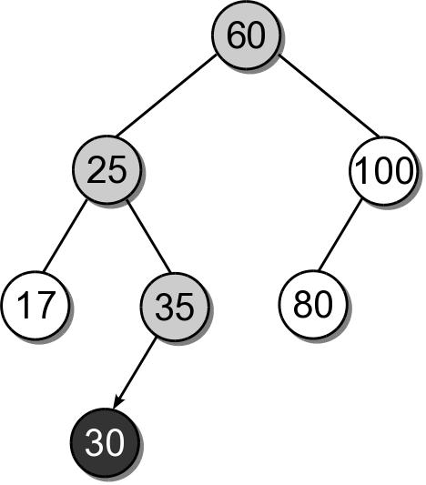
BST – Insertion
We can insert the new node where the search fell off the tree.

Slide 16
BST – Insert Implementation
bst.py
class BST :
# ...
def add( self, key, value ):
node = self._bstSearch( key )
if node is not None :
node.value = value
return False
else :
self._root = self._bstInsert( self._root, key, value )
self._size += 1
return True
def _bstInsert( self, subtree, key, value ):
if subtree is None :
subtree = _BSTMapNode( key, value )
elif key < subtree.key :
subtree.left = self._bstInsert(subtree.left, key, value)
elif key > subtree.key :
subtree.right = self._bstInsert(subtree.right, key, value)
return subtree

Slide 17
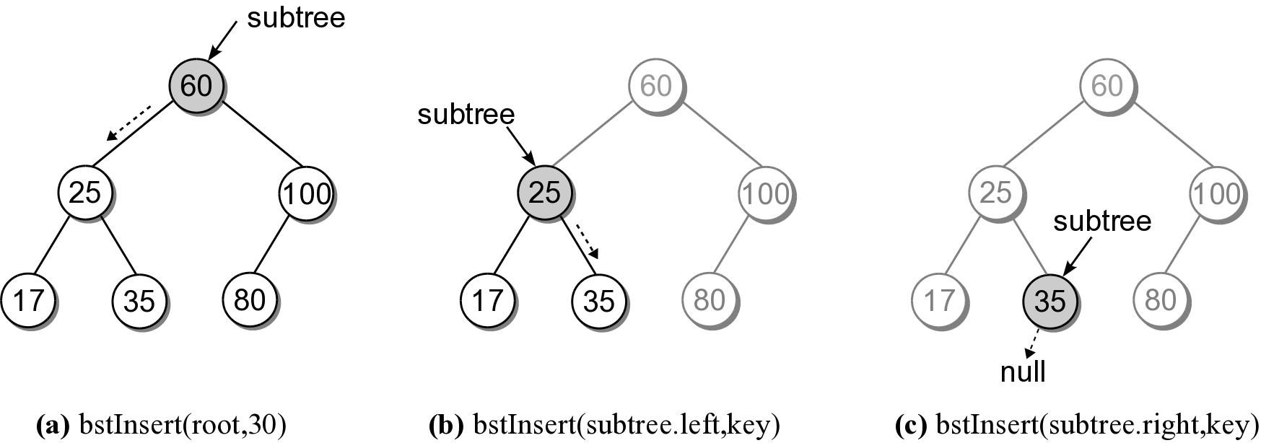
BST – Insert Steps
Add 30 to our sample BST.

Slide 18
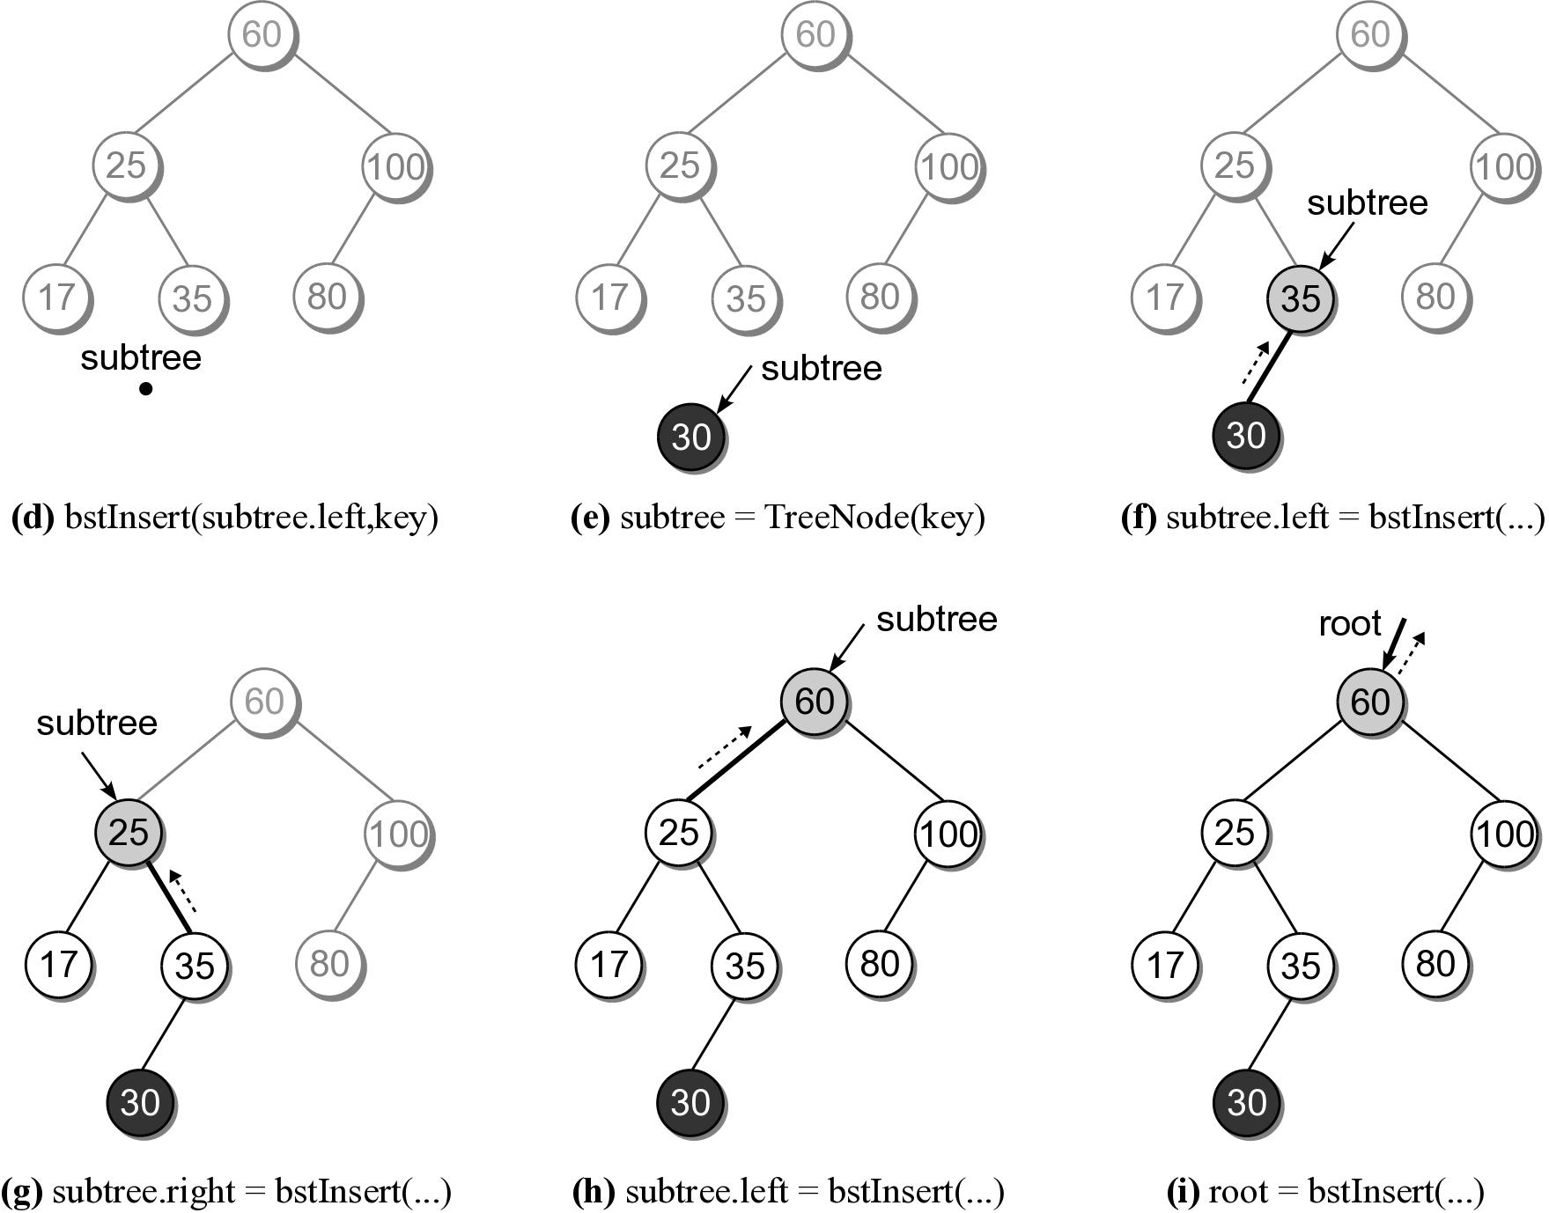
BST – Insert Steps

Slide 19
BST – Deletions
Deleting a node from a BST is a bit more complicated.
Locate the node containing the node.
Delete the node.
When a node is removed, the remaining nodes must preserve the search tree property.

Slide 20
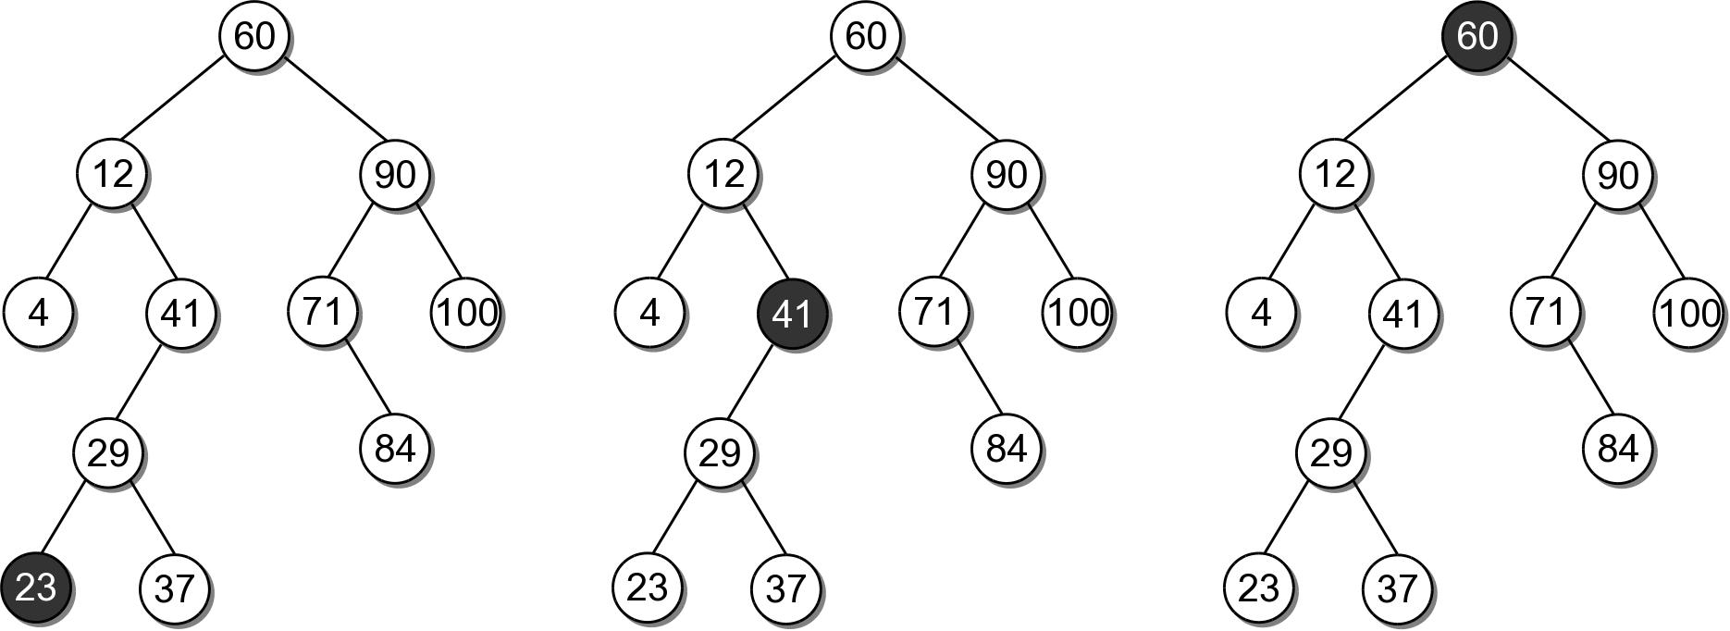
BST – Deletions
There are three cases to consider:
the node is a leaf.
the node has a single child
the node has two children.

Slide 21
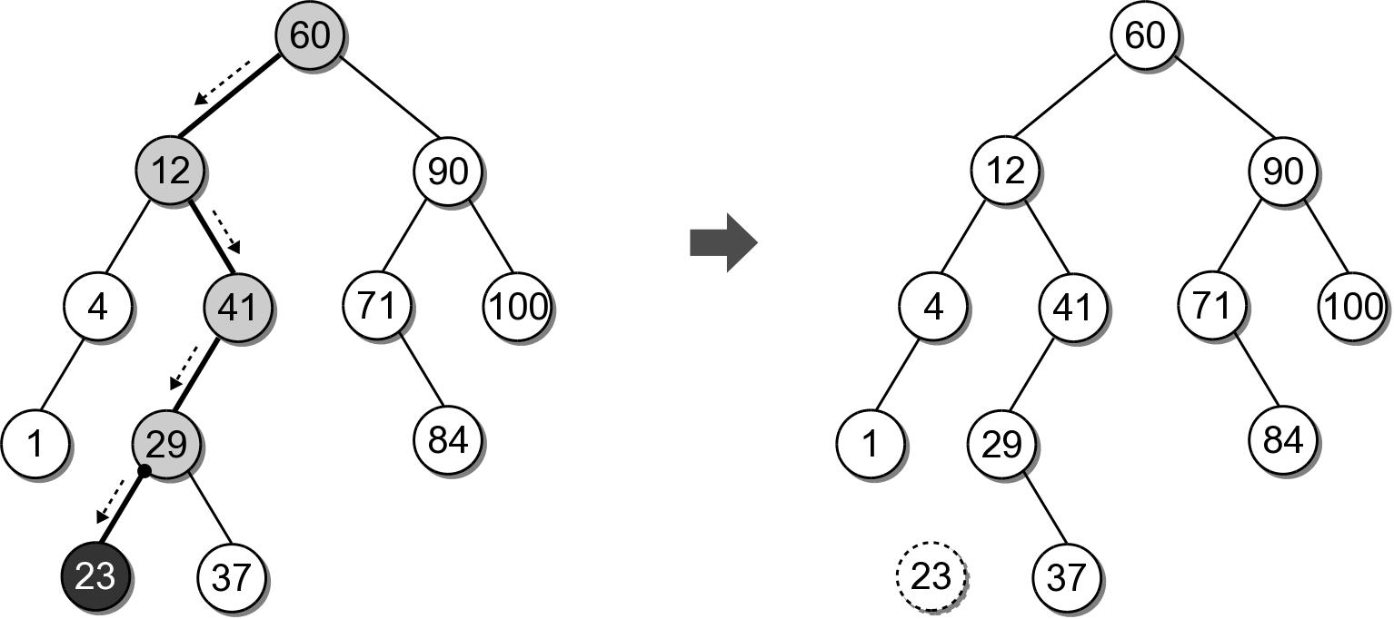
BST – Delete Leaf Node
Removing a leaf node is the easiest case.
Suppose we want to remove 23.

Slide 22
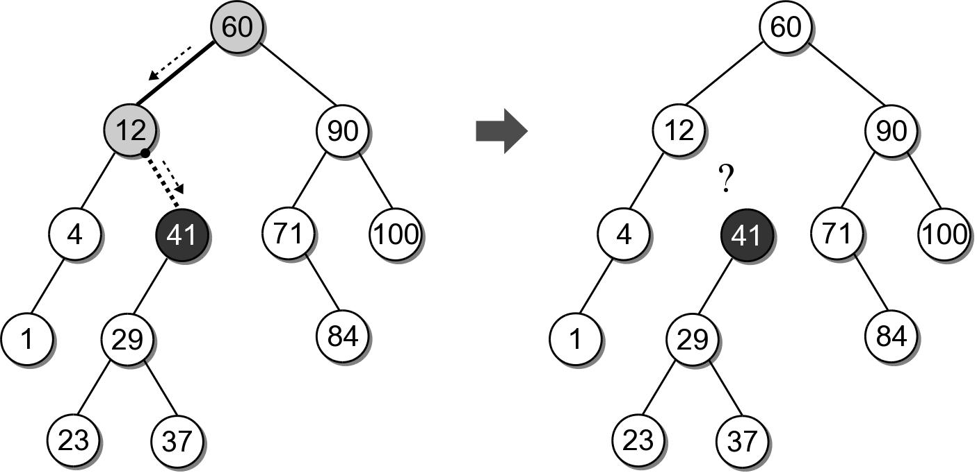
BST – Delete Interior Node
Removing an interior node with one child.
Suppose we want to remove 41.
We can not simply unlink the node.

Slide 23
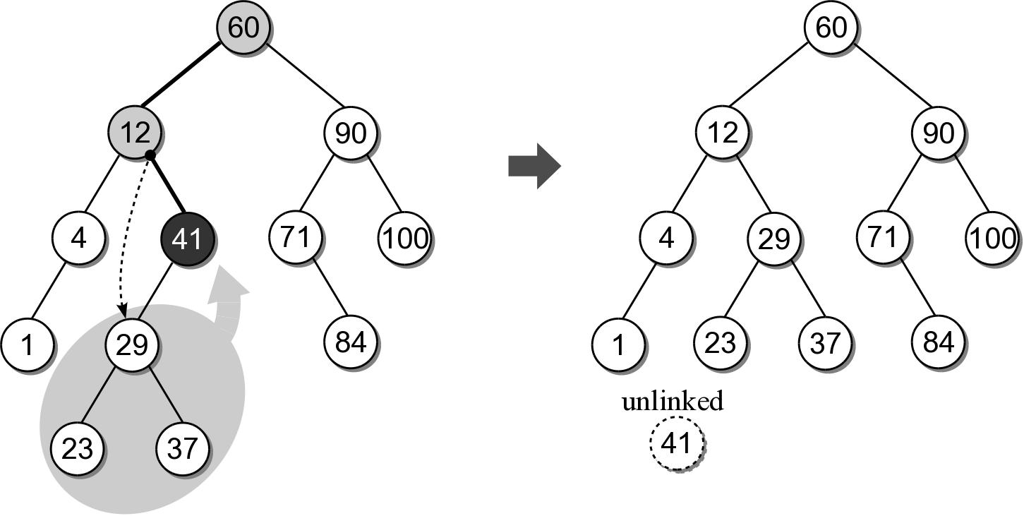
BST – Delete Interior Node
After locating the node to be removed, it's child must be linked to it's parent.

Slide 24
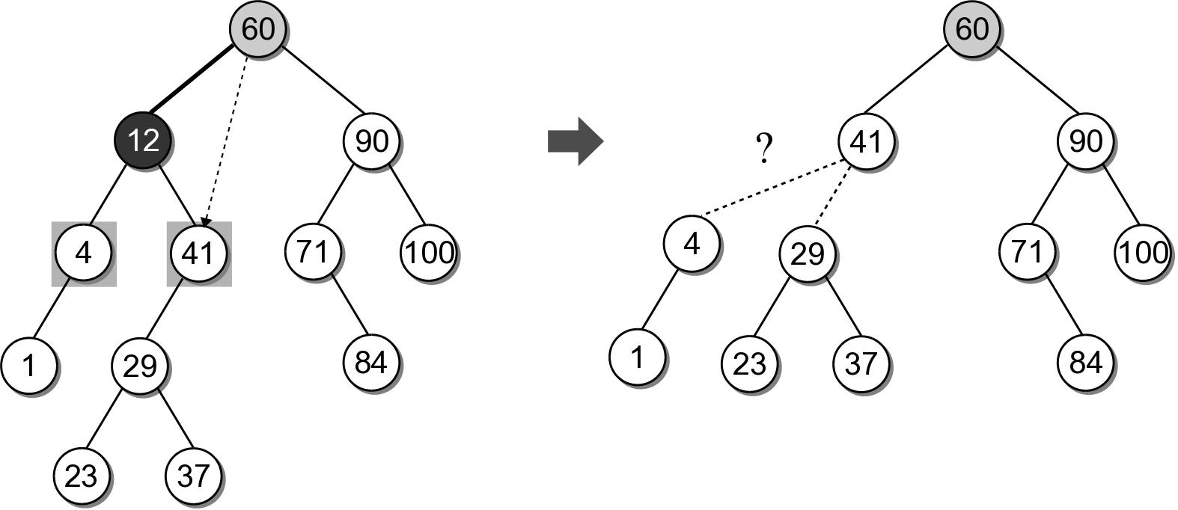
BST – Delete Interior Node
The most difficult case is deleting a node with two children.
Suppose we want to delete node 12.
Which child should be linked to the parent?

Slide 25
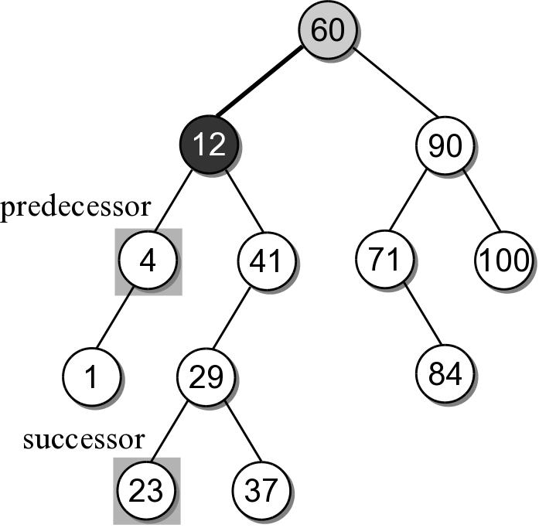
BST – Delete Interior Node
Based on the search tree property, each node has a logical predecessor and successor.
For node 12, those are 4 and 23.

Slide 26
BST – Delete Interior Node
We can replace to be deleted with either its logical successor or predecessor.
Both will either be a leaf or an interior node with one child.
We already know how to remove those nodes.

Slide 27
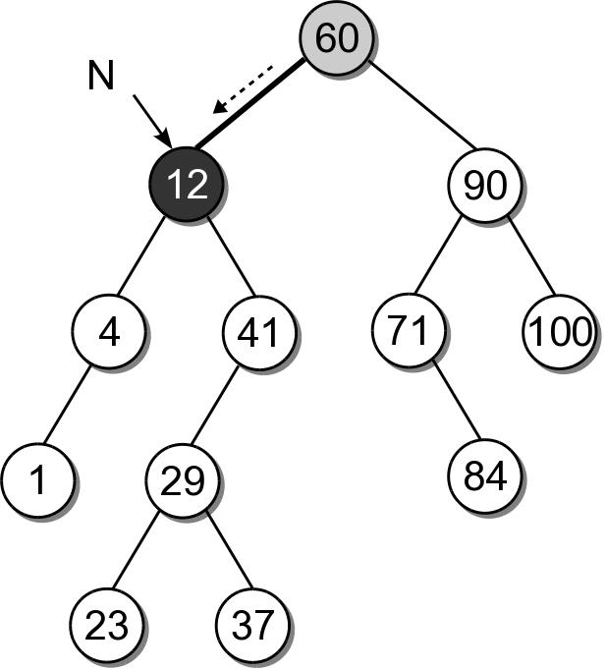
BST – Delete Interior Node
Removing an interior node with two children requires 4 steps:
(1) Find the node to be deleted, N.

Slide 28
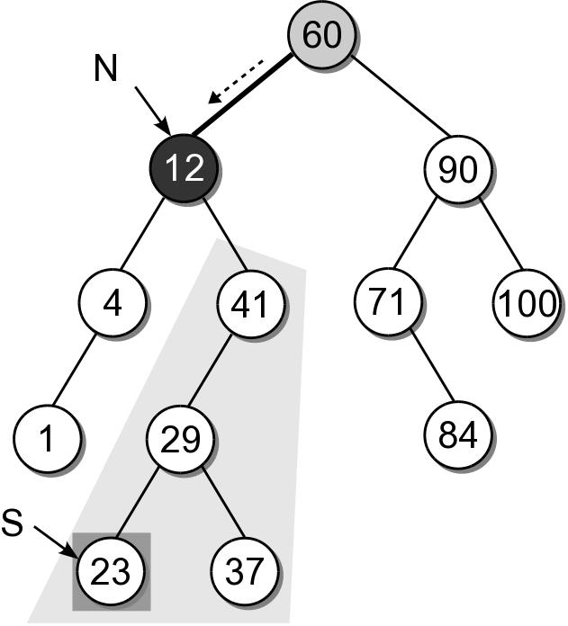
BST – Delete Interior Node
(2) Find the successor, S, of node N.

Slide 29
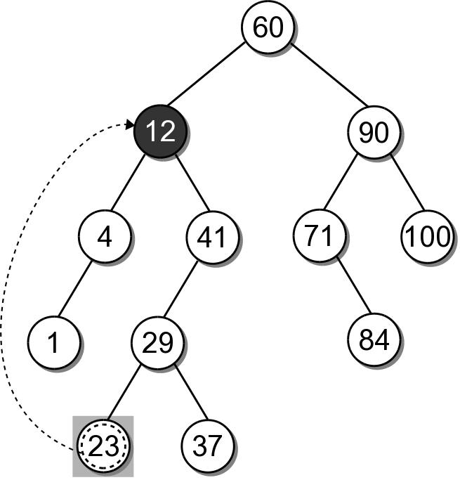
BST – Delete Interior Node
(3) Copy the payload from node S to node N.

Slide 30
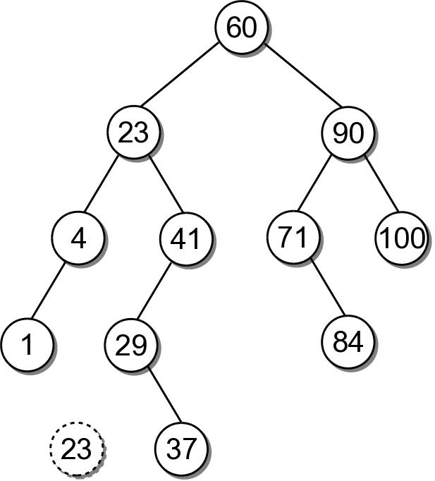
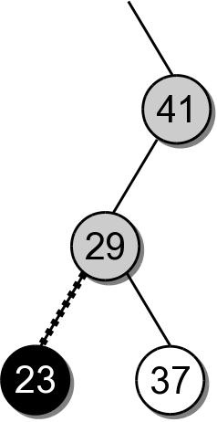
BST – Delete Interior Node
(4) Remove node S from the tree.

Slide 31
BST – Delete Interior Node
Removing an interior node with two children requires 4 steps:
Find the node to be deleted, N.
Find the logical successor, S, of node N.
Copy the payload from node S to node N.
Remove node S from the tree.

Slide 32
BST – Delete Implementation
bst.py
class BST :
# ...
def remove( self, key ):
assert key in self, "Invalid key."
self._root = self._bstRemove( self._root, key )
self._size -= 1

Slide 33
BST – Delete Implementation
bst.py
class BST :
# ...
def _bstRemove( self, subtree, target ):
if subtree is None : # not found
return subtree
elif target < subtree.key : # search for the left tree
subtree.left = self._bstRemove( subtree.left, target )
return subtree
elif target > subtree.key : # search for the right tree
subtree.right = self._bstRemove( subtree.right, target )
return subtree
else : # target == subtree.key, delete the node
......

Slide 34
BST – Delete Implementation
bst.py
class BST :
# ...
def _bstRemove( self, subtree, target ):
......
else :
if subtree.left is None and subtree.right is None :
return None # leaf node
elif subtree.left is None or subtree.right is None :
# has one child only
if subtree.left is not None :
return subtree.left
else :
return subtree.right
else : # has both children
successor = self._bstMinimum( subtree.right )
subtree.key = successor.key
subtree.value = successor.value
subtree.right = self._bstRemove( subtree.right,
successor.key )
return subtree

Slide 35
BST – Efficiency
Operation | Worst Case
_bstSearch( root, k ) | O(n)
_bstMinimum( root ) | O(n)
_bstInsert( root, k ) | O(n)
_bstRemove( root, k ) | O(n)
traversal | O(n)

Slide 36
Exercises
The remove() method uses a bst_find_min(subtree) method to search and return the node with minimum key in a tree rooted at subtree. Implement this method.
Write a method bst_sort_reverse() to sort a binary search tree rooted at subtree in reverse order.
Test your methods by running the program testbst.py on the course website.

