Slide 1
CSCI 204: Data Structures & Algorithms
Prof. Xiannong Meng
Office Hours: MWF 2-4, TR 10-11
Office: Dana 212
Email: xmeng@bucknell.edu
Phone: 570-577-1214 (x 71214 on campus)

Slide 2
What will we do in class this semester?
Lectures (but just to get the declarative knowledge down)
PowerPoints
Active Learning
Group activities
Discussion and reflection

Slide 3
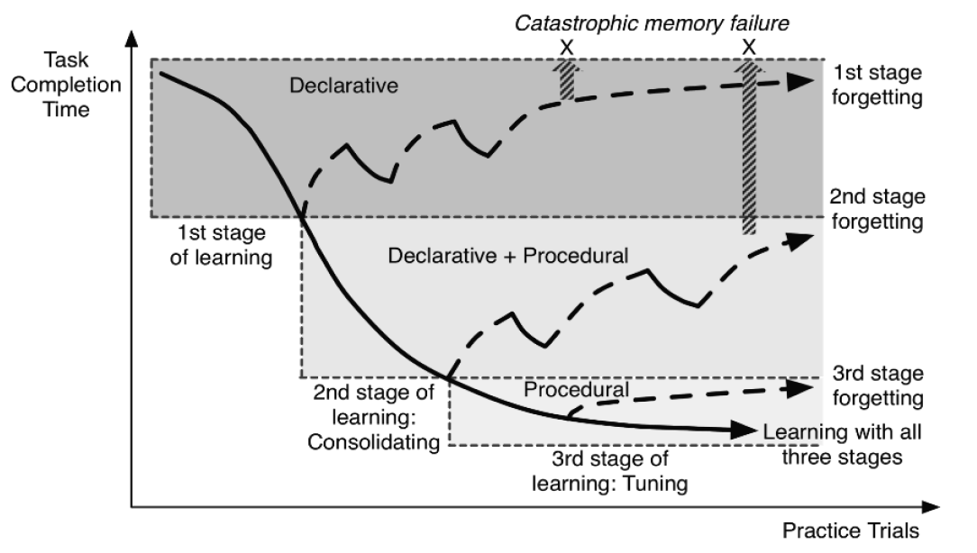
I may repeat things you may have seen before (e.g., in a lab)!

Slide 4
Course Documents
Course website
http://www.eg.bucknell.edu/~csci204/
Syllabus, schedule, lab, projects, …
Course Moodle site
http://moodle.bucknell.edu/course/view.php?id=37628
Submit work, check grades
Prof Meng’s posted notes
http://www.eg.bucknell.edu/~csci204/2020-spring/meng/notes/index.html
Lecture notes, code examples, exercises
Notes:
4

Slide 5
Syllabus
Lectures
MWF: 8 am
Key skills, topics, and their motivation
I’d like to see you! Let me know if you’ll be absent…
Labs
Th: 1-3 pm or 3-5 pm
Guided work on the material.
You are required to attend your section.
Let the lab instructor know if you’ll be absent…
Office Hours
MWF: 2-4 PM, TR: 10-11 AM; 212 Dana
Notes:
5
still before the quiz… (syllabus is in the back of your handout…)

Slide 6
Syllabus
Grading
Projects 16% Labs 16%
Professionalism 8% Mid-term exams 30%
HW/Activities 10% Final exam 20%
Honor Code
As a student and citizen of the Bucknell University community:
I will not lie, cheat, or steal in my academic endeavors.
I will forthrightly oppose each and every instance of academic dishonesty.
I will let my conscience guide my decision to communicate directly with any person or persons I believe to have been dishonest in academic work.
I will let my conscience guide my decision on reporting breaches of academic integrity to the appropriate faculty or deans.
Access Statement
Any student who needs an accommodation based on the impact of a disability please feel free to talk to me as well as submit the Disability Accommodation Request Form or contact the Office of Accessibility Resources at OAR@bucknell.edu, 570-577-1188 or in room 107 Carnegie Building so that such accommodations may be arranged.
Basic Needs Security
Any student who has difficulty affording groceries or accessing sufficient food to eat every day, or who lacks a safe and stable place to live, and believes this may affect their performance in the course, is urged to contact the Dean of Students for support. Furthermore, please notify the professor if you are comfortable in doing so. This will enable them to provide any resources that they may possess.
Notes:
6

Slide 7
What will we cover?
Data Structures
Particular way to organize and manipulate data, e.g., lists, arrays, stacks, queues, and trees
Data Abstraction
Data type properties (independent of implementation)
Algorithms & Algorithm Analysis
Common algorithms, searching, sorting
Advanced Python Programming
OOP, classes, inheritance, exceptions, etc.

Slide 8
What will we cover?
Program design and style will be important!
https://google.github.io/styleguide/pyguide.html
https://www.python.org/dev/peps/pep-0008/

Slide 9
Tools to be used
spyder
idle (idle3)
repl.it
command line

Slide 10
List Review
Python Lists are Mutable
What does mutable mean?
test_list = [14, 2, 42, 3, 24]

Slide 11
List Review
Accessing and manipulating Python Lists
Some useful list operators
+ (concat), * (mult), : (slicing)
List methods
append, extend, insert, pop
Comprehensions
Build lists from existing lists
Ex:
my_list = [2, 3, 1, 5]
new_list = [x*2 for x in my_list ]

Slide 12
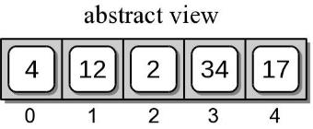
List Review (Examples)
test_list.append(17)
test_list[0:3]
test_list.pop()
>>> [4, 12, 2]

Slide 13
List Review (Examples)
test_list.append([17])
test_list*3
(Abstract view)
test_list[0:4]
(Abstract view of test_list)
(Command Line output)
>>> [4, 12, 2, 34]
What happens when we use * with this version of test_list?

Slide 14
Strings Review
Strings operate in a very similar way to lists, but they are immutable
Lets say test_string = ‘team’
What happens when I execute test_string[1] = ‘l’ ?
Several methods
split, upper, lower, count, find, … https://docs.python.org/3/library/stdtypes.html#textseq
Notes:
20-Jan-2016: Stopped

Slide 15
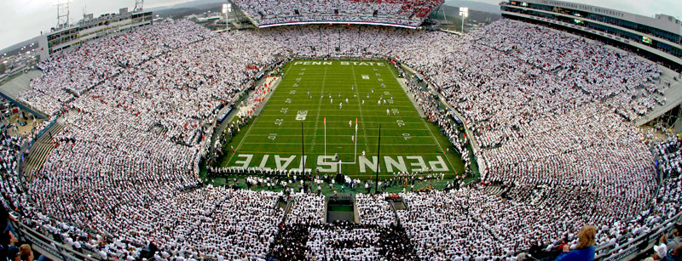
Dictionaries Review
Dictionaries contain a key and a corresponding value
Ex. B10FB = {‘PSU’ : ‘Penn State’, ‘OSU’ : ‘Ohio State’, ‘MSU’ : ‘Michigan State’, ‘Mary’ : ‘Maryland’, ‘Rut’ : ‘Rutgers’, ‘Ind’: ‘Indiana’}
B10FB[‘PSU’] returns…..’Penn State’
What if we didn’t know which B10 teams were in B10FB?
B10FB[‘Umich’] throws an error, BUT B10FB.get(‘Umich’) simply returns None

Slide 16
Classroom exercise
Take as inputs from the user a sequence of nick names, and a sequence of full names, both groups separated by commas. Build a dictionary with the nick names as key and full names as value. Sample program behavior (program printing in green, user input in red):
Enter nicknames separated by commas: bb, cc, dd
Enter full names separated by commas: bob barker,chris christie, donny darko
bob barker or bb for short.
chris christie or cc for short.
donny darko or dd for short.
Retrieve the starting source code from the course website
www.eg.bucknell.edu/~csci204/2020-spring/meng/notes/

