Slide 1
Implementing the 2-D Array
There are various approaches that can be used to implement a 2-D array.
  Use a single 1-D array with the elements arranged by row or column.
  Use a 1-D array of 1-D arrays.
  Use lists

Slide 2
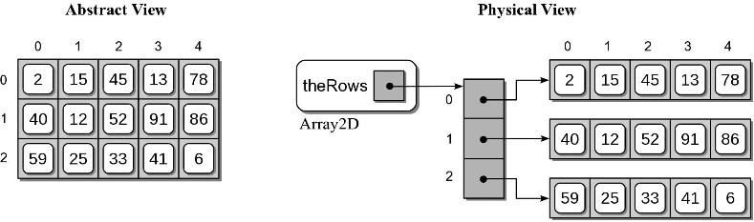
Array of Arrays Implementation
Each row is stored within its own 1-D array.
A 1-D array is used to store references to each row array.
How are the dimensions represented? Number of rows, number of columns?

Slide 3
2-D Array Implementation
array.py
class Array2D :
def __init__( self, n_rows, n_cols ):
self._the_rows = Array( numRows )
for i in range( n_rows ) :
self._the_rows[i] = Array( n_cols )
def num_rows( self ):
return len( self._the_rows )
def num_cols( self ):
return len( self._the_rows[0] )
def clear( self, value = 0):
for row in range( self.num_rows() ):
row.clear( value )

Slide 4
2-D Array Implementation
Subscript notation:
  y = x[r, c] x[r, c] = z
Subscripts are passed to the methods as a tuple.
  Must verify the size of the tuple.

Slide 5
2-D Array Implementation
array.py
class Array2D :
# ...
def __getitem__( self, ndx_tuple ):
assert len(ndx_tuple) == 2, "Invalid number of array subscripts."
row = ndx_tuple[0]
col = ndx_tuple[1]
assert row >= 0 and row < self.num_rows() \
and col >= 0 and col < self.num_cols(), \
"Array subscript out of range."
the_row_array = self._the_rows[row]
return the_row_array[col]

Slide 6
2-D Array Implementation
array.py
class Array2D :
# ...
def __setitem__( self, ndx_tuple, value ):
assert len(ndx_tuple) == 2, "Invalid number of array subscripts."
row = ndx_tuple[0]
col = ndx_tuple[1]
assert row >= 0 and row < self.num_rows() \
and col >= 0 and col < self.num_cols(), \
"Array subscript out of range."
the_row_array = self._the_rows[row]
the_row_array[col] = value

Slide 7
CSCI 204: Data Structures & Algorithms
Object-Oriented Design
Notes:
7

Slide 8
Object-Oriented Design is the process of planning a system of interacting objects for the purpose of solving a software problem. It is one approach to software design.

Slide 9
Object-Oriented Design is the process of planning a system of interacting objects for the purpose of solving a software problem. It is one approach to software design.
Objects – Any physical or logical elements.
Objects are distinguished first by their classification (or just class)
  Objects classified as Dogs are different than you and I, which are classified as Human
Objects of a specific class are called instances of the class.
  You and I are instances of Human

Slide 10
Objects have a set of characteristics that make them unique
  What are some of our characteristics that make each of us unique?
    Eye color, Hair color, Sleeping, Hungry
  In O-O terminology, these are called attributes, or fields, or properties
Characteristics (attributes) have values
  These values determine the state of an object at any time
  Most values are temporal, changing over time (for example, hair!)
    NOTE - If they are not temporal, then they may make good named constants in your code

Slide 11
Examples of Classes and Objects

Slide 12
Fruit
Characteristics (attributes)
  Name
  Color
  Weight
Methods
  be_eaten()

Slide 13
Apple(Fruit)
Additional attributes
  None
Additional methods
  throw()

Slide 14
Orange(Fruit)
Additional features
  None
Additional methods
  squeeze()

Slide 15
Person
Attributes
  Name
  Age
  Place_of_birth
Methods
  eat()
  walk()
  sleep()

Slide 16
Student(Person)
Attributes
  Major
  Class_year
  GPA
Methods
  attend_class()
  take_exam()
  play_club_sports()

Slide 17
Employee(Person)
Attributes
  Department
  Work_schedule
Methods
  get_paid()
  attend_meeting()

Slide 18
Your example(s)?

Slide 19
Encapsulation and O-O design
Encapsulation
  The grouping of data and methods together into one package in such a way that the internal representation of the object is hidden
  All interaction with the object is performed only through the object's methods
  Why is encapsulation an important part of the design process?
    An object should always manage its own internal state!
    An object is responsible for itself and how it carries out its own actions
Notes:
An object should always manage its own internal state. It is responsible for how it carries out its own actions! Analogous to how a restaurant operates

Slide 20
Encapsulation Example
Our Array class example:
  How Array class is defined is hidden, whether an array of ctype objects, or a Python list
  To the outside world, all we need to know is how to use it
grades = Array2D(7, 3)
Notes:
What are the factors here? What would you need to know?

Slide 21
OO Design: Coupling vs. Cohesion
Coupling – (aka dependency) – the degree to which each object relies on all of the other objects in the system
Cohesion – the degree to which all of the functionality in an object are related
What does a good OOD strive for?
  Low coupling
    High coupling means high interclass dependencies
    Minimize coupling to avoid a "snowball effect" of change in one class
  High cohesion
    All public data and methods should all be related directly to the concept the class represents

Slide 22
Relationship: Inheritance
The strongest class relationship
Models the “is-a” relationship
From an SE view, inheritance is POWERFUL, yet simple concept.
  Idea – extend what you already have by adding only those capabilities / features you need
  It can save an enormous amount of development time through code reuse!
Notes:
- Draw it for Pacman
Powerful idea… because I’ve noticed that it is how my son learn
Loves T-Rex. This is how he roars

Slide 23
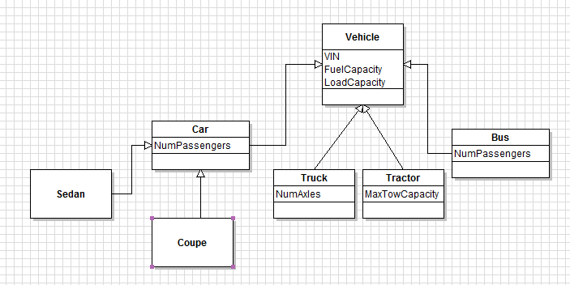
Example: Vehicles
What attributes do objects of Sedan have?
What attributes do objects of Truck have?

Slide 24
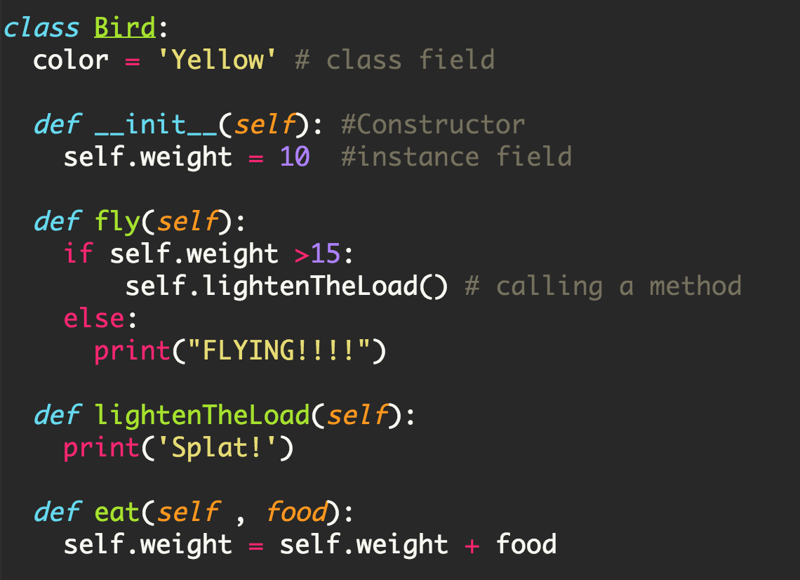
Code Example for Class Bird
big_bird = Bird()
big_bird.fly()
big_bird.eat(20)
big_bird.fly()

Slide 25
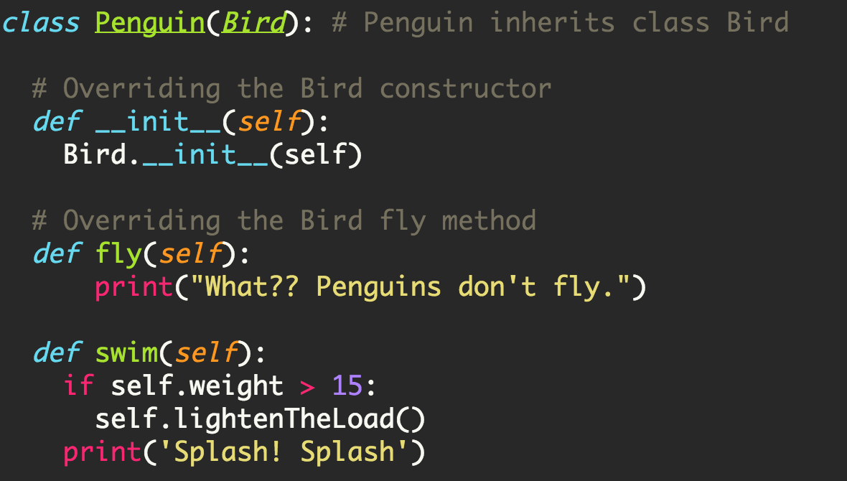
Class Penguin that inherits from class Bird
wheezy = Penguin()
wheezy.fly()
wheezy.eat(10)
wheezy.swim()

Slide 26
Design Exercise
Take out your computer
Write the code for class Vehicle and its subclasses Car and Truck in a file named vehicle.py
Write the code in a separate file named vehicle_app.py for testing the Vehicle class that creates a few Car and Truck objects and prints their information.

