Slide 1
CSCI 204: Data Structures & Algorithms
Algorithm Analysis
Notes:
1

Slide 2
Pretend we had a list with x different names.
We build the following method to see if a name is in
our list:
def is_name_in_list(my_list, search_name):
for item in my_list:
if item == search_name:
return True
return False
How do we measure the “speed” of a program?
What do we need to know to determine how fast this will run?
Notes:
What do we need to know in order to determine how fast this will run?

Slide 3
Why does this matter?
Computers are so fast! But…
Large Scale Data
Google, Twitter, Facebook.. Big Data
Limited Resources
phones, watches, wearable computing
High Performance Environments
milliseconds matter

Slide 4
Measure the work instead of timing
If we actually measure time, e.g., using the Linux time command, we can’t account for the speed differences among different computers.
Rather, we’d measure the steps an algorithm or a program will take when comparing them.
Try a few examples with the time command …

Slide 5
Big-O Notation
No need to count precise number of steps
Classify algorithms by order of magnitude
Execution time
Space requirements
Big O gives us a rough upper bound
Goal is to give you intuition

Slide 6
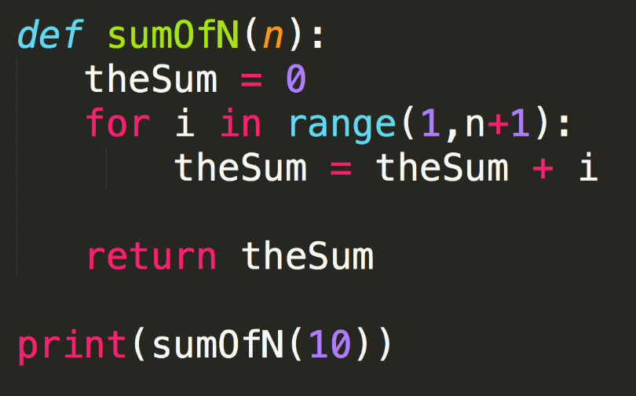
How do we know what matters in code?
1
1 * (n)
1 * (n)
1
1
2n+3

Slide 7
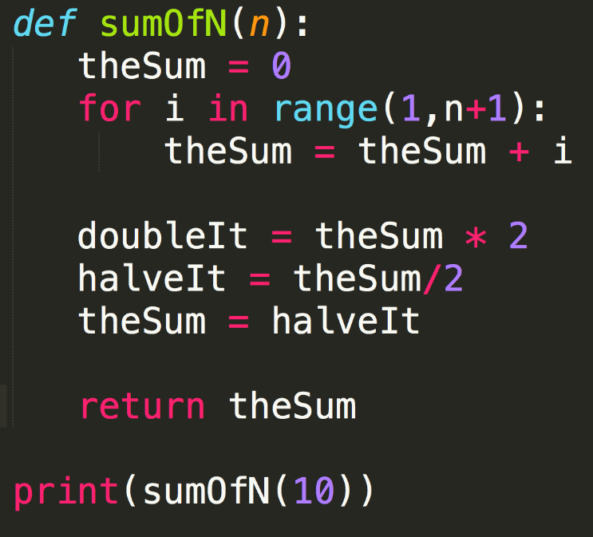
How do we know what matters in code?
2n+3
O(n)
2n+6
Pay attention to what changes as the variables increases

Slide 8
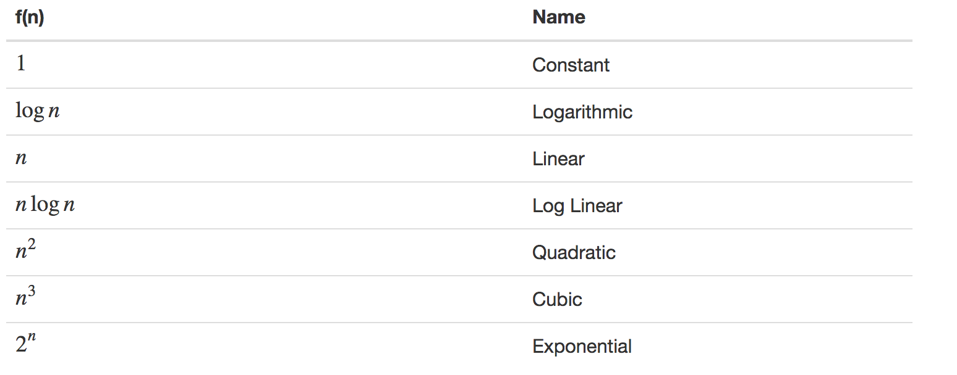
Describing Growth
Let’s Visualize It
See for example:
http://science.slc.edu/jmarshall/courses/2002/spring/cs50/BigO/index.html

Slide 9
Does it REALLY matter?
Try out two examples
time python bubblesort.py
time python quicksort.py
Try out a few more examples from mainRun.py which calls various operations in bigO.py

Slide 10
Definition
Given a function T(n)
# of steps required for an input of size n.
Ex: T₂(n) = n² + n
Suppose there exist a function f(n) for all integers n > 0 such that
for some constant c and for all large values of n > m (a constant).
T(n) < c f(n)
We say function T(n) is on the order of f(n). In our above example, T(n) is on the order of n².

Slide 11
Code Examples

Slide 12
What is the Big O?
3 n^2 + 10 n log n
O(n^2)
n log n + n/2
O(n log n)
0.01n + 100n^2
O(n^2)
100n + 0.1n^2
O(n^2)
5 + 0.001n^3 + 0.025n
O(n^3)

Slide 13
Code Evaluation #1
def ex1( n ):
count = 0
for i in range( n ):
count += i
return count

Slide 14
Code Evaluation #2
def ex2( n ):
count = 0
for i in range( n ):
count += 1
for j in range( n ):
count += 1
return count

Slide 15
Code Evaluation #3
def ex3( n ):
count = 0
for i in range( n ):
for j in range( n ):
count += 1
return count
def ex3b( n ):
count = 0
for i in range( n ):
count += ex3( n )
return count

Slide 16
Code Evaluation #4
def ex4( n ):
count = 0
for i in range( n ):
for j in range( 25 ):
count += 1
return count

Slide 17
Code Evaluation #6
def ex6( n ):
count = 0
i = n
while i >= 1 :
count += 1
i = i // 2
return count

Slide 18
Code Evaluation #7
def ex6( n ):
count = 0
i = n
while i >= 1 :
count += 1
i = i // 2
return count
def ex7( n ):
count = 0
for i in range( n ) :
count += ex6( n )
return count

