Slide 1
CSCI 204: Data Structures & Algorithms
Algorithm Analysis
The case of recursion
Notes:
1

Slide 2
Last time we discussed the case for loops
for item in my_list:
if item == search_name:
return True
O(n)
for i in range(len(my_list)):
for j in range(len(my_list)):
sum += i + j + my_list[i]
O(n^2)
while n > 0:
n = n // 2 # binary search
# fall in this pattern
O(log n)
Notes:
What do we need to know in order to determine how fast this will run?

Slide 3
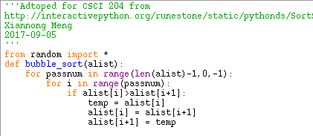
n
n-i
T(n) = n + (n-1) + (n-2) + … + (n-i) + … + 1 + n*C
= n*C + sum(i)__{(for i = 1 to n)} = n*C + n*(n-1)/2
---> O(n^2)

Slide 4
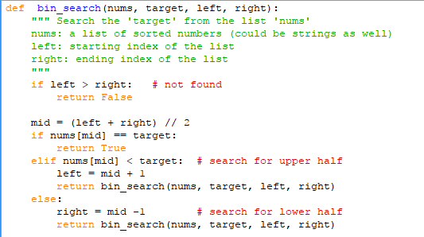
Today we will discuss the case for recursion,
then we’ll do some exercises.
O(1)
O(n/2)
T(n) = C + T(n/2) = C + [C + T(n/4)] = … = kC + CT(1) = C log n + B
So for binary search, T(n) is on the order of O(log n).

Slide 5
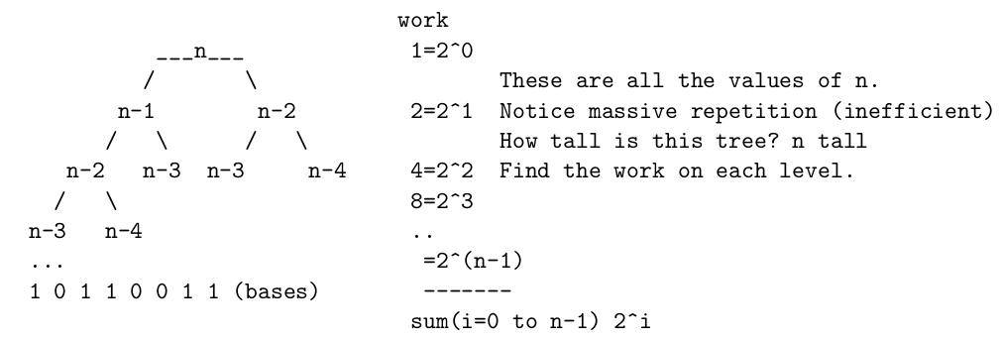
def fib(n):
if n == 0 or n == 1:
return n
else:
return fib(n-1) + fib(n-2)

Slide 6
Tower Of Hanoi
def tower_of_hanoi(n , from_rod, to_rod, aux_rod):
if n == 1:
print( "Move disk 1 from rod ", from_rod, “ to rod ", to_rod )
return
tower_of_hanoi(n-1, from_rod, aux_rod, to_rod)
print( "Move disk", n, "from rod", from_rod, “ to rod ", to_rod )
tower_of_hanoi(n-1, aux_rod, to_rod, from_rod)
T(n) = 1 + 2 * T(n-1) = 1 + 2*[1 + 2*T(n-2)] = 1 + 2 + 4*T(n-2) = …
= 1 + 2 + 4 + 8 + … 2^(n-k) * T(n-k)
O(2^n)

