Slide 1
CSCI 204: Data Structures & Algorithms
Singly Linked lists
Revised based on textbook author’s notes.
Notes:
1

Slide 2
Consider this problem
Given a sorted list of numbers, insert a new number into this sorted list
[3, 5, 7, 10, 12, 20]
insert 6 into this list to become
[3, 5, 6, 7, 10, 12, 20]
How do YOU accomplish this seemly simple task? Take 3 min to work it out. Consider what may happen with your solution.

Slide 3
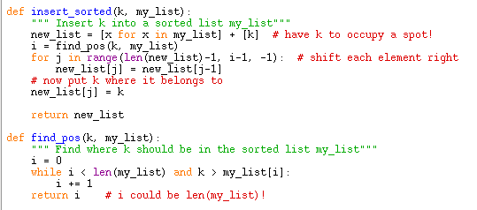
Here is a possible solution
n steps
n steps
n steps
n steps
How many steps to complete this work?
It takes 4*n steps to do this.
Can we do better? How?

Slide 4
Let’s look at one issue at a time
new_list = [x for x in my_list] + [k]
We need to increase the capacity of the list to hold the new element. Weather the list is implemented as a Python list or an array, this would take n steps.
i = find_pos(k, my_list)
We need to find the right spot for the new number, which takes n steps
for j in range(len(new_list)-1, i-1, -1):
Shifting elements to the right takes 2*n steps

Slide 5
Linked lists
Use linked list we can make two of the three operations in constant time!

Slide 6
Linked Structure
Constructed using a collection of objects called nodes.
Each node contains data and at least one reference or link to another node.
Linked list – a linked structure in which the nodes are linked together in linear order.

Slide 7
Linked List
Terms:
node – each element in the list.
head – first node in the list.
tail – last node in the list; link field has a null reference.
tail

Slide 8
How does it look like in Python?
The nodes are constructed from a simple storage class:
List contains two nodes, a head and a tail
class ListNode:
def __init__( self, data ):
self.data = data
self.next = None
class UserList:
def __init__( self ):
self.head = None
self.tail = None

Slide 9
How to build a list?
my_list = UserList() # initial list head == None
a_node = ListNode(12) # create a node
my_list.insert_after(node) # insert the node to list
my_list.insert_after(ListNode(3))# another node
head
tail
The ‘next’ field has a value of None
12
head
tail
12
3

Slide 10
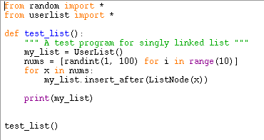
Try out an example

Slide 11
Exercise: write the function insert_before() that inserts the node before the head.

Slide 12
Removing nodes
An item can be removed from a linked list by removing or unlinking the node containing the item.
Find the node containing the item.
Unlink it from the list.

Slide 13
Removing nodes
Removing a node from the middle of the list requires a second external reference.
Resulting list.

Slide 14
Removing Nodes
Removing the first node is a special case.
The head reference must be reposition to reference the next node in the list.

Slide 15
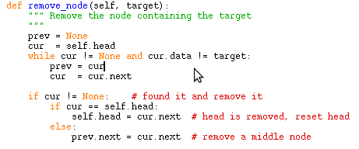
Removing nodes
Given the head reference, we can remove a target from a linked list.

