Slide 1
CSCI 204: Data Structures & Algorithms
Singly Linked lists
Part 2
Revised based on textbook author’s notes.
Notes:
1

Slide 2
A quick review what we did last Friday
Discussed the basic idea of singly linked list
Implemented some functions, insert_before(), insert_after()
Run a demo from the code on the course website (11-code)

Slide 3
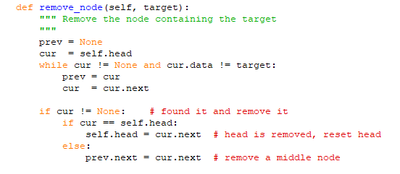
Removing nodes
How to remove a node from a singly linked list
In general, removing a node involves a search first.

Slide 4
List search
def search( self, target ):
cur_node = self.head
while cur_node is not None and \
cur_node.data != target :
cur_node= cur_node.next
return cur_node
What are the possible return values?

Slide 5
  How to insert a node into a sorted list?

Slide 6
Insert a node to sorted list
head
tail
7
13
19
45
How to insert a value 14 into this list?
Two steps:
Find where it should be inserted
Put the node in place
Be careful in the cases of first and last node.

Slide 7
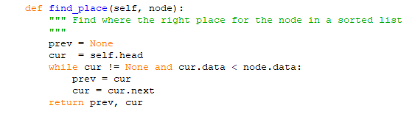
Find the correct place
Assume sorting the list in ascending order, how to find the proper place for a new node?

Slide 8
Insert the node
Need to consider three cases:
-- Insert in before the head
-- Insert after the tail
-- Insert in the middle

Slide 9
Insert before the head
head
5
New node
7
10
node1
node2

Slide 10
Insert after the tail
tail
15
7
10
New node
node1
node2

Slide 11
Insert in the middle
tail
7
10
node1
node2
9
New node

Slide 12
Work as an activity, report it back to the class.

