Slide 1
CSCI 204: Data Structures & Algorithms
Doubly Linked List
Notes:
1

Slide 2
Advanced Linked lists Doubly Linked and Circular Lists
Revised based on textbook author’s notes.

Slide 3
Doubly linked lists
A linked list in which each node contains a data component(s) and two links:
one pointing the next node and
one pointing to the preceding node.

Slide 4
In Python’s term …
The node storage class is similar to that of a singly linked list.
class DListNode :
def __init__( self, data ):
self.data = data
self.next = None
self.prev = None

Slide 5
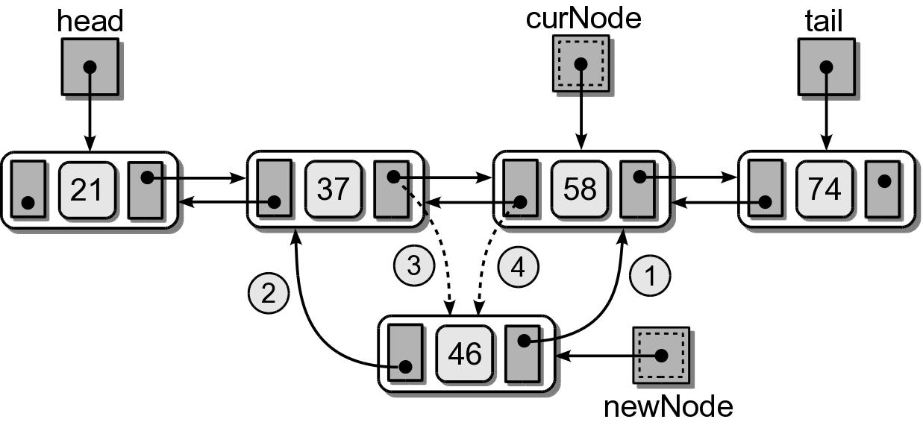
Doubly Linked: Insert
(1) Insert in the middle before a given node.

Slide 6
Doubly Linked: Insert
(1) Insert in the middle before a given node.
node.next = cur
node.prev = cur.prev
node.prev.next = node
cur.prev = node

Slide 7
Doubly Linked: Insert
(2) Insert at the front before the head.

Slide 8
Doubly Linked: Insert
(2) Insert at the front before the head.
node.next = self.head
self.head.prev = node
self.head = node

Slide 9
Doubly Linked: Insert
(3) Insert at the end after the tail.

Slide 10
Doubly Linked: Insert
(3) Insert at the end after the tail.
node.prev = self.tail
self.tail.next = node
self.tail = node

Slide 11
Exercise
Implement insert_before()
Implement insert_after()
Implement insert_sorted()

