Slide 1
CSCI 204: Data Structures & Algorithms
Notes:
1

Slide 2
Advanced Linked lists Circular Lists
Revised based on textbook author’s notes.

Slide 3
Circular Linked List
Another variation of the linked list in which the nodes form a continuous circle.
Allows for a complete traversal from any initial node.
Used with round-robin type applications.
The external reference can point to any node in the list. Common to reference “end” of the list.

Slide 4
Circular Linked List
A circular linked list can also be doubly linked.
For now, we will concentrate on singly linked circular lists

Slide 5
ListNode and List

Slide 6
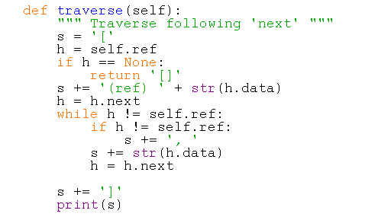
Circular Linked List: Traverse

Slide 7
Circular Linked Lists: Inserting a Node
We can look at two different types of circular lists
Unsorted
Sorted

Slide 8
Unsorted Circular Linked Lists: Inserting
One needs to consider two cases (identical to other lists insertion) :
Insert a new node into an empty list
Insert a new node into a non-empty list

Slide 9
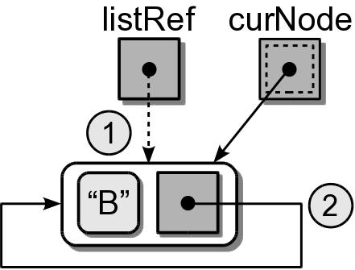
Sorted Circular Linked: Inserting, Three cases
(1) Insert into an empty list.

Slide 10
Sorted Circular Linked: Inserting
(2) Insert at the “front” (one node past listRef)
“W”

Slide 11
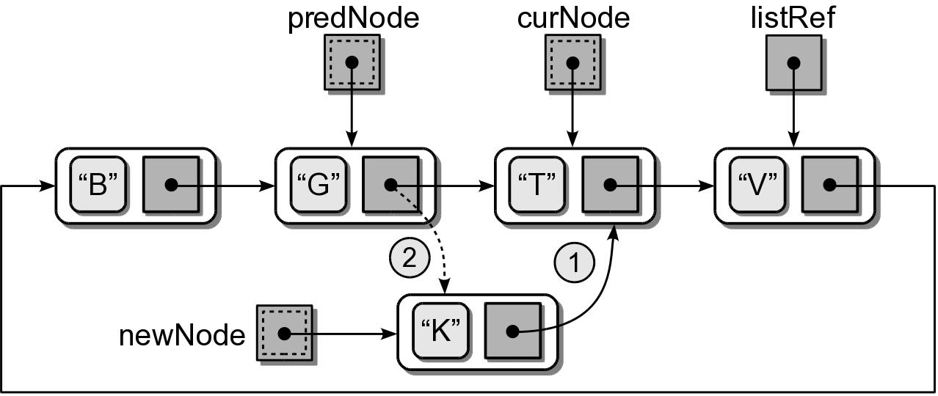
Sorted Circular Linked: Inserting
(3) Insert in the middle.

Slide 12
Sorted Circular Linked: find_place()
How to find the right place to insert?

Slide 13
Circular Singly Linked: Inserting
Try out test_singly_circular_list.py

Slide 14
How to remove a node?
Your exercise

