Slide 1
CSCI 204: Data Structures & Algorithms
Stacks
Notes:
1

Slide 2
Stacks
Revised based on textbook author’s notes.

Slide 3
Stacks
A restricted access container that stores a linear collection.
  Very common for solving problems in computer science.
  Provides a last-in first-out (LIFO) protocol.

Slide 4
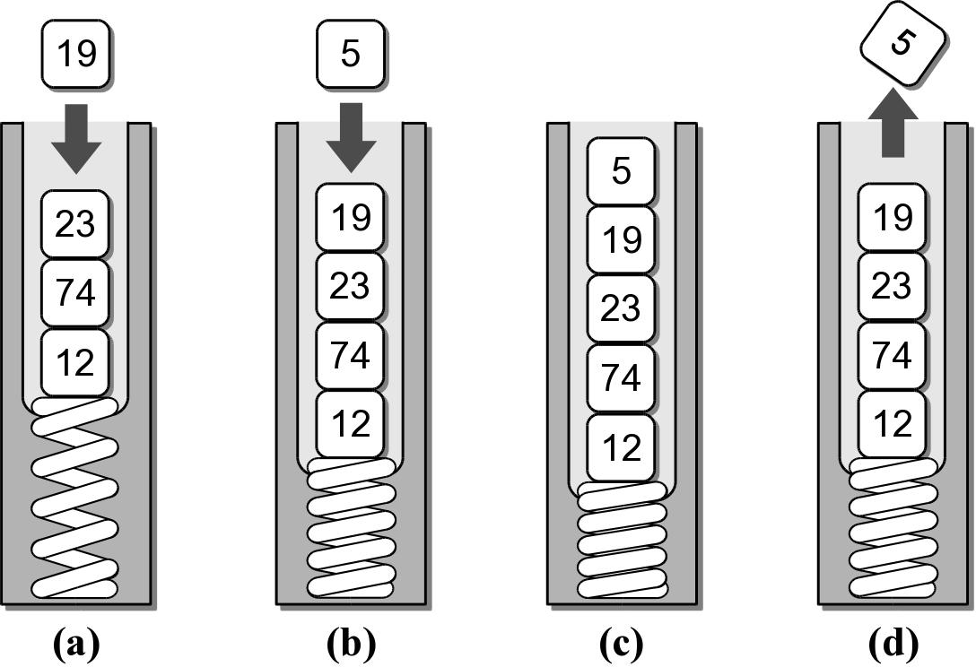
The Stack
New items are added and existing items are removed from the top of the stack.

Slide 5
Why stacks are useful?
Many computer science problems (and real life problems) are solved using stacks.
We’ll touch a few here.
  Determine if a string is a palindrome
  Find paths among a set of cities
  Evaluate math expressions

Slide 6
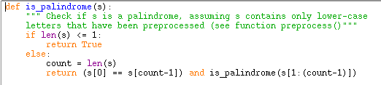
The palindrome problem
  A palindrome is a string that reads the same in forward and backward
  Here is a list of palindrome
  http://www.palindromelist.net
  We saw the solution recursion before
A Toyota’s a Toyota.
Civic
Go dog.
Tell a ballet.

Slide 7
We can also solve the problem using stacks
Given a string s, put the sting into a stack, then take the one on stack out in order (LIFO). If the two are the same, it is a palindrome!
Original string
In-stack
Output
civic
civic
civic
Yes
godog
godog
godog
Yes
hello
olleh
olleh
No

Slide 8
The Stack ADT
A stack stores a linear collection of items with access limited to a last-in first-out order.
  Adding and removing items is restricted to the top of the stack.
Stack() is_empty() len() pop() peek() push( item )

Slide 9
Stack Example
reverse.py
# Extracts a collection of integer values from the user
# and prints them in reverse order.
from list_stack import Stack
#from pyliststack import Stack
PROMPT = "Enter an int value (<0 to end): "
my_stack = Stack()
# Extract the values and push them onto a stack.
value = int(input( PROMPT ))
while value >= 0 :
my_stack.push( value )
value = int(input( PROMPT ))
# Pop the values from the stack and print each.
while not my_stack.is_empty() :
value = my_stack.pop()
print( value )

Slide 10
Stack Implementation
Several common ways to implement a stack:
  Python list
    easiest to implement
  Linked list
    better choice when a large number of push and pop operations are performed.

Slide 11
Activity
Implement the Stack ADT in two different ways
  Using a singly linked list
  Using a Python list

