Slide 1
CSCI 204: Data Structures & Algorithms
Revised based on textbook author’s notes.
Notes:
1

Slide 2
Breadth First Search with Queues
Compared with Stacks

Slide 3
Solution with stack

Slide 4
Backtracking
Here is an example HPAir of using stack for backtracking
  Given
    A set of cities that HPAir serves
    Pairs of city names, each pair represents the origin and destination of one flight
    Pair of cities names each of which represents a request to fly from an origin to a destination
  Find whether or not a path exists between two cities requested by a passenger

Slide 5
General ideas
  Start from the origin city
  Find a city that is connected to the current city
  If the next city is the destination, we are done. Report a route has been found
  Otherwise
    If we found next city, push it onto stack
    If we found none, just pop the stack
  If we visited all cities and no route is found, we declare the failure
When we pursue a path, we explore a path as deep as possible. This type of solution is called “depth-first search” or DFS.

Slide 6
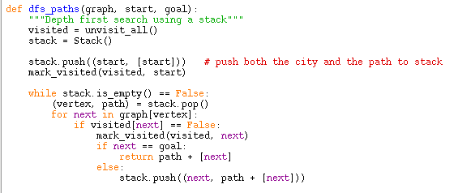
Source code
Note: both the city (vertex) and the path (as a list) are on stack!
Try out dfs.py

Slide 7
Solution with queue

Slide 8
General ideas
  Start from the origin city
  While the queue is not empty
  For each connected city,
    If next is the destination, return success
    If not, add next and current path to queue
  Continue in Step 2
  If we visited all cities and no route is found, we declare the failure
When we pursue a path, we explore a path as wide as possible. This type of solution is called “breadth-first search” or BFS.

Slide 9
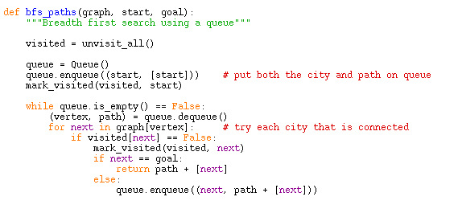
Source code
Note: both the city (vertex) and the path are on queue!
Try out bfs.py

