Slide 1
CSCI 204: Data Structures & Algorithms
Notes:
1

Slide 2
Circular Queue
Revised based on textbook author’s notes.

Slide 3
Queue
A restricted access container that stores a linear collection.
Very common for solving problems in computer science that require data to be processed in the order in which it was received.
Provides a first-in first-out (FIFO) protocol.
New items are added at the back while existing items are removed from the front of the queue.

Slide 4
The Queue ADT
A queue stores a linear collection of items with access limited to a first-in first-out order.
New items are added to the back.
Existing items are removed from the front.
Queue() is_empty() len() enqueue( item ) dequeue()

Slide 5
Queue: Circular Array
circular array – an array viewed as a circle instead of a line.
Items can be added/removed without having to shift the remaining items in the process.
Introduces the concept of a maximum-capacity queue that can become full.

Slide 6
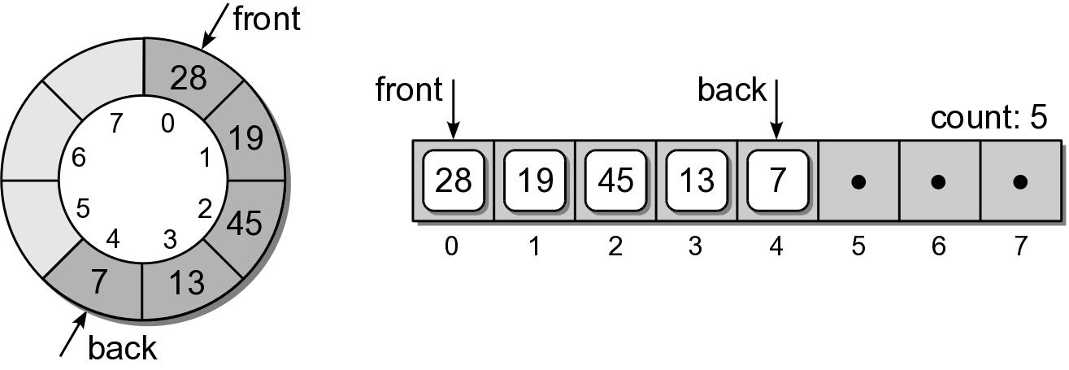
Queue: Circular Array
How should the data be organized within the array?
count field – number of items in the queue.
front and back markers – indicate the array elements containing the queue items.

Slide 7
Queue: Circular Array
To enqueue an item:
new item is inserted at the position following back
back is advanced by one position
count is incremented by one.
Suppose we enqueue 32:

Slide 8
Queue: Circular Array
To dequeue an item:
the value in the front position is saved
front is advanced by one position.
count is decremented by one.
Suppose we dequeue an item:

Slide 9
Queue: Circular Array
Suppose we enqueue items 8 and 23:

Slide 10
Queue: Circular Array
What happens if we enqueue 39?
Since we are using a circular array, the same steps are followed.
But since back is at the end of the array, it wraps around to the front.

Slide 11
Queue: Circular Array
arrayqueue.py
class Queue :
def __init__( self, max_size ) :
self._count = 0
self._front = 0
self._back = max_size - 1
self._qarray = Array( max_size )
def is_empty( self ) :
return self._count == 0
# A new operation specifically for the circular array.
def is_full( self ) :
return self._count == len(self._qarray)
def __len__( self ) :
return self._count
# ...

Slide 12
Queue: Circular Array
arrayqueue.py
class Queue :
# ...
def enqueue( self, item ):
assert not self.is_full(), "Cannot enqueue to a full queue."
max_size = len(self._qarray)
self._back = (self._back + 1) % max_size
self._qarray[self._back] = item
self._count += 1
def dequeue( self ):
assert not self.is_empty(), "Cannot dequeue from an empty queue."
item = self._qarray[ self._front ]
max_size = len(self._qarray)
self._front = (self._front + 1) % max_size
self._count -= 1
return item

Slide 13
Queue Analysis: Circular Array
Queue Operation | Worst Case
q = Queue() | O(1)
len(q) | O(1)
q.is_empty() | O(1)
q.is_full() | O(1)
q.enqueue(x) | O(1)
x = q.dequeue() | O(1)

Slide 14
Your Exercise
The circular queue we just implemented uses a count to control how the queue operates.
Your exercise is to implement the same circular queue without the count variable.
The basic idea is to use the relation between front and back to manage the queue.
Note that without a count, one can’t tell the difference between a full queue or empty queue if front == back, so the two have to be different when queue is empty or full.

