Slide 1
CSCI 204: Data Structures & Algorithms
Revised by Xiannong Meng based on textbook author’s notes
Notes:
1

Slide 2
Binary Tree ADT
So far the ADTs we studied are linear
Lists
Arrays
Stacks
Queues
Some applications require non-linear ADTs. Examples may include ADTs
To represent an organization
To represent class inheritance in OOP
To represent a complex algebraic expression
Or even to represent a collection of sorted numbers!

Slide 3
The Tree Structure
Consists of nodes and edges that organize data in a hierarchical fashion.
nodes – store the data elements.
edges – connect the nodes.
The organization of the nodes form relationships among the data elements.

Slide 4
Definition of a tree
A tree data structure is defined as follows.
A tree consists of a node called root
The root may have zero or more children
Each child itself is a tree
A recursive definition!

Slide 5
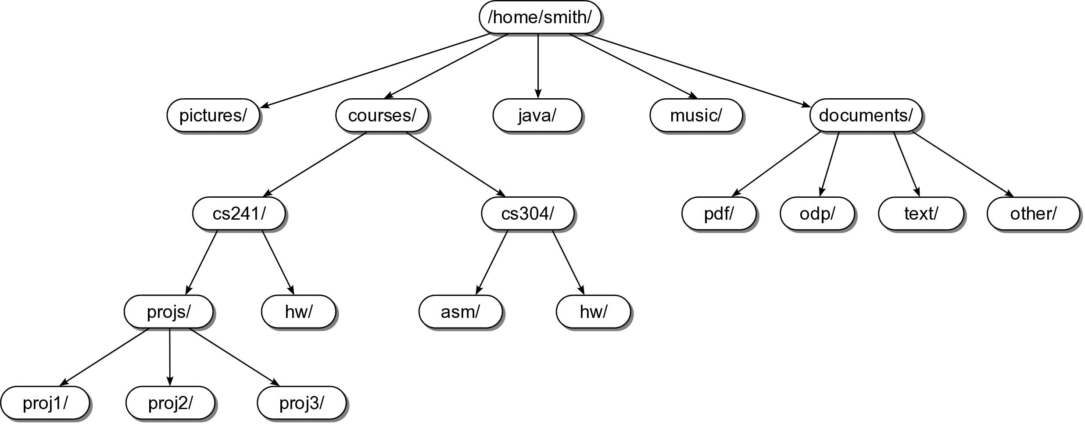
Tree Example #1
Linux file system is a tree!

Slide 6
Tree Example #2
Chapters and sections in a book
can be organized as a tree!

Slide 7
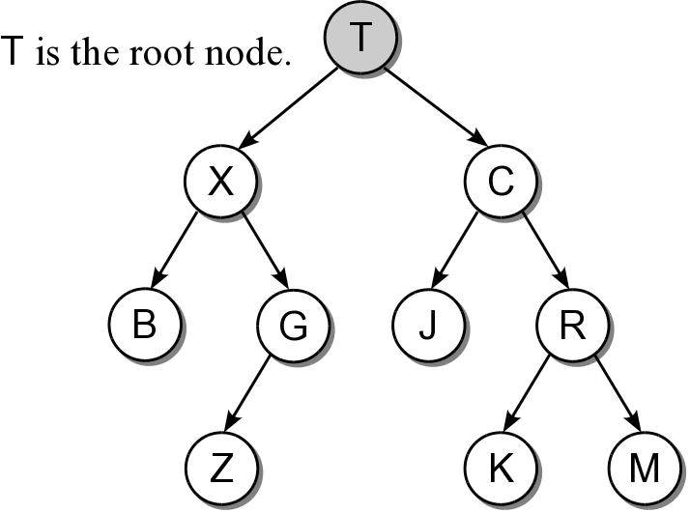
Root Node
Topmost node of the tree.
Provides the single access point into the tree.
Has no incoming edges.

Slide 8
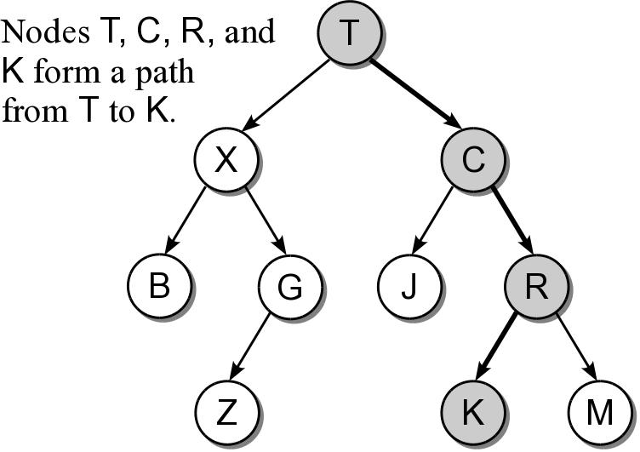
Tree Path
The nodes encountered when following the edges from the root node to the destination node.
Access to all other nodes must start with the root.

Slide 9
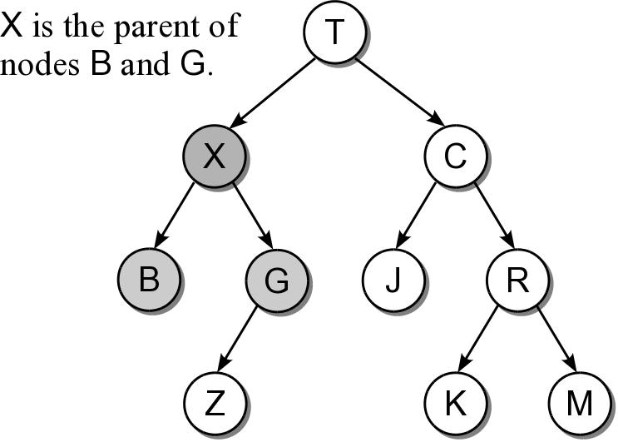
Parent Node
The node from which an incoming edge originates.
Every node, except the root, has a parent node.
A node can only have one parent.

Slide 10
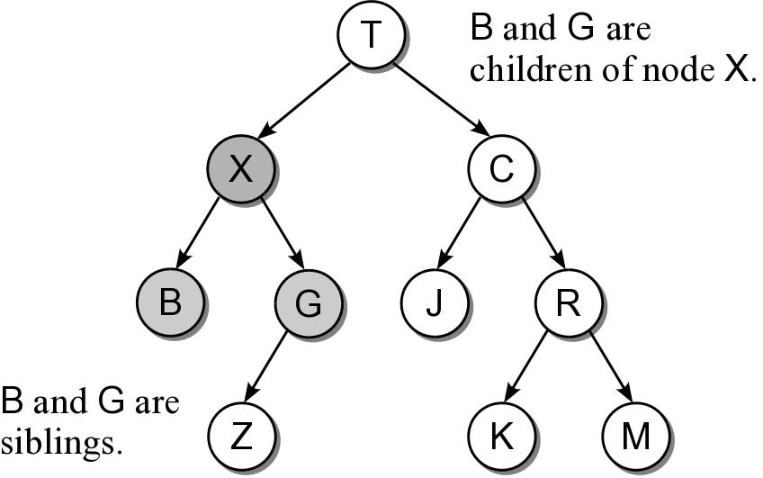
Child Node
The nodes to which outgoing edges are connected.
Each node can have one or more child nodes.
Results in a parent-child relationship.
sibling nodes – all nodes that have the same parent.

Slide 11
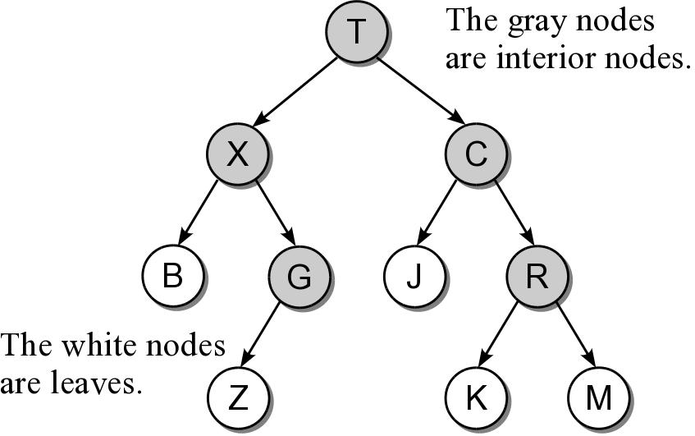
Types of Nodes
Nodes can be classified as either:
interior node – a node that has at least one child.
leaf node – a node that has no children.

Slide 12
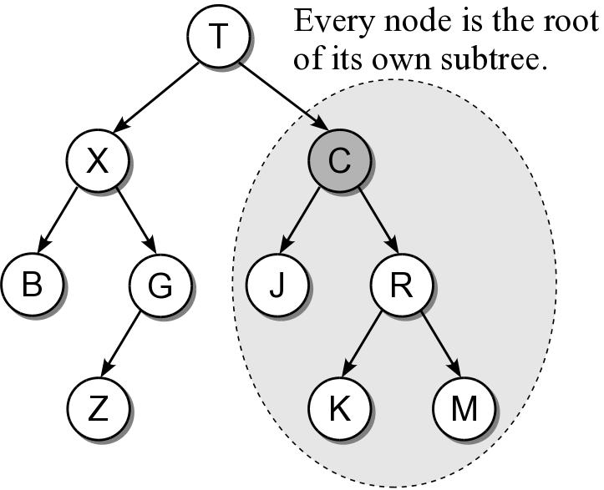
Subtree
A tree is by definition a recursive structure.
Every node can be the root of its own subtree.
A subtree consists of a subset of nodes and edges of the larger tree.

Slide 13
Relatives
descendants
All nodes of a subtree are the descendants of the subtree's root.
Every node in the tree is a descendant of the root.
ancestors
The ancestors of a node include all of the nodes along the node's path, excluding the node itself.
The root is the ancestor of all the other nodes.

Slide 14
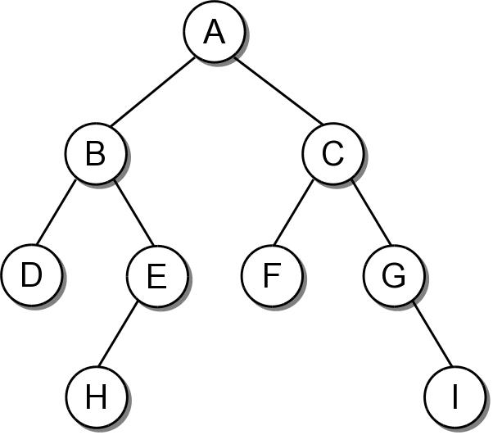
The Binary Tree
A tree in which each node can have at most two children. The nodes are commonly labeled:
left child
right child

Slide 15
Binary Tree Properties
There are several properties associated with binary trees that depend on the node organization.
depth – the distance of a node from the root.
level – all nodes at a given depth share a level.
height – number of levels in the tree.
width – number of nodes on the level containing the most nodes.
size – number of nodes in the tree.

Slide 16
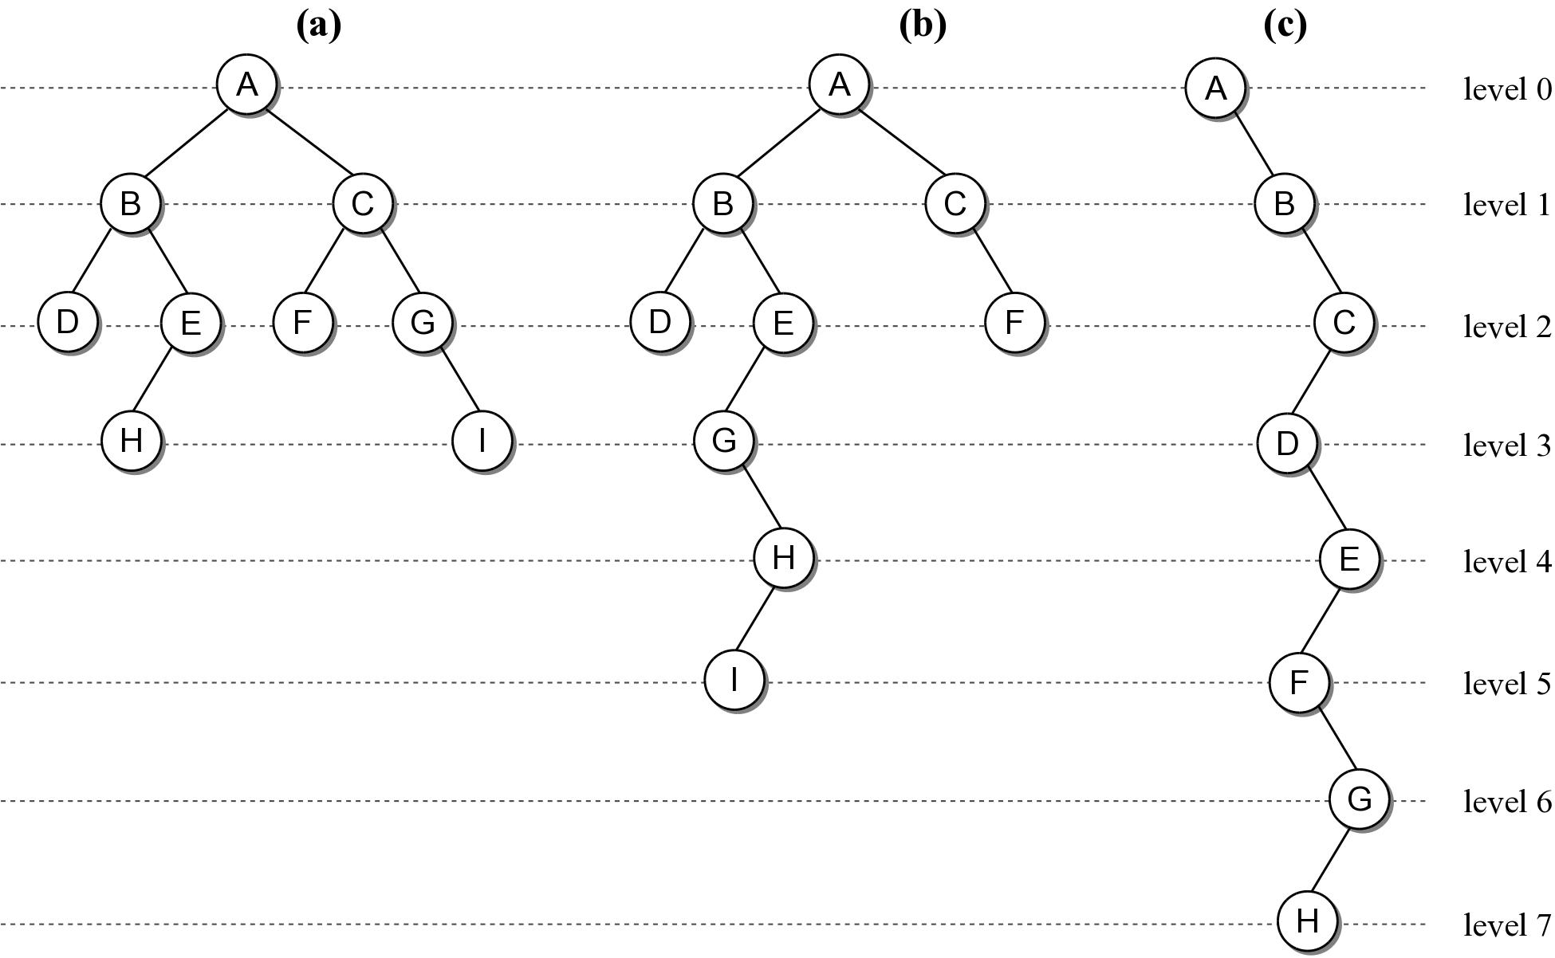
Binary Tree Properties

Slide 17
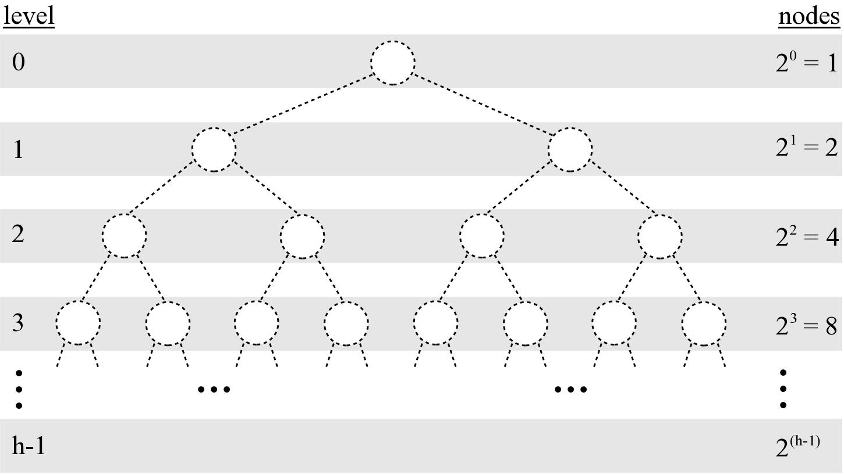
Binary Tree Properties
Given a tree of size n:
max height = n
min height =

Slide 18
Binary Tree Structure
Height of a tree will be important in analyzing the efficiency of binary tree algorithms.
Structural properties can play a role in the efficiency of an algorithm.

Slide 19
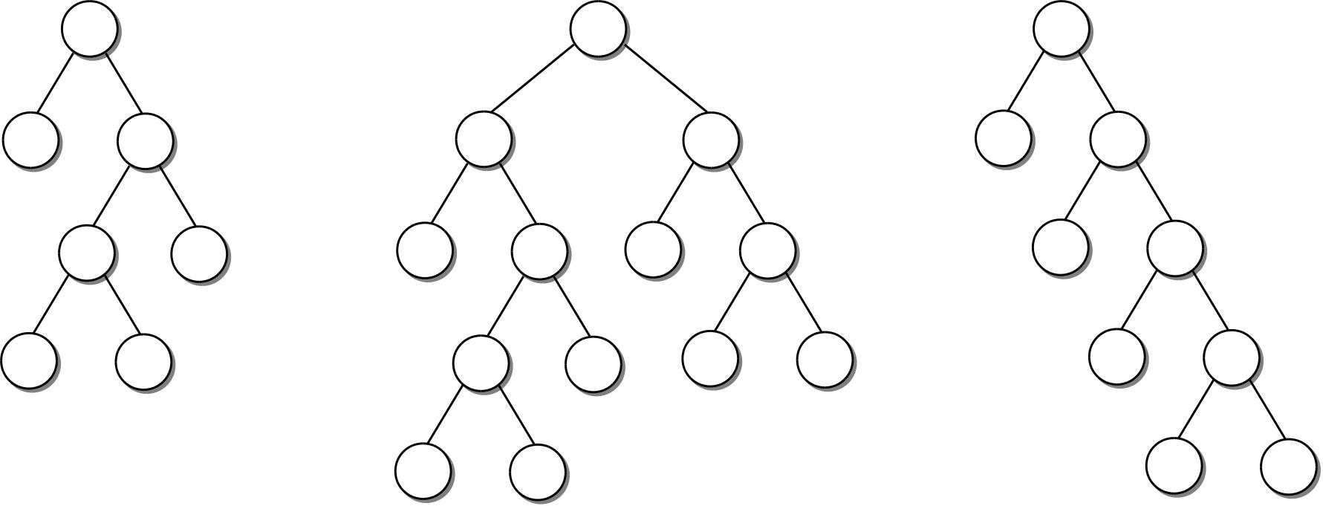
Full Binary Tree
A binary tree in which each interior node contains two children.

Slide 20
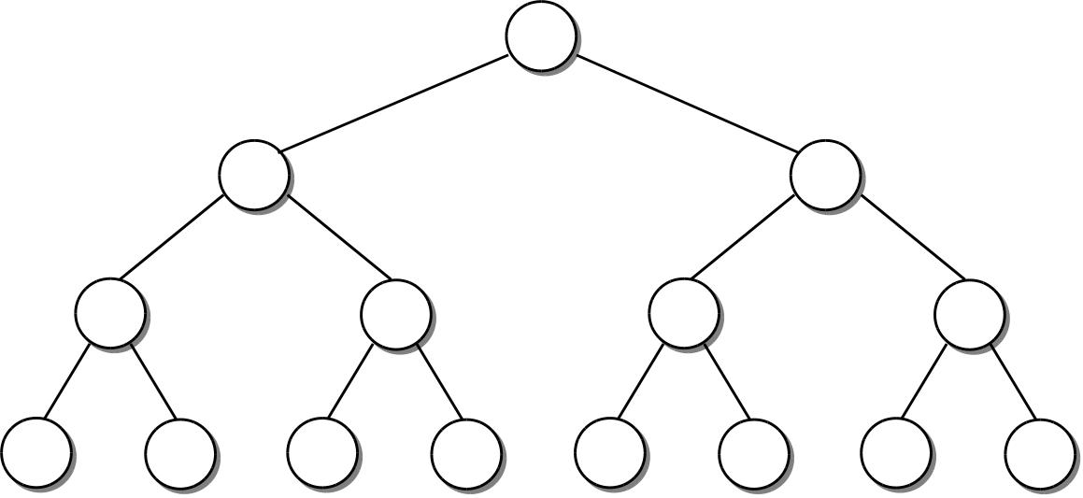
Perfect Binary Tree
A full binary tree in which all leaf nodes are at the same level.

Slide 21
Complete Binary Tree
A binary tree of height h, is a perfect binary tree down to height h – 1 and the nodes at the lowest level are filled from left to right (no gaps).

