Slide 1
CSCI 204: Data Structures & Algorithms
Revised by Xiannong Meng based on textbook author’s notes
Notes:
1

Slide 2
Binary Tree Application Build Expression Tree Heaps
Revised based on textbook author’s notes.

Slide 3
Heaps
A heap is a complete binary tree in which the nodes are organized based on their data values.
heap order property – how the nodes in a heap or arranged.
heap shape property – as a complete binary tree.

Slide 4
Heap property, examples
For each non-leaf node V,
max-heap: the value in V is greater than the value of its two children.
min-heap: the value in V is smaller than the value of its two children.

Slide 5
Heap Operations
The heap is a specialized structure with limited operations.
Insert an element into the heap.
Remove the element from root node.

Slide 6
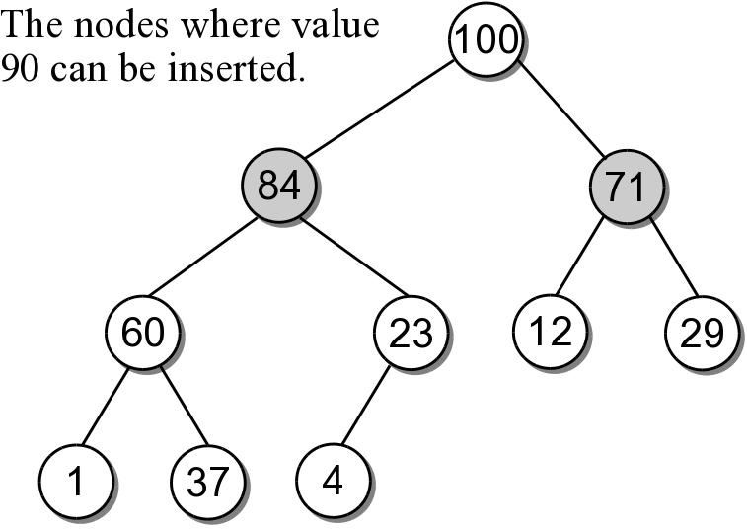
Heap Insertions
When an element is inserted into a heap, both properties must be maintained.
Example: add 90 to the max-heap.
There are only 2 places where 90 can be inserted.

Slide 7
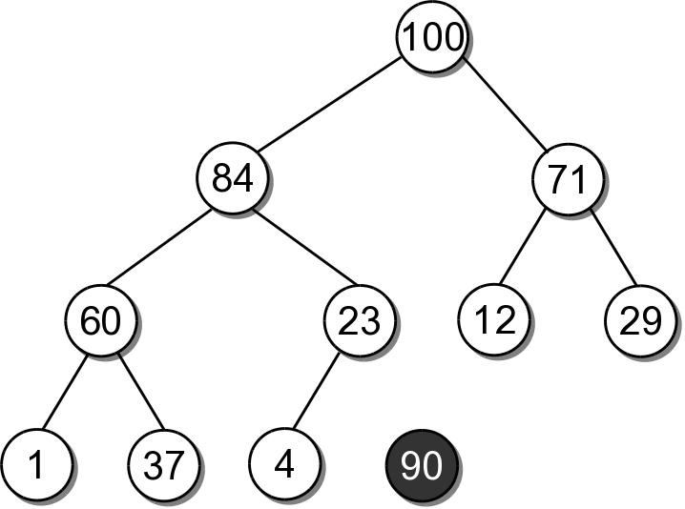
Heap Insertions
To properly insert an element into a heap involves several steps.
Create a new node for value.

Slide 8
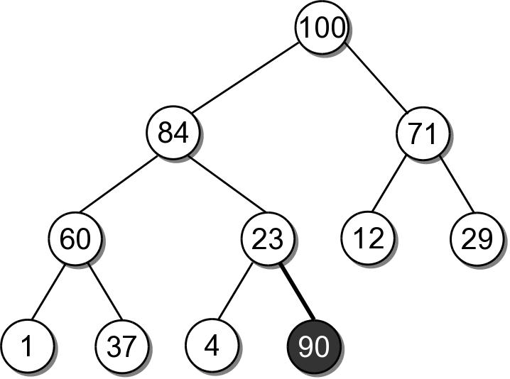
Heap Insertions
Link the node in as the last child in the complete tree.

Slide 9
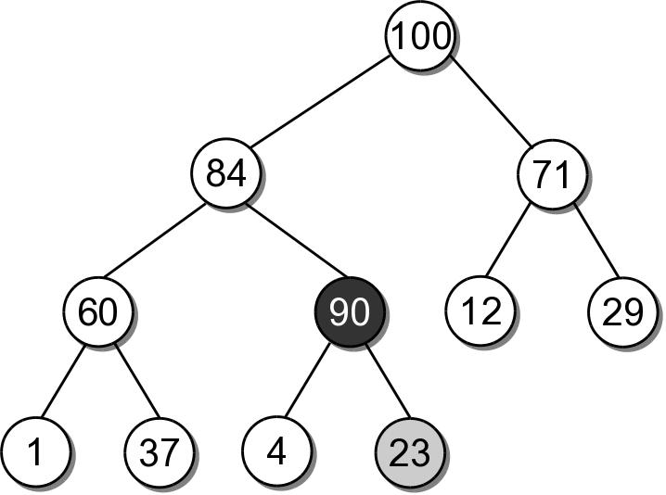
Heap Insertions
To restore the heap property, the new element has to move up along its path:
the data is swapped with its parent's data.
sift-up

Slide 10
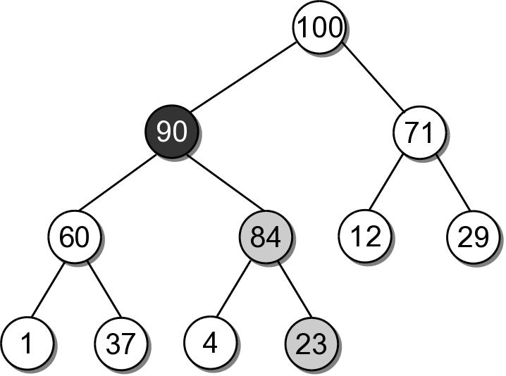
Heap Insertions
90 must move up another level since 84 is smaller.
After which, it is in it's correct position.

Slide 11
Heap Insert Example
Insert 41 into the heap from the previous slide.

Slide 12
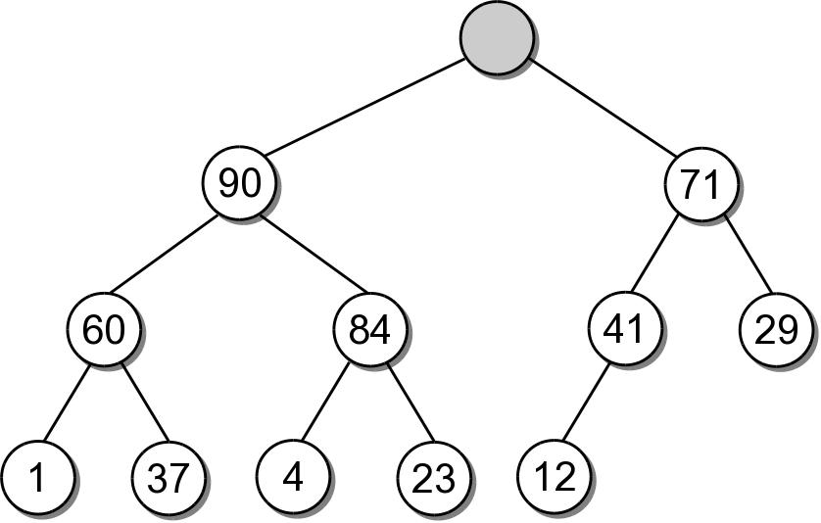
Heap Extractions
When an element is extracted from the heap, it can only come from the root node.
Both heap properties must be maintained.

Slide 13
Heap Extractions
To restore the tree to a heap:
another value will have to take the place of the extracted value in the root node.
a node has to be removed from the tree.

Slide 14
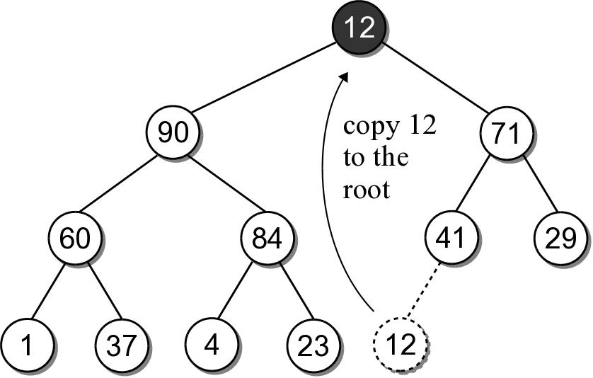
Heap Extractions
There is only one node that can be removed and still maintain the heap shape property.
Copy the data from the last child node to the root.
Delete the last child node.

Slide 15
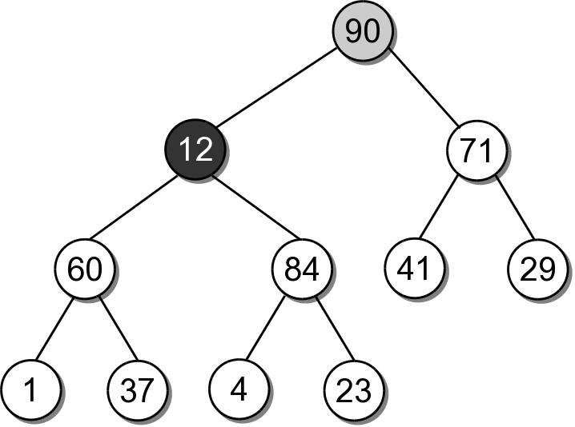
Heap Extractions
To maintain the heap order property, the new root value has to be sifted-down.

Slide 16
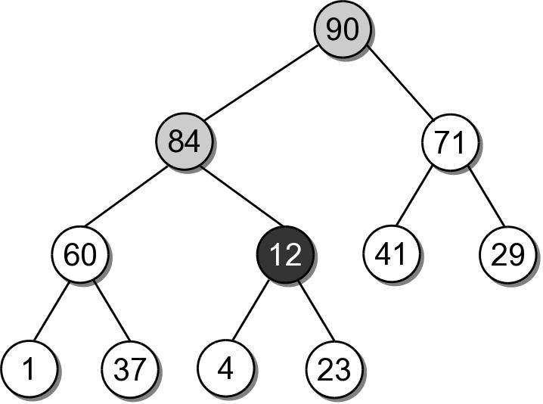
Heap Extractions
The shifting continues until the value is placed into a leaf node, or it is larger than its children.

Slide 17
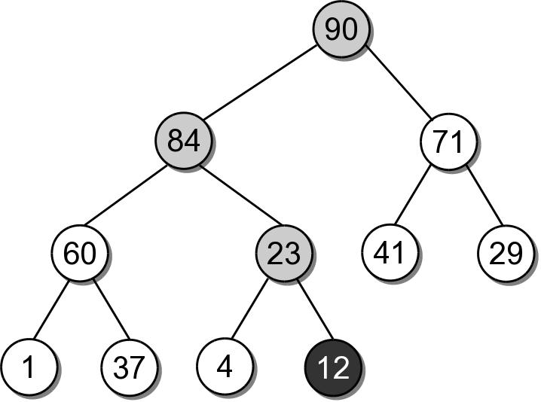
Heap Extractions
After being swapped with 23, value 12 will be in a node that maintains the heap order property.

