Slide 1
CSCI 204: Data Structures & Algorithms
Revised by Xiannong Meng based on textbook author’s notes
Notes:
1

Slide 2
Binary Tree Application Operations in Heaps
Revised based on textbook author’s notes.

Slide 3
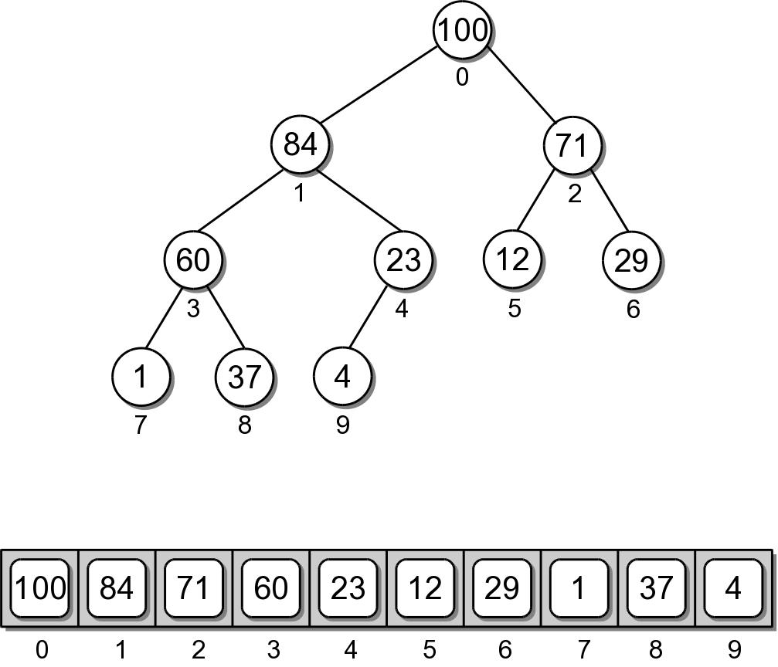
Heap Implementation
While a heap is a binary tree, it's seldom implemented as a dynamically linked structure.
Use a sequence to physically store the nodes.
We could use an array or a Python list

Slide 4
Heap – Node Access
The complete tree will never contain “holes”.
The root will always be at position 0.
Its two children will always occupy positions 1 and 2.
The children of any node will always occupy the positions in the same relation to their parent.

Slide 5
Heap – Node Access
Given the array index i
parent = (i-1) // 2
left = 2 * i + 1
right = 2 * i + 2
A child link is null if the index is out of range.

Slide 6
Heap – Class Definition
listheap.py
class MaxHeap :
def __init__( self, max_size = 16 ):
self._elements = [None for i in range(max_size)]
self._count = 0
self._max_size = max_size
def __len__( self ):
return self._count
def capacity( self ):
return len( self._elements )
# ...

Slide 7
Heap – Class Definition
listheap.py
class MaxHeap :
# ...
def add( self, value ):
if self._count >= self.capacity():
self._expand() # double the capacity and copy the content
# Add the new value to the end of the list.
self._elements[ self._count ] = value
self._count += 1
# Sift the new value up the tree.
self._sift_up( self._count - 1 )
def _sift_up( self, ndx ):
if ndx > 0 :
parent = ndx // 2
if self._elements[ndx] > self._elements[parent] :
tmp = self._elements[ndx]
self._elements[ndx] = self._elements[parent]
self._elements[parent] = tmp
self._sift_up( parent )

Slide 8
Heap – Class Definition
listheap.py
class MaxHeap :
# ...
def extract( self ):
assert self._count > 0,
"Cannot extract from an empty heap."
value = self._elements[0]
self._count -= 1
self._elements[0] = self._elements[ self._count ]
self._sift_down( 0 )
return value

Slide 9
Your Exercise
Following the pattern of function sift-up(), write the function sift-down() when the top (root) item is removed.

Slide 10
Heap – Class Definition
listheap.py
Student write the sift_down() function.

Slide 11
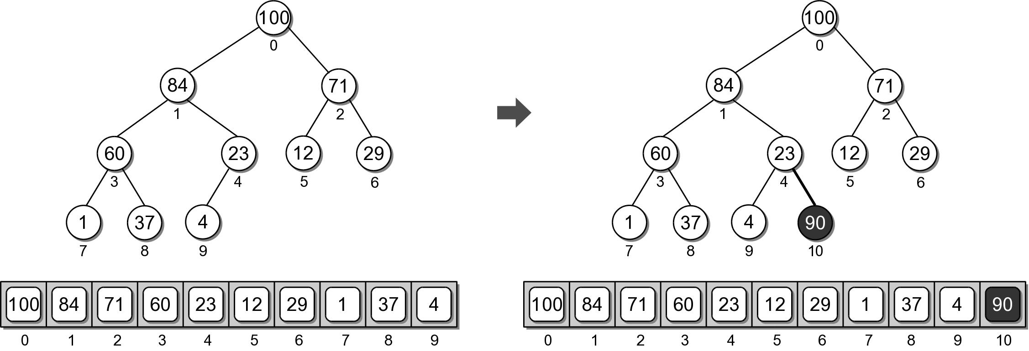
Heap Example
Physical view of adding value 90.

Slide 12
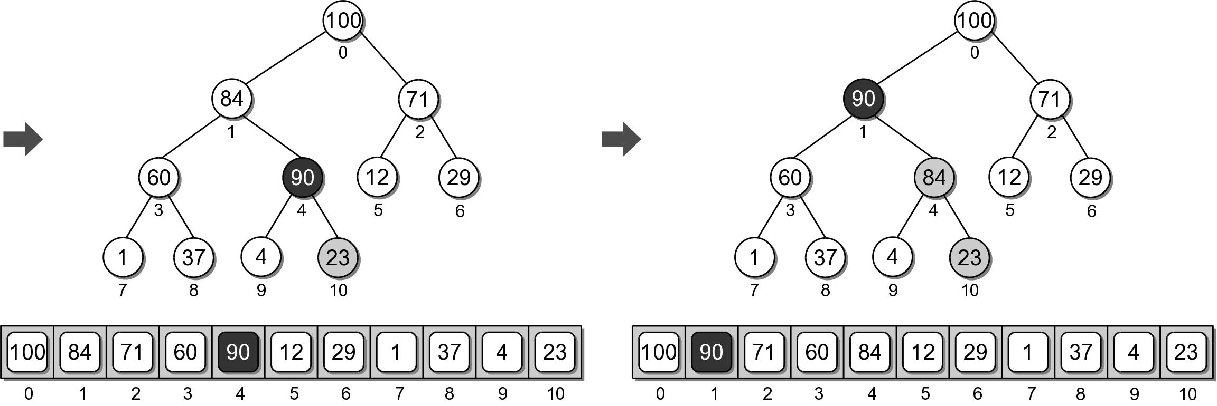
Heap Example
Physical view of adding value 90.

Slide 13
Heap Analysis
Assume a heap containing n elements:
Insertion: O(log n)
Extraction: O(log n)
Why?
Height of the heap is O(log n)

Slide 14
The Heapsort
The simplicity and efficiency of the heap structure can be applied to the sorting problem.
Build a heap from a sequence of unsorted keys.
Extract the keys from the heap to create a sorted sequence.
Very efficient: O(n log n)

Slide 15
Heapsort Implementation
A simple implementation is provided below.
def simple_heap_sort( the_seq ):
# Create an array-based max-heap.
n = len(the_seq)
heap = MaxHeap( n )
# Build a max-heap from the list of values.
for item in the_seq :
heap.add( item )
# Extract each value from the heap and store
# them back into the list.
for i in range( n-1, -1, -1 ) : # small to large
# for i in range( n ) : # large to small
theSeq[i] = heap.extract()

