Slide 1
CSCI 204: Data Structures & Algorithms
Revised by Xiannong Meng based on textbook author’s notes
Notes:
1

Slide 2
Binary Search Tree
Revised based on textbook author’s notes.

Slide 3
Search Trees
The tree structure can be used for searching.
Each node contains a search key as part of its data.
Nodes are organized based on the relationship between the keys.
Search trees can be used to implement various types of data structures.
Most common use is with the Map ADT.

Slide 4
Binary Search Tree (BST)
A binary tree in which each node contains a search key and the tree is structured such that for each interior node V:
All keys less than the key in node V are stored in the left subtree of V.
All keys greater than the key in node V are stored in the right subtree of V.

Slide 5
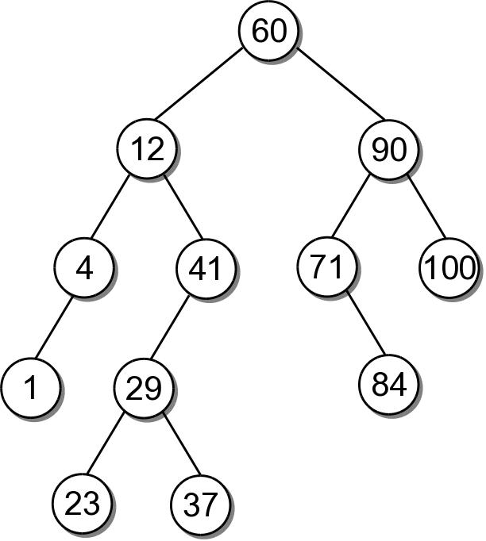
BST Example
Consider the example tree

Slide 6
BST – ADT
bst.py
# We use an unique name to distinguish this version
# from others in the chapter.
class BST :
def __init__( self ):
self._root = None
self._size = 0
def __len__( self ):
return self._size
# ...
# Storage class for the binary search tree nodes.
class _BSTNode :
def __init__( self, key, data ):
self.key = key
self.data = data
self.left = None
self.right = None

Slide 7
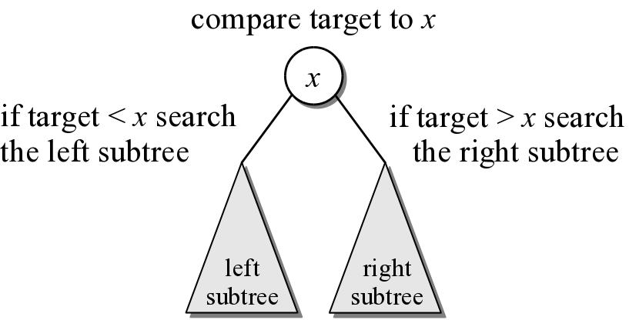
BST – Searching
A search begins at the root node.
The target is compared to the key at each node.
The path depends on the relationship between the target and the key in the node.

Slide 8
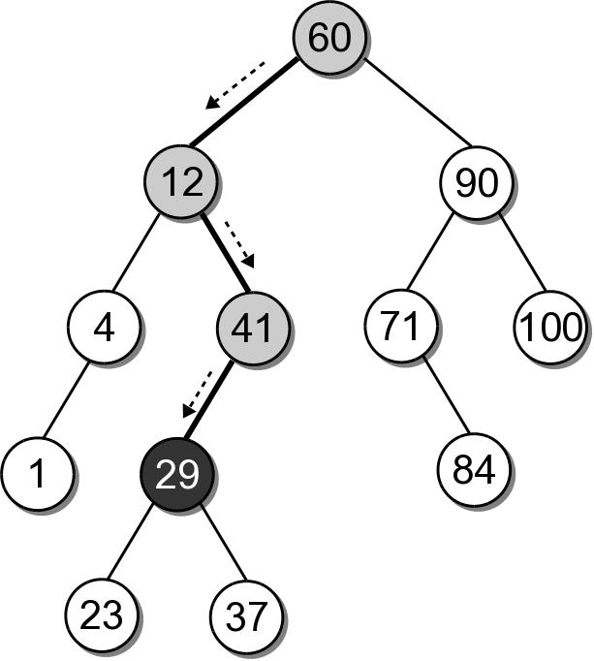
BST – Search Example
Suppose we want to search for 29 in our BST.

Slide 9
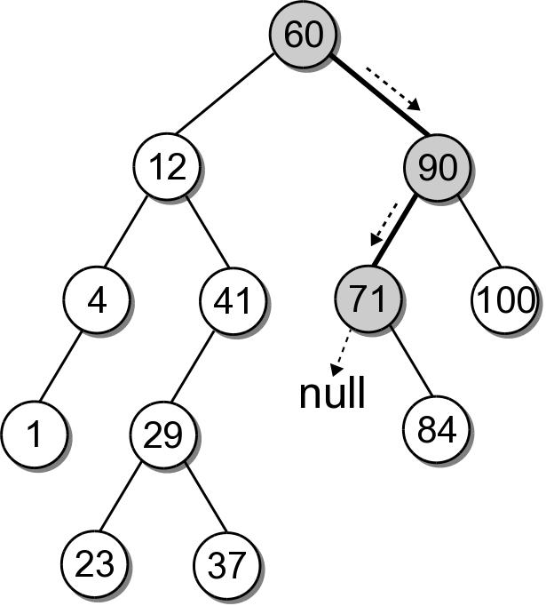
BST – Search Example
What if the key is not in the tree? Search for key 68 in our BST.

Slide 10
BST – Search Implementation
bst.py
class BST :
# ...
def __contains__( self, key ):
return self._bstSearch( self._root, key ) is not None
def valueOf( self, key ):
node = self._bstSearch( self._root, key )
assert node is not None, "Invalid map key."
return node.value
def _bstSearch( self, subtree, target ):
if subtree is None :
return None
elif target < subtree.key :
return self._bstSearch( subtree.left, target )
elif target > subtree.key :
return self._bstSearch( subtree.right, target )
else :
return subtree

Slide 11
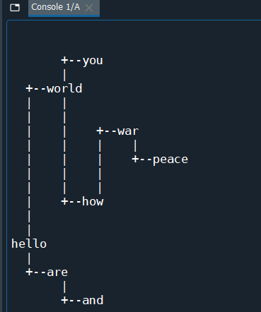

Slide 13
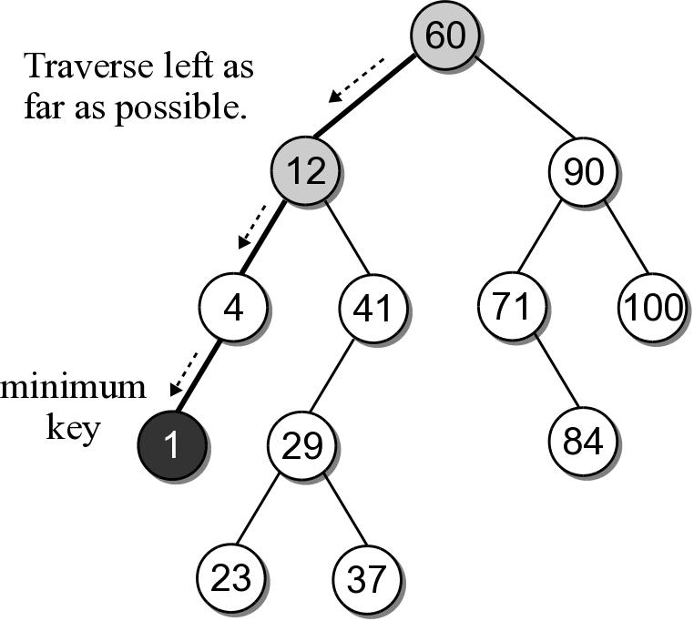
BST – Min or Max Key
Finding the minimum or maximum key within a BST is similar to the general search.
Where might the smallest key be located?
Where might the largest key be located?

Slide 14
BST – Min or Max Key
The helper method below finds the node containing the minimum key.
class BST :
# ...
def _bstMinumum( self, subtree ):
if subtree is None :
return None
elif subtree.left is None :
return subtree
else :
return self._bstMinimum( subtree.left )

Slide 15
BST – Insertions
When a BST is constructed, the keys are added one at a time. As keys are inserted
A new node is created for each key.
The node is linked into its proper position within the tree.
The search tree property must be maintained.

Slide 16
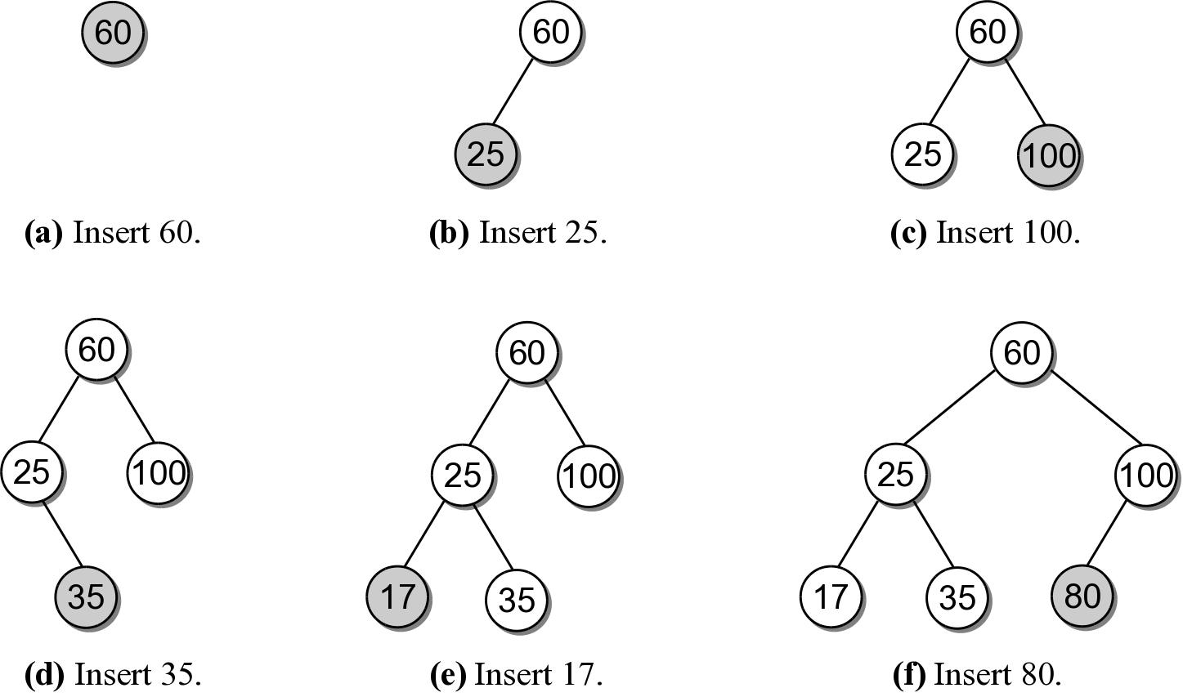
Building a BST
Suppose we want to build a BST from the key list
60 25 100 35 17 80

Slide 17
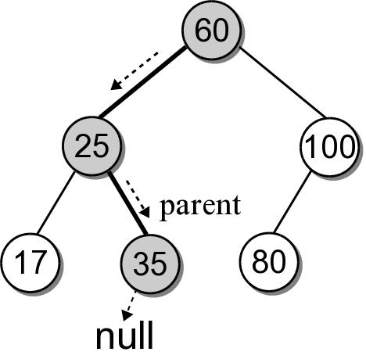
BST – Insertion
Building a BST by hand is easy. How do we insert an entry in program code?
What happens if we use the search method from earlier to search for key 30?

Slide 18
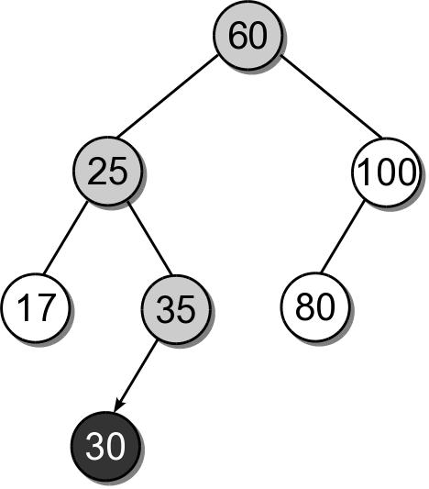
BST – Insertion
We can insert the new node where the search fell off the tree.

Slide 19
BST – Insert Implementation
bst.py
class BST :
# ...
def add( self, key, value ):
node = self._bstSearch( key )
if node is not None : # just update the value
node.value = value
return False
else :
self._root = self._bstInsert( self._root, key, value )
self._size += 1
return True
def _bstInsert( self, subtree, key, value ):
if subtree is None :
subtree = _BSTMapNode( key, value )
elif key < subtree.key :
subtree.left = self._bstInsert(subtree.left, key, value)
elif key > subtree.key :
subtree.right = self._bstInsert(subtree.right, key, value)
return subtree

Slide 20
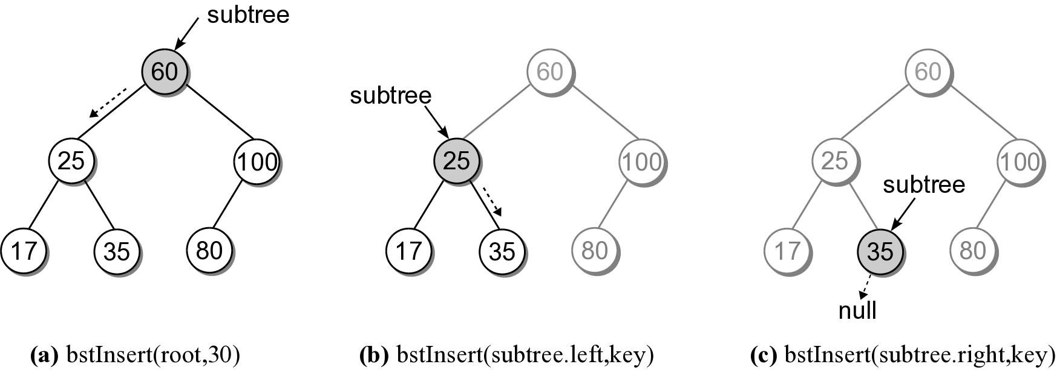
BST – Insert Steps
Add 30 to our sample BST.

Slide 21
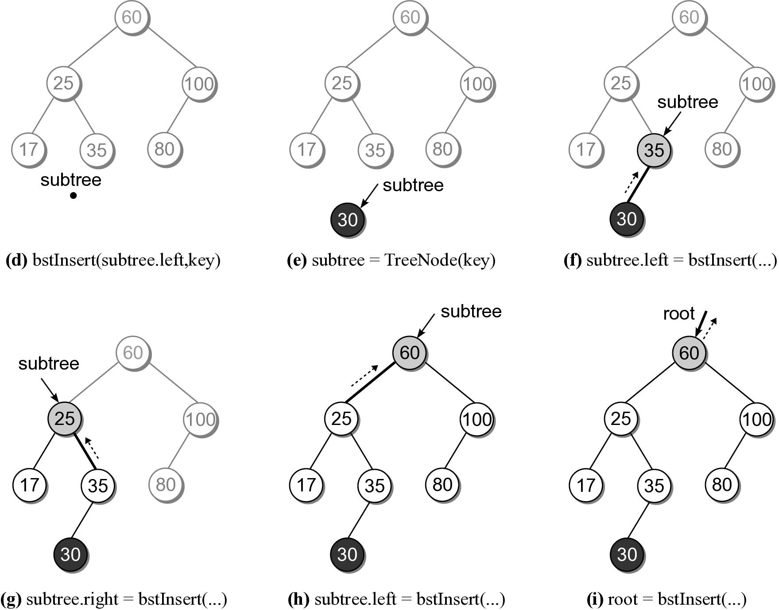
BST – Insert Steps

