Slide 1
CSCI 204: Data Structures & Algorithms
Revised by Xiannong Meng based on textbook author’s notes
Notes:
1

Slide 2
Sorting
The process of arranging a collection of items such that each item and its successor satisfy a preferred order.
  sequence sort – sorting within a sequence such as a list or an array.
  sort key – values on which items are ordered such as priority in a priority queue.
  items arranged in ascending or descending order.
  sorted in place – within the same structure.

Slide 3
Compared to the Priority Queues We Learned
We’ve learned how to maintain a priority queue, inserting items into a queue based on their priorities.
Difference and similarity between a priority queue and sorting a list in order
  Once an item is inserted into a priority queue, the queue as a whole is “sorted.”
    A priority queue may be in an un-sorted order, like the one in the textbook, removing the top-priority item involves a search
  The action of sorting re-arranges a list originally un-ordered into an ordered sequence.

Slide 4
There are many different sorting and searching algorithms. The famous sequence of books by Knuth “The Art of Programming” dedicates an entire book of 800 pages to just sorting and searching!
https://en.wikipedia.org/wiki/The_Art_of_Computer_Programming
We will examine a few here in CSCI 204.

Slide 5
Bubble Sort
A simple solution to the sorting problem.
Arranges the items by
  iterating over the sequence multiple times.
  smaller values bubble to the top (or large values “sink” to the bottom).

Slide 6
Bubble Sort Code (“sink”)
def bubble_sort( the_seq ):
n = len( the_seq )
for i in range( n – 1, 0, -1 ) :
for j in range( i ) :
if the_seq[j] > the_seq[j + 1] :
# swap the two items
tmp = the_seq[j]
the_seq[j] = the_seq[j + 1]
the_seq[j + 1] = tmp

Slide 7
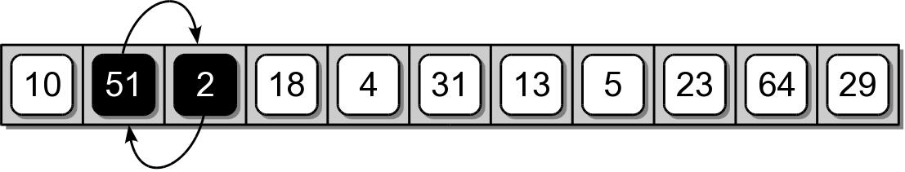
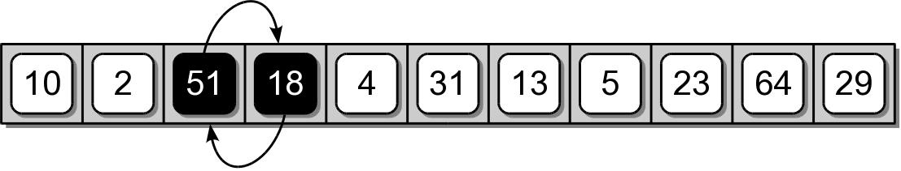
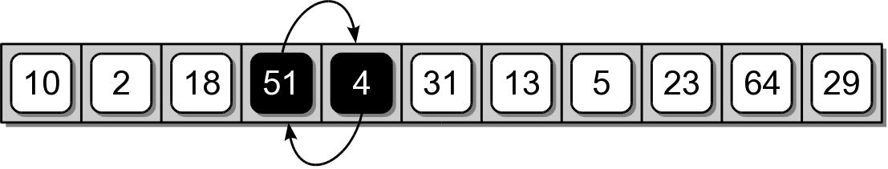
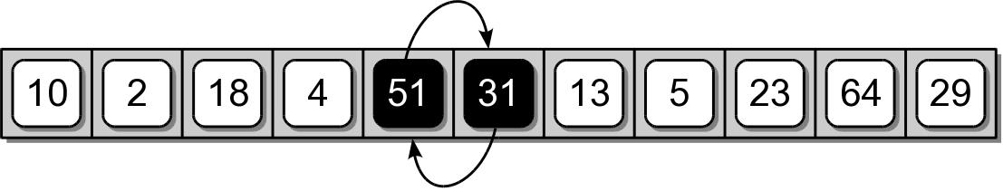
Bubble Sort Example
First complete iteration of the inner loop.

Slide 8
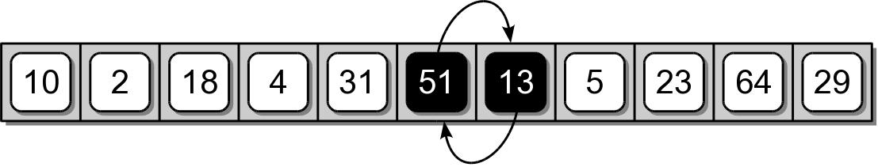
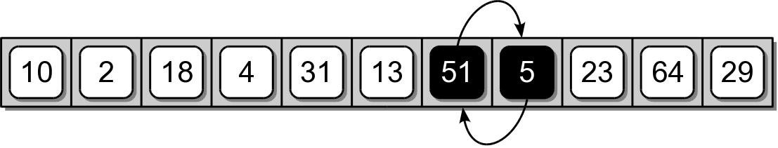
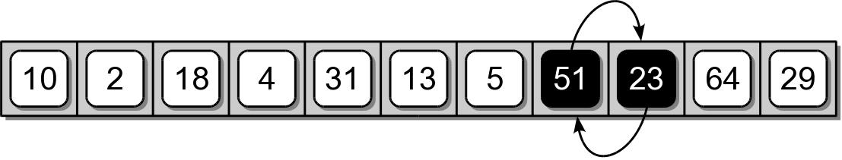
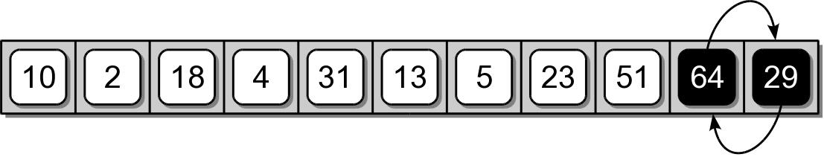
Bubble Sort Example

Slide 9
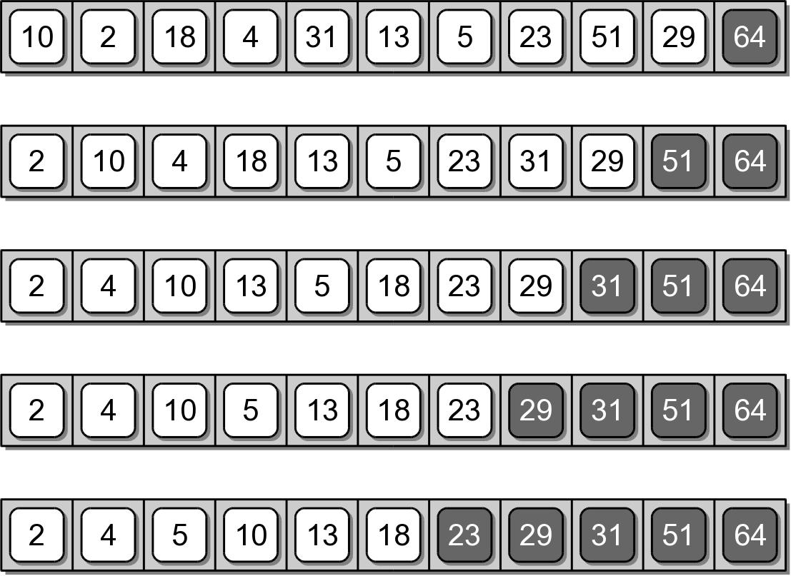
Bubble Sort Example
Results after each iteration of the outer loop.

Slide 10
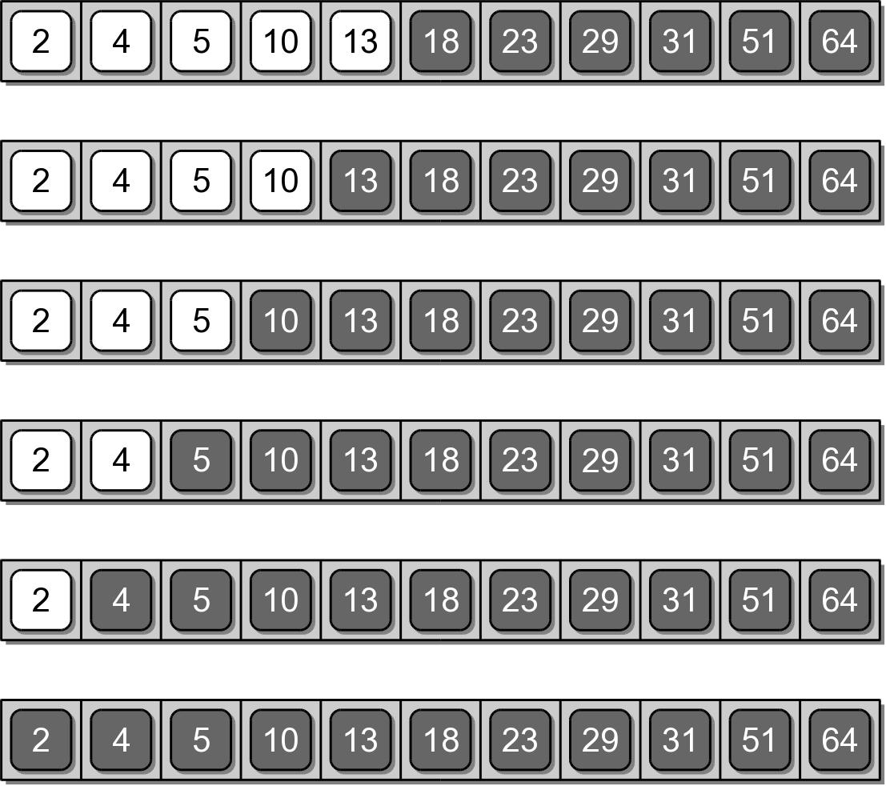
Bubble Sort Example

Slide 11
Two Issues to Consider
The above program works correctly. But we can think about the following two issues.
  The algorithm “sinks” the largest value to the end of the list. How can we re-write it so that the smallest value “bubbles” to the beginning?
  Do we really need to run the outer loop to its full count? How can we stop earlier? E.g., when the sequence becomes 2,4,5,10,13,18,23,29,31,51,64 in the 5th round, we could’ve stopped!

Slide 12
Selection Sort
Improves on the bubble sort.
Works in a fashion similar to what a human may use to sort a sequence.
Instead of swapping many items,
  repeatedly selects the next largest (or the smallest) item from among the unsorted items, puts it in the right place.
  requires a search to select the smallest item in each round.

Slide 13
Selection Sort Code
def selection_sort( the_seq ):
n = len( the_seq )
for i in range( n - 1 ):
small_index = i
for j in range( i + 1, n ):
if the_seq[j] < the_seq[small_index] :
small_index = j
if small_index != i : # found a new small
tmp = the_seq[i]
the_seq[i] = the_seq[small_index]
the_seq[small_index] = tmp

Slide 14
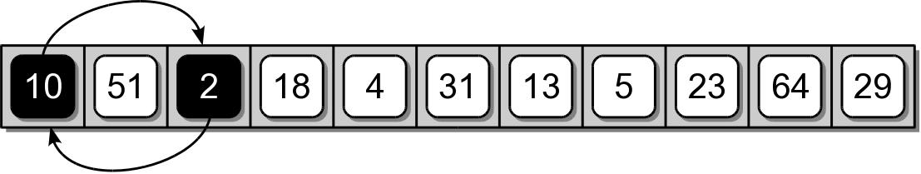
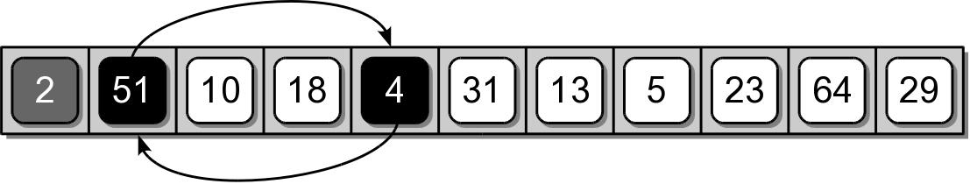
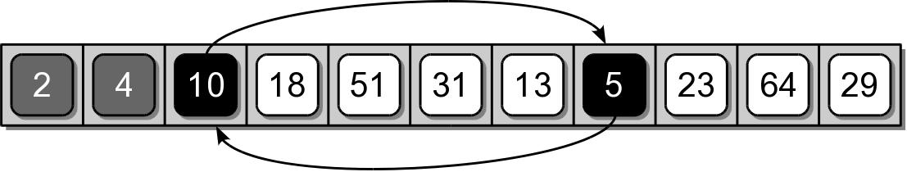
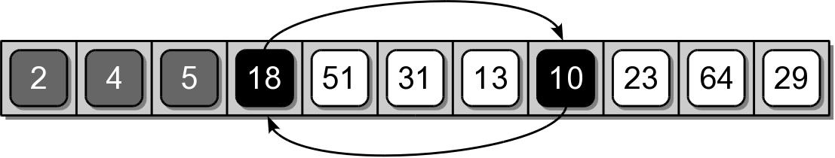
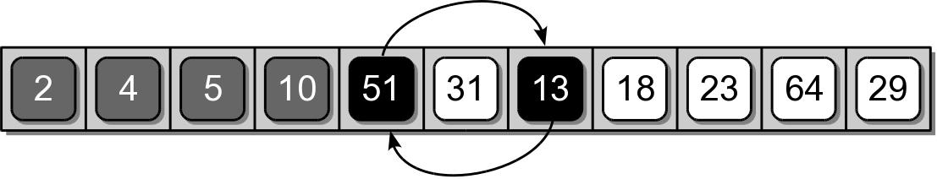
Selection Sort Example

Slide 15
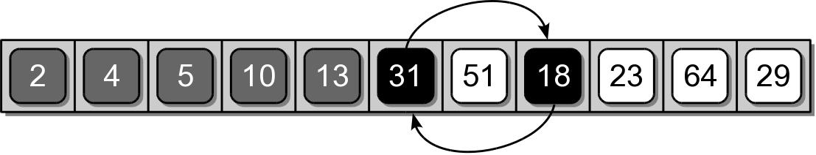
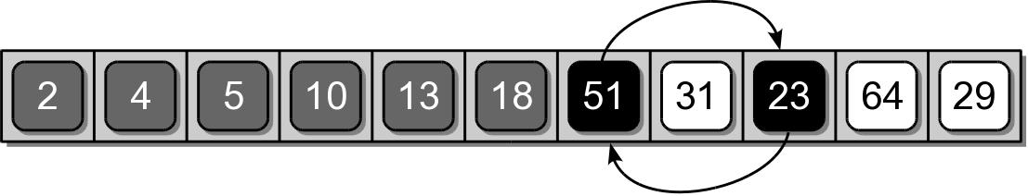
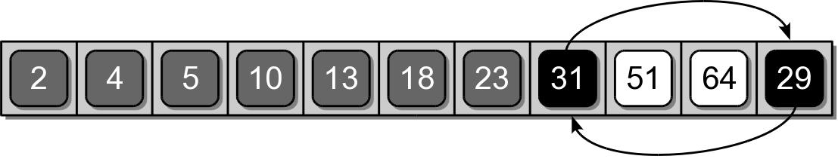
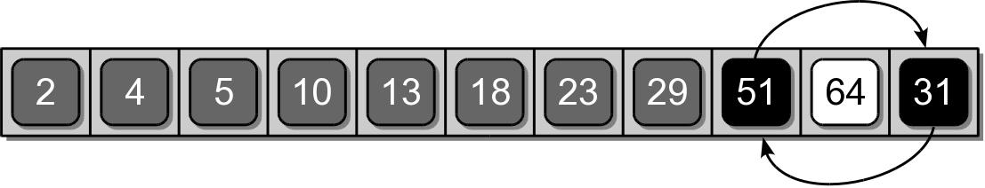
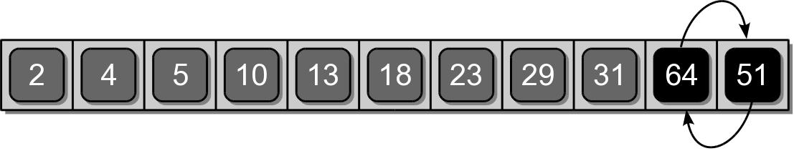
Selection Sort Example

