Slide 1
CSCI 305:
Introduction to Database Systems
Professor Xiannong Meng
Spring 2018
Lecture and activity contents are based on what Prof Chris Ré
used in his CS 145 in the fall 2016 term

Slide 2
Today’s Lecture
Introduction, examples of data in various forms
Motivation
Admin & setup
  ACTIVITY: Jupyter “Hello World!”
Overview of the relational data model
  ACTIVITY: SQL in Jupyter

Slide 3


All of society is online.
Data analysis in the fight against human trafficking.
New York DA use MEMEX Data for all trafficking investigations this year.
http://deepdive.stanford.edu/showcase/memex

Slide 4
Increasingly many companies see themselves as data driven.

Slide 5
Even more “traditional” companies…
https://www.youtube.com/watch?v=yH12xmwsvII

Slide 6
The world is increasingly driven by data…
This class teaches the basics of how to use & manage data.

Slide 7
1. Examples of data in various forms
Section 1

Slide 8
Data in various forms
CSV (Comma-Separated Values) that in turn can be in spreadsheet format such as Excel
  Example: Congress terms data (80th through 113th, or 1947 through 2015)
XML
  Example: Web IR books that can be accessed through http://www.eg.bucknell.edu/~xmeng/webir-course/common-files/sortingWebIRTextbooks.html
Problems with these representation are two fold, one is redundancy, the other is hard to update or look for information (search).

Slide 9
Database fills in the gap!
A database is a collection of information that is organized so that it can be easily accessed, managed and updated.
http://searchsqlserver.techtarget.com/definition/database

Slide 10
2. Motivation
Section 1

Slide 11
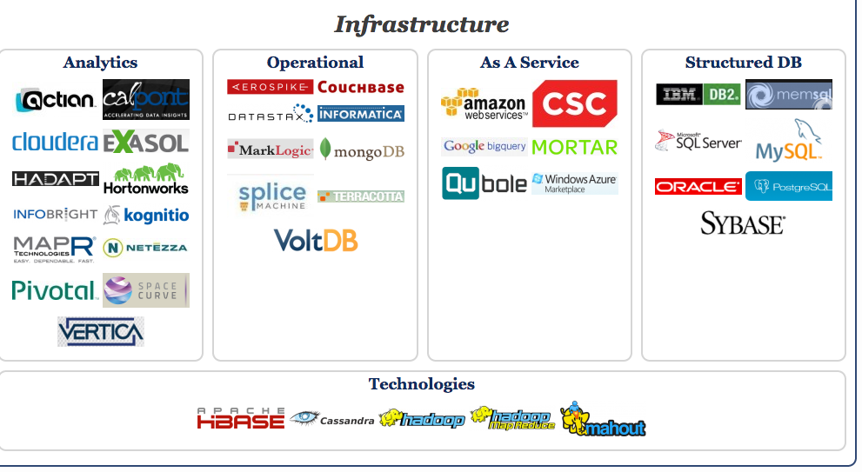
Big Data Landscape…
Infrastructure is Changing
Section 1 > Introduction
New tech. Same Principles.
http://www.bigdatalandscape.com/

Slide 12


Why should you study databases?
Section 1 > Introduction
Mercenary- make more $$$:
  Startups need DB talent right away = low employee #
  Massive industry…
Intellectual:
  Science: data poor to data rich
    No idea how to handle the data!
  Fundamental ideas to/from all of CS:
    Systems, theory, AI, logic, stats, analysis….
Many great computer systems ideas started in DB.

Slide 13
What this course is (and is not)
Section 1 > Introduction
Discuss fundamentals of data management
  How to design databases, query databases, build applications with them.
  How to debug them when they go wrong!
  Not how to be a DBA or how to tune Oracle 12g.
We’ll cover how database management systems work using sqlite as a programming platform
But not the principles of how to build them ☹ (though we’d touch a bit of it)
    Stanford’s CS 245, CS345, and CS346 do that.

Slide 14
3. Admin and setup
Section 1

Slide 15
Course Website: http://www.eg.bucknell.edu/~csci305/
Section 1 > Administrative
Course Moodle site:
http://moodle.bucknell.edu/course/view.php?id=27445

Slide 16
Lectures and work
Section 1 > Logistics
Lecture slides cover essential material
  This is your best reference.
Try to cover same thing in many ways: Lecture, activities, homework, projects, and exams .

Slide 17
Graded Elements
Section 1 > Logistics
Professional and engagement (8%)
Projects and HW (26%)
Quizzes (8%)
Class activities (8%) [check, check+, check-, missing]
Midterm (30%, 15% each)
Final exam (20%)

Slide 18
What is expected from you
Section 1 > Logistics
Attend lectures
  If you don’t, it’s at your own peril
Be active and think critically
  Ask questions, post comments on forums
Do programming and homework projects
  Start early and be honest
Study for quizzes and exams

Slide 19
Lectures: 1st half - from a user’s perspective
Section 1 > Lectures
Foundations: Relational data models & SQL
  How to manipulate data with SQL, a declarative language
Database Design: Design theory and constraints
  Designing relational schema to keep your data from getting corrupted
Transactions: Syntax & supporting systems
  A programmer’s abstraction for data consistency

Slide 20
Lectures: 2nd half - understanding how it works
Section 1 > Lectures
4. Introduction to database systems
  Indexing
  External Memory Algorithms (IO model) for sorting, joins, etc.
  Basics of query optimization (Cost Estimates)
  Relational algebra
5. Some elements of database implementation
  Indexing and storage using B+ tree

Slide 21
Setup your gitlab for this course
Please set up a gitlab repo for this course using the naming convention:
  https://gitlab.bucknell.edu/user/csci305
Share the git repo with your instructor as a master
If you don’t remember how to set gitlab, please read the first lab of CSCI 206 and follow the instructions there
  http://www.eg.bucknell.edu/~cs206/sp18/lab/lab-1/

Slide 22

Jupyter Notebook “Hello World”
Section 1 > ACTIVITY
Jupyter notebooks are interactive shells which save output in a nice notebook format
  They also can display markdown, LaTeX, HTML, js…
You’ll use these for
  in-class activities
  interactive lecture supplements/recaps
  homeworks, projects, etc.- if helpful!
FYI: “Jupyter Notebook” are also called iPython notebooks but they handle other languages too.
Note: you do need to know Python for this course!

Slide 23
Jupyter Notebook
Section 1 > ACTIVITY
  It has been installed in our Linux systems, the path is /usr/remote/anaconda-3.6/bin/jupyter
  Try type jupyter at your Linux command line prompt.
  If it doesn’t work, add the following paths to your .bashrc file in your home directory
  export PATH=/usr/remote/anaconda-3.6/bin:$PATH
  export PYTHONPATH=/usr/remote/anaconda-3.6/bin

Slide 24
Activity-1-1.ipynb
Section 1 > ACTIVITY

Slide 25
4. Overview of the relational data model
Section 2

Slide 26
What is a DBMS?
Section 2 > DBMS
A large, integrated collection of data
Models a real-world enterprise
  Entities (e.g., Students, Courses)
  Relationships (e.g., Alice is enrolled in CSCI 305)
A Database Management System (DBMS) is a piece of software designed to store and manage databases

Slide 27
A Motivating, Running Example
Section 2 > Data models
Consider building a course management system (CMS):
  Students
  Courses
  Professors
  Who takes what
  Who teaches what
Entities
Relationships

Slide 28
Data models
Section 2 > Data models
A data model is a collection of concepts for describing data
  The relational model of data is the most widely used model today
    Main Concept: the relation- essentially, a table
A schema is a description of a particular collection of data, using the given data model
  E.g. every relation in a relational data model has a schema describing types, etc.

Slide 29
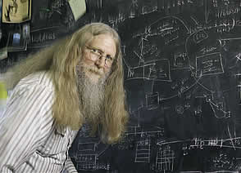
“Relational databases form the bedrock of western civilization”
Section 2 > Data models
- Bruce Lindsay, IBM Research

Slide 30
Modeling the CMS
Section 2 > Data models
Logical Schema
  Students(sid: string, name: string, gpa: float)
  Courses(cid: string, cname: string, credits: int)
  Enrolled(sid: string, cid: string, grade: string)
sid | Name | Gpa
101 | Bob | 3.2
123 | Mary | 3.8
Relations
cid | cname | credits
564 | 564-2 | 4
308 | 417 | 2
Students
sid | cid | Grade
123 | 564 | A
Courses
Enrolled

Slide 31
Modeling the CMS
Section 2 > Data models
Logical Schema
  Students(sid: string, name: string, gpa: float)
  Courses(cid: string, cname: string, credits: int)
  Enrolled(sid: string, cid: string, grade: string)
sid | Name | Gpa
101 | Bob | 3.2
123 | Mary | 3.8
Corresponding keys
cid | cname | credits
564 | 564-2 | 4
308 | 417 | 2
Students
sid | cid | Grade
123 | 564 | A
Courses
Enrolled

Slide 32
Other Schema…
Section 2 > Schemata
Physical Schema: describes data layout
  Relations as unordered files
  Some data in sorted order (index)
Logical Schema: Previous slide
External Schema: (Views)
  Course_info(cid: string, enrollment: integer)
  Derived from other tables
Administrators
Applications

Slide 33
Data independence
Section 2 > Schemata
Concept: Applications do not need to worry about how the data is structured and stored
Logical data independence: protection from changes in the logical structure of the data
I.e., should not need to ask: can we add a new entity or attribute without rewriting the application?
Physical data independence: protection from physical layout changes
I.e., should not need to ask: which disks are the data stored on? Is the data indexed?
One of the most important reasons to use a DBMS

Slide 34
Activity-1-2.ipynb
Section 2 > ACTIVITY

Slide 35
5. Overview of DBMS topics
Section 3
Key concepts & challenges

Slide 36
Challenges with Many Users
Section 3 > DBMS Challenges
Suppose that our CMS application serves 1000’s of users or more- what are some challenges?
  Security: Different users, different roles
  Performance: Need to provide concurrent access
  Consistency: Concurrency can lead to update problems
  We won’t look at too much in this course, but is extremely important
  Disk/SSD access is slow, DBMS hide the latency by doing more CPU work concurrently
DBMS allows user to write programs
as if they were the only user

Slide 37
Transactions
Section 3 > DBMS Challenges
A key concept is the transaction (TXN): an atomic sequence of db actions (reads/writes)
Atomicity: An action either completes entirely or not at all
Acct | Balance
a10 | 20,000
a20 | 15,000
Transfer $3k from a10 to a20:
Debit $3k from a10
Credit $3k to a20
Acct | Balance
a10 | 17,000
a20 | 18,000
Written naively, in which states is atomicity preserved?
Crash before 1,
After 1 but before 2,
After 2.
DB Always preserves atomicity!

Slide 38
Transactions
Section 3 > DBMS Challenges
A key concept is the transaction (TXN): an atomic sequence of db actions (reads/writes)
  If a user cancels a TXN, it should be as if nothing happened!
Transactions leave the DB in a consistent state
  Users may write integrity constraints, e.g., ‘each course is assigned to exactly one room’
Atomicity: An action either completes entirely or not at all
Consistency: An action results in a state which conforms to all integrity constraints
However, note that the DBMS does not understand the real meaning of the constraints– consistency burden is still on the user!

Slide 39
Challenge: Scheduling Concurrent Transactions
Section 3 > DBMS Challenges
The DBMS ensures that the execution of {T₁,…,T_{n}} is equivalent to some serial execution
One way to accomplish this: Locking
  Before reading or writing, transaction requires a lock from DBMS, holds until the end
Key Idea: If T_{i} wants to write to an item x and T_{j} wants to read x, then T_{i}, T_{j} conflict. Solution via locking:
  only one winner gets the lock
  loser is blocked (waits) until winner finishes
A set of TXNs is isolated if their effect is as if all were executed serially
What if T_{i} and T_{j} need X and Y, and T_{i} asks for X before T_{j,} and T_{j} asks for Y before T_{i}?
-> Deadlock! One is aborted…
All concurrency issues handled by the DBMS…

Slide 40
Ensuring Atomicity & Durability
Section 3 > DBMS Challenges
DBMS ensures atomicity even if a TXN crashes!
One way to accomplish this: Write-ahead logging (WAL)
Key Idea: Keep a log of all the writes done.
  After a crash, the partially executed TXNs are undone using the log
Write-ahead Logging (WAL): Before any action is finalized, a corresponding log entry is forced to disk
We assume that the log is on “stable” storage
All atomicity issues also handled by the DBMS…

Slide 41
A Well-Designed DBMS makes many people happy!
Section 3 > Summary
End users and DBMS vendors
  Reduces cost and makes money
DB application programmers
  Can handle more users, faster, for cheaper, and with better reliability / security guarantees!
Database administrators (DBA)
  Easier time of designing logical/physical schema, handling security/authorization, tuning, crash recovery, and more…
Must still understand
DB internals

Slide 42
Summary of DBMS
Section 3 > Summary
DBMS are used to maintain, query, and manage large datasets.
  Provide concurrency, recovery from crashes, quick application development, integrity, and security
Key abstractions give data independence
DBMS R&D is one of the broadest, most exciting fields in CS. Fact!

