Slide 1
Lectures 4: Introduction to SQL 3
Lecture and activity contents are based on what Prof Chris Ré
used in his CS 145 in the fall 2016 term with permission.

Slide 2
Joins
Lecture 2 > Section 3 > Joins: Basics
Product(PName, Price, Category, Manufacturer)
Company(CName, StockPrice, Country)
Note: we will often omit attribute types in schema definitions for brevity, but assume attributes are always atomic types
Ex: Find all products under $200 manufactured in Japan; return their names and prices.
SELECT PName, Price FROM Product, Company WHERE Manufacturer = CName
AND Country=‘Japan’ AND Price <= 200

Slide 3
Joins
Lecture 2 > Section 3 > Joins: Basics
Product(PName, Price, Category, Manufacturer)
Company(CName, StockPrice, Country)
Ex: Find all products under $200 manufactured in Japan; return their names and prices.
SELECT PName, Price FROM Product, Company WHERE Manufacturer = CName
AND Country=‘Japan’ AND Price <= 200
A join between tables returns all unique combinations of their tuples which meet some specified join condition

Slide 4
Joins
Lecture 2 > Section 3 > Joins: Basics
Product(PName, Price, Category, Manufacturer)
Company(CName, StockPrice, Country)
Several equivalent ways to write a basic join in SQL:
SELECT PName, Price FROM Product, Company WHERE Manufacturer = CName
AND Country=‘Japan’ AND Price <= 200
SELECT PName, Price FROM Product
JOIN Company ON Manufacturer = Cname
AND Country=‘Japan’ WHERE Price <= 200
A few more later on…

Slide 5
Joins
Lecture 2 > Section 3 > Joins: Basics
Product
Company
PName | Price | Category | Manuf
Gizmo | $19 | Gadgets | GWorks
Powergizmo | $29 | Gadgets | GWorks
SingleTouch | $149 | Photography | Canon
MultiTouch | $203 | Household | Hitachi
Cname | Stock | Country
GWorks | 25 | USA
Canon | 65 | Japan
Hitachi | 15 | Japan
SELECT PName, Price FROM Product, Company WHERE Manufacturer = CName
AND Country=‘Japan’ AND Price <= 200
PName | Price
SingleTouch | $149.99

Slide 6
Tuple Variable Ambiguity in Multi-Table
Lecture 2 > Section 3 > Joins: Semantics
Person(name, address, worksfor) Company(name, address)
Which “address” does this refer to?
Which “name”s??
SELECT DISTINCT name, address FROM Person, Company WHERE worksfor = name

Slide 7
Tuple Variable Ambiguity in Multi-Table
Lecture 2 > Section 3 > Joins: Semantics
Person(name, address, worksfor) Company(name, address)
SELECT DISTINCT Person.name, Person.address FROM Person, Company WHERE Person.worksfor = Company.name
Both equivalent ways to resolve variable ambiguity
SELECT DISTINCT p.name, p.address FROM Person p, Company c WHERE p.worksfor = c.name

Slide 8
Meaning (Semantics) of SQL Queries
Lecture 2 > Section 3 > Joins: semantics
SELECT x₁.a₁, x₁.a₂, …, x_{n}.a_{k}
FROM R₁ AS x₁, R₂ AS x₂, …, R_{n} AS x_{n}
WHERE Conditions(x₁,…, x_{n})
Almost never the fastest way to compute it!
Answer = {}
for x₁ in R₁ do
for x₂ in R₂ do
…..
for x_{n} in R_{n} do
if Conditions(x₁,…, x_{n})
then Answer = Answer ∪ {(x₁.a₁, x₁.a₂, …, x_{n}.a_{k})}
return Answer
Note: this is a multiset union

Slide 9
An example of SQL semantics
Lecture 2 > Section 3 > Joins: semantics
SELECT R.A
FROM R, S
WHERE R.A = S.B
Output
A
3
3
A
1
3
A | B | C
1 | 2 | 3
1 | 3 | 4
1 | 3 | 5
3 | 2 | 3
3 | 3 | 4
3 | 3 | 5
Cross Product
Apply Projection
Apply Selections / Conditions
B | C
2 | 3
3 | 4
3 | 5
A | B | C
3 | 3 | 4
3 | 3 | 5

Slide 10
An Unintuitive Query
Lecture 3 > Section 1 > Set Operators
SELECT DISTINCT R.A
FROM R, S, T
WHERE R.A=S.B OR R.A=T.A
S
T
R
But what if S = φ?
Computes R ∩ (S ∪ T)
Go back to the semantics!

Slide 11
An Unintuitive Query
Lecture 3 > Section 1 > Set Operators
SELECT DISTINCT R.A
FROM R, S, T
WHERE R.A=S.B OR R.A=T.A
Recall the semantics!
Take cross-product
Apply selections / conditions
Apply projection
If S = {}, then the cross product of R, S, T = {}, and the query result = {}!
Must consider semantics here.
Are there more explicit way to do set operations like this?

Slide 12
What does this look like in Python?
Lecture 3 > Section 1 > Set Operators
S
T
SELECT DISTINCT R.A
FROM R, S, T
WHERE R.A=S.B OR R.A=T.A
R
R ∩ (S ∪ T)
Semantics:
Take cross-product
Apply selections / conditions
Apply projection
Joins / cross-products are just nested for loops (in simplest implementation)!
If-then statements!

Slide 13
What does this look like in Python?
Lecture 3 > Section 1 > Set Operators
S
T
SELECT DISTINCT R.A
FROM R, S, T
WHERE R.A=S.B OR R.A=T.A
R
R ∩ (S ∪ T)
output = {}
for r in R:
for s in S:
for t in T:
if r[‘A’] == s[‘A’] or r[‘A’] == t[‘A’]:
output.add(r[‘A’])
return list(output)
Can you see now what happens if S = []?

Slide 14
1. Set Operators & Nested Queries
Lecture 3 > Section 1

Slide 15
What you will learn about in this section
Lecture 3 > Section 1
Multiset operators in SQL
Nested queries
ACTIVITY: Set operator subtleties

Slide 16
Multiset Operations
Lecture 3 > Section 1 > Set Operators

Slide 17
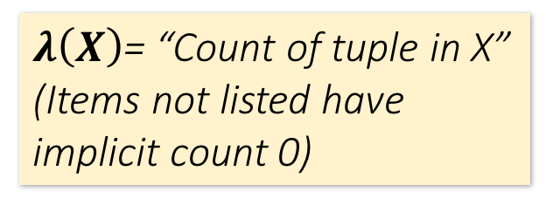
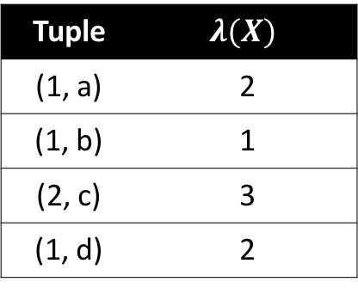
Recall Multisets
Lecture 3 > Section 1 > Set Operators
$λ\left(X\right)$= “Count of tuple in X”
(Items not listed have implicit count 0)
Multiset X
Tuple
(1, a)
(1, a)
(1, b)
(2, c)
(2, c)
(2, c)
(1, d)
(1, d)
Multiset X
Tuple | $$λ(X)$$
(1, a) | 2
(1, b) | 1
(2, c) | 3
(1, d) | 2
Equivalent Representations of a Multiset
Note: In a set all counts are {0,1}.

Slide 18
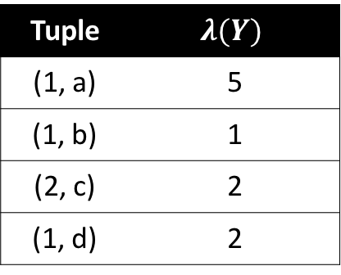
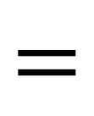
Generalizing Set Operations to Multiset Operations
Lecture 3 > Section 1 > Set Operators
Multiset X
Multiset Y
Multiset Z
Tuple | $$λ(X)$$
(1, a) | 2
(1, b) | 0
(2, c) | 3
(1, d) | 0
Tuple | $$λ(Y)$$
(1, a) | 5
(1, b) | 1
(2, c) | 2
(1, d) | 2
Tuple | $$λ(Z)$$
(1, a) | 2
(1, b) | 0
(2, c) | 2
(1, d) | 0
$$∩$$
$$=$$
For sets, this is intersection
$$λ\left(Z\right)=min(λ\left(X\right),λ\left(Y\right))$$

Slide 19
Generalizing Set Operations to Multiset Operations
Lecture 3 > Section 1 > Set Operators
Multiset X
Multiset Y
Multiset Z
Tuple | $$λ(X)$$
(1, a) | 2
(1, b) | 0
(2, c) | 3
(1, d) | 0
Tuple | $$λ(Y)$$
(1, a) | 5
(1, b) | 1
(2, c) | 2
(1, d) | 2
Tuple | $$λ(Z)$$
(1, a) | 7
(1, b) | 1
(2, c) | 5
(1, d) | 2
$$∪$$
$$=$$
For sets,
this is union
$$λ\left(Z\right)=λ\left(X\right)+ λ\left(Y\right)$$

Slide 20
Multiset Operations in SQL
Lecture 3 > Section 1 > Set Operators

Slide 21
Explicit Set Operators: INTERSECT
Lecture 3 > Section 1 > Set Operators
SELECT R.A
FROM R, S
WHERE R.A=S.B
INTERSECT
SELECT R.A
FROM R, T
WHERE R.A=T.A
$$\left\{r.A | r.A=s.A\right\}∩\left\{r.A \right|r.A=t.A\}$$
Q₁
Q₂

Slide 22
UNION
Lecture 3 > Section 1 > Set Operators
SELECT R.A
FROM R, S
WHERE R.A=S.B
UNION
SELECT R.A
FROM R, T
WHERE R.A=T.A
$$\left\{r.A | r.A=s.A\right\}∪\left\{r.A \right|r.A=t.A\}$$
Q₁
Q₂
Why aren’t there duplicates?
What if we want duplicates?

Slide 23
UNION ALL
Lecture 3 > Section 1 > Set Operators
SELECT R.A
FROM R, S
WHERE R.A=S.B
UNION ALL
SELECT R.A
FROM R, T
WHERE R.A=T.A
$$\left\{r.A | r.A=s.A\right\}∪\left\{r.A \right|r.A=t.A\}$$
Q₁
Q₂
ALL indicates Multiset operations

Slide 24
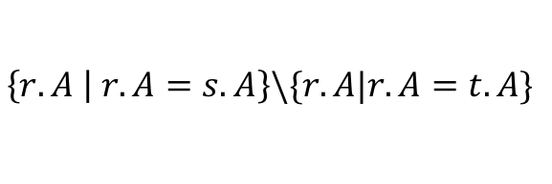
EXCEPT
Lecture 3 > Section 1 > Set Operators
SELECT R.A
FROM R, S
WHERE R.A=S.B
EXCEPT
SELECT R.A
FROM R, T
WHERE R.A=T.A
$$\left\{r.A | r.A=s.A\right\}\backslash \{r.A|r.A=t.A\}$$
Q₁
Q₂
What is the multiset version?

Slide 25
INTERSECT: Still some subtle problems…
Lecture 3 > Section 1 > Set Operators
Company(name, hq_city)
Product(pname, maker, factory_loc)
SELECT hq_city
FROM Company, Product
WHERE maker = name
AND factory_loc = ‘US’
INTERSECT
SELECT hq_city
FROM Company, Product
WHERE maker = name
AND factory_loc = ‘China’
“Headquarters of companies which make gizmos in US AND China”
What if two companies have HQ in US: BUT one has factory in China (but not US) and vice versa? What goes wrong?

Slide 26
INTERSECT: Remember the semantics!
Lecture 3 > Section 1 > Set Operators
Example: C JOIN P on maker = name
Company(name, hq_city) AS C
Product(pname, maker, factory_loc) AS P
C.name | C.hq_city | P.pname | P.maker | P.factory_loc
X Co. | Seattle | X | X Co. | U.S.
Y Inc. | Seattle | X | Y Inc. | China
SELECT hq_city
FROM Company, Product
WHERE maker = name
AND factory_loc=‘US’
INTERSECT
SELECT hq_city
FROM Company, Product
WHERE maker = name
AND factory_loc=‘China’

Slide 27
INTERSECT: Remember the semantics!
Lecture 3 > Section 1 > Set Operators
Example: C JOIN P on maker = name
Company(name, hq_city) AS C
Product(pname, maker, factory_loc) AS P
C.name | C.hq_city | P.pname | P.maker | P.factory_loc
X Co. | Seattle | X | X Co. | U.S.
Y Inc. | Seattle | X | Y Inc. | China
SELECT hq_city
FROM Company, Product
WHERE maker = name
AND factory_loc=‘US’
INTERSECT
SELECT hq_city
FROM Company, Product
WHERE maker = name
AND factory_loc=‘China’
X Co has a factory in the US (but not China)
Y Inc. has a factor in China (but not US)
But Seattle is returned by the query!
We did the INTERSECT on the wrong attributes!

Slide 28
One Solution: Nested Queries
Lecture 3 > Section 1 > Nested Queries
Company(name, hq_city)
Product(pname, maker, factory_loc)
“Headquarters of companies which make gizmos in US AND China”
SELECT DISTINCT hq_city
FROM Company, Product
WHERE maker = name
AND name IN (
SELECT maker
FROM Product
WHERE factory_loc = ‘US’)
AND name IN (
SELECT maker
FROM Product
WHERE factory_loc = ‘China’)

Slide 29
High-level note on nested queries
Lecture 3 > Section 1 > Nested Queries
We can do nested queries because SQL is compositional:
Everything (inputs / outputs) is represented as multisets- the output of one query can thus be used as the input to another (nesting)!
This is extremely powerful!

Slide 30
Nested queries: Sub-queries Returning Relations
Lecture 3 > Section 1 > Nested Queries
Another example:
Company(name, city) Product(name, maker) Purchase(id, product, buyer)
SELECT c.city
FROM Company c
WHERE c.name IN (
SELECT pr.maker
FROM Purchase p, Product pr
WHERE p.product = pr.name
AND p.buyer = ‘Joe Blow‘)
“Cities where one can find companies that manufacture products bought by Joe Blow”

