Slide 1
Lectures 14:
Design Theory III
Professor Xiannong Meng
Spring 2018
Lecture and activity contents are based on what Prof Chris Ré
used in his CS 145 in the fall 2016 term with permission

Slide 2
Closures

Slide 3
Closure of a set of Attributes
Given a set of attributes A₁, …, A_{n} and a set of FDs F:
Then the closure, {A₁, …, A_{n}}⁺ is the set of attributes B s.t. {A₁, …, A_{n}} → B
Example: F =
{name} → {color}
{category} → {department}
{color, category} → {price}
Example Closures:
{name}⁺ = {name, color}
{name, category}⁺ =
{name, category, color, dept, price}
{color}⁺ = {color}

Slide 4
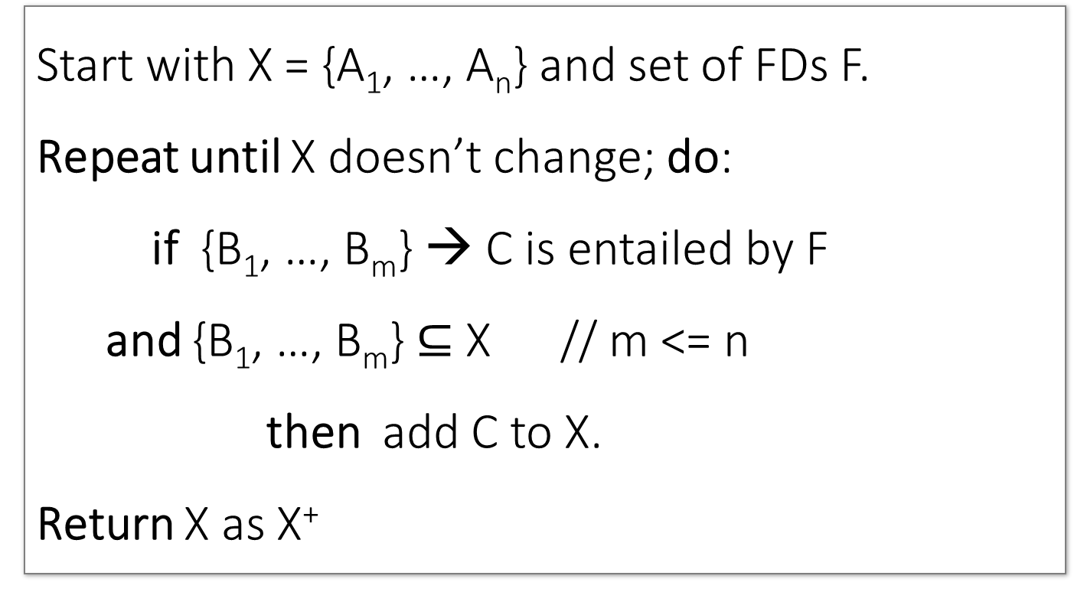
Closure Algorithm
Start with X = {A₁, …, A_{n}} and set of FDs F.
Repeat until X doesn’t change; do:
if {B₁, …, B_{m}} → C is entailed by F
and {B₁, …, B_{m}} $⊆$ X // m <= n
then add C to X.
Return X as X⁺

Slide 5
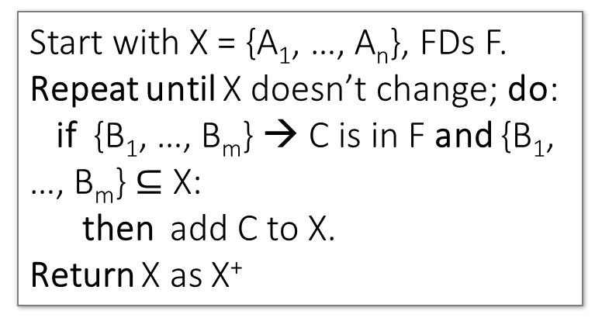
Closure Algorithm
Start with X = {A₁, …, A_{n}}, FDs F.
Repeat until X doesn’t change; do:
if {B₁, …, B_{m}} → C is in F and {B₁, …, B_{m}} $⊆$ X:
then add C to X.
Return X as X⁺
{name, category}⁺ =
{name, category}
F =
{name} → {color}
{category} → {dept}
{color, category} → {price}

Slide 6
Closure Algorithm
Start with X = {A₁, …, A_{n}}, FDs F.
Repeat until X doesn’t change; do:
if {B₁, …, B_{m}} → C is in F and {B₁, …, B_{m}} $⊆$ X:
then add C to X.
Return X as X⁺
{name, category}⁺ =
{name, category}
{name, category}⁺ =
{name, category, color}
F =
{name} → {color}
{category} → {dept}
{color, category} → {price}

Slide 7
Closure Algorithm
Start with X = {A₁, …, A_{n}}, FDs F.
Repeat until X doesn’t change; do:
if {B₁, …, B_{m}} → C is in F and {B₁, …, B_{m}} $⊆$ X:
then add C to X.
Return X as X⁺
{name, category}⁺ =
{name, category}
{name, category}⁺ =
{name, category, color}
F =
{name, category}⁺ =
{name, category, color, dept}
{name} → {color}
{category} → {dept}
{color, category} → {price}

Slide 8
Closure Algorithm
Start with X = {A₁, …, A_{n}}, FDs F.
Repeat until X doesn’t change; do:
if {B₁, …, B_{m}} → C is in F and {B₁, …, B_{m}} $⊆$ X:
then add C to X.
Return X as X⁺
{name, category}⁺ =
{name, category}
{name, category}⁺ =
{name, category, color}
F =
{name, category}⁺ =
{name, category, color, dept}
{name} → {color}
{category} → {dept}
{color, category} → {price}
{name, category}⁺ =
{name, category, color, dept, price}

Slide 9
Example
Attributes
F’s
R(A,B,C,D,E,F)
{A,B} → {C}
{A,D} → {E}
{B} → {D}
{A,F} → {B}
Compute {A,B}⁺ = {A, B, }
Compute {A, F}⁺ = {A, F, }

Slide 10
Example
Attributes
F’s
R(A,B,C,D,E,F)
{A,B} → {C}
{A,D} → {E}
{B} → {D}
{A,F} → {B}
Compute {A,B}⁺ = {A, B, C, D }
Compute {A, F}⁺ = {A, F, B }

Slide 11
Example
Attributes
F’s
R(A,B,C,D,E,F)
{A,B} → {C}
{A,D} → {E}
{B} → {D}
{A,F} → {B}
Compute {A,B}⁺ = {A, B, C, D, E}
Compute {A, F}⁺ = {A, B, C, D, E, F}

Slide 12
3. Closures, Superkeys & Keys

Slide 13
What you will learn about in this section
Closures Pt. II
Superkeys & Keys
ACTIVITY: The key or a key?

Slide 14
Why Do We Need the Closure?
With closure we can find all FD’s easily
To check if X → A
  Compute X⁺
  Check if A ∈ X⁺
Note here that X is a set of attributes, but A is a single attribute. Why does considering FDs of this form suffice?
Recall the Split/combine rule:
X → A₁, …, X → A_{n}
implies
X → {A₁, …, A_{n}}

Slide 15
Using Closure to Infer ALL FDs
Example:
Given F =
{A,B} → C
{A,D} → B
{B} → D
Step 1: Compute X⁺, for every set of attributes X:
{A}⁺ = {A}
{B}⁺ = {B,D}
{C}⁺ = {C}
{D}⁺ = {D}
{A,B}⁺ = {A,B,C,D}
{A,C}⁺ = {A,C}
{A,D}⁺ = {A,B,C,D}
{B,C}⁺ = {B,C,D}
{C,D}⁺ = {C, D}
{A,B,C}⁺ = {A,B,D}⁺ = {A,C,D}⁺ = {A,B,C,D}
{B,C,D}⁺ = {B,C,D}
{A,B,C,D}⁺ = {A,B,C,D}
No need to compute these- why?

Slide 16
Using Closure to Infer ALL FDs
Example:
Given F =
{A,B} → C
{A,D} → B
{B} → D
Step 1: Compute X⁺, for every set of attributes X:
{A}⁺ = {A}, {B}⁺ = {B,D}, {C}⁺ = {C}, {D}⁺ = {D}, {A,B}⁺ = {A,B,C,D}, {A,C}⁺ = {A,C}, {A,D}⁺ = {A,B,C,D}, {B,C}⁺ = {B,C,D}, {C,D}⁺ = {C, D}
{A,B,C}⁺ = {A,B,D}⁺ = {A,C,D}⁺ = {A,B,C,D}, {B,C,D}⁺ = {B,C,D}, {A,B,C,D}⁺ = {A,B,C,D}
Step 2: Enumerate all FDs X → Y, s.t. Y ⊆ X⁺ and X ∩ Y = ∅:
{A,B} → {C,D}, {A,D} → {B,C}, {B,C} → {D},
{A,B,C} → {D}, {A,B,D} → {C},
{A,C,D} → {B}

Slide 17
Using Closure to Infer ALL FDs
Example:
Given F =
{A,B} → C
{A,D} → B
{B} → D
Step 1: Compute X⁺, for every set of attributes X:
{A}⁺ = {A}, {B}⁺ = {B,D}, {C}⁺ = {C}, {D}⁺ = {D}, {A,B}⁺ = {A,B,C,D}, {A,C}⁺ = {A,C}, {A,D}⁺ = {A,B,C,D}, {B,C}⁺ = {B,C,D}, {C,D}⁺ = {C, D}
{A,B,C}⁺ = {A,B,D}⁺ = {A,C,D}⁺ = {A,B,C,D}, {B,C,D}⁺ = {B,C,D}, {A,B,C,D}⁺ = {A,B,C,D}
Step 2: Enumerate all FDs X → Y, s.t. Y ⊆ X⁺ and X ∩ Y = ∅:
“Y is in the closure of X”
{A,B} → {C,D}, {A,D} → {B,C}, {B,C} → {D},
{A,B,C} → {D}, {A,B,D} → {C},
{A,C,D} → {B}

Slide 18
Using Closure to Infer ALL FDs
Example:
Given F =
{A,B} → C
{A,D} → B
{B} → D
Step 1: Compute X⁺, for every set of attributes X:
{A}⁺ = {A}, {B}⁺ = {B,D}, {C}⁺ = {C}, {D}⁺ = {D}, {A,B}⁺ = {A,B,C,D}, {A,C}⁺ = {A,C}, {A,D}⁺ = {A,B,C,D}, {B,C}⁺ = {B,C,D}, {C,D}⁺ = {C, D}
{A,B,C}⁺ = {A,B,D}⁺ = {A,C,D}⁺ = {A,B,C,D}, {B,C,D}⁺ = {B,C,D}, {A,B,C,D}⁺ = {A,B,C,D}
Step 2: Enumerate all FDs X → Y, s.t. Y ⊆ X⁺ and X ∩ Y = ∅:
The FD X → Y is non-trivial
{A,B} → {C,D}, {A,D} → {B,C}, {B,C} → {D},
{A,B,C} → {D}, {A,B,D} → {C},
{A,C,D} → {B}

Slide 19
Superkeys and Keys

Slide 20
Keys and Superkeys
A superkey is a set of attributes A₁, …, A_{n} s.t.
for any other attribute B in R,
we have {A₁, …, A_{n}} → B
I.e., all attributes are functionally determined by a superkey
A key is a minimal superkey
Meaning that no subset of a key is also a superkey

Slide 21
Finding Keys and Superkeys
For each set of attributes X
  Compute X⁺
  If X⁺ = set of all attributes then X is a superkey
  If X is minimal, then it is a key
Do we need to check all sets of attributes? Which sets?

Slide 22
Example of Finding Keys
Product(name, price, category, color)
{name, category} → price
{category} → color
What is a key?

Slide 23
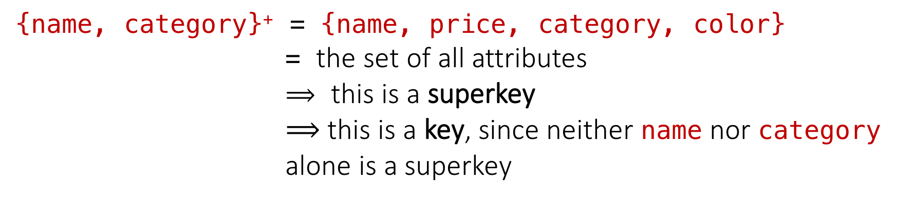
Example of Keys
Product(name, price, category, color)
{name, category} → price
{category} → color
{name, category}⁺ = {name, price, category, color}
              = the set of all attributes
              $⟹$ this is a superkey
              $⟹$ this is a key, since neither name nor category alone is a superkey

Slide 24
Activity-5-1.ipynb

