Slide 1
Lecture 28: Index 3
B+ Trees
Professor Xiannong Meng
Spring 2018
Lecture and activity contents are based on what Prof Chris Ré of Stanford
used in his CS 145 in the fall 2016 term with permission

Slide 2
B+ Trees in Practice
Fill-factor is the percent of available slots in the B+ Tree that are filled; is usually < 1 to leave slack for (quicker) insertions
Typical order: d=100. Typical fill-factor: 67%.
  average fanout = 133
Typical capacities:
  Height 4: 133⁴ = 312,900,700 records
  Height 3: 133³ = 2,352,637 records
Top levels of tree sit in the buffer pool:
  Level 1 = 1 page = 8 Kbytes
  Level 2 = 133 pages = 1 Mbyte
  Level 3 = 17,689 pages = 133 MBytes
What is the relationship between fill factor F and fanout f?
(2d+1)*F = f
Typically, only pay for one IO!

Slide 3
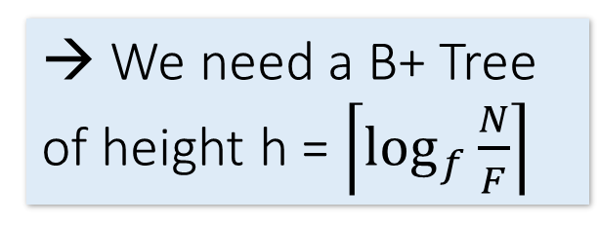
Simple Cost Model for Search
Let:
  f = fanout, which is in [d+1, 2d+1] (we’ll assume it’s constant for our cost model…)
  N = the total number of pages we need to index
  F = fill-factor (usually ~= 2/3)
Our B+ Tree needs to have room to index N / F pages!
  We have the fill factor in order to leave some open slots for faster insertions
What height (h) does our B+ Tree need to be?
  h=1 → Just the root node- room to index f pages
  h=2 → f leaf nodes- room to index f² pages
  h=3 → f² leaf nodes- room to index f³ pages
  …
  h → f^{h-1} leaf nodes- room to index f^{h} pages!
→ We need a B+ Tree of height h = $\left\lceil \log_{f}{\frac{N}{F}}\right\rceil$

Slide 4
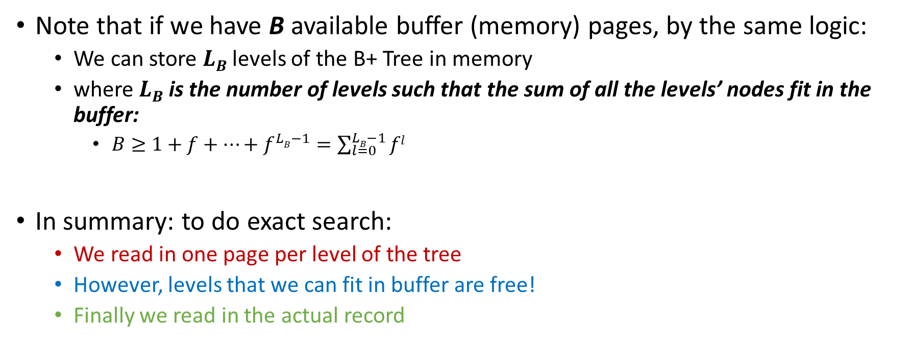
Simple Cost Model for Search
Note that if we have B available buffer (memory) pages, by the same logic:
  We can store $LB$ levels of the B+ Tree in memory
  where $LB$ is the number of levels such that the sum of all the levels’ nodes fit in the buffer:
    $B≥1+f+…+f^{LB−1}=\sum_{l=0}^{LB−1}{fl}$
In summary: to do exact search:
  We read in one page per level of the tree
  However, levels that we can fit in buffer are free!
  Finally we read in the actual record
Height of B tree
already in memory
Height of B tree
IO Cost: $\left\lceil \log_{f}{\frac{N}{F}}\right\rceil −LB+1$
where $B≥\sum_{l=0}^{LB−1}{fl}$

Slide 5
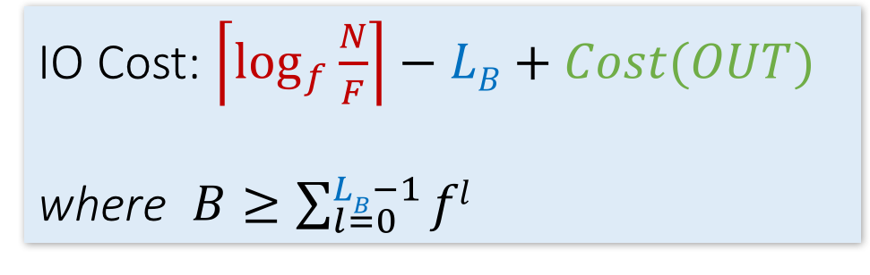
Simple Cost Model for Search
To do range search, we just follow the horizontal pointers
The IO cost is that of loading additional leaf nodes we need to access + the IO cost of loading each page of the results- we phrase this as “Cost(OUT)”.
IO Cost: $\left\lceil \log_{f}{\frac{N}{F}}\right\rceil −LB+Cost(OUT)$
where $B≥\sum_{l=0}^{LB−1}{fl}$
Cost(OUT) has one subtle but important twist… let’s watch again

Slide 6
B+ Tree Range Search Animation
K in [30,85]?
How many IOs did our friend do?
Depends on how the data are arranged
30 < 80
80
30 in [20,60)
20 |  | 60
100 |  | 120 |  | 140
30 in [30,40)
10 |  | 15 |  | 18
20 |  | 30 |  | 40 |  | 50
60 |  | 65
80 |  | 85 |  | 90
Not all nodes pictured
To the data!
10
12
15
20
28
30
40
59
63
80
84
89

Slide 7
Clustered Indexes
An index is clustered if the underlying data is ordered in the same way as the index’s data entries.
Notes:
11

Slide 8
Clustered vs. Unclustered Index
30
30
Index Entries
22 |  | 25 |  | 28 |  | 29
32 |  | 34 |  | 37 |  | 38
22 |  | 25 |  | 28 |  | 29
32 |  | 34 |  | 37 |  | 38
19
22
27
28
30
33
35
37
19
33
27
22
37
28
35
30
Data Records
Clustered
Unclustered

Slide 9
Clustered vs. Unclustered Index
Recall that for a disk with block access, sequential IO is much faster than random IO
For exact search, no difference between clustered / unclustered
For range search over R values: difference between 1 random IO + R sequential IO, and R random IO:
  A random IO costs ~ 10ms (sequential much much faster)
  For R = 100,000 records- difference between ~10ms and ~17min!

Slide 10
Fast Insertions & Self-Balancing
We won’t go into specifics of B+ Tree insertion algorithm, but has several attractive qualities:
  ~ Same cost as exact search
  Self-balancing: B+ Tree remains balanced (with respect to height) even after insert
B+ Trees also (relatively) fast for single insertions!
However, can become bottleneck if many insertions (if fill-factor slack is used up…)

Slide 11
Bulk Loading
20 |  | 30 |  | 30
12 |  | 17
22 |  | 25 |  | 28 |  | 29
32 |  | 34 |  | 37 |  | 38
11
15
21
22
27
28
30
33
35
37
11
15
21
22
27
28
30
33
35
37
Input: Sorted File
Output: B+ Tree
Message: Bulk Loading is faster!

Slide 12
Summary
We create indexes over tables in order to support fast (exact and range) search and insertion over multiple search keys
B+ Trees are one index data structure which support very fast exact and range search & insertion via high fanout
  Clustered vs. unclustered makes a big difference for range queries too

