Slide 1
Lecture 33:
The Relational Model 2
Professor Xiannong Meng
Spring 2018
Lecture and activity contents are based on what Prof Chris Ré of Stanford
used in his CS 145 in the fall 2016 term with permission

Slide 2
Relational Algebra (RA)
Five basic operators:
  Selection: σ
  Projection: Π
  Cartesian Product: ×
  Union: ∪
  Difference: -
Derived or auxiliary operators:
  Intersection, complement
  Joins (natural,equi-join, theta join, semi-join)
  Renaming: ρ
  Division
We’ll look at these first!
And also at one example of a derived operator (natural join) and a special operator (renaming)

Slide 3

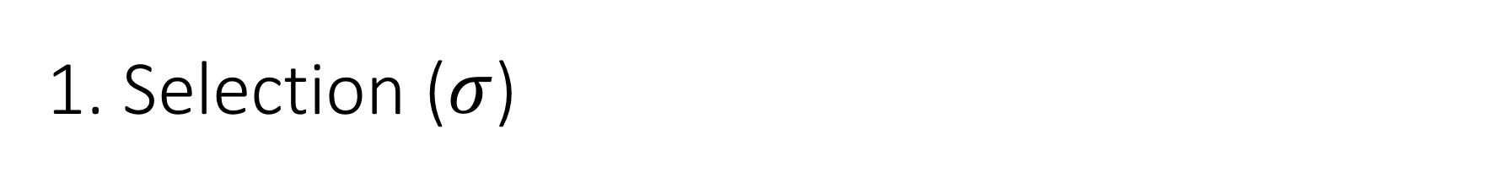
1. Selection ($σ$)
Students(sid,sname,gpa)
SQL:
Returns all tuples which satisfy a condition
Notation: σ_{c}(R)
Examples
  σ_{Salary > 40000} (Employee)
  σ_{name = “Smith”} (Employee)
The condition c can be =, <, ≤, >, ≥, <>
SELECT *
FROM Students
WHERE gpa > 3.5;
RA:
$$σ_{gpa >3.5}(Students)$$

Slide 4

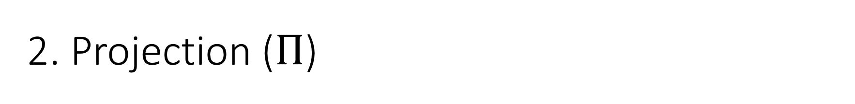
2. Projection ($Π$)
Students(sid,sname,gpa)
SQL:
Eliminates columns, then removes duplicates
Notation: Π _{A1,…,An} (R)
Example: project social-security number and names:
  Π _{SSN, Name} (Employee)
  Output schema: Answer(SSN, Name)
SELECT DISTINCT
sname,
gpa
FROM Students;
RA:
$$Π_{sname,gpa}(Students)$$

Slide 5
Note that RA Operators are Compositional!
Students(sid,sname,gpa)
SELECT DISTINCT
sname,
gpa
FROM Students
WHERE gpa > 3.5;
$$Π_{sname,gpa}(σ_{gpa>3.5}(Students))$$
$${σ_{gpa>3.5}(Π}_{sname,gpa}( Students))$$
How do we represent this query in RA?
Are these logically equivalent?

Slide 6


3. Cross-Product ($×$)
Students(sid,sname,gpa)
People(ssn,pname,address)
SQL:
Each tuple in R1 with each tuple in R2
Notation: R1 × R2
Example:
  Employee × Dependents
Rare in practice; mainly used to express joins
SELECT *
FROM Students, People;
RA:
$$Students × People$$

Slide 7


Another example:
People
Students
ssn | pname | address
1234545 | John | 216 Rosse
5423341 | Bob | 217 Rosse
sid | sname | gpa
001 | John | 3.4
002 | Bob | 1.3
$$×$$
$$Students × People$$
ssn | pname | address | sid | sname | gpa
1234545 | John | 216 Rosse | 001 | John | 3.4
5423341 | Bob | 217 Rosse | 001 | John | 3.4
1234545 | John | 216 Rosse | 002 | Bob | 1.3
5423341 | Bob | 216 Rosse | 002 | Bob | 1.3

Slide 8


Renaming ($ρ$)
Students(sid,sname,gpa)
SQL:
Changes the schema, not the instance
A ‘special’ operator- neither basic nor derived
Notation: ρ _{B1,…,Bn} (R)
Note: this is shorthand for the proper form (since names, not order matters!):
  ρ _{A1→B1,…,An→Bn} (R)
SELECT
sid AS studId,
sname AS name,
gpa AS gradePtAvg
FROM Students;
RA:
$$ρ_{studId,name,gradePtAvg}(Students)$$
We care about this operator because we are working in a named perspective

Slide 9
Another example:
Students
sid | sname | gpa
001 | John | 3.4
002 | Bob | 1.3
$$ρ_{studId,name,gradePtAvg}(Students)$$
Students
studId | name | gradePtAvg
001 | John | 3.4
002 | Bob | 1.3

Slide 10

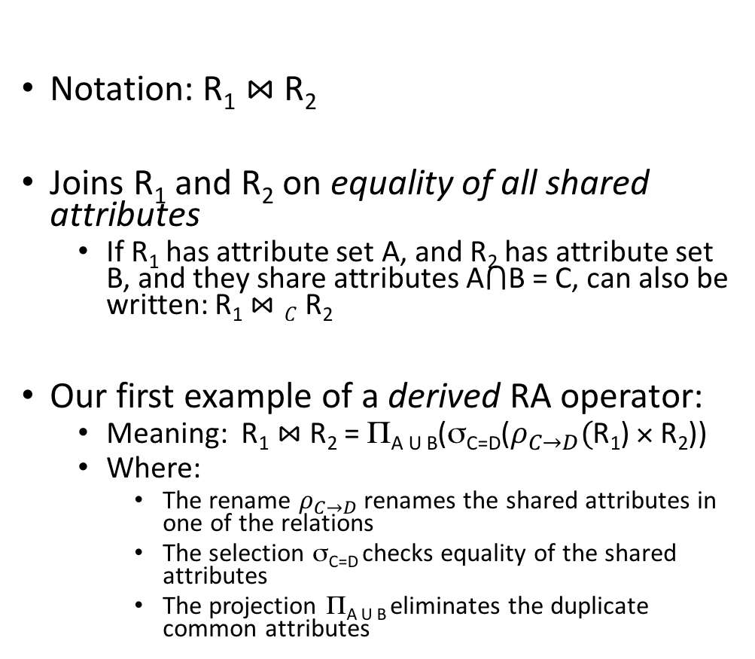

Natural Join ($⋈$)
Students(sid,name,gpa)
People(ssn,name,address)
SQL:
Notation: R₁ $⋈$R₂
Joins R₁ and R₂ on equality of all shared attributes
  If R₁ has attribute set A, and R₂ has attribute set B, and they share attributes A$⋂$B = C, can also be written: R₁ $⋈C$R₂
Our first example of a derived RA operator:
  Meaning: R₁ $⋈$ R₂ = Π_{A U B}(σ_{C=D}($ρ_{C→D}($R₁) × R₂))
  Where:
    The rename $ρ_{C→D}$ renames the shared attributes in one of the relations
    The selection σ_{C=D} checks equality of the shared attributes
    The projection Π_{A U B} eliminates the duplicate common attributes
SELECT DISTINCT
ssid, S.name, gpa,
ssn, address
FROM
Students S,
People P
WHERE S.name = P.name;
RA:
$$Students ⋈ People$$

Slide 11


Another example:
Students S
People P
sid | S.name | gpa
001 | John | 3.4
002 | Bob | 1.3
$$⋈$$
ssn | P.name | address
1234545 | John | 216 Rosse
5423341 | Bob | 217 Rosse
$$Students ⋈People$$
sid | S.name | gpa | ssn | address
001 | John | 3.4 | 1234545 | 216 Rosse
002 | Bob | 1.3 | 5423341 | 216 Rosse

Slide 12
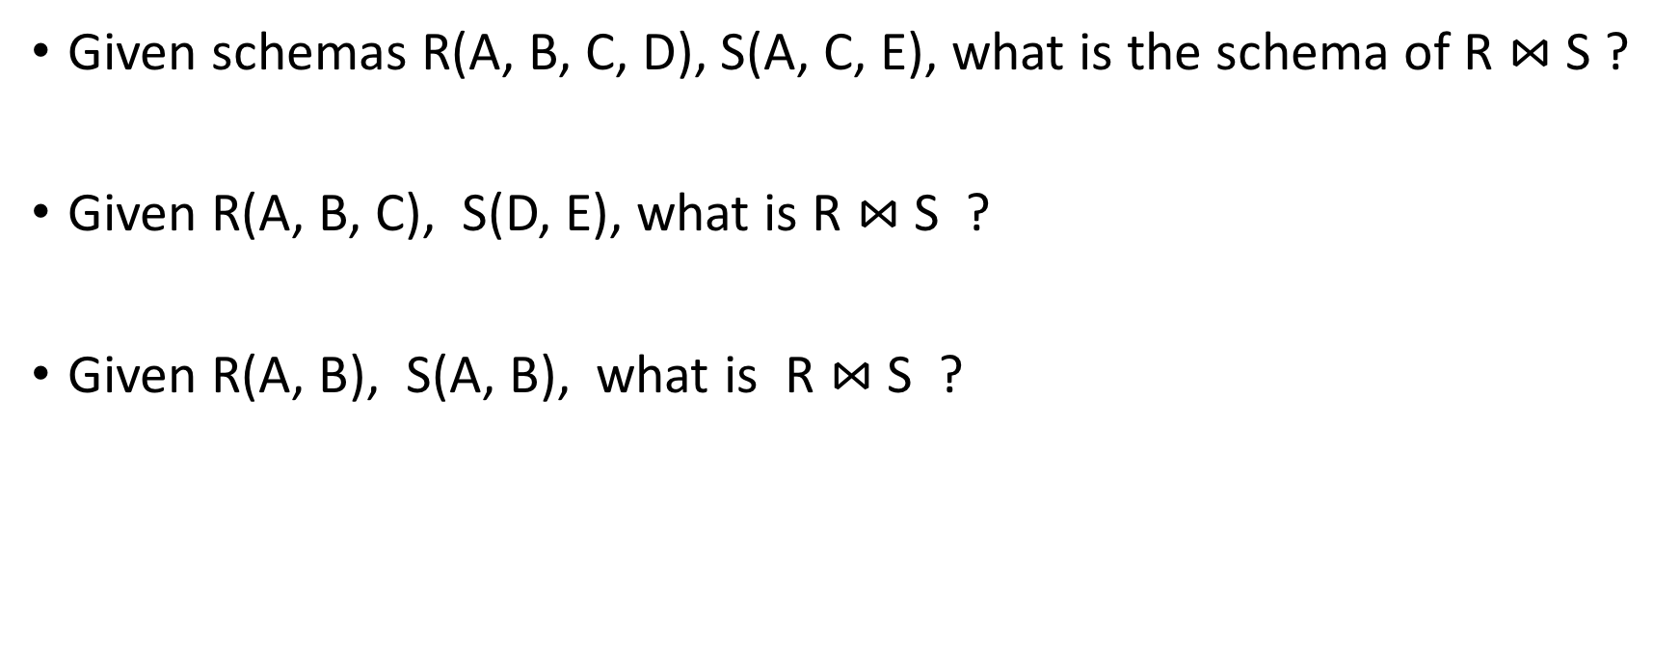
Natural Join
Given schemas R(A, B, C, D), S(A, C, E), what is the schema of R $⋈$S ?
Given R(A, B, C), S(D, E), what is R $⋈$S ?
Given R(A, B), S(A, B), what is R $⋈$S ?

Slide 13

Example: Converting SFW Query -> RA
Students(sid,sname,gpa)
People(ssn,sname,address)
SELECT DISTINCT
gpa,
address
FROM Students S,
People P
WHERE gpa > 3.5 AND
sname = pname;
$$Π_{gpa,address}(σ_{gpa>3.5}(S⋈P))$$
How do we represent this query in RA?

Slide 14
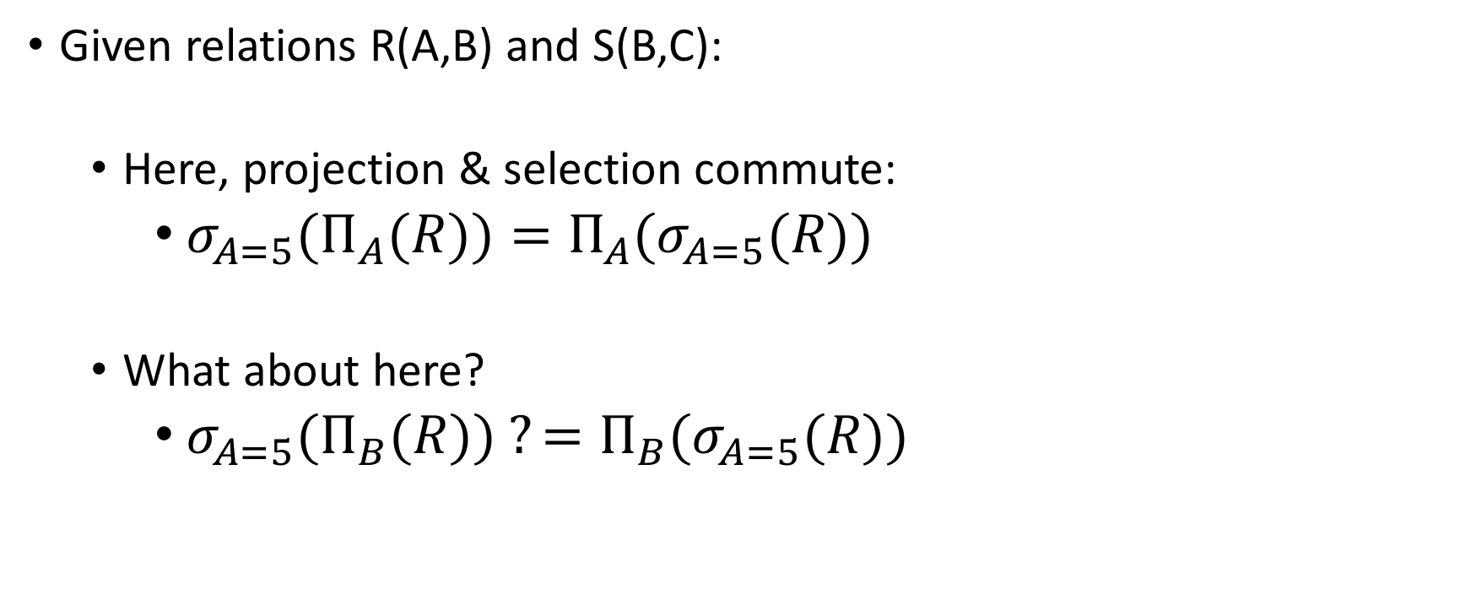
Logical Equivalence of RA Plans
Given relations R(A,B) and S(B,C):
  Here, projection & selection commute:
    ${σ_{A=5}(Π}_{A}(R))=Π_{A}(σ_{A=5}(R))$
  What about here?
    ${σ_{A=5}(Π}_{B}(R)) ?=Π_{B}(σ_{A=5}(R))$
We’ll look at this in more depth later in the lecture…

Slide 15
RDBMS Architecture
How does a SQL engine work ?
SQL Query
Relational Algebra (RA) Plan
Optimized RA Plan
Execution
We saw how we can transform declarative SQL queries into precise, compositional RA plans

Slide 16
RDBMS Architecture
How does a SQL engine work ?
SQL Query
Relational Algebra (RA) Plan
Optimized RA Plan
Execution
We’ll look at how to then optimize these plans later in this lecture

Slide 17
RDBMS Architecture
How is the RA “plan” executed?
SQL Query
Relational Algebra (RA) Plan
Optimized RA Plan
Execution
We already know how to execute all the basic operators!

Slide 18
RA Plan Execution
Natural Join / Join:
  We saw how to use memory & IO cost considerations to pick the correct algorithm to execute a join with (BNLJ, SMJ, HJ…)!
Selection:
  We saw how to use indexes to aid selection
  Can always fall back on scan / binary search as well
Projection:
  The main operation here is finding distinct values of the project tuples; we briefly discussed how to do this with e.g. hashing or sorting
We already know how to execute all the basic operators!

Slide 19
2. Adv. Relational Algebra

Slide 20
What you will learn about in this section
Set Operations in RA
Fancier RA
Extensions & Limitations

Slide 21
Relational Algebra (RA)
Five basic operators:
  Selection: σ
  Projection: Π
  Cartesian Product: ×
  Union: ∪
  Difference: -
Derived or auxiliary operators:
  Intersection, complement
  Joins (natural,equi-join, theta join, semi-join)
  Renaming: ρ
  Division
We’ll look at these
And also at some of these derived operators

Slide 22
1. Union (∪) and 2. Difference (–)
R1 ∪ R2
Example:
  ActiveEmployees ∪ RetiredEmployees
R1 – R2
Example:
  AllEmployees - RetiredEmployees
R₁
R₂
R₁
R₂

Slide 23
What about Intersection (∩) ?
It is a derived operator
R1 ∩ R2 = R1 – (R1 – R2)
Also expressed as a join!
Example
  UnionizedEmployees ∩ RetiredEmployees
R₁
R₂

Slide 24
Fancier RA

Slide 25



Theta Join ($⋈$_{θ})
Students(sid,sname,gpa)
People(ssn,pname,address)
SQL:
A join that involves a predicate
R1 $⋈$_{θ} R2 = σ _{θ} (R1 × R2)
Here θ can be any condition
SELECT *
FROM
Students,People
WHERE θ;
Note that natural join is a theta join + a projection.
RA:
$$Students ⋈_{θ} People$$

Slide 26

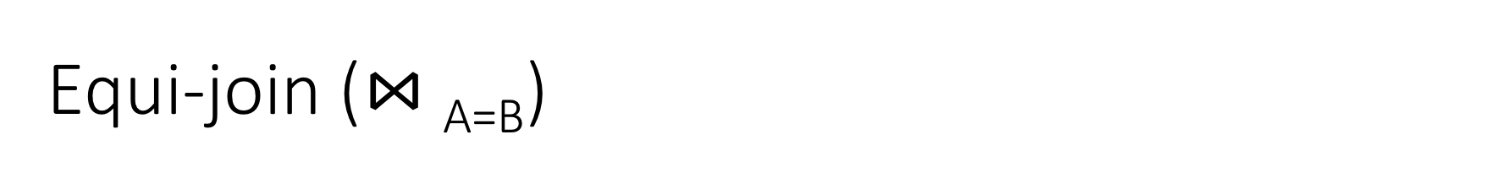

Equi-join ($⋈$_{A=B})
Students(sid,sname,gpa)
People(ssn,pname,address)
SQL:
A theta join where θ is an equality
R1 $⋈$_{A=B} R2 = σ _{A=B} (R1 × R2)
Example:
  Employee $⋈$_{SSN=SSN} Dependents
SELECT *
FROM
Students S,
People P
WHERE sname = pname;
Most common join in practice!
RA:
$$S ⋈_{sname=pname} P$$

Slide 27



Semijoin ($⋉$)
Students(sid,sname,gpa)
People(ssn,pname,address)
SQL:
R $⋉$ S = Π _{A1,…,An} (R $⋈$ S)
Where A₁, …, A_{n} are the attributes in R
Example:
  Employee $⋉$Dependents
SELECT DISTINCT
sid,sname,gpa
FROM
Students,People
WHERE
sname = pname;
RA:
$$Students⋉People$$

Slide 28
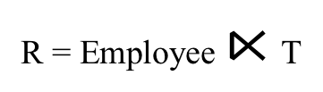
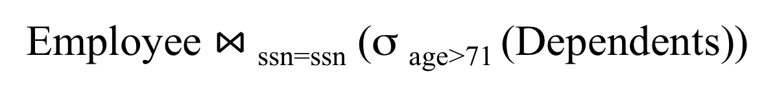
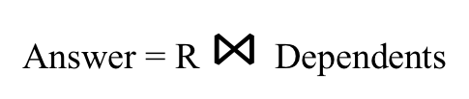
Semijoins in Distributed Databases
Semijoins are often used to compute natural joins in distributed databases
Dependents
Employee
SSN | Dname | Age
. . . |  | . . .
SSN | Name
. . . | . . .
network
Employee $⋈$_{ssn=ssn} (σ _{age>71} (Dependents))
Send less data to reduce network bandwidth!
T = Π _{SSN} σ _{age>71} (Dependents)
R = Employee $⋉$T
Answer = R $⋈$Dependents

Slide 29
RA Expressions Can Get Complex!
Π _{name}
buyer-ssn=ssn
pid=pid
seller-ssn=ssn
Π _{ssn}
Π _{pid}
σ_{name=fred}
σ_{name=gizmo}
Person Purchase Person Product

Slide 30
Multisets

Slide 31

Recall that SQL uses Multisets
$λ\left(X\right)$= “Count of tuple in X”
(Items not listed have implicit count 0)
Multiset X
Tuple
(1, a)
(1, a)
(1, b)
(2, c)
(2, c)
(2, c)
(1, d)
(1, d)
Multiset X
Tuple | $$λ(X)$$
(1, a) | 2
(1, b) | 1
(2, c) | 3
(1, d) | 2
Equivalent Representations of a Multiset
Note: In a set all counts are {0,1}.

Slide 32
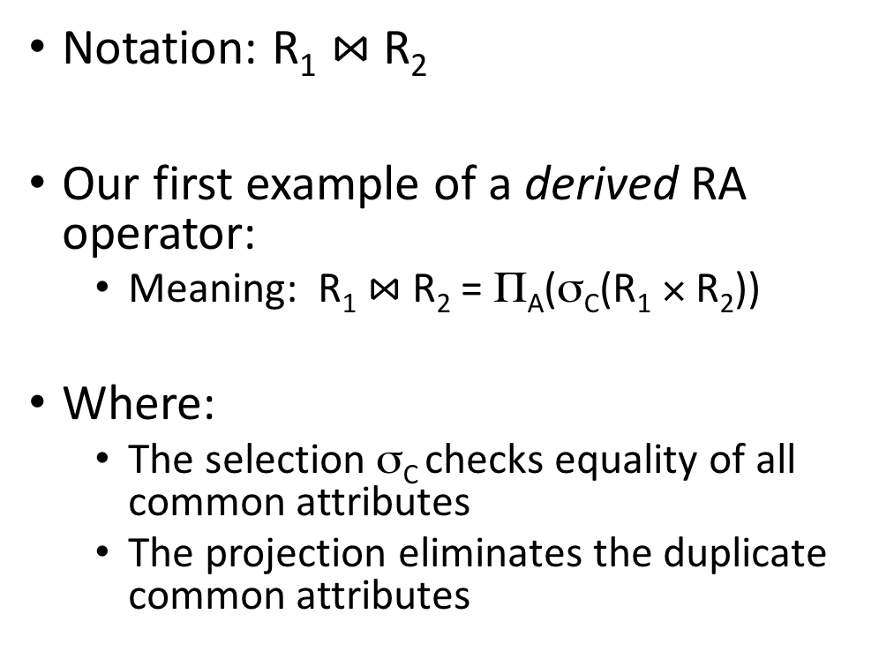
Generalizing Set Operations to Multiset Operations
Multiset X
Multiset Y
Multiset Z
Tuple | $$λ(X)$$
(1, a) | 2
(1, b) | 0
(2, c) | 3
(1, d) | 0
Tuple | $$λ(Y)$$
(1, a) | 5
(1, b) | 1
(2, c) | 2
(1, d) | 2
Tuple | $$λ(Z)$$
(1, a) | 2
(1, b) | 0
(2, c) | 2
(1, d) | 0
$$∩$$
$$=$$
For sets, this is intersection
$$λ\left(Z\right)=min(λ\left(X\right),λ\left(Y\right))$$

Slide 33
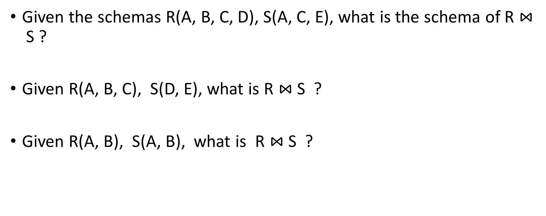

Generalizing Set Operations to Multiset Operations
Multiset X
Multiset Y
Multiset Z
Tuple | $$λ(X)$$
(1, a) | 2
(1, b) | 0
(2, c) | 3
(1, d) | 0
Tuple | $$λ(Y)$$
(1, a) | 5
(1, b) | 1
(2, c) | 2
(1, d) | 2
Tuple | $$λ(Z)$$
(1, a) | 7
(1, b) | 1
(2, c) | 5
(1, d) | 2
$$∪$$
$$=$$
For sets,
this is union
$$λ\left(Z\right)=λ\left(X\right)+ λ\left(Y\right)$$

Slide 34
Operations on Multisets
All RA operations need to be defined carefully on bags
  σ_{C}(R): preserve the number of occurrences
  Π_{A}(R): no duplicate elimination
  Cross-product, join: no duplicate elimination
This is important- relational engines work on multisets, not sets!

Slide 35
RA has Limitations !
Cannot compute “transitive closure”
Find all direct and indirect relatives of Fred
Cannot express in RA !!!
  Need to write C program, use a graph engine, or modern SQL…
Name1 | Name2 | Relationship
Fred | Mary | Father
Mary | Joe | Cousin
Mary | Bill | Spouse
Nancy | Lou | Sister

