Slide 1
Optimization Overview
Professor Xiannong Meng
Spring 2018
Lecture and activity contents are based on what Prof Chris Ré of Stanford
used in his CS 145 in the fall 2016 term with permission

Slide 2
Today’s Lecture
Logical Optimization
Physical Optimization

Slide 3
Logical vs. Physical Optimization
SQL Query
Relational Algebra (RA) Plan
Logical optimization:
  Find equivalent plans that are more efficient
  Intuition: Minimize # of tuples at each step by changing the order of RA operators
Physical optimization:
  Find algorithm with lowest IO cost to execute our plan
  Intuition: Calculate based on physical parameters (buffer size, etc.) and estimates of data size (histograms)
Optimized RA Plan
Execution

Slide 4
1. Logical Optimization

Slide 5
RDBMS Architecture
How does a SQL engine work ?
SQL Query
Relational Algebra (RA) Plan
Optimized RA Plan
Execution
Declarative query (from user)
Translate to relational algebra expressions
Find logically equivalent- but more efficient- RA expression
Execute each operator of the optimized plan!

Slide 6
RDBMS Architecture
How does a SQL engine work ?
SQL Query
Relational Algebra (RA) Plan
Optimized RA Plan
Execution
Relational Algebra allows us to translate declarative (SQL) queries into precise and optimizable expressions!

Slide 7
Recall: Relational Algebra (RA)
Five basic operators:
  Selection: σ
  Projection: Π
  Cartesian Product: ×
  Union: ∪
  Difference: -
Derived or auxiliary operators:
  Intersection, complement
  Joins (natural,equi-join, theta join, semi-join)
  Renaming: ρ
  Division
We’ll look at these first!
And also at one example of a derived operator (natural join) and a special operator (renaming)

Slide 8

Recall: Converting SFW Query -> RA
Students(sid,sname,gpa)
People(ssn,sname,address)
SELECT DISTINCT
gpa,
address
FROM Students S,
People P
WHERE gpa > 3.5 AND
sname = pname;
$$Π_{gpa,address}(σ_{gpa>3.5}(S⋈P))$$
How do we represent this query in RA?

Slide 9
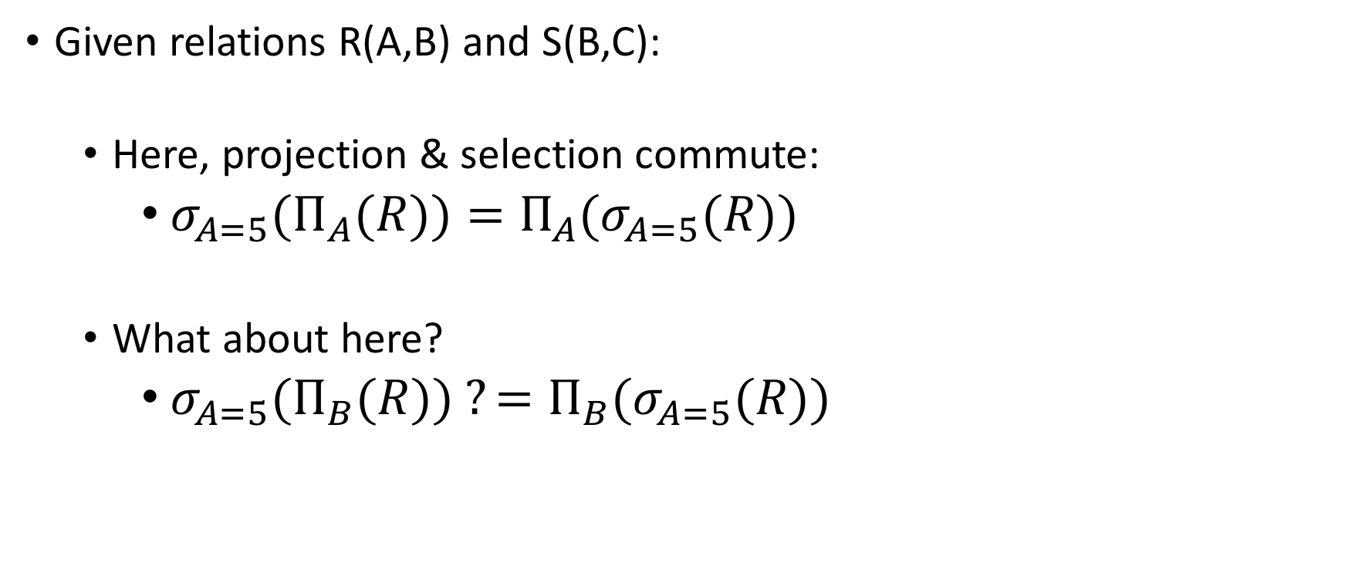
Recall: Logical Equivalece of RA Plans
Given relations R(A,B) and S(B,C):
  Here, projection & selection commute:
    ${σ_{A=5}(Π}_{A}(R))=Π_{A}(σ_{A=5}(R))$
  What about here?
    ${σ_{A=5}(Π}_{B}(R)) ?=Π_{B}(σ_{A=5}(R))$
We’ll look at this in more depth later in the lecture…

Slide 10
RDBMS Architecture
How does a SQL engine work ?
SQL Query
Relational Algebra (RA) Plan
Optimized RA Plan
Execution
We’ll look at how to then optimize these plans now

Slide 11

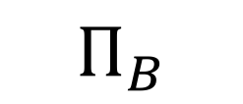
Note: We can visualize the plan as a tree
$Π_{B}$
$$Π_{B}(R\left(A,B\right)⋈S\left(B,C\right))$$
R(A,B)
S(B,C)
Bottom-up tree traversal = order of operation execution!

Slide 12
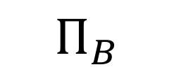
A simple plan
$Π_{B}$
What SQL query does this correspond to?
Are there any logically equivalent RA expressions?
R(A,B)
S(B,C)

Slide 13
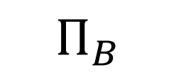
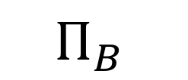
“Pushing down” projection
$Π_{B}$
$Π_{B}$
$$Π_{B}$$
R(A,B)
S(B,C)
R(A,B)
S(B,C)
Why might we prefer this plan?

Slide 14
Takeaways
This process is called logical optimization
Many equivalent plans used to search for “good plans”
Relational algebra is an important abstraction.

Slide 15
RA commutators
The basic commutators:
  Push projection through (1) selection, (2) join
  Push selection through (3) selection, (4) projection, (5) join
  Also: Joins can be re-ordered!
Note that this is not an exhaustive set of operations
  This covers local re-writes; global re-writes possible but much harder
This simple set of tools allows us to greatly improve the execution time of queries by optimizing RA plans!

Slide 16
Optimizing the SFW RA Plan

Slide 17
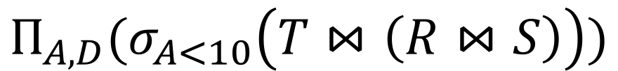

Translating to RA
R(A,B) S(B,C) T(C,D)
$$Π_{A,D}$$
SELECT R.A,S.D
FROM R,S,T
WHERE R.B = S.B
AND S.C = T.C
AND R.A < 10;
σ_{Α<10}
T(C,D)
R(A,B)
S(B,C)
$$Π_{A,D}(σ_{A<10}\left(T⋈\left(R⋈S\right)\right))$$

Slide 18
Logical Optimization
Heuristically, we want selections and projections to occur as early as possible in the plan
  Terminology: “push down selections” and “pushing down projections.”
Intuition: We will have fewer tuples in a plan.
  Could fail if the selection condition is very expensive (say runs some image processing algorithm).
  Projection could be a waste of effort, but more rarely.

Slide 19
Optimizing RA Plan
Push down selection on A so it occurs earlier
R(A,B) S(B,C) T(C,D)
$$Π_{A,D}$$
SELECT R.A,S.D
FROM R,S,T
WHERE R.B = S.B
AND S.C = T.C
AND R.A < 10;
σ_{Α<10}
T(C,D)
R(A,B)
S(B,C)
$$Π_{A,D}(σ_{A<10}\left(T⋈\left(R⋈S\right)\right))$$

Slide 20
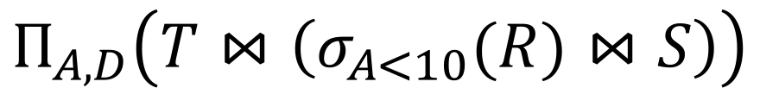

Optimizing RA Plan
Push down selection on A so it occurs earlier
R(A,B) S(B,C) T(C,D)
SELECT R.A,S.D
FROM R,S,T
WHERE R.B = S.B
AND S.C = T.C
AND R.A < 10;
$$Π_{A,D}$$
T(C,D)
σ_{Α<10}
S(B,C)
$$Π_{A,D}\left(T⋈\left(σ_{A<10}(R)⋈S\right)\right)$$
R(A,B)

Slide 21
Optimizing RA Plan
Push down projection so it occurs earlier
R(A,B) S(B,C) T(C,D)
SELECT R.A,S.D
FROM R,S,T
WHERE R.B = S.B
AND S.C = T.C
AND R.A < 10;
$$Π_{A,D}$$
T(C,D)
σ_{Α<10}
S(B,C)
$$Π_{A,D}\left(T⋈\left(σ_{A<10}(R)⋈S\right)\right)$$
R(A,B)

Slide 22
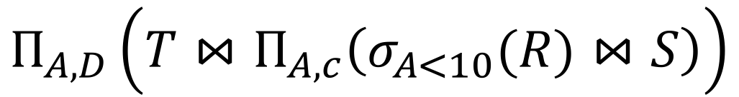


Optimizing RA Plan
We eliminate B earlier!
In general, when is an attribute not needed…?
R(A,B) S(B,C) T(C,D)
$$Π_{A,D}$$
SELECT R.A,S.D
FROM R,S,T
WHERE R.B = S.B
AND S.C = T.C
AND R.A < 10;
C is retained in pushing down because T(C,D) needs it in join
$$Π_{A,C}$$
T(C,D)
$$Π_{A,D}\left(T⋈Π_{A,c}\left(σ_{A<10}(R)⋈S\right)\right)$$
σ_{Α<10}
S(B,C)
R(A,B)

Slide 23
2. Physical Optimization

Slide 24
What you will learn about in this section
Index Selection
Histograms

Slide 25
Index Selection
Input:
  Schema of the database
  Workload description: set of (query template, frequency) pairs
Goal: Select a set of indexes that minimize execution time of the workload.
  Cost / benefit balance: Each additional index may help with some queries, but requires updating
This is an optimization problem!

Slide 26
Example
Workload description:
SELECT pname
FROM Product
WHERE year = ? AND category = ?
Frequency10,000,000
SELECT pname,
FROM Product
WHERE year = ? AND Category = ?
AND manufacturer = ?
Frequency10,000,000
Which indexes might we choose?

Slide 27
Example
Workload description:
SELECT pname
FROM Product
WHERE year = ? AND category =?
Frequency10,000,000
SELECT pname
FROM Product
WHERE year = ? AND Category =?
AND manufacturer = ?
Frequency100
Now which indexes might we choose? Worth keeping an index with manufacturer in its search key around?

Slide 28
Simple Heuristic
Can be framed as standard optimization problem: Estimate how cost changes when we add index.
    We can ask the optimizer!
Search over all possible space is too expensive, optimization surface is really nasty.
  Real DBs may have 1000s of tables!
Techniques to exploit structure of the space.
  In SQLServer Autoadmin.
NP-hard problem, but can be solved!

Slide 29
Estimating index cost?
Note that to frame as optimization problem, we first need an estimate of the cost of an index lookup
Need to be able to estimate the costs of different indexes / index types…
We will see this mainly depends on getting estimates of result set size!

Slide 30
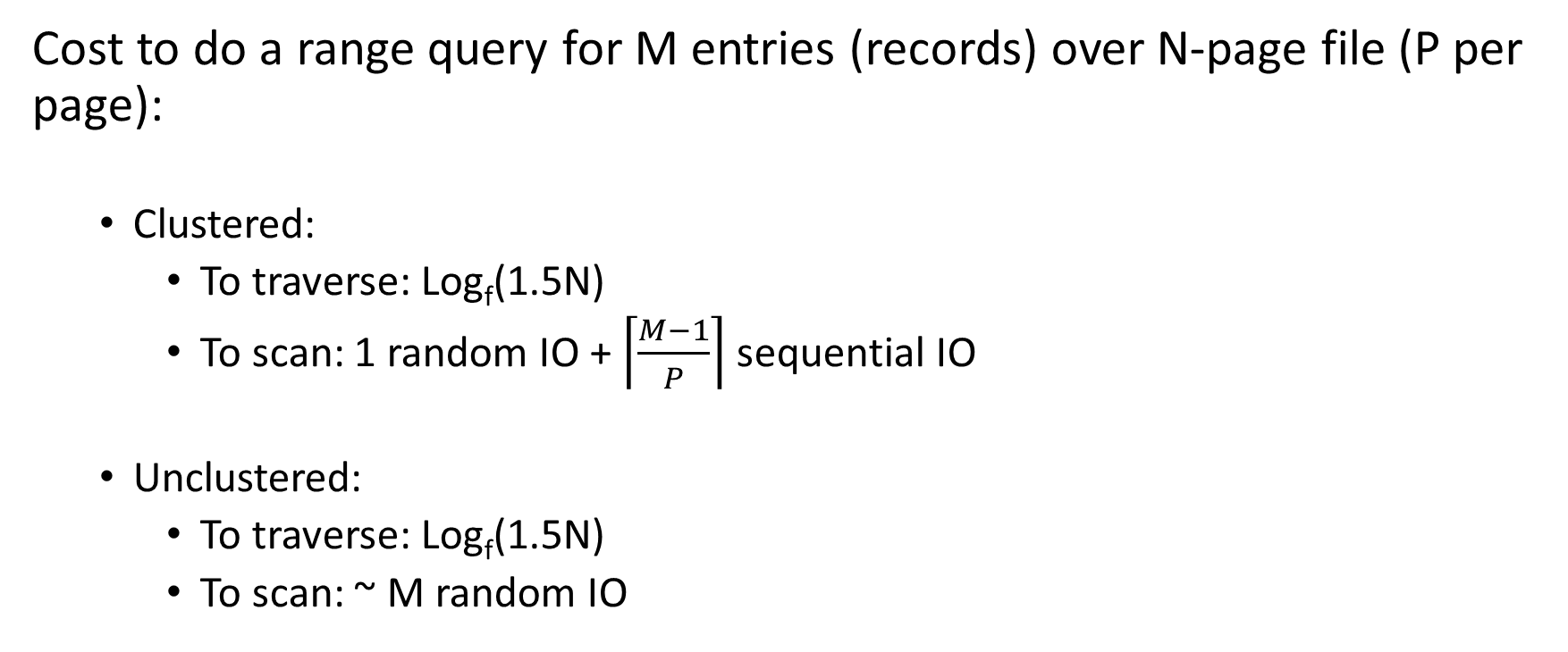
Ex: Clustered vs. Unclustered
Cost to do a range query for M entries (records) over N-page file (P per page):
  Clustered:
    To traverse: Log_{f}(1.5N)
    To scan: 1 random IO + $\left\lceil \frac{M−1}{P}\right\rceil$sequential IO
  Unclustered:
    To traverse: Log_{f}(1.5N)
    To scan: ~ M random IO
Suppose we are using a B+ Tree index with:
Fanout f
Fill factor 2/3

Slide 31
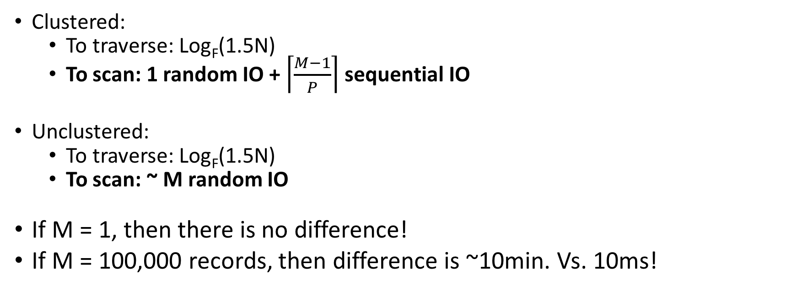
Plugging in some numbers
To simplify:
Random IO = ~10ms
Sequential IO = free
Clustered:
  To traverse: Log_{F}(1.5N)
  To scan: 1 random IO + $\left\lceil \frac{M−1}{P}\right\rceil$ sequential IO
Unclustered:
  To traverse: Log_{F}(1.5N)
  To scan: ~ M random IO
If M = 1, then there is no difference!
If M = 100,000 records, then difference is ~10min. Vs. 10ms!
~ 1 random IO = 10ms
~ M random IO = M*10ms
If only we had good estimates of M…

Slide 32
Histograms & IO Cost Estimation

Slide 33
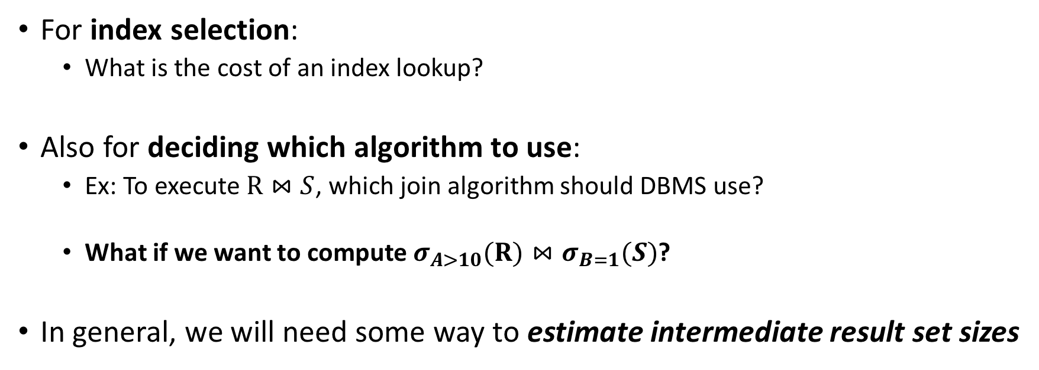
IO Cost Estimation via Histograms
For index selection:
  What is the cost of an index lookup?
Also for deciding which algorithm to use:
  Ex: To execute $R⋈S$, which join algorithm should DBMS use?
  What if we want to compute $σ_{A>10}(R)⋈σ_{B=1}(S)$?
In general, we will need some way to estimate intermediate result set sizes
Histograms provide a way to efficiently store estimates of these quantities

Slide 34
Histograms
A histogram is a set of value ranges (“buckets”) and the frequencies of values in those buckets occurring
How to choose the buckets?
  Equiwidth & Equidepth
Turns out high-frequency values are very important

Slide 35
Example
Frequency
How do we compute how many values between 8 and 10?
(Yes, it’s obvious)
Values
Problem: counts take up too much space!

Slide 36
Full vs. Uniform Counts
How much space do the full counts (bucket_size=1) take?
How much space do the uniform counts (bucket_size=ALL) take?

Slide 37
Fundamental Tradeoffs
Want high resolution (like the full counts)
Want low space (like uniform)
Histograms are a compromise!
So how do we compute the “bucket” sizes?

Slide 38
Equi-width
All buckets roughly the same width

Slide 39
Equi-depth
All buckets contain roughly the same number of items (total frequency)

Slide 40
Histograms
Simple, intuitive and popular
Parameters: # of buckets and type
Can extend to many attributes (multidimensional)

Slide 41
Maintaining Histograms
Histograms require that we update them!
  Typically, you must run/schedule a command to update statistics on the database
  Out of date histograms can be terrible!
There is research work on self-tuning histograms and the use of query feedback
  Oracle 11g

Slide 42
Nasty example
1. we insert many tuples with value > 16
2. we do not update the histogram
3. we ask for values > 20?

Slide 43
Compressed Histograms
One popular approach:
  Store the most frequent values and their counts explicitly
  Keep an equiwidth or equidepth one for the rest of the values
  People continue to try all manner of fanciness here wavelets, graphical models, entropy models,…

