Slide 1
How to give a good scientific talk
S/GMR Skill Building session
July 15, 2020
Amy Graves
Dept. of Physics and Astronomy
Swarthmore College

Slide 2
Outline of this talk
The structure of a good scientific talk.
Some meta - ideas about communication
Some specific ideas communicating scientific ideas and results
Some examples
Conclusions
Notes:
Unless this is a 1-slide lightening talk ... always have an outline ... and conclusion and the other stuff we'll mention.

Slide 3
Talk Structure:
Tell ‘em what you’re going to tell ‘em;
Next, tell ‘em;
Next, tell ‘em what you told ‘em
Notes:
I have heard this from many sources ... quoteinvestigator.com has too ... from Aristotle to Dale Carnegie to Suzanne Coppersmith's husband Rob.
So this motivates both the intro and the conclusions ...
Abstract: You are often asked for this when your talk is scheduled ... e.g. for the lightening talks. You will also have an abstract in a "book" (or online) for Sigma Xi poster session
for national meetings and local ones ... so no reason to not place the abstract text somewhere in your talk slides. But don't make folks read it and don't read it to them ... have it there for archival purposes.
The story of your work is nonlinear. You will need to weave back and forth ...

Slide 4
Talk Structure:
Tell ‘em what you’re going to tell ‘em;
Next, tell ‘em;
Next, tell ‘em what you told ‘em
What you're going to tell 'em: •Outline •Abstract (For archival purposes!)
Tell ‘em: • Motivation: Why should they care? • The story of your work: context ... prior work on topic, framing your questions methods ... how it was done results ... what you found connections ... comparisons with other work ramifications ... practical consequences future plans ... what are the next steps?
What you told ‘em: • Conclusions 4. Acknowledgements: people, funding sources
Notes:
I have heard this from many sources ... quoteinvestigator.com has too ... from Aristotle to Dale Carnegie to Suzanne Coppersmith's husband Rob.
So this motivates both the intro and the conclusions ...
Abstract: You are often asked for this when your talk is scheduled ... e.g. for the lightening talks. You will also have an abstract in a "book" (or online) for Sigma Xi poster session
for national meetings and local ones ... so no reason to not place the abstract text somewhere in your talk slides. But don't make folks read it and don't read it to them ... have it there for archival purposes.
The story of your work is nonlinear. You will need to weave back and forth ...

Slide 5
Talk Structure:
Tell ‘em what you’re going to tell ‘em;
Next, tell ‘em;
Next, tell ‘em what you told ‘em
What you're going to tell 'em: •Outline •Abstract (For archival purposes!)
Tell ‘em: • Motivation: Why should they care? • The story of your work: context ... prior work on topic, framing your questions methods ... how it was done results ... what you found connections ... comparisons with other work ramifications ... practical consequences future plans ... what are the next steps?
What you told ‘em: • Conclusions 4. Acknowledgements: people, funding sources
Notes:
I have heard this from many sources ... quoteinvestigator.com has too ... from Aristotle to Dale Carnegie to Suzanne Coppersmith's husband Rob.
So this motivates both the intro and the conclusions ...
Abstract: You are often asked for this when your talk is scheduled ... e.g. for the lightening talks. You will also have an abstract in a "book" (or online) for Sigma Xi poster session
for national meetings and local ones ... so no reason to not place the abstract text somewhere in your talk slides. But don't make folks read it and don't read it to them ... have it there for archival purposes.
The story of your work is nonlinear. You will need to weave back and forth ...

Slide 6
Talk Structure:
Tell ‘em what you’re going to tell ‘em;
Next, tell ‘em;
Next, tell ‘em what you told ‘em
What you're going to tell 'em: •Outline •Abstract (For archival purposes!)
Tell ‘em: • Motivation: Why should they care? • The story of your work: context ... prior work on topic, framing your questions methods ... how it was done results ... what you found connections ... comparisons with other work ramifications ... practical consequences future plans ... what are the next steps?
What you told ‘em: • Conclusions 4. Acknowledgements: people, funding sources
Notes:
I have heard this from many sources ... quoteinvestigator.com has too ... from Aristotle to Dale Carnegie to Suzanne Coppersmith's husband Rob.
So this motivates both the intro and the conclusions ...
Abstract: You are often asked for this when your talk is scheduled ... e.g. for the lightening talks. You will also have an abstract in a "book" (or online) for Sigma Xi poster session
for national meetings and local ones ... so no reason to not place the abstract text somewhere in your talk slides. But don't make folks read it and don't read it to them ... have it there for archival purposes.
The story of your work is nonlinear. You will need to weave back and forth ...

Slide 7
Talk Structure:
Tell ‘em what you’re going to tell ‘em;
Next, tell ‘em;
Next, tell ‘em what you told ‘em
What you're going to tell 'em: •Outline •Abstract (For archival purposes!)
Tell ‘em: • Motivation: Why should they care? • The story of your work: context ... prior work on topic, framing your questions methods ... how it was done results ... what you found connections ... comparisons with other work ramifications ... practical consequences future plans ... what are the next steps?
What you told ‘em: • Conclusions 4. Acknowledgements: people, funding sources
Notes:
I have heard this from many sources ... quoteinvestigator.com has too ... from Aristotle to Dale Carnegie to Suzanne Coppersmith's husband Rob.
So this motivates both the intro and the conclusions ...
Abstract: You are often asked for this when your talk is scheduled ... e.g. for the lightening talks. You will also have an abstract in a "book" (or online) for Sigma Xi poster session
for national meetings and local ones ... so no reason to not place the abstract text somewhere in your talk slides. But don't make folks read it and don't read it to them ... have it there for archival purposes.
The story of your work is nonlinear. You will need to weave back and forth ...

Slide 8
Advice about giving a talk ...
Remember it's about communicating your science
Communicating •Know your audience •Know the parameters of the talk Duration? (Rule: 1- 3 min = 1 slide) AV Setup Are you mic'ed? Need vocal warmup? Water? Q&A during or after? Save time for questions. • Practice your talk. Memorize key phrases within an outline, especially ones that have ideas that are subtle to convey. Memorize your first few sentences, to get yourself off to a great start.
Your science ... let your enthusiasm show ☺
Getting scientific ideas across: tip of iceberg on next slide ...
Notes:
Three operative words ... communicating, your, science
Communicating:
Are your audience non-scientists? Scientists not physicists? Jamming experts? A thesis committee? Discuss ...

Slide 9
Tips and tricks about getting science across with words and slides:
Provide highlight, not minute detail. •Give URL, email address, QR symbol where folks can look for supplementary info and math details. • If environment permits, be ready to write on (real or virtual) whiteboard for questions involving derivations or sketches.
Avoid jargon unless you are sure the audience expects it. Explain any term you think is new to the majority of listeners.
Slide skills -Mika Kostic (CrossTalk, 2017)
One message per slide
The most important part of your slide should be the biggest.
Use contrast to focus the viewer's attention , and help them parse the text.
No more than six objects per slide
4. Presentation skills Practice the art of speaking while using a real world pointer, laser pointer (real or virtual world), highlighting or pencil (virtual world)
Notes:
Three operative words ... communicating, your, science
Communicating:
Are your audience non-scientists? Scientists not physicists? Jamming experts? A thesis committee? Discuss ...

Slide 10
More tips and tricks about getting science across with words and slides:
The APS has some great additional advice ... https://www.aps.org/meetings/policies/speaker.cfm
• don't use words if a graph or table or chart conveys information better
• Use line graphs to show trends; bar graphs to compare magnitudes; pie graphs to demonstrate relative portions of a whole
• Slides should be concise and uncluttered and readable from a distance (which depends on room you are in if it is real-world ... so find out) Use large enough fonts.
• My advice about graphs: Avoid rookie mistakes and ... label axes, give your graphs titles, provide legends, indicate length scales on images, ... give the numbers and words that help the viewer interpret your graphs. Make these elements large and legible
Notes:
Three operative words ... communicating, your, science
Communicating:
Are your audience non-scientists? Scientists not physicists? Jamming experts? A thesis committee? Discuss ...

Slide 11
Exercise for us …
Go to the Web and find an example of a good or bad slide … if bad, how you would improve it? Let’s take 10 minutes for this? ☺
Notes:
Don't forget to thank the audience!

Slide 12
Abstract
Example of Abstract ... for audience of general soft-matter physicists
More technical
We perform simulations in 2d of soft particles and tiny pins which interact via harmonic, repulsive forces. Pins are either distributed randomly, or form square, triangular, or honeycomb lattices. While at low pin densities the jamming threshold, φ_{j}, decreases linearly with pin density, independently of pin geometry; at higher densities it reflects lattice-specific constraints on particle packing. The distribution of bond angles becomes increasingly anisotropic with pin density. Contact force distributions develop super-exponential tails. Lattice geometry affects the scaling behavior of bulk and shear moduli near jamming. The Zener anisotropy ratio indicates that pins can break the mechanical isotropy of the jammed state

Slide 13
Abstract
Example of Abstract ... for audience of STEM-interested people
More technical
Granular Materials are ubiquitous in daily life. By “granular” we mean not only hard objects like salt, rice, or sand; but also soft objects like bubbles, and living entities like cells. Dense granular materials can change dramatically under pressure, by suddenly solidifying into a disorderly “jammed” structure. Our research group has been using computer simulations to ask what is new and different about jamming when the mobile grains are in contact with a fixed scaffolding, like a lattice of diminutive “pins”. Pins influence when the sudden, jamming transition occurs in a granular packing. They also affect the structure of the material and how it responds to stresses ... making pins a very useful part of the "recipe" to create a jammed solid with desirable properties.

Slide 14
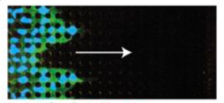
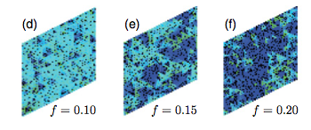
Example of Motivation slide
Why care about jamming with pins?
arrays for sorting DNA, cancer cells, ...
in glass-forming systems: suppresses relaxation, slows dynamics
Chen et al. (Oncology Lett., 2019)
Mohan and Doyle (PRE, 2007)
Wong et al (Nature Materials, 2014)
Kim (EPL, 2003)
Karmakar and Procaccia (arXiv, 2011)
Berthier and Kob (PRE, 2012)
Cammarota and Biroli (PNAS, 2012)
Jack and Berthier (PRE, 2012)
Brito, Parisi and Zamponi (Soft Matter, 2013)
Notes:
Cherry pick some results from the papers you cite to tell folks ... be ready to tell them about more in e.g. Q&A. Be honest ... no one knows everything ...
but be sure you know enough about any papers you cite that you can convey their main results, and
demonstrate that they truly motivate or support your work.

Slide 15
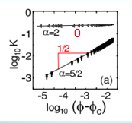
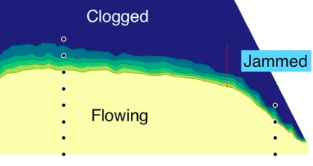
Example of another Motivation slide
The Big Questions
φ _{mobile}
φ _{obstacle}
Péter, Libai, Reichhardt & Reichhardt
(Nature, 2018)
van Hecke (J Phys Cond Matt, 2010)
What geometrical arrangement
of obstacles best facilitates jamming?
How are previously-known mechanical properties affected by pins?

Slide 16
Big questions (are beginning to be) answered ... Conclusions
Example of Conclusions
What we have found ...
Jamming threshold is lattice-specific can plateau (square lattice, bidisperse) can increase (square lattice, polydisperse)
Distribution of bond angles correlates with lattice symmetry
Contact force distribution has ... fat tails at high forces increasing mean force and width of distribution of forces
Bulk and shear moduli conventional scaling with pressure near jamming Pin geometry can produce mechanical anisotropy

Slide 17
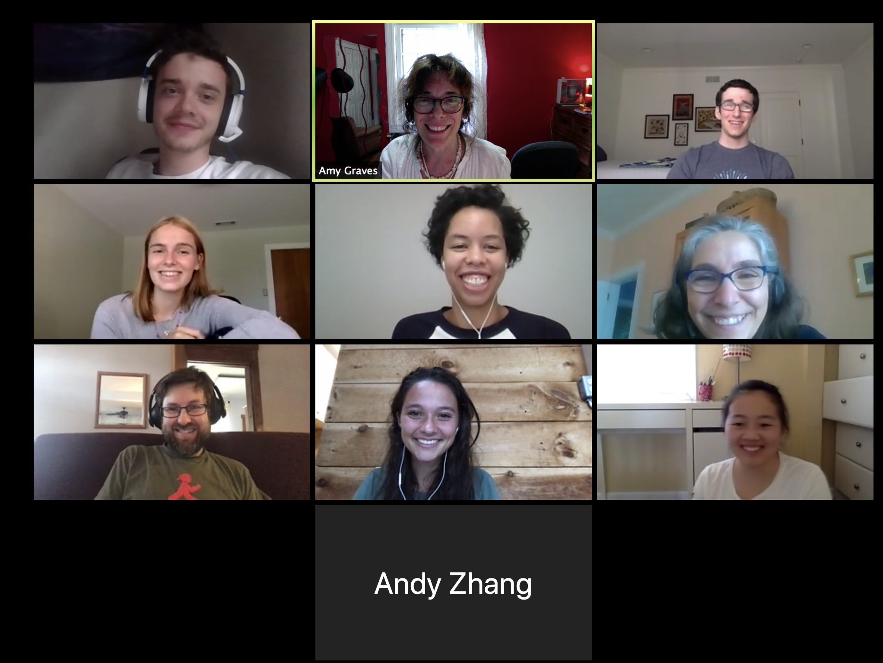
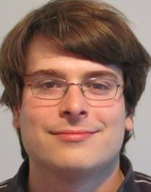
The people responsible for this work ...
Example of Acknowledgement Slide
The people who did this work
Sean Ridout
Your names and affiliations go in a list here ...
Your names would all be listed here ...

Slide 18
Acknowledgements
The National Science Foundation (DMR-1905474)
Other funding source 1
Other funding source 2
...
Thank you for your kind attention!
Notes:
Don't forget to thank the audience!

Slide 19
Conclusions
I claimed every talk is supposed to have a conclusion. However the great David Mermin gave a talk where he finished this way: The ubiquitous heavy-handed concluding summary should be omitted; a talk should tell such a good story that a summary is uncalled for. Imagine War and Peace ending with a summary. There is no better way to make an audience happy than briskly finishing a talk five minutes earlier than it expected you to. Like this.
Rules are meant to be broken. Communicate clearly. Enjoy doing it. So will your audience!
Thank you for your kind attention!
Notes:
Don't forget to thank the audience!

