Slide 1
Display of Quantitative Information
PHYS 310
February 21, 2017

Slide 2
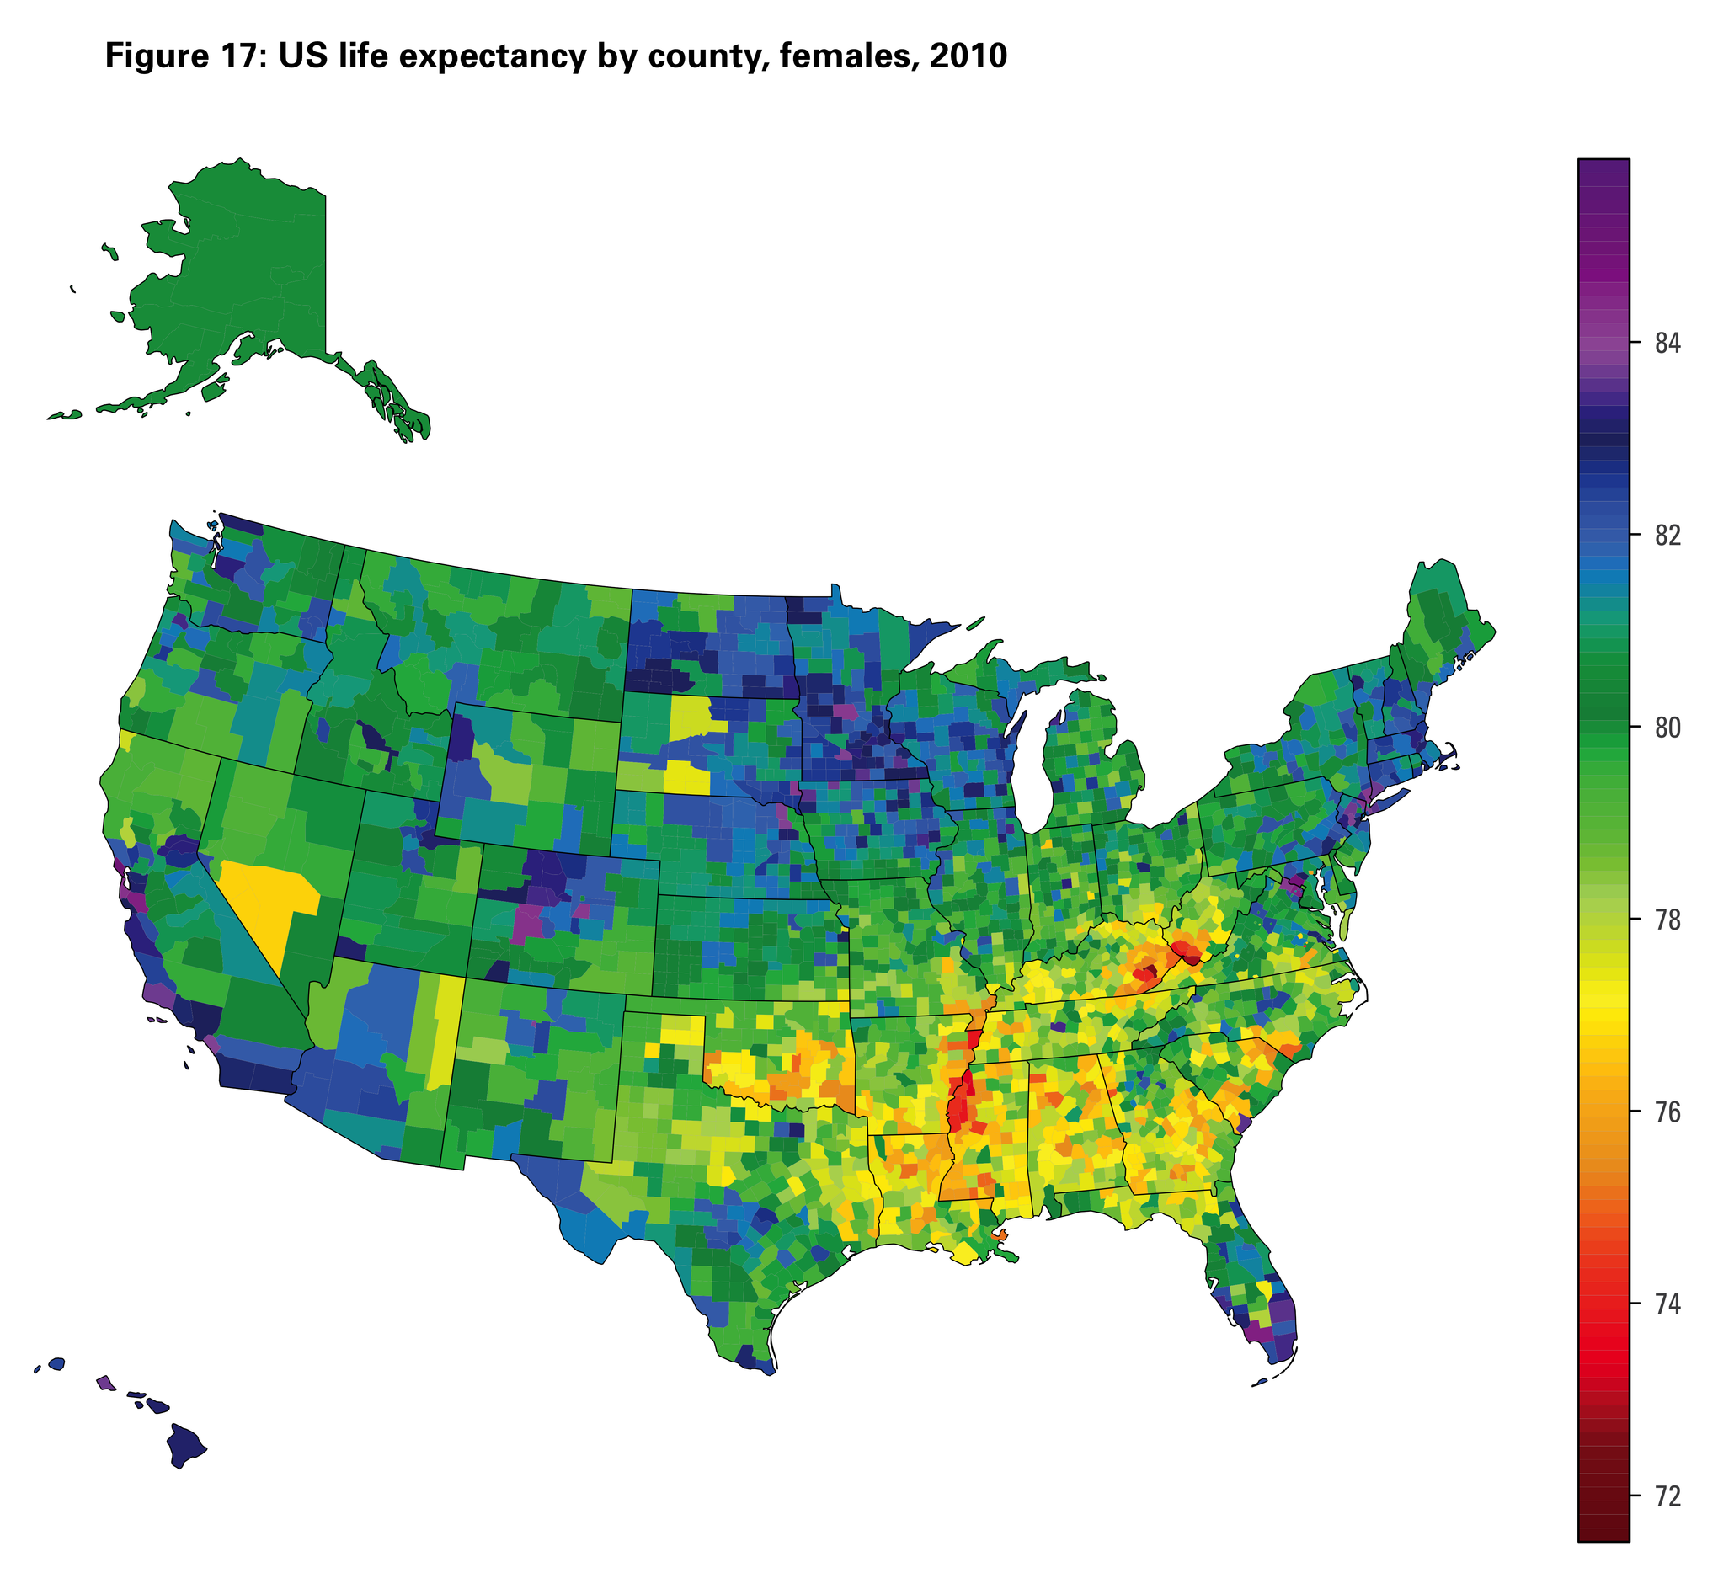

Slide 3
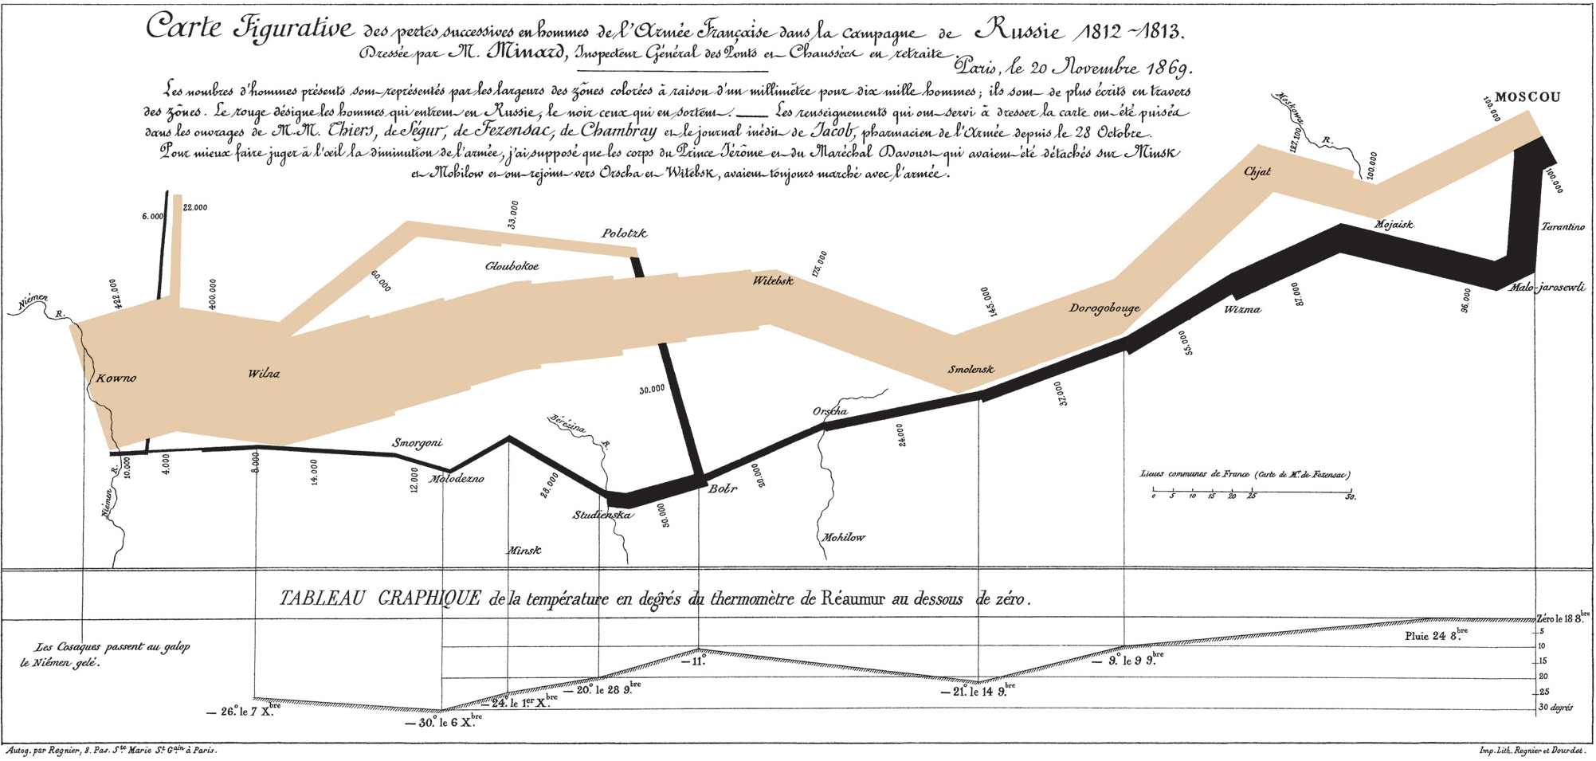
https://en.wikipedia.org/wiki/Charles_Joseph_Minard

Slide 4
Design is choice...The principles should not be applied rigidly or in a peevish spirit. What is to be sought in designs for the display of information is the clear portrayal of complexity, not the complication of the simple.
Notes:
Clear and precise seeing becomes as one with clear and precise thinking.

Slide 5
Good design brings absolute attention to data.

Slide 6
The fundamental question in statistical analysis is:
Compared with what?

Slide 7
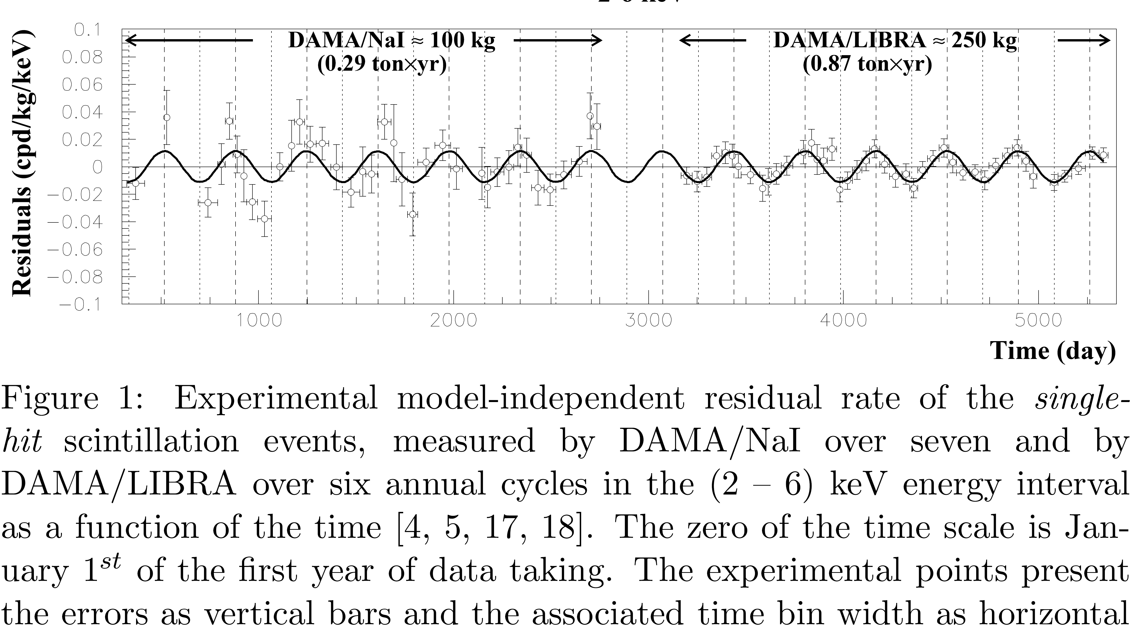
Time Series

Slide 8
Visual representations… should be governed by principles of reasoning about quantitative evidence…scientific reasoning.
Notes:
Clear and precise seeing becomes as one with clear and precise thinking.

Slide 9
Documenting the sources
Enforcing appropriate comparisons
demonstrating mechanisms of cause and effect
Recognizing multivariate nature of problem
Inspecting and evaluating alternative explanations.
Notes:
Clear and precise seeing becomes as one with clear and precise thinking.

Slide 10
https://gfycat.com/ImprobableFemaleBasenji#?speed=0.5
From Darkhorse Analytics

Slide 11
Data-Ink Ratio
In The Visual Display of Quantitative Information (1983), Tufte claims that good graphical representations maximize data-ink and erase as much non-data-ink as possible.
Non-data-ink: Scales, borders, and etc.

Slide 12
Examples of Graphical Excellence
https://arxiv.org/pdf/1702.05556.pdf
http://matplotlib.org/
http://journals.aps.org/prl/abstract/10.1103/PhysRevLett.118.061302

Slide 16
More Chart Junk Examples

Slide 17
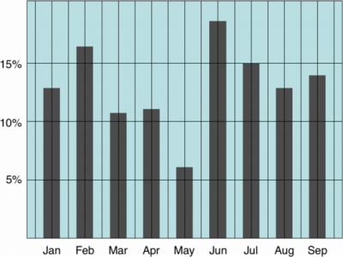
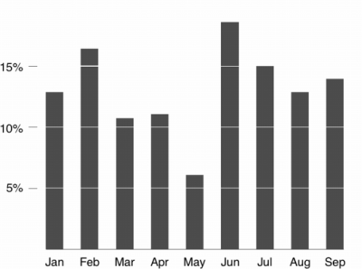
Data-Ink Ratio
Low Data-Ink Ratio
High Data-Ink Ratio

Slide 18
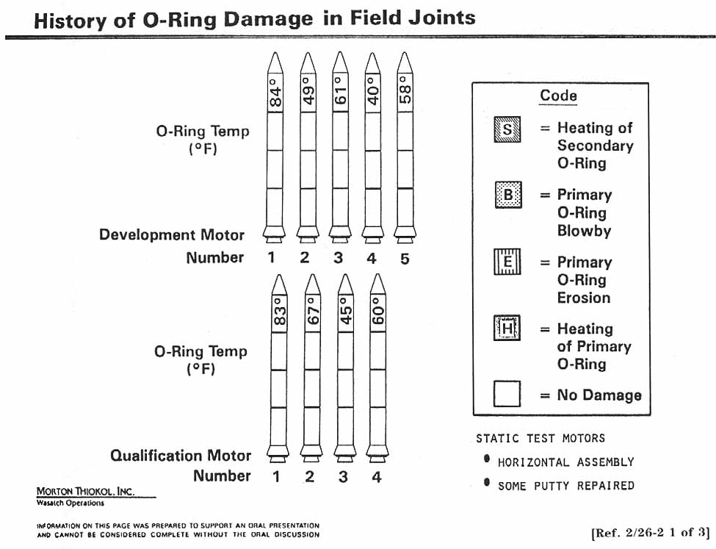

Slide 19
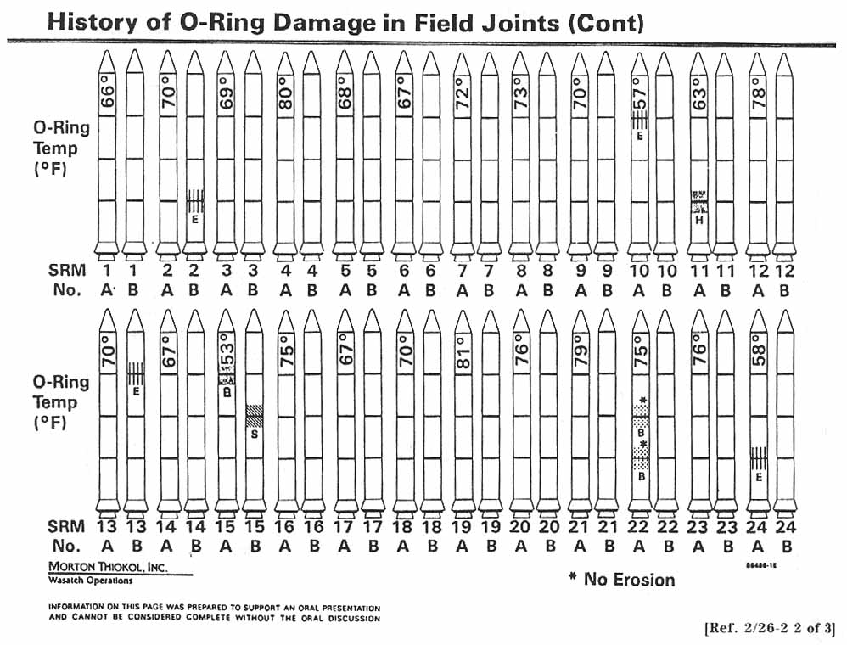

Slide 20
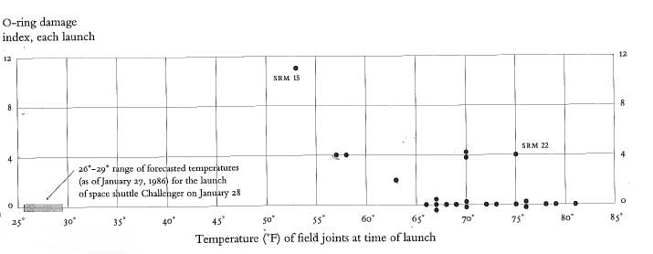

Slide 21
Log Plots

Slide 22
Chart Junk
“The interior decoration of graphics generates a lot of ink that does not tell the viewer anything new. The purpose of decoration varies — to make the graphic appear more scientific and precise, to enliven the display, to give the designer an opportunity to exercise artistic skills. Regardless of its cause, it is all non-data-ink or redundant data-ink, and it is often chartjunk.”

Slide 23
Beauty of Visualization
In Beautiful Visualization (2010), four criteria were raised to define the beauty of Visualization:
Informative
Successfully convey information
Efficient
Simple, focused, clear and straightforward
Aesthetic
Use axes, layout, shape, colors, lines, and typography appropriately
Novel
Be creative and attract readers with new design

