Slide 1


Slide 2
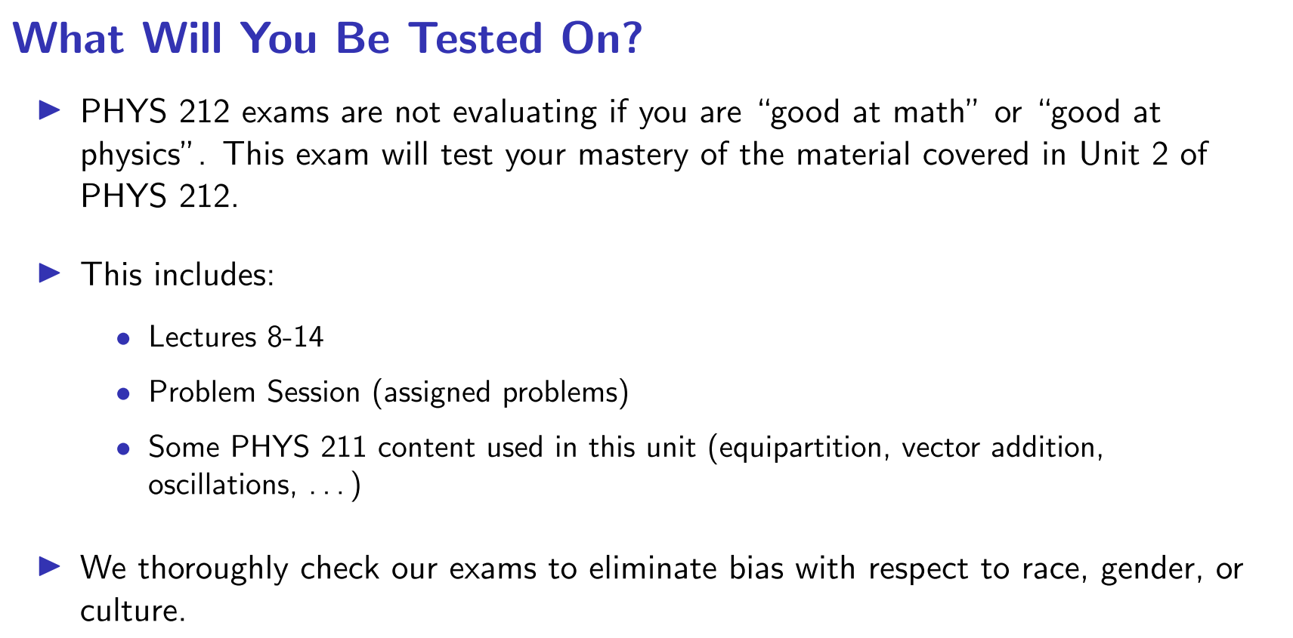

Slide 3
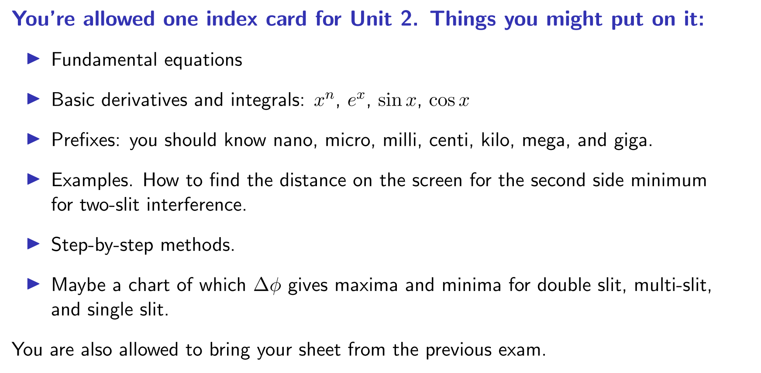

Slide 4
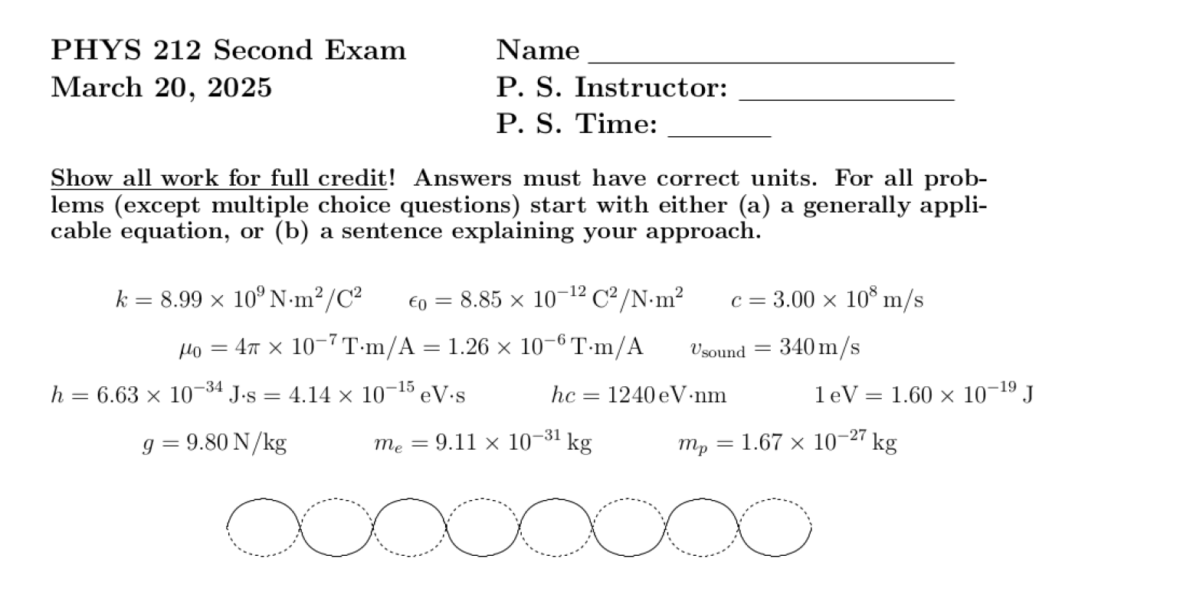

Slide 5
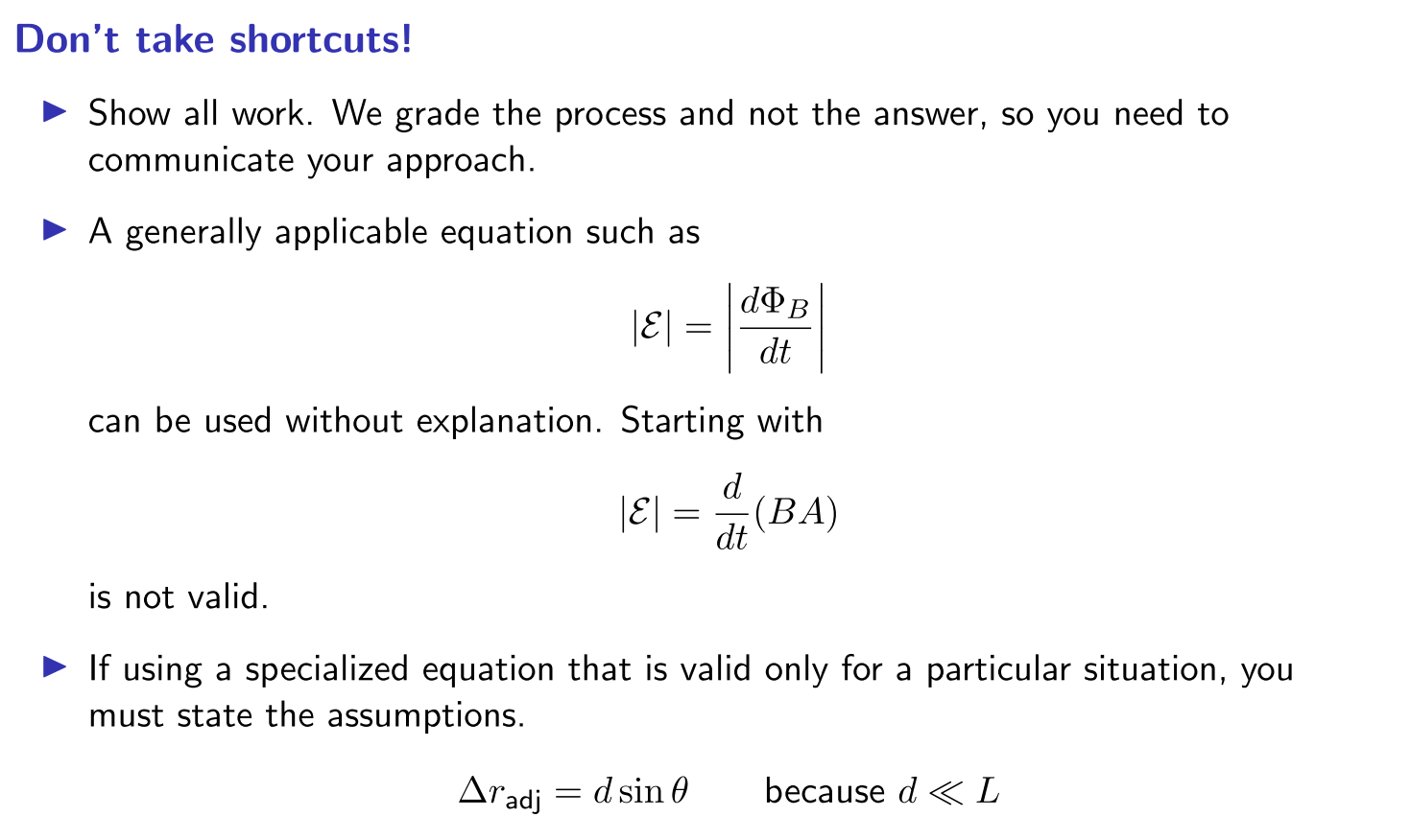

Slide 6
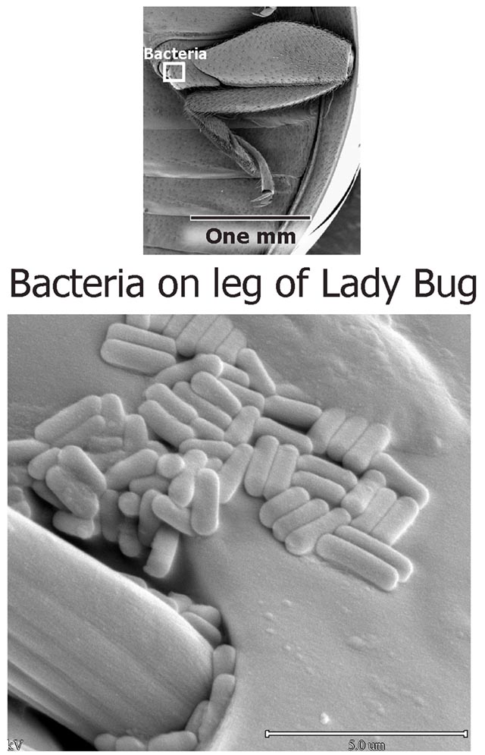
Electron microscope images of bacteria on a leg of a lady bug (From http://home.att.net/~woody.white/)

Slide 7
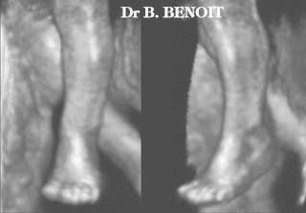
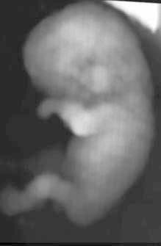
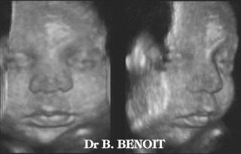
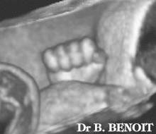
Ultrasound images of fetuses (feti? fetoxen?)
(from http://www.ob-ultrasound.net/joewoo3d.html)

Slide 8
ConcepTest #1, Lecture 14: If the information on a CD was already packed together as close as an infrared beam can probe, then how was it possible to fit more data on a disk with the same size for DVDs and Blu-ray disks?
It wasn’t possible. DVDs and Blu-ray disks were never successful.
DVDs and Blu-ray disks used higher frequency electromagnetic waves to read the disks.
DVDs and Blu-ray disks uses lower frequency electromagnetic waves to read the disks.

Slide 9
Example 1: Light of wavelength 510 nm falls on a barrier with 3 thin slits each spaced 2.5 μm apart from its adjacent slit as shown in the figure. A pattern of dots appears on a distant screen. Determine the angle θ₂ for the 2nd major bright side maximum.
ConcepTest #2, Lecture 14: Which of the following is the sequence that you’ll use to solve this problem?
1. Start with geometry → determine Δr → determine Δφ → maybe phasor addition
2. Use the interference pattern → determine Δφ → determine Δr → geometry (e.g., find θ or d).

Slide 10
Example 1: Light of wavelength 510 nm falls on a barrier with 3 thin slits each spaced 2.5 μm apart from its adjacent slit as shown in the figure. A pattern of dots appears on a distant screen. Determine the angle θ₂ for the 2nd major bright side maximum.
ConcepTest #3, Lecture 14: What is the phase difference for this problem?
1. Δφ_{adj} = 0 | 4. Δφ_{adj} = 2π rad
2. Δφ_{adj} = π/2 rad | 5. Δφ_{adj} = 3π rad
3. Δφ_{adj} = π rad | 6. Δφ_{adj} = 4π rad

Slide 11
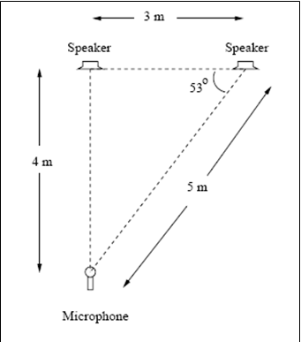
Example 2: The illustrated speakers emit sound waves that are in phase as they leave the speakers. The waves have a frequency of 85 Hz and a wavelength of 4 m. The stereo is adjusted so that the individual sound waves from the speakers have identical amplitudes A at the microphone. Calculate the amplitude of the total sound wave detected by the microphone when both speakers are on.
ConcepTest #4, Lecture 14: Which of the following is the sequence that you’ll use to solve this problem?
1. Start with geometry → determine Δr → determine Δφ → maybe phasor addition
2. Start with interference pattern → determine Δφ → determine Δr → geometry (e.g., find θ or d).

Slide 12
Example 2: The illustrated speakers emit sound waves that are in phase as they leave the speakers. The waves have a frequency of 85 Hz and a wavelength of 4 m. The stereo is adjusted so that the individual sound waves from the speakers have identical amplitudes A at the microphone. Calculate the amplitude of the total sound wave detected by the microphone when both speakers are on.
ConcepTest #5, Lecture 14: What is Δr for this problem?
1. 1 m | 4. (1 m) * sin(37º)
2. 3 m | 5. (3 m) * sin(53º)
3. (1 m) * sin(53º) | 6. (3 m) * sin(37º)

Slide 13
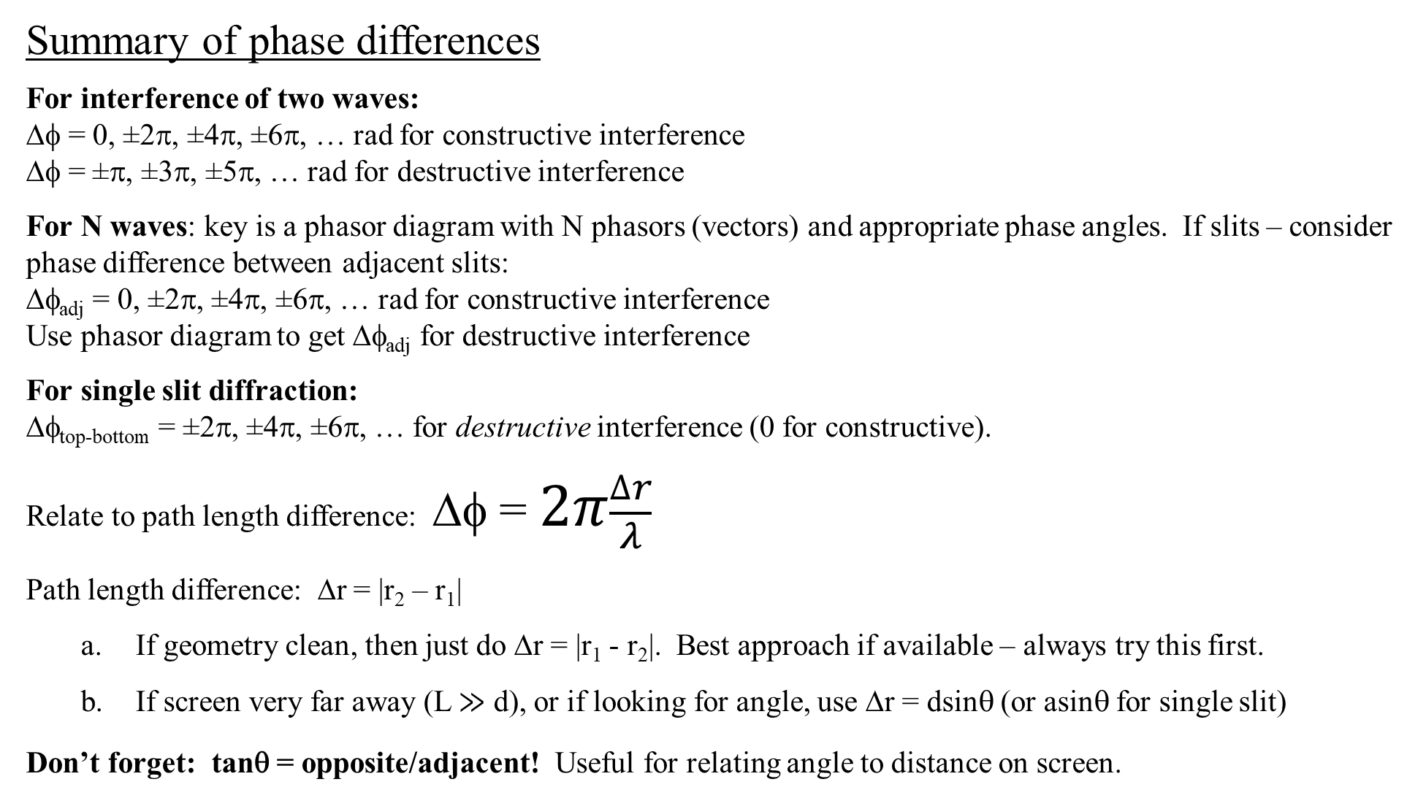
Summary of phase differences
For interference of two waves:
Δφ = 0, ±2π, ±4π, ±6π, … rad for constructive interference
Δφ = ±π, ±3π, ±5π, … rad for destructive interference
For N waves: key is a phasor diagram with N phasors (vectors) and appropriate phase angles. If slits – consider phase difference between adjacent slits:
Δφ_{adj} = 0, ±2π, ±4π, ±6π, … rad for constructive interference
Use phasor diagram to get Δφ_{adj} for destructive interference
For single slit diffraction:
Δφ_{top-bottom} = ±2π, ±4π, ±6π, … for destructive interference (0 for constructive).
Relate to path length difference: Δφ = $2π\frac{∆r}{λ}$
Path length difference: Δr = |r₂ – r₁|
a. If geometry clean, then just do Δr = |r₁ - r₂|. Best approach if available – always try this first.
b. If screen very far away (L ≫ d), or if looking for angle, use Δr = dsinθ (or asinθ for single slit)
Don’t forget: tanθ = opposite/adjacent! Useful for relating angle to distance on screen.

Slide 14
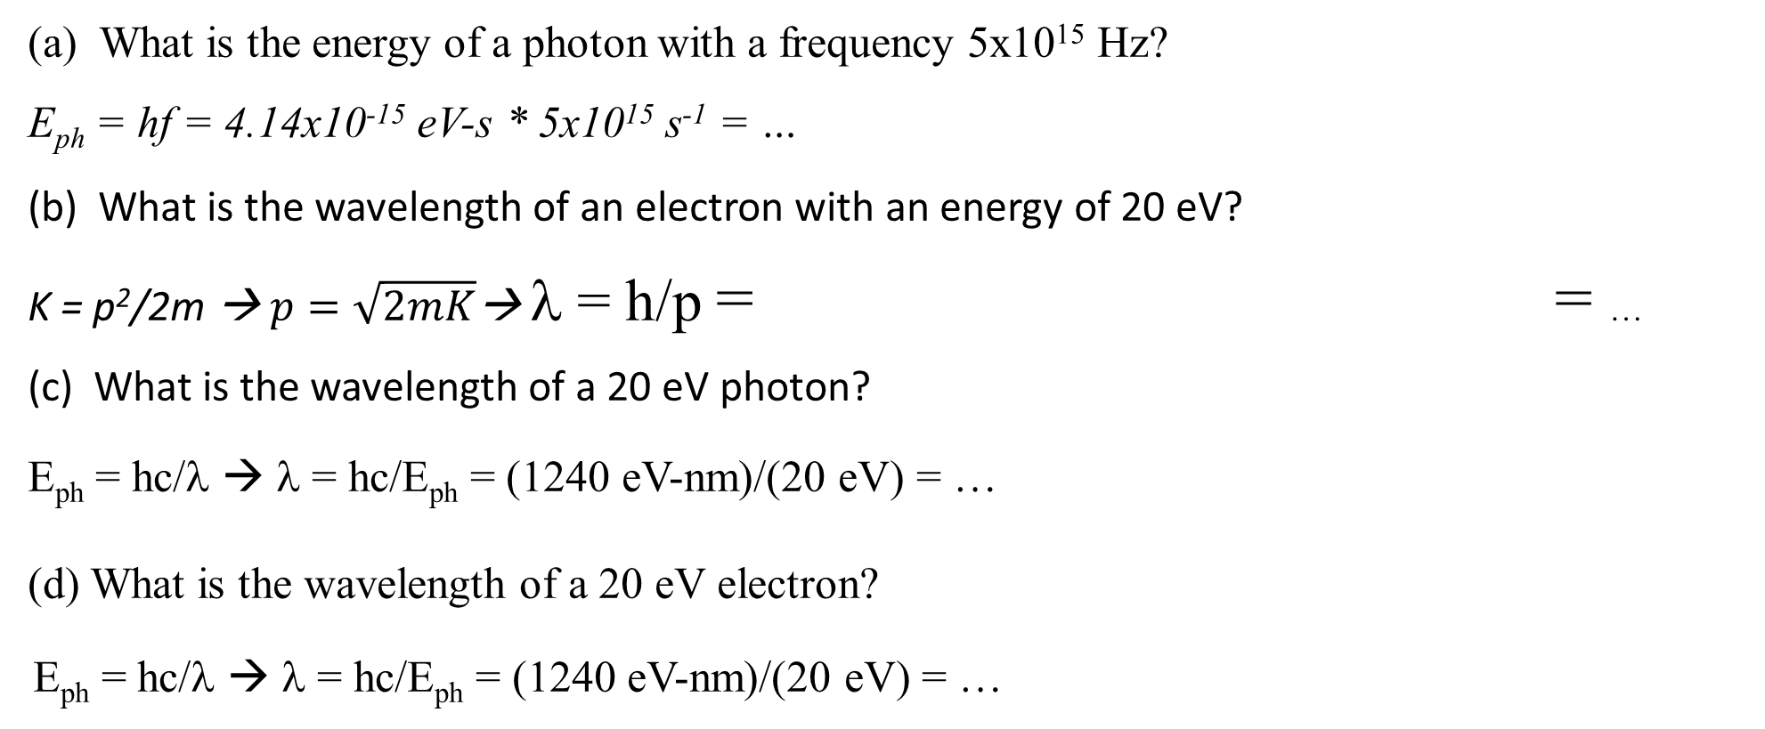
ConcepTest #6, Lecture 14, Lightning Round
For each of the following cases, put up a “1” if the the approach (including units) is correct, and a “2” if not.
(a) What is the energy of a photon with a frequency 5x10¹⁵ Hz?
E_{ph} = hf = 4.14x10⁻¹⁵ eV-s * 5x10¹⁵ s⁻¹ = …
(b) What is the wavelength of an electron with an energy of 20 eV?
K = p²/2m → $p=\sqrt{2mK}$→ λ = h/p = = …
(c) What is the wavelength of a 20 eV photon?
E_{ph} = hc/λ → λ = hc/E_{ph} = (1240 eV-nm)/(20 eV) = …
(d) What is the wavelength of a 20 eV electron?
E_{ph} = hc/λ → λ = hc/E_{ph} = (1240 eV-nm)/(20 eV) = …

Slide 15
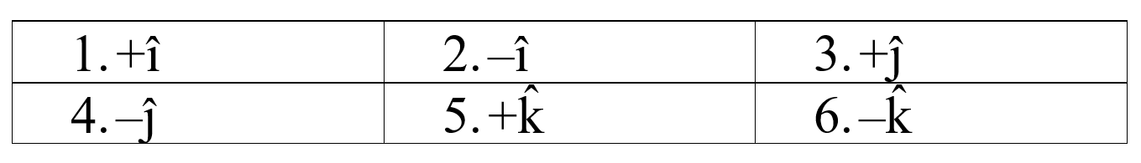

ConcepTest #7, Lecture 14
The electric field in an electromagnetic plane wave in a vacuum is given by
where E is in N/C, y is in meters and t is in seconds.
The wave propagates in which direction?
(b) What is the direction of the electric field $\vec{E}$ at the origin (y = 0) at time t = 0?

Slide 16
ConcepTest #8, Lecture 14
Which of the following statements is true about electromagnetic waves? (Put up any card that is appropriate.)
1. Light is an electromagnetic wave.
2. An electromagnetic wave is a stream of charged particles.
3. Electromagnetic waves are longitudinal waves.
4. Electromagnetic waves can travel through a vacuum.
5. Electromagnetic waves always travel at a speed 3.0 × 10⁸ m/s in a vacuum.
6. None of the other statements are true.

Slide 17
ConcepTest #9, Lecture 14
(a) The current in the wire is decreased. What is the
direction of the current induced in the square loop?
1 = “Clockwise”
2= “Counter-Clockwise”
3= “There is no induced current”
4= “Not enough information”
(b) The current is now held constant, but the loop is moved to the right with a constant speed. What is the direction of the current induced in the loop?
1 = “Clockwise”
2=”Counter-Clockwise”
3=”There is no induced current”
4=”Not enough information”
I

Slide 18
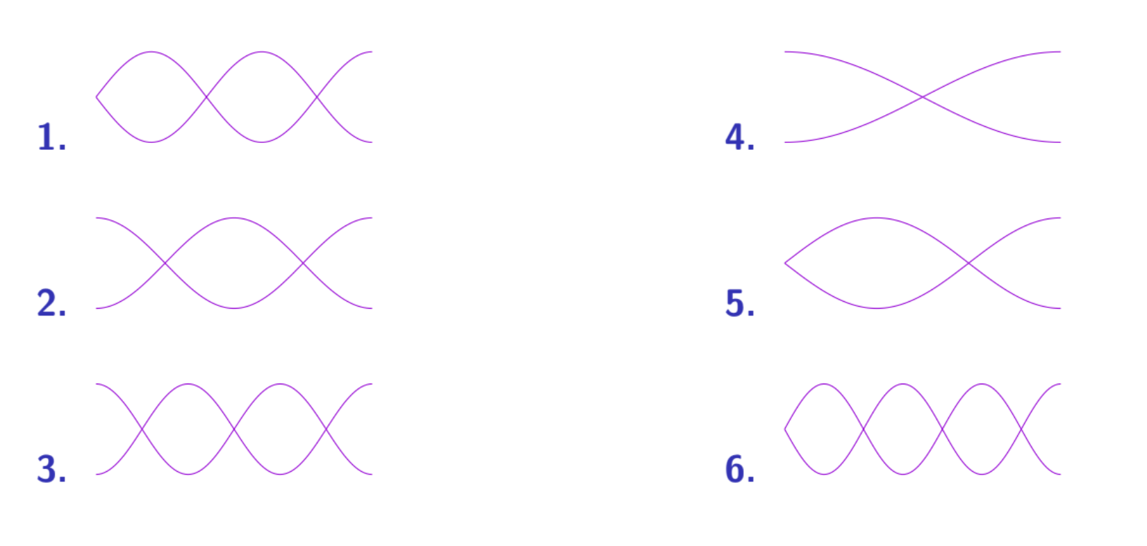
ConcepTest #10, Lecture 14
I blow on a slide whistle (open one side, closed the other) and create an awful squawking sound that corresponds to the third lowest frequency. Which of the following diagrams depicts the nodes and antinodes for this standing wave?

Slide 19
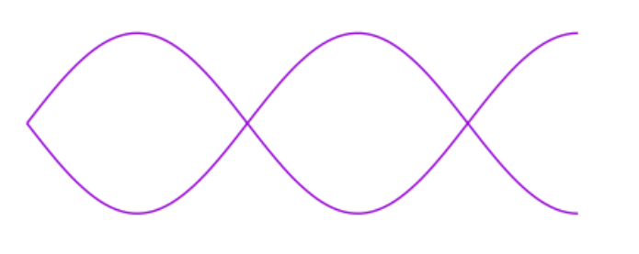
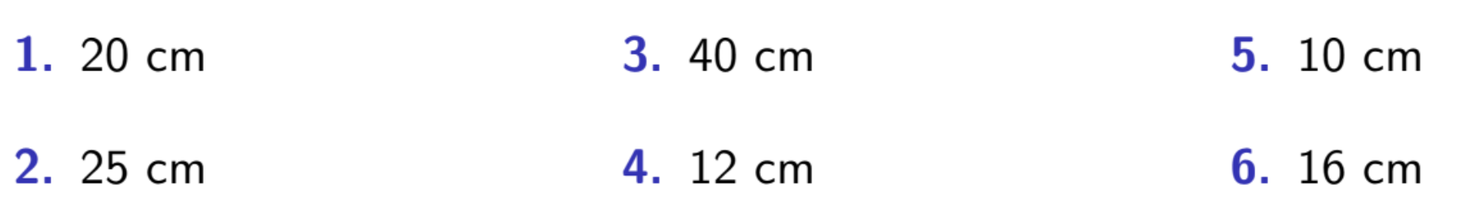
ConcepTest #11, Lecture 14
I blow on a slide whistle (open one side, closed the other) and create an awful squawking sound that corresponds to the third lowest frequency with the standing wave shown to the right. If the slide whistle is 20 cm long, what is the wavelength oof the standing wave??

Slide 20
ConcepTest #12, Lecture 14 (From Test #2, 2017; also an A-problem from supplement.)
1. The light that you see is unpolarized | 3. The light is polarized up-down.
2. The light is polarized left-right. | 4. The light is polarized in-out

Slide 21
Brainstorm, Lecture 14
When dealing with Doppler fetal heartbeat monitors, the frequency of the ultrasound is typically 1 MHz or larger, while the frequency shifts due to the Doppler effect are as low as 100 Hz, a factor of 10,000 smaller. How can you detect such a small shift with any accuracy?

