Slide 1
On designing graphs for your papers and presentations

Slide 2
Design is choice.... What is to be sought in designs for the display of information is the clear portrayal of complexity, not the complication of the simple. -- Tufte
From: The Visual Display of Quantitative Information --- Tufte
Notes:
Clear and precise seeing becomes as one with clear and precise thinking.

Slide 3
Good design brings absolute attention to data.

Slide 4
The fundamental question in statistical analysis is:
Compared with what?

Slide 5
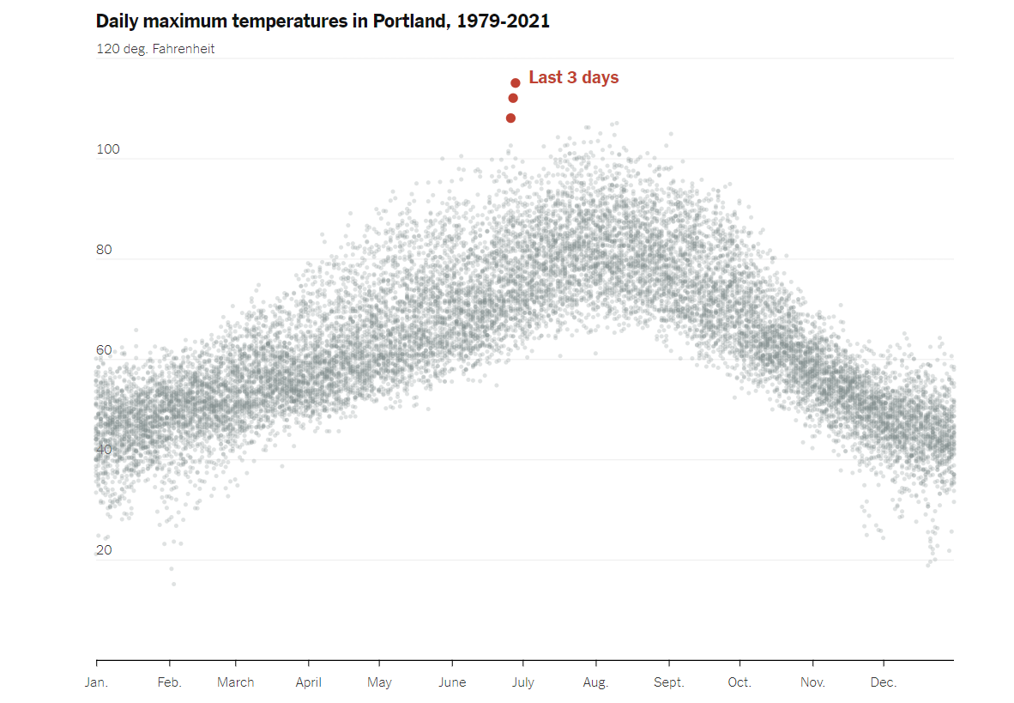
Example # 1: Extreme Weather
https://www.nytimes.com/interactive/2021/06/29/upshot/portland-seattle-vancouver-weather.html
What design Choices were made in this figure? Were they effective?

Slide 6
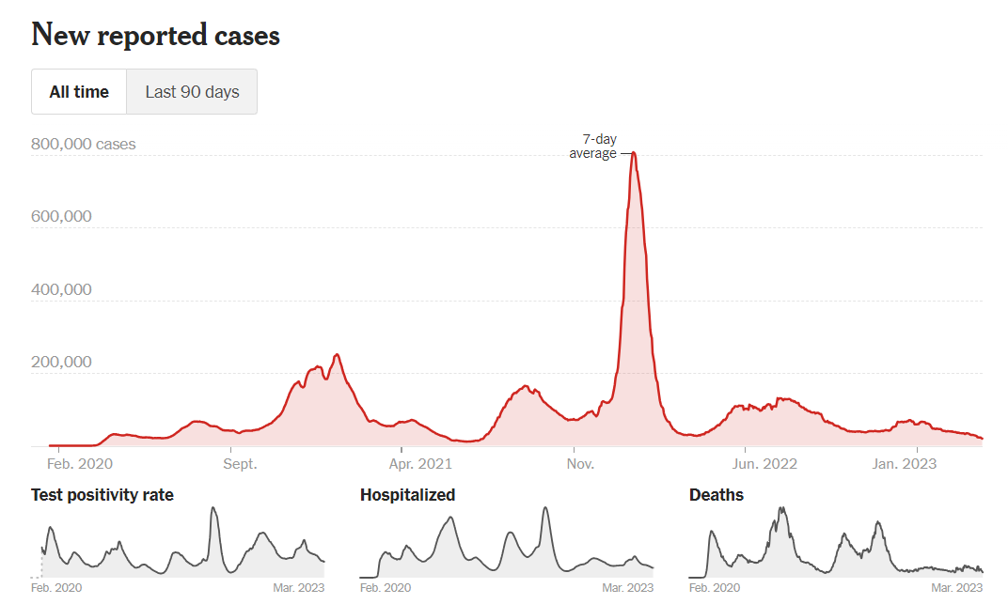
Example # 2: covid
https://www.nytimes.com/interactive/2021/us/covid-cases.html

Slide 7
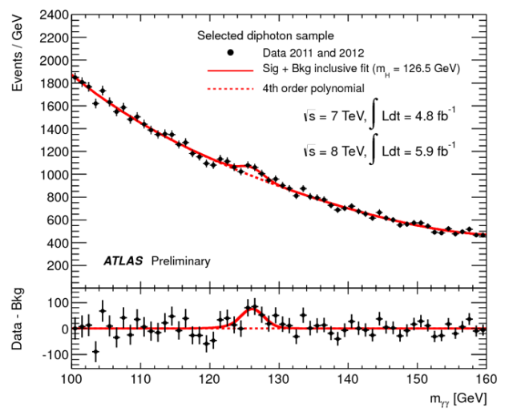
Example # 3: The Higgs Boson Discovery
What design Choices were made in this figure. Are they effective?

Slide 8
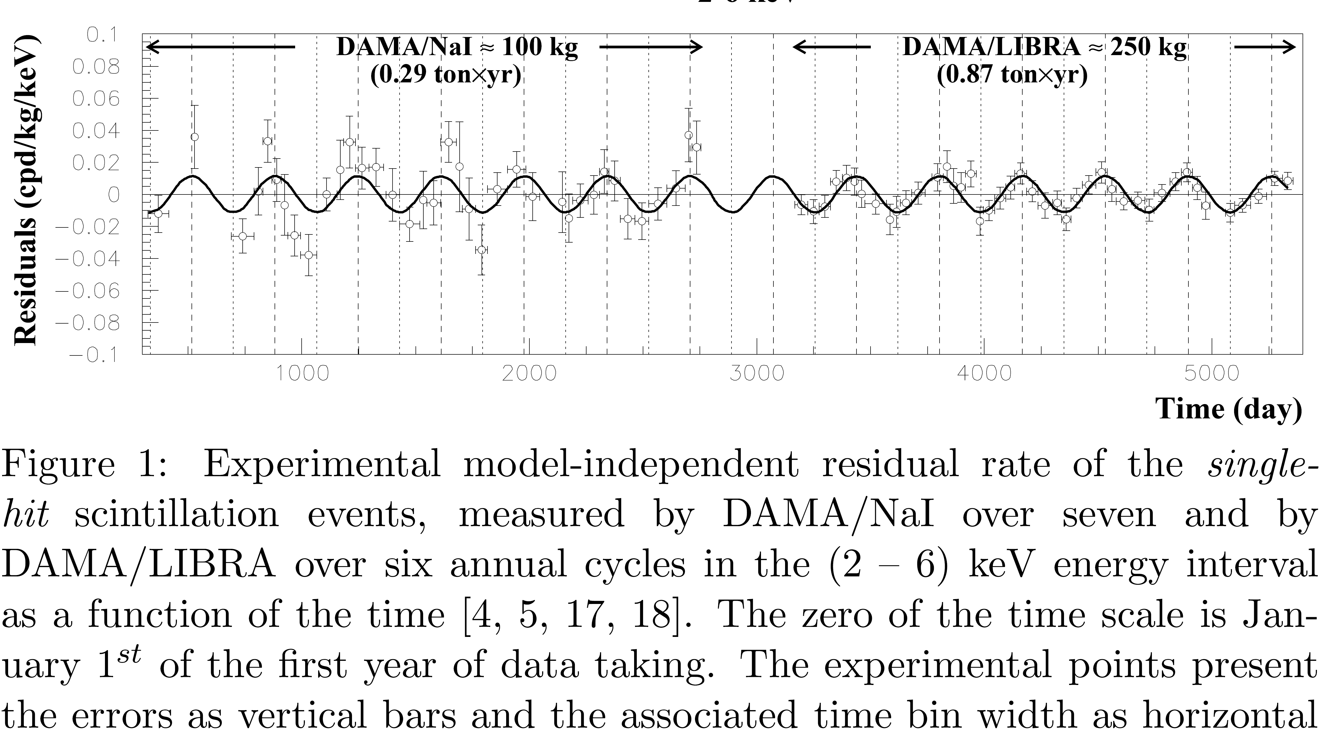
Time Series (Note choice of aspect ratio)
Bernebei et al
AIP conf. proc
(2009)
Notes:
This graph shows measurements spanning over 5000 days of an experiment tracking the modulation of the counts on a detector. The investigators suggest that it may indicated an annual modulation. Note the aspect ratio. It is reminiscent of a strip chart. This graph would not be as effective if the aspect ratio was square.

Slide 9
Some Pro Tips
Know your audience
Ensure text in graphics is legible
Anticipate how figures will appear in print (color or BW)
Use legends / labels for your data and axes
Save graphs with high resolution. Use vector graphics if possible

Slide 10
Learn from effectively constructed graphs
The Matplotlib Gallery has example code for how to achieve certain looks.
http://matplotlib.org/
Refer to examples from your favorite journal such as
Physical Review
American Journal of Physics
Nature

Slide 11
Practical Tips -- what to avoid
https://junkcharts.typepad.com/junk_charts/ has quite a collection

Slide 12
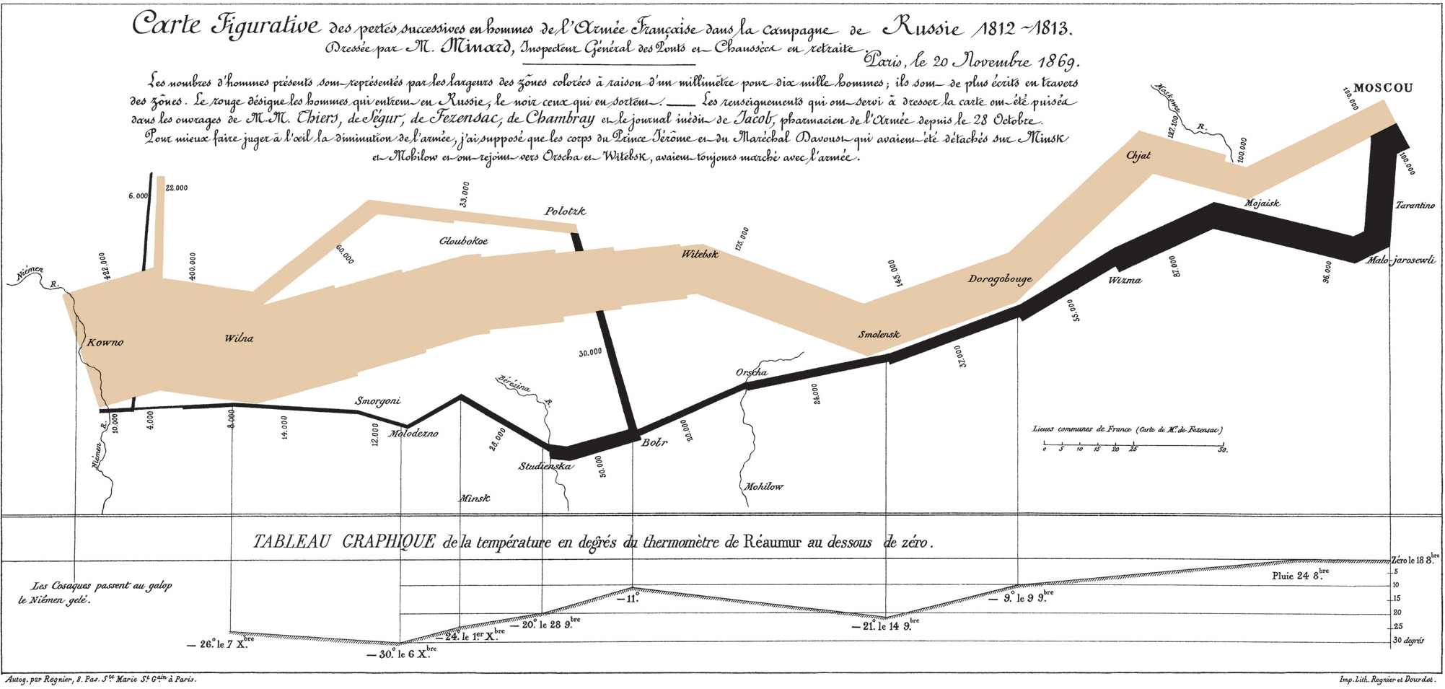
https://en.wikipedia.org/wiki/Charles_Joseph_Minard

