Slide 1
Course Introduction
History of Computing
Computers and Society
Notice: This set of slides is based on the notes by Professor Guattery of Bucknell and by the textbook author Michael Quinn

Slide 2
Course Introduction

Slide 3
Why This Course
Student self introduction in a few sentences
Why offering/taking this course?

Slide 4
Student Reasons to Take the Course

Slide 5
The Runaway Trolley
The runaway trolley is a moral dilemma first posed in a philosophy paper (Foot, 1967 - Wikipedia has the citations for the original paper, and for some subsequent papers that reformulate the choices).
You could control a trolley car that …
http://en.wikipedia.org/wiki/Trolley_problem

Slide 6
What would YOU do?!!!

Slide 7
An Extreme, But True Story
In the summer of 1884, four English sailors were floating on a lifeboat after their ship sank. On the 20th day, they voted to kill the young and sick sailor to keep the other three alive. The other three sailors survived. They were arrested and tried upon return.
Justice with Michael Sandel. Accessed September 23rd, 2010 from: http://www.justiceharvard.org/
Sandel, M. (2009). Justice – What’s the Right Thing to Do? NY:Farrar, Straus and Giroux.

Slide 8
What would YOU do?!!!

Slide 9
Course Introduction
The place of the computer in modern society. An in-depth study of the societal, ethical, and legal issues of computing. Historical as well as futurists' views of computing and technology. Public perception of computers and computer scientists and how that influences the role of the computer scientist as a professional. Course work includes oral and written presentations.
From Bucknell couse catalog

Slide 10
Basic Information
Course home page at
  http://www.eg.bucknell.edu/~xmeng/computer-society/
Syllabus at
  http://www.eg.bucknell.edu/~xmeng/computer-society/syllabus.html
A tentative schedule at
  http://www.eg.bucknell.edu/~xmeng/computer-society/schedule.html
TAs: 赵睿, 浦楚楠

Slide 11
Goals of The Course
After taking this course, a student will be able to
  collect and analyze information from a variety of sources about societal issues related to computers and computing, and present informed opinions based on the information and analysis;
  analyze ethical issues concerning both computer technologies and the exercise of their professional responsibilities.

Slide 12
Topics to Discuss (1)
A brief history of computing and its impact on society
Framework of ethics
  What’s the right thing to do?
Internet and the world wide web
  Email and spam; freedom of expression vs. censorship.
Intellectual Property and the Media Industry
  Changing business models in the music, film, and publishing industries; copyright law; music and movie piracy.

Slide 13
Topics To Discuss (2)
Intellectual Property: Software
  Software patents; Proprietary vs. open software; licensing arrangements; software piracy; Creative Commons.
Privacy
  Privacy concepts; public and personal information; laws governing information access
  Surveillance; social networks; data mining; identity theft; encryption & export restrictions
Computer Security
  Security threats (viruses, worms, trojan horses); hacking, ethical and otherwise; legal issues; government sponsored hacking

Slide 14
Topics To Discuss (3)
Software Reliability and Liability
  Software failure, moral and professional responsibility.
Computers, Government, and Politics
  Campaigns, blogs, e-voting, social networks.
Computer Technologies in the Workplace
  Automation and the job market; effects of technology on productivity.
Globalization and Computers
  Trade agreements; offshoring and outsourcing

Slide 15
Topics To Discuss (4)
Computers and Education Divide
  Digital divide; net neutrality; “winner-takes-all”?
Professional Ethics
  Professional associations' codes of ethics; professional ethical dilemmas.

Slide 16
Student Work
Go over the syllabus
Expected of the students
  Reading the assigned papers
  Participating discussions
  Writing three short summary papers
  Three quizzes
A tentative schedule

Slide 17
Computing and their historical impact on society

Slide 18
Aids to Manual Calculating
Tablet
  Clay, wax tablets (ancient times)
  Slates (late Middle Ages)
  Paper tablets (19th century)
Abacus
  Rods or wires in rectangular frame
  Lines drawn on a counting board
Mathematical tables
  Tables of logarithms (17th century)
  Income tax tables (today)

Slide 19
Slate and Counting Board
© Science Museum Library/Science & Society Picture Library

Slide 20
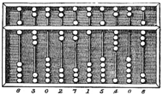
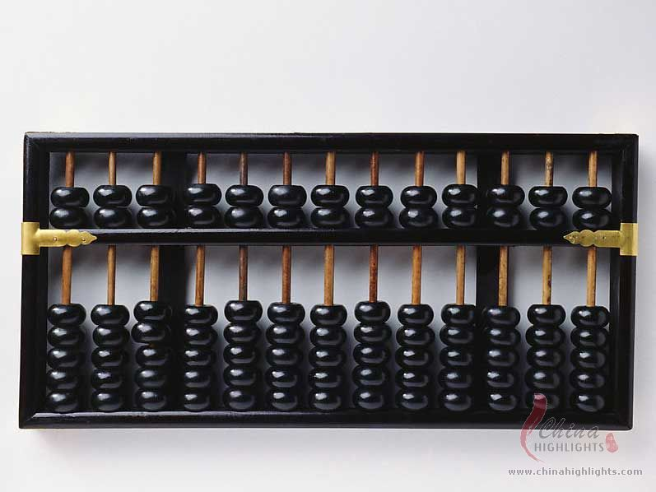
Chinese Abacus
the number represented in the picture
is 6,302,715,408
http://en.wikipedia.org/wiki/Suanpan
http://www.chinahighlights.com/travelguide/culture/the-chinese-abacus.htm
The earliest known written documentation of the
Chinese abacus dates to the 2nd century BC
http://en.wikipedia.org/wiki/Suanpan

Slide 21
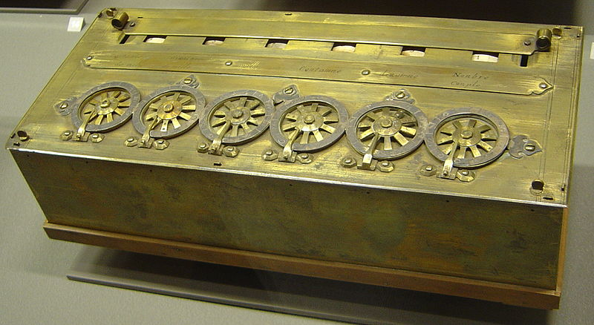
Early Mechanical Calculators -- Pascaline
Calculators of Pascal and Leibniz (17th century)
  The only functional mechanical calculator in the 17th century
  Worked with whole numbers
  Unreliable
http://en.wikipedia.org/wiki/Pascal%27s_calculator

Slide 22
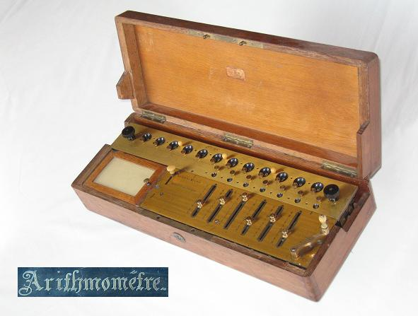
Early Mechanical Calculators -- Arithmometer
Arithmometer of (Charles Thomas) de Colmar (19th century)
  Took advantage of advances in machine tools
  Much more reliable, can be used in daily work
  Adopted by insurance companies
  Its production debut of 1851 launched the mechanical calculator industry which ultimately built millions of machines well into the 1970s.
http://en.wikipedia.org/wiki/Arithmometer

Slide 23
Feminization of Bookkeeping
Women can be as productive
as men in work place when doing
bookkeeping
In 1880, 5.7 percent of cashiers,
bookkeepers, and accountants
were women. By 1910, the
numbers had risen to 38.5 percent
Princeton University Press

Slide 24
Social Change → Market for Calculators
Gilded Age (late 19th century America)
  Rapid industrialization
  Economic expansion
  Concentration of corporate power
New, larger corporations
  Multiple layers of management
  Multiple locations
  Needed up-to-date, comprehensive, reliable, and affordable information

Slide 25
Calculator Adoptions → Social Change
Fierce market
  Continuous improvements in size, speed, ease of use
  Sales increased rapidly
“Deskilling” and feminization of bookkeeping
  People of average ability quite productive
  Calculators 6× faster than adding by hand
  Wages dropped
  Women replaced men

Slide 26
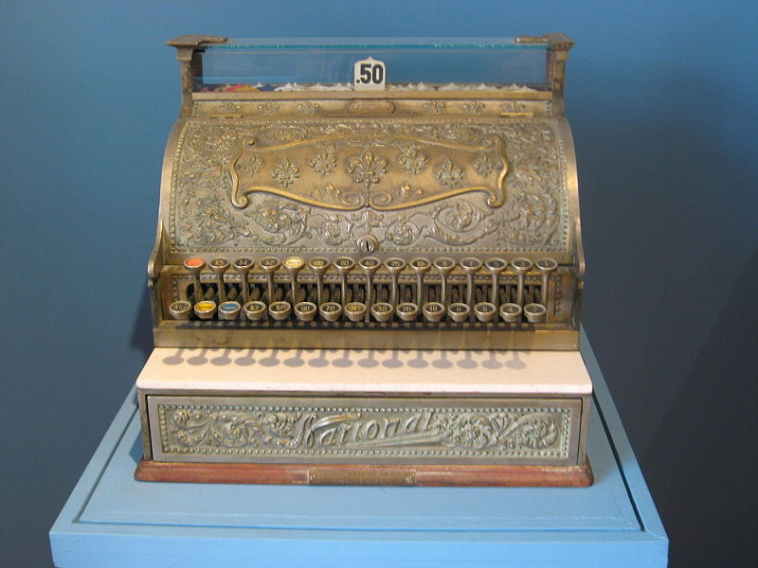
Cash Register
NCR: the original name came from
National Cash Register Company (1884)
The company contributed or invented
various systems involving computing
  Teradata: parallel database machines
  ATM machines
  Modern cash registers
  Barcode scanners
An active high-tech company today
http://en.wikipedia.org/wiki/NCR_Corporation
http://www.ncr.com/about-ncr/company-overview/history-timeline

Slide 27
Punched Card Tabulation
Punched cards (late 19th century)
  Herman Hollerith invented punched card and mechanical tabulating machine
  One record per card
  Cards could be sorted into groups, allowing computation of subtotals by categories
  Greatly reduced the time needed for tabulating the census data
    1880 census data took 8 years to finish
    1890 data used 2 years to finish with Hollerith’s machines

Slide 28
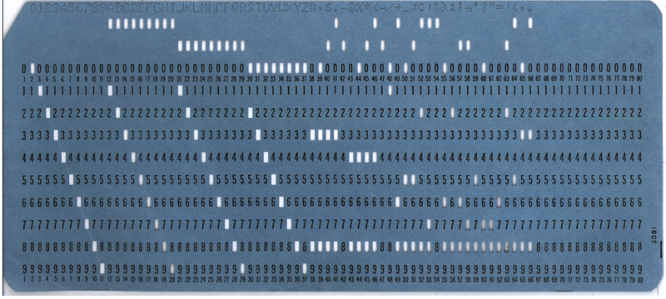
Punched Cards
http://en.wikipedia.org/wiki/Punched_card

Slide 29
Electric Tabulator at U.S. Census Bureau
© Bettmann/CORBIS

Slide 30
Social Impact
Time needed for census data shortened
Possible statistical analysis of data from cash registers
Keeping accounting information
Creation of IBM (International Business Machines) and modern data-processing systems

Slide 31
Dawn of the Computing Age
Colossus was the world's first electronic digital computer that was at all programmable.
  The prototype, Colossus Mark 1, was shown to be working in December 1943 and was operational at Bletchley Park by 5 February 1944
  An improved Colossus Mark 2 first worked on 1 June 1944, just in time for the Normandy Landings
  Ten Colossus computers were working by the end of WWII
  Breaking German communication code, played a critical role in winning WWII --- social impact!!
http://en.wikipedia.org/wiki/Colossus_computer

Slide 32
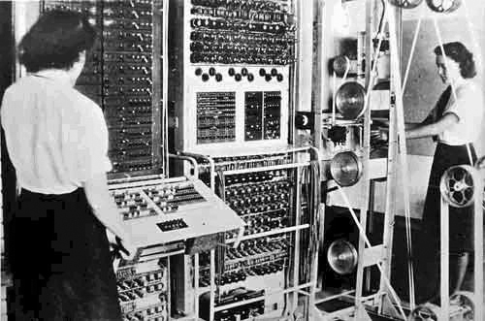
Colossus Computers
http://en.wikipedia.org/wiki/Colossus_computer

Slide 33
Precursors of Commercial Computers
Atanasoff-Berry Computer: vacuum tubes
ENIAC: externally programmed with wires
EDVAC: program stored in memory
Small-Scale Experimental Machine: CRT memory

Slide 34
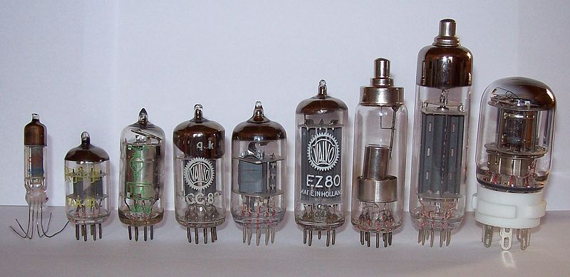
Computer Technology:
Vacuum Tubes
http://en.wikipedia.org/wiki/Vacuum_tube

Slide 35
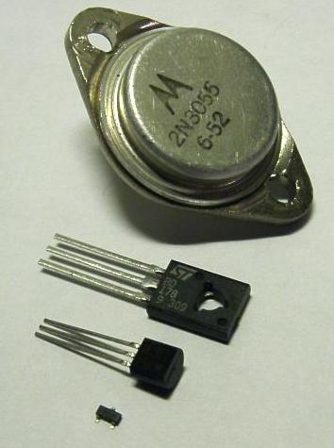
Computer Technology:
Transistors
http://en.wikipedia.org/wiki/Transistor

Slide 36
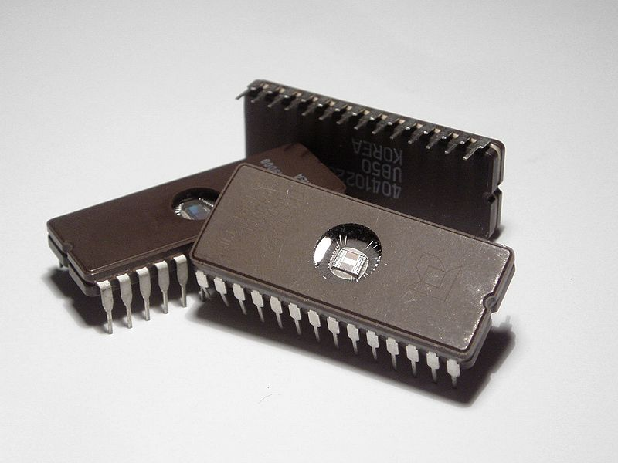
Computer Technology:
Integrated Circuits
http://en.wikipedia.org/wiki/Integrated_circuit

Slide 37
Programming the ENIAC
© CORBIS

Slide 38
First Commercial Computers
Remington-Rand
  Completed UNIVAC in 1951
  Delivered to U.S. Bureau of the Census
  Predicted winner of 1952 Pres. election
IBM
  Larger base of customers
  Far superior sales and marketing organization
  Greater investment in research and development
  Dominated mainframe market by mid-1960s

Slide 39
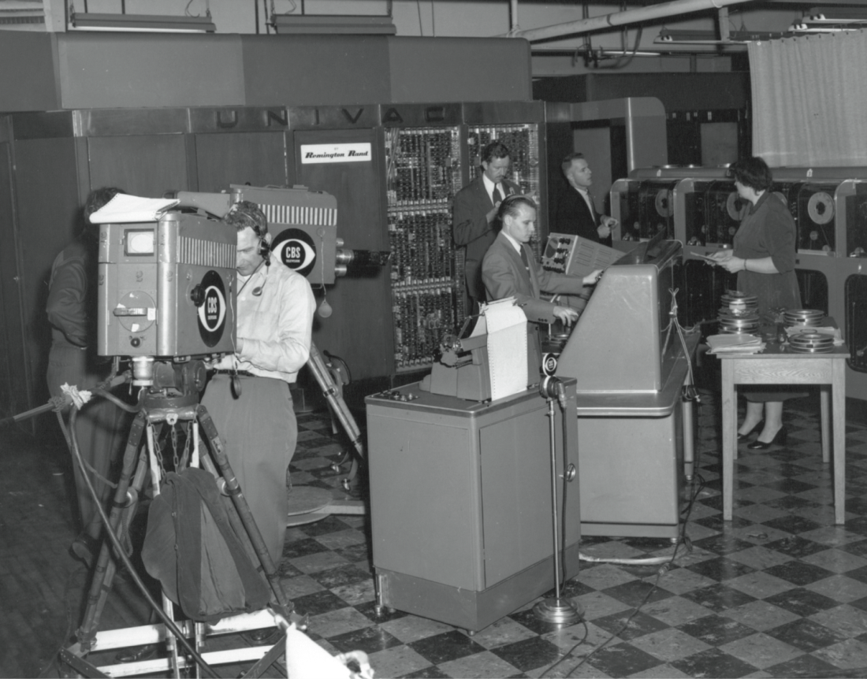
CBS News Coverage of 1952 Presidential Election Featured UNIVAC Computer
Hagley Museum and Library. Accession number 1984.240

Slide 40
The Infamous 1952 President Election Prediction
UNIVAC became known for predicting the outcome of the U.S. presidential election in 1952.
The computer predicted an Eisenhower landslide when traditional pollsters all called it for Adlai Stevenson.
The numbers were so skewed that CBS's news boss in New York, Mickelson, decided the computer was in error and refused to allow the prediction to be read.
The CBS called an 8-7 win for Eisenhower (the actual computer prediction was 100-1).
When the predictions proved true and Eisenhower won a landslide within 1% of the initial prediction, Charles Collingwood, the on-air announcer, embarrassingly announced that they had covered up the earlier prediction.
http://en.wikipedia.org/wiki/UNIVAC

Slide 41
Reflection
As the technology advances, things that were unimaginable are now a possibility!
Society changes;
People changes;
Culture changes.

Slide 42
Computer, internet, and storage

Slide 43
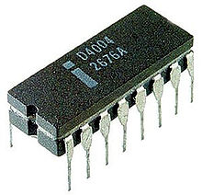
Microprocessor and Personal Computing
Computer inside a single semiconductor chip
Invented in 1970 at Intel
Made personal computers practical
Interl 4004
http://en.wikipedia.org/wiki/Microprocessor

Slide 44
Antecedents to the Personal Computer
Whole Earth Catalog
  “Sort of like Google in paperback form” (Steve Jobs)
  Stewart Brand saw “technology as a tool for individual and collective transformation” (Fred Turner)
People’s Computer Company
  Educated people on how to use computers
  People gathered around time-share computers
  Culture promoted free exchange of software
Homebrew Computer Club
  Meeting place for hobbyists interested in building personal computers
  Member Steve Wozniak created system that became Apple I

Slide 45
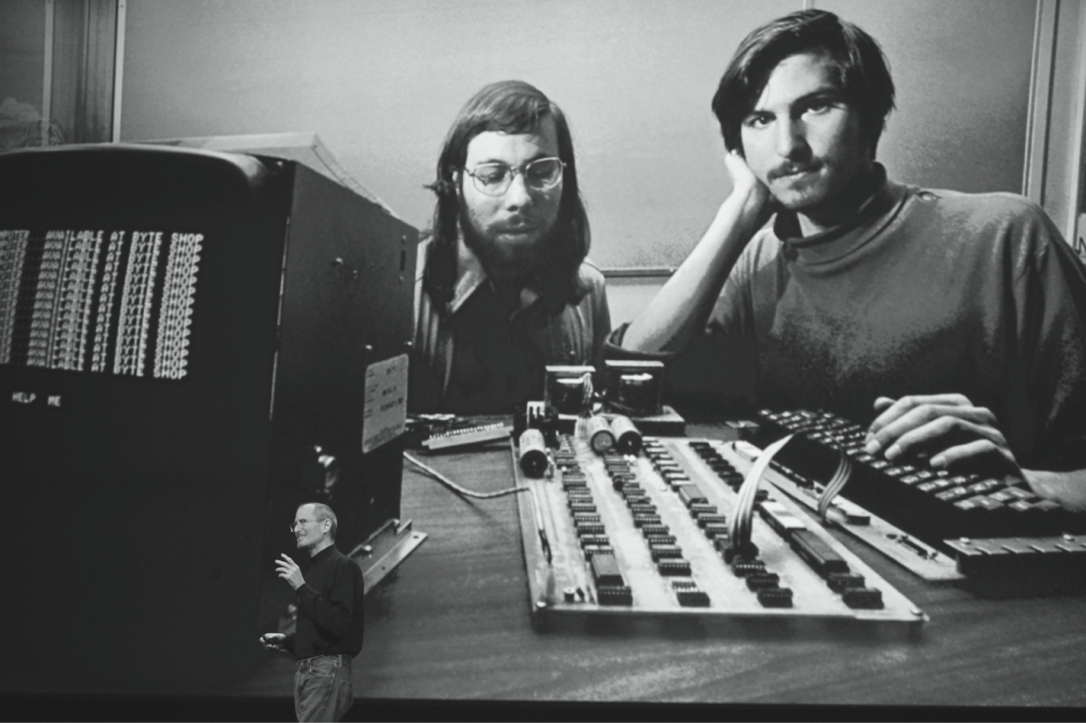
Steve Wozniak and Steve Jobs with Apple I Personal Computer
© Kimberly White/Corbis

Slide 46
Personal Computer
Altair 8800
  Gates and Allen create BASIC interpreter
  Interpreter pirated at Homebrew Computer Club meeting
Personal computers become popular
  Apple Computer: Apple II
  Tandy Corporation: TRS 80
Developments draw businesses to personal computers
  Computer spreadsheet program: VisiCalc
  IBM launches IBM PC

Slide 47
Milestones in Networking

Slide 48
Early Networking: Semaphore Telegraph Tower
Photo l’Adresse Musée de La Poste, Paris / La Poste

Slide 49
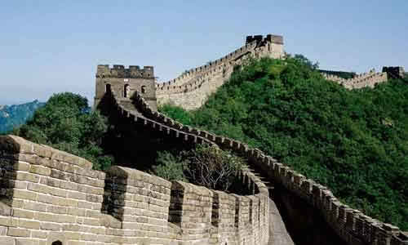
Chinese Beacon Towers
(烽火台)
http://www.wsbedu.com/jia/showw-402-w8.html

Slide 50
Telegraph
U.S. government funded first line
  40 miles from Washington, D.C. to Baltimore
  Built by Samuel Morse in 1843-1844
Private networks flourished
  12,000 miles of lines in 1850
  Transcontinental line in 1861 put Pony Express out of business
  200,000 miles of lines by 1877
Technology proved versatile
  Fire alarm boxes
  Police call boxes

Slide 51
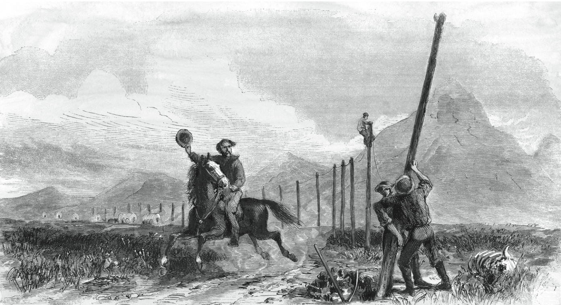
Transcontinental Telegraph:
Pony Express Riders Lose Jobs
© North Wind Picture Archives / Alamy

Slide 52
Telephone
Alexander Graham Bell
  Constructed harmonic telegraph
  Leveraged concept into first telephone
Social impact of telephone
  Blurred public life / private life boundary
  Eroded traditional social hierarchies
  Reduced privacy
  Enabled first “online” communities

Slide 53
Typewriter and Teletype
Typewriter
  Individual production of “type set” documents
  Common in offices by 1890s
Teletype
  Typewriter connected to telegraph line
  Popular uses
    Transmitting news stories
    Sending records of stock transactions

Slide 54
Radio
Pioneers
  Hertz creates electromagnetic waves
  Marconi invents radio
First used in business
  Wireless telegraph
  Transmit voices
Entertainment uses
  Suggested by Sarnoff
  Important entertainment medium by 1930s

Slide 55
Orson Welles Broadcasts
War of the Worlds
http://en.wikipedia.org/wiki/The_War_of_the_Worlds_%28radio_drama%29
© Bettmann/CORBIS

Slide 56
Television
Became popular in 1950s
  Price fell dramatically
  Number of stations increased
Social effects
  Worldwide audiences
  Networks strive to be first to deliver news
  Impact of incorrect information; e.g., 2000 presidential election (Bush v. Gore)

Slide 57
Hundreds of Millions Watch
Moon Landing in 1969
Courtesy of NASA

Slide 58
Remote Computing
Stibitz and Williams build Complex Number Calculator at Bell Labs
Bell Labs part of AT&T (phone company)
Teletype chosen for input/output
Allows operator to be distant from machine
Long-distance demonstration between New Hampshire and New York City

Slide 59
ARPANET
DoD creates ARPA in late 1950s
Licklider conceives of “Galactic Network”
Decentralized design to improve survivability
Packet-switching replaces circuit switching
First working ARPANET was established in 1969 among four nodes across different states.

Slide 60
Email
Creation
  Tomlinson at BBN writes software to send, receive email messages
  Roberts creates email utility
Current status
  One of world’s most important communication technologies
  Billions of messages sent in U.S. every day

Slide 61
Internet
Kahn conceives of open architecture networking
Cerf and Kahn design TCP/IP protocol
Internet: network of networks communicating using TCP/IP

Slide 62
Broadband
Broadband
  High-speed Internet connection
  At least 10x faster than dial-up connection
  Enhanced by fiber optic networks
Typical broadband speeds (2011 figures)
  Japan (#1 in world): 63 megabits/second
  South Korea (#2): 40 megabits/second
  United States (#15): 2 megabits/second
http://www.akamai.com/html/about/press/releases/2011/press_072611.html

Slide 63
Milestones in Information Storage and Retrieval

Slide 64
Codex
Codex
  Rectangular pages sewn together on one side
  Replaced papyrus scrolls as way of storing books
Advantages of codex over scroll
  More durable
  Allows quicker access to particular passages
Manufacturing technologies
  Copying by hand
  Wood engraving

Slide 65
Gutenberg’s Printing Press
Based on movable metal type
Church principal customer of early publishers
Powerful mass communication tool
Printing press’s impact on Reformation
  More than 300,000 copies of Luther’s publications
  Protestants out-published Catholics by
  10-to-1 in the middle 16th century

Slide 66
Newspapers
Newspapers: Stimulated free expression
Governments responded
  Licensing
  Censorship
Impact on American Revolution
  Newspapers helped unify colonies
  Swayed public opinion toward independence

Slide 67
Hypertext
Vannevar Bush envisions Memex (1945)
Ted Nelson (1963)
  Coined word hypertext
  Proposed creation of Xanadu
Douglas Engelbart (1962)
  Directed construction of NLS (oNLine System)
  Demonstrated windows, email, mouse, videoconferencing

Slide 68
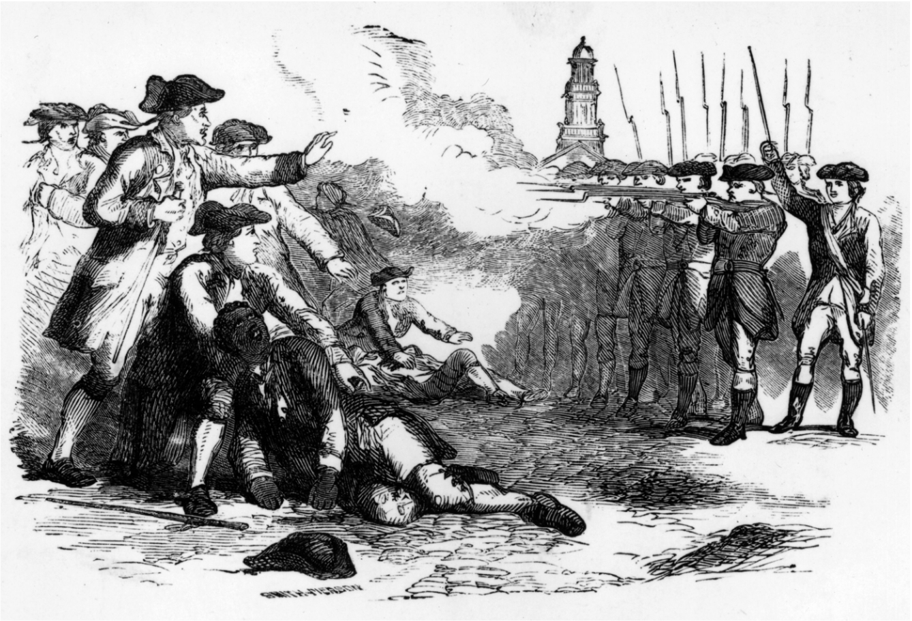
Douglas Engelbart:
“The Mother of All Demos”
Courtesy of SRI

Slide 69
Graphical User Interface
Xerox PARC (Palo Alto Research Center)
  Alan Kay sees Doug Engelbart demo in 1968
  Alto personal computer (early 1970s)
  Bit-mapped display, keyboard, and mouse
Apple Computer
  Steve Jobs visits Xerox PARC in 1979
  Macintosh (1984)
  Bit-mapped display, keyboard, and mouse
Microsoft Windows (1990)
  Released in May 1990
  Quickly became dominant graphical user interface

Slide 70
Single-Computer Hypertext Systems
Peter Brown at University of Kent
  Guide (1982)
  Released versions for Macintosh and IBM PC
Apple Computer
  HyperCard (1987)
  Hypertext system based on “stacks” of “cards”
  Links represented by buttons
  Basis for best-selling games Myst and Riven

Slide 71
World Wide Web
First browser built at CERN in Switzerland
  Tim Berners-Lee: World Wide Web (1990)
  Berners-Lee created Web protocols
  Protocols based on TCP/IP → general
Later browsers
  Mosaic
  Netscape Navigator
  Netscape Mozilla
  Microsoft Internet Explorer (most popular)
  Google’s Chrome
  Apple’s Safari

Slide 72
Traffic Information on the Web
Copyright © 2011 by WSDOT. Reprinted with permission.

Slide 73
Search Engines
Crawler-based engines (Google, AltaVista)
  Programs called spiders follow hyperlinks and visit millions of Web pages
  System automatically constructs Web page database
Human-assisted engines (Open Directory)
  Humans build Web page database
  Web page summaries more accurate
  Far fewer Web pages in database
Hybrid systems (MSN Search)

Slide 74
Summary and Your Work
We gave an introduction to the topics in the course and how the course will run;
We discussed some of the historical computing events and their impact on the society;
Your work
  Read the chapter 1 and chapter 2 of the text, as well as Vesilind’s ethics decision process
  Ask questions!

