Slide 1
Ethics and Morality
Computers and Society
Notice: This set of slides is based on the notes by Professor Guattery of Bucknell and by the textbook author Michael Quinn

Slide 2
An important part of this class is a discussion of ethics.
Per Quinn (Ethics for the Information Age, p. 53), “Ethics is the philosophical study of morality, a rational examination into people’s moral beliefs and behaviors.”

Slide 3
Society
A society is an association of people organized under a system of rules designed to advance the good of its members over time.
A society may be a nation, but it may also be a social organization, a professional organization, a sports organization, a musical group, etc.

Slide 4
Morality
People in society also interact and compete with each other. For example, how should the society divide limited resources? To deal with this competition, societies set rules of conduct. These rules specify the morality of the society.
People usually belong to multiple societies, which can lead to conflicts between the moralities of those societies. People within a single society may have different moral beliefs. In such cases, how should we determine what is the right thing to do?

Slide 5
Different Moral Views Exist
A view from a typical western culture
Self-centered, if everyone takes care of herself, the society would be taken care of as a whole;
Of course, taking care of oneself need to collaborate with others. E.g., to drive safely on a highway, everyone has to follow the traffic rules.

Slide 6
Confucius View
先天下之忧而忧，后天下之乐而乐
宋·范仲淹《岳阳楼记》
This would be different from self-centered view of the world
Each has its own strengths and weaknesses

Slide 7
Ethics and Morality
Ethics is the philosophical study of morality. It involves a rational examination of moral beliefs and behaviors. It often is applied to analysis of moral dilemmas.
A dilemma is a situation in which one is confronted with a choice, neither of which is desirable. A moral dilemma is a dilemma in which the choices are based on moral principles: the choices represent conflicting ideas of what is right.

Slide 8
Asiana Airline Crash Victim
Another example of real life moral dilemma (July 6, 2013)
http://www.cbsnews.com/news/new-video-shows-firefighters-knew-asiana-victim-was-on-the-ground/
We’ll leave it to the legal system to come to a conclusion
But the fire-fighters were facing at least a very serious moral dilemma …

Slide 9
Do these stories (or moral dilemma)
have anything to do with us
(CS/IT professionals)??

Slide 10
Let’s try this on an example from Quinn (Scenario 4, p. 56):
You are the senior software engineer at a start-up developing an exciting new app for smartphones.
Your company’s sales people have told important customers that your product will be available next week. Unfortunately your program still has errors (bugs). The testing group says that all bugs appear minor, but it will take another month of testing to insure that there are no catastrophic bugs.
It is important that you be “first to market” with your product. It appears a major competitor will release a similar product in a few weeks. If their product appears first, your start-up company will probably go out of business.
Should you recommend release of your product next week?

Slide 11
You May Actually Have to Make that Decision!
Does the previous example sound familiar? Are there any recent example(s) that resemble the situation?
The October 1st, 2013 roll-out of the “Affordable Care Act” website!
http://www.reuters.com/article/2013/11/22/us-usa-healthcare-website-idUSBRE9AL03K20131122

Slide 12
Overview of Ethical Theories
There is a wide range of ethical theories people use for discussing moral dilemmas. Quinn argues that we should focus on the theories “that make it possible for a person to present a persuasive, logical argument to a diverse audience of skeptical, yet open-minded people.”
Quinn calls these theories “the workable theories” (p. 58)

Slide 13
Eight Ethical Theories
Quinn then presents eight ethical theories. He rejects the first four (in sections 2.2-2.5) as not meeting his standard.
Quinn accepts four that are workable, which will be discussed in detail.

Slide 14
The Four That Are Rejected
Subjective Relativism
Each person decides right and wrong for himself or herself.
Cultural Relativism
“Right” or “Wrong” rests with a society’s actual moral guidelines, which can vary from place to place and from time to time
Divine Command Theory
Good actions are those aligned with the will of God and bad actions are those contrary to the will of God.
Ethical Egoism
Each person focuses exclusively on his or her self-interest.

Slide 15
The Four To Be Considered
We will consider the four ethical systems that meet Quinn’s standard. We will apply them to ethical problems throughout the course:
Kantianism (Section 2.6)
Act Utilitarianism (Section 2.7)
Rule Utilitarianism (Section 2.8)
Social Contract Theory (Section 2.9)

Slide 16
Kantianism
Kantianism is based on the writings of philosopher Immanuel Kant (康德). Kant believed that people should be guided by universal moral laws. For these laws to apply to all rational beings, they must be based on reason. Kant said the only thing that is good without qualification is a good will.

Slide 17
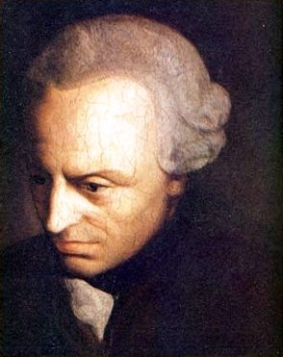
Immanuel Kant 1724-1804
People’s actions should be guided by absolute moral laws, which are universal. Moral laws are derived through a rational process.
For example, The Golden Rule and The Universal Declaration of Human Rights can be considered as examples of Kantianism
Picture source: Wikipedia
The United Nations. (1948). The Universal Declaration of Human Rights. Accessed January 16th, 2014 from: http://www.un.org/en/documents/udhr/index.shtml

Slide 18
The Golden Rule
Do unto others as you would have them do unto you.
or
Treat others as you would like to be treated.
or
己所不欲，勿施于人。
Many different versions exist.

Slide 19
Kantian Ethics (Duty-Based Ethics)
Kant believed that there are higher principles that are good in every time, every culture, and every situation. When faced with an ethical dilemma, he believes we should ask ourselves: “To whom do I owe a duty and what duty do I owe them?”
Duty-based ethics
http://www.bbc.co.uk/ethics/introduction/duty_1.shtml
Accessed January 16th, 2014

Slide 20
The Categorical Imperative
How does someone know what he or she ought to do? Kant stated this in his Categorical Imperative. The first formulation of the categorical imperative says “Act only from moral rules you can at the same time will to be universal moral laws.”
Note that “you can” and “you will!”
-- “You can”, actions allowed by moral rules
-- “You will”, take the action no matter what
This is called Categorical Imperative (First Formation)

Slide 21
Universal Moral Rule Illustrated
How do you universalize a moral rule? Kant illustrates this with the following example
Consider a moral rule: “A person makes a false promise when that is the only way to escape a difficult situation.”
To universalize it, consider what would happen if everyone followed this rule. Then no one would believe promises, and no one in a difficult situation could make a promise that anyone would believe. The rule falls apart.

Slide 22
Categorical Imperative, 2nd Form
Kant restated his categorical imperative in a second way (the second formulation): “Act so that you always treat both yourself and other people as ends in themselves, and never only as a means to an end.”
That is, it is wrong for one person to use another person to get what he or she wants. An example is when you make friends with someone because they can help you get something (an end), then drop him or her when you have what you want. You have used them as a means to that end.

Slide 23
Kantianism Pros and Cons
Minuses:
Sometimes no single rule fully characterizes an action.
Steal food for starving children?
Sometimes there is no way to resolve a conflict between rules.
“Don’t steal.” vs. “Don’t starve your children.”
Kantianism allows no exceptions to perfect duties.

Slide 24
Kantianism Pros and Cons
Pluses:
Kantianism is rational.
Kantianism produces universal moral guidelines.
In summary, Kantianism is a workable ethical theory.

Slide 25
Can you give some examples of Kantianism?

Slide 26
Act Utilitarianism
Principle of Utility
(Greatest Happiness Principle)
An action is right (or wrong) to the extent that it increases (or decreases) the total happiness of the affected parties.

Slide 27
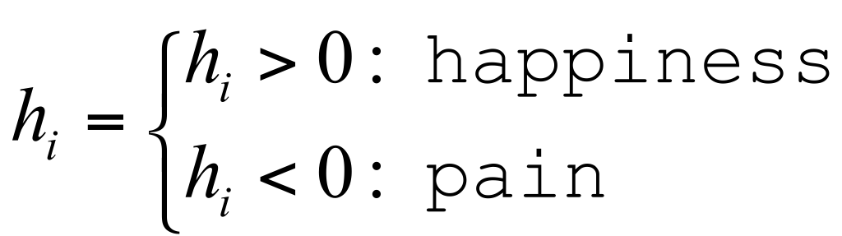


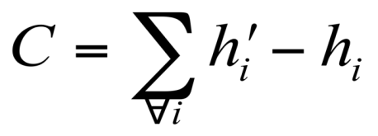
Assessing Utility
For some being i affected by an action:
Quantify before the action and after the action.
Estimate the consequences as:
If C > 0, the action is good. If C < 0, the action is bad.

Slide 28
Bentham: Weighing Pleasure/Pain
Intensity (强度）
Duration （长度）
Certainty （确定性）
Propinquity （临近性）
Fecundity （成果富有）
Purity （纯粹性）
Extent （广度， 影响度）

Slide 29
Principle of Utility

Slide 30
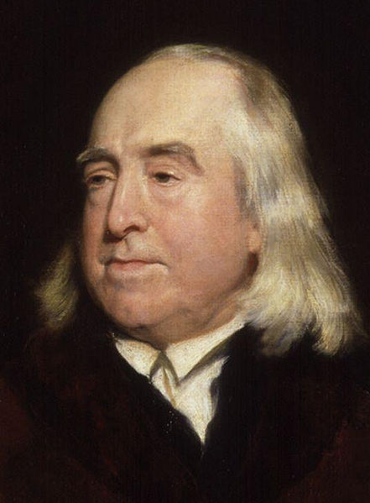
Jeremy Bentham 1748 - 1832
English philosopher
The Principle of Utility
(Greatest Happiness Principle)
An action is right (or wrong) to the extent that it increases (or decreases) the total happiness of the affected parties.
http://en.wikipedia.org/wiki/Jeremy_Bentham

Slide 31
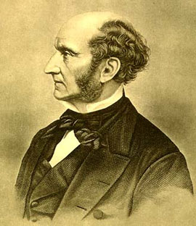
John Stuart Mill 1806-1873
English philosopher
Authored the book Utilitarianism
Influenced by Jeremy Bentham and James Mill
An influential contributors to social theory, political theory and political economy.
Picture source: Wikipedia

Slide 32
Act Utilitarianism Pros
Plusses:
It focuses on happiness.
It is down-to-earth.
It is comprehensive.

Slide 33
Act Utilitarianism Cons
Minuses:
Where do we draw the line in calculating happiness? Who do we include/how far in the future do we look?
It is impractical to work so hard in making every moral decision.
It ignores our sense of duty.
We cannot predict with certainty the consequences of an action.
It is susceptible to moral luck: actions may have unforeseen consequences.
We need a way to measure happiness. The usual choice is in terms of money, which doesn’t always make sense.

Slide 34
Act Utilitarianism Workable
While it is not perfect, act utilitarianism is an objective, rational ethical theory that allows a person to explain why a particular action is right or wrong.

Slide 35
Can you give some examples of act utilitarianism?

Slide 36
Rule Utilitarianism
Rule Utilitarianism is another ethical system based on the Principle of Utility. It is meant to improve on weaknesses of Act Utilitarianism.
Rule Utilitarianism holds that we should adopt moral rules that, if followed by everyone (that is, followed universally), will lead to the greatest increase in total happiness (that is, across all of society).

Slide 37
Rule Utilitarianism (2)
Rule Utilitarianism applies the Principle of Utility to moral rules; Act Utilitarianism applies it to individual moral actions.
Rule Utilitarianism looks at the consequences of actions; it is different from Kantianism, which looks at the will motivating the action.

Slide 38
Rule Utilitarianism (3)
Rule Utilitarianism has the problem that all happiness must be computed and measured on a single scale, even if the consequences may be of very different kinds.
It shares the problem of how to measure happiness with Act Utilitarianism. Again, money is used, but doesn’t always make sense in the context of the problem.

Slide 39
Rule Utilitarianism Pros
Plusses:
Not every decision requires utilitarian calculus.
Exceptional situations do not overthrow moral rules.
It solves the problem of moral luck.
It avoids the problem of egocentrism.
It appeals to a wide cross section of society.

Slide 40
General Utilitarianism Cons
Minuses:
Utilitarianism forces us to use a single scale to evaluate completely different kinds of consequences.
Utilitarianism ignores the problem of an unjust distribution of good consequences (i.e., some people may always win, while others may always lose).

Slide 41
Can you give some examples of Rule Utilitarianism?

Slide 42
Social Contract Theory
Social Contract Theory is based on the work of philosopher Thomas Hobbes. It states that social cooperation requires people to agree to rules of behavior. These rules form the moral basis of society. Everyone in the society implicitly agrees to these rules.
Hobbes also thought that everyone living in a society implicitly agrees to having a government that is able to enforce these rules.

Slide 43
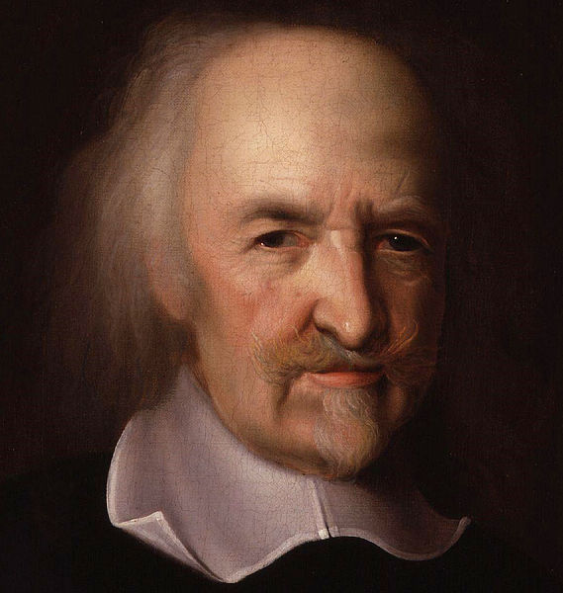
Thomas Hobbes 1588 - 1679
English philosopher
Best known today for his work on political philosophy, among others, social contract theory.
http://en.wikipedia.org/wiki/Thomas_Hobbes

Slide 44
Rousseau’s Social Contract Theory
Jean-Jacques Rousseau (罗素) extended the idea of the social contract to this form (as stated by James Rachels):
“Morality consists in the sets of rules, governing how people treat one another, that rational people will agree to accept, for their mutual benefit, on the condition that others will follow those rules as well.”

Slide 45
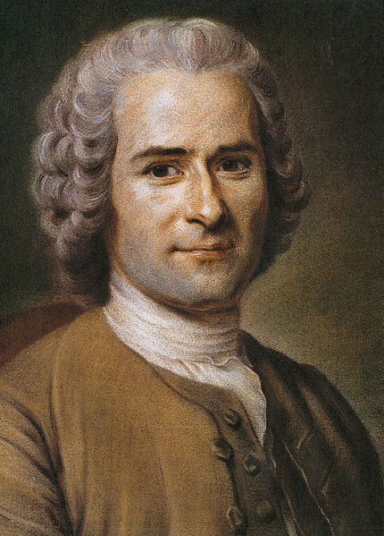
Jean-Jacques Rousseau 1712 - 1778
A Genevan philosopher, writer, and composer
His political philosophy influenced the French Revolution as well as the overall development of modern political, sociological, and educational thought.
He argued that private property was the start of civilization, inequality, murders and wars.
http://en.wikipedia.org/wiki/Jean-Jacques_Rousseau

Slide 46
Social Contract Theory Explained
Social Contract Theory also deals with rights. Rights imply duties that the rules of the society must respect. Rights may be positive or negative. A positive right obligates others to do something on your behalf. For example, a right to free health care obligates others (society) to provide you with health care. A negative right obligates others to leave you alone to exercise that right. For example, a right to free expression is a negative right.

Slide 47
Another View on Rights
Another way to look at two types of rights (negative and positive) is to consider whether they are absolute or limited
An absolute right is a right guaranteed without exception.
Usually negative rights are considered as absolute rights. The right to life is an example of an absolute right.
A limited right is a right that may be restricted based on the circumstances.
Usually positive rights are considered as limited rights. For example, rights to education in the U.S. While k-12 education is guaranteed, higher education is not because of budget.

Slide 48
John Rawls’s Principles of Justice
John Rawls proposed two principles of justice based on contract:
First Principle: Each person has the same indefeasible claim to a fully adequate scheme of equal basic liberties, which scheme is compatible with the same scheme of liberties for all;
Second Principle: Social and economic inequalities are to satisfy two conditions (The Difference Principle):
They are to be attached to offices and positions open to all under conditions of fair equality of opportunity;
They are to be to the greatest benefit of the least-advantaged members of society.

Slide 49
Rawls’s First Principle of Justice

Slide 50
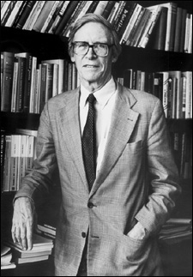
John Rawls (1921-2002)
Most reasonable principles of justice are those everyone would accept and agree to from a fair position.
Photo source: Wikipedia

Slide 51
How to handle moral dilemma?

Slide 52
Vesilind’s Ethical Process
Vesilind specifies a process with eight steps for dealing with ethical dilemmas. The process asks you to answer these questions:
What are the relevant facts?
What are the moral issues?
Who is affected by the decision you have to make?
What are your options?
Professor Vesilind is a retired professor of civil engineering at Bucknell

Slide 53
Vesilind’s Ethical Process continued
What are the expected outcomes of each possible action?
What are the personal costs associated with each possible action?
Given the issues, alternatives, and costs, where can you get some help thinking through the problem?
Considering the moral issues, practical constraints, possible costs, and expected outcomes, what is the right thing to do?

