Slide 1
Web Information Retrieval
Textbook by
Christopher D. Manning, Prabhakar Raghavan, and Hinrich Schutze
Notes Revised by X. Meng for SEU
May 2014

Slide 2
Outlines
We will discuss two more topics.
  Boolean retrieval
  Posting list

Slide 3
Posting Lists

Slide 4
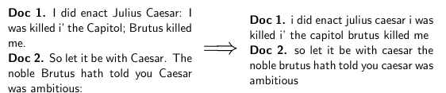
Tokenizing And Preprocessing
4

Slide 5
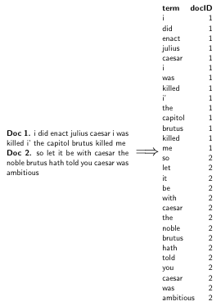
Generate Posting
5

Slide 6
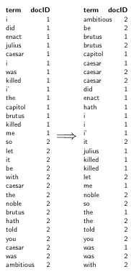
Sort Postings
6

Slide 7
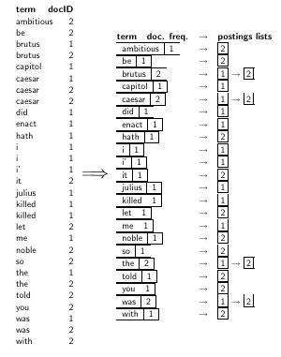
Creating Postings Lists, Determine Document Frequency
7

Slide 8
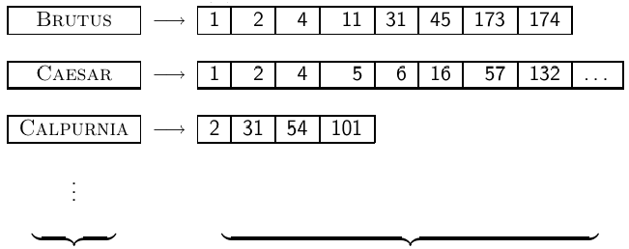
Split the Result into Dictionary and Postings File
dictionary postings
8

Slide 9
Inverted Index
D_{j}, tf_{j}
Index terms
df
computer
3
D₇, 4
database
2
D₁, 3
• • •
science
4
D₂, 4
system
1
D₅, 2
Term List
(a.k.a. Dictionary)
Postings lists

Slide 10
Creating an Inverted Index
Create an empty index term list I;
For each document, D, in the document set V
For each (non-zero) token, T, in D:
If T is not already in I
Insert T into I;
Find the location for T in I;
If (T, D) is in the posting list for T
increase its term frequency for T;
Else
Create (T, D);
Add it to the posting list for T;

Slide 11
In-Class Work
Creating an inverted index for the following documents
  “The quick brown fox jumps over the lazy dog”
  “The quick fox run”
  “The lazy dog sleep”
Assume:
  “the” and “over” are stopwords that are not indexed
  various forms of verbs are not indexed separately, only the original form (stem) is indexed

Slide 12
Boolean Retrieval
Processing Boolean queries
Query optimization

Slide 13
Simple Conjunctive Query (two terms)
Consider the query: BRUTUS AND CALPURNIA
To find all matching documents using inverted index:
  Locate BRUTUS in the dictionary (term list)
  Retrieve its postings list from the postings file
  Locate CALPURNIA in the dictionary
  Retrieve its postings list from the postings file
  Intersect the two postings lists
  Return intersection to user
13

Slide 14
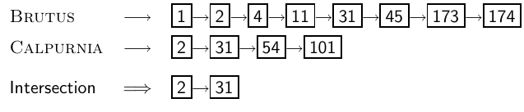
Intersecting Two Posting Lists
The complexity is linear in the length of the postings lists.
Note: This only works if postings lists are sorted.
14

Slide 15
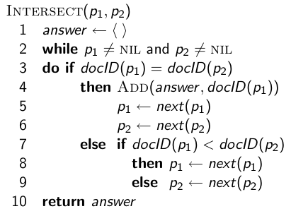
Algorithm of Intersecting Two Posting Lists
Assume posting lists are sorted by docID
15

Slide 16

Query Processing: In-Class Work
  Compute hit list for ((paris AND NOT france) OR lear)
16

Slide 17
Boolean Queries
The Boolean retrieval model can answer any query that is a Boolean expression.
  Boolean queries are queries that use AND, OR and NOT to join query terms.
  Views each document as a set of terms.
  Precise: either document matches condition or not, nothing in between.
Primary commercial retrieval tool for three decades
Many professional searchers (e.g., lawyers) still like Boolean queries.
  You know exactly what you are getting.
Many search systems you use are also Boolean: spotlight, email, intranet etc.
17

Slide 18
Outline
Processing Boolean queries
Query optimization

Slide 19
Query Optimization
Consider a query that is an and of n terms, n > 2
For each of the terms, get its postings list, then and them together
Example query: BRUTUS AND CALPURNIA AND CAESAR
What is the best order for processing this query? That is, should we process BRUTUS first? CALPURNIA first? Or CEASAR first?
19

Slide 20
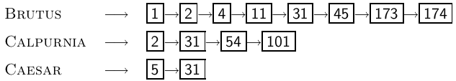
Query Optimization
Example query: BRUTUS AND CALPURNIA AND CAESAR
Simple and effective optimization: Process in order of increasing frequency
Start with the shortest postings list, then keep cutting further
In this example, first CAESAR, then CALPURNIA, then BRUTUS
20

Slide 21
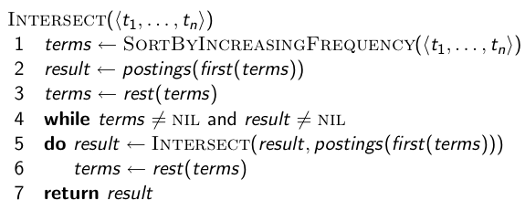
Optimized Intersection Algorithm for
Conjunctive Queries
21

Slide 22
More General Optimization
Example query: (MADDING OR CROWD) and (IGNOBLE OR STRIFE)
Get frequencies for all terms
Estimate the size of each or by the sum of its frequencies (conservative)
Process in increasing order of or sizes
22

