Slide 1
Web Information Retrieval
Textbook by
Christopher D. Manning, Prabhakar Raghavan, and Hinrich Schutze
Notes Revised by X. Meng for SEU
May 2014

Slide 2
Recap
Index construction in memory
Boolean query and retrieval

Slide 3
Creating an Inverted Index
Create an empty index term list I;
For each document, D, in the document set V
For each (non-zero) token, T, in D:
If T is not already in I
Insert T into I;
Find the location for T in I;
If (T, D) is in the posting list for T
increase its term frequency for T;
Else
Create (T, D);
Add it to the posting list for T;

Slide 4
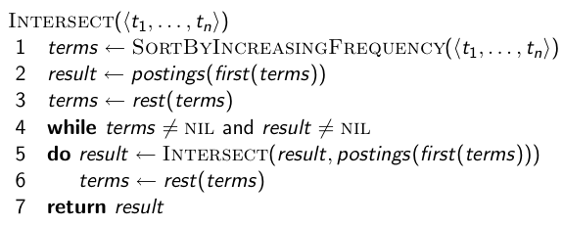
Optimized Intersection Algorithm for
Conjunctive Queries
4

Slide 5
Outlines
We will discuss two topics.
  Index construction
  Index compression

Slide 6
Index Construction Review
We’ve discussed the basic algorithm for index construction:
Create an empty index term list I;
For each document, D, in the document set V
For each (non-zero) token, T, in D:
If T is not already in I
Insert T into I;
Find the location for T in I;
If (T, D) is in the posting list for T
increase its term frequency for T;
Else
Create (T, D);
Add it to the posting list for T;

Slide 7
Discuss the Simple Indexing Algorithm
Everything in SIA is in memory while in reality the data indexed by a commercial search engine is much bigger that will not fit in memory
  Solution: read and write information from and to secondary storage (e.g., disks)
Even with secondary storage, we still need to consider the issue of index compression

Slide 8
Hardware Basics
Many design decisions in information retrieval are based on hardware constraints.
We begin by reviewing hardware basics that we’ll need in this course.
8

Slide 9
Hardware Basics
Access to data is much faster in memory than on disk. (roughly a factor of 1000)
Disk seeks are “idle” time: No data is transferred from disk while the disk head is being positioned.
To optimize transfer time from disk to memory: one large chunk is faster than many small chunks.
9

Slide 10
Hardware Basics
Disk I/O is block-based: Reading and writing of entire blocks (as opposed to smaller chunks). Block sizes: 8KB to 256 KB (Google file system blocks are 64 MB in size)
Servers used in IR systems typically have several GB of main memory, sometimes tens of GB, and TBs or 100s of TB of disk space.
Fault tolerance is expensive: It’s cheaper to use many regular machines than one fault tolerant machine.
10

Slide 11
Some Stats (ca. 2008)
symbol | statistic | value
s b P | average seek time transfer time per byte processor’s clock rate Low level operation (e.g., compare & swap a word) size of main memory size of disk space | 5 ms = 5 × 10⁻³ s 0.02 μs = 2 × 10⁻⁸ s 10⁹ s⁻¹ 0.01 μs = 10⁻⁸ s several GB 1 TB or more
11

Slide 12
Some Definitions Used in the Textbook
Token: a useful unit for processing, such as “word,” “2013,” or “LLC”
Type: a class of all tokens containing the same character sequence
Term: a type that is included in the IR system
For example, “to be, or not to be: that is the question.”
  10 tokens
  8 types (to, be, or, not, that, is, the, question)
  1 term, if “to, be, or, not, that, is, the” are considered stopwords

Slide 13
RCV1 Collection
RCV: Reuters (路透社) Corpus Volume, English news article collections between 1995 and 1996
Shakespeare’s collected works are not large enough for demonstrating many of the points in this course.
As an example for applying scalable index construction algorithms, we will use the Reuters RCV1 collection.
13

Slide 14

A Reuters RCV1 Document
14

Slide 15
Reuters RCV1 statistics
N L M T | documents tokens per document terms (= word types) bytes per token (incl. spaces/punct.) bytes per token (without spaces/punct.) bytes per term (= word type) non-positional postings | 800,000 200 400,000 6 4.5 7.5 100,000,000
Average frequency of a term (how many tokens)? 4.5 bytes per word token vs. 7.5 bytes per word type: why the difference?
15

Slide 16
Outline
Recap
Introduction
Blocked sort-based indexing (BSBI) algorithm
SPIMI algorithm
Distributed indexing
Dynamic indexing

Slide 17
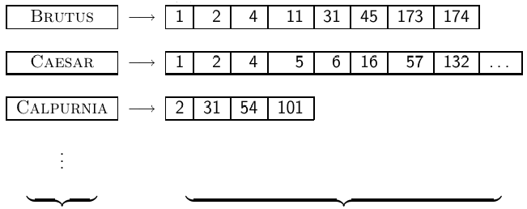
Goal: Construct the Inverted Index
dictionary postings
17

Slide 18
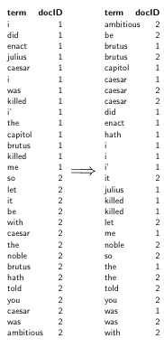
Index Construction in IIR 1:
Sort Postings in Memory
18

Slide 19
Sort-based Index Construction
As we build index, we parse docs one at a time.
The final postings for any term are incomplete until the end of the entire document collection.
Can we keep all postings in memory and then do the sort in-memory at the end?
No, not for large collections.
19

Slide 20
Why?
At 10–12 bytes per postings entry, we need a lot of space for large collections.
T = 100,000,000 in the case of RCV1: we can do this in memory on a typical machine in 2010.
But in-memory index construction does not scale for large collections.
Thus: We need to store intermediate results on disk.
20

Slide 21
Same Algorithm for Disk?
Can we use the same index construction algorithm for larger collections, but by using disk instead of memory?
No: Sorting T = 100,000,000 records on disk is too slow – too many disk seeks.
We need an external sorting algorithm.
21

Slide 22
“External” Sorting Algorithm
(Using Few Disk Seeks)
We must sort T = 100,000,000 non-positional postings.
  Each posting has size 12 bytes (4+4+4: termID, docID, document frequency).
Define a block to consist of 10,000,000 such postings
  Assume we can fit that many postings into memory.
  We will have 10 such blocks for RCV1.
22

Slide 23
“External” Sorting Algorithm
(Using Few Disk Seeks)
Basic idea of algorithm:
  For each block:
    (i) accumulate postings,
    (ii) sort in memory,
    (iii) write to disk
  Then merge the blocks into one long sorted order.
23

Slide 24
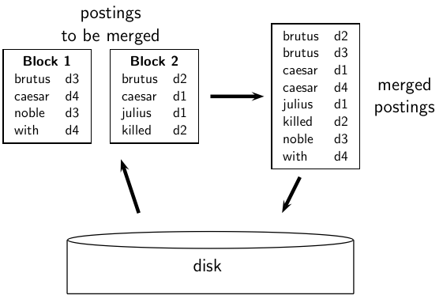
Merging Two Blocks
24

Slide 25
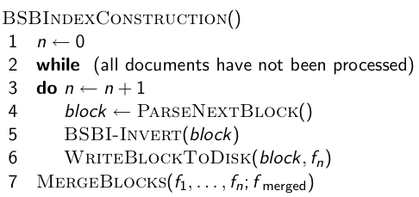
Blocked Sort-Based Indexing (BSBI)
  Key decision: What is the size of one block?
25

Slide 26
Outline
Recap
Introduction
BSBI algorithm
Single Pass In-Memory Index (SPIMI) algorithm
Distributed indexing
Dynamic indexing

Slide 27
Problem with Sort-Based Algorithm
Our assumption was: we can keep the dictionary in memory.
We need the dictionary (which grows dynamically) in order to implement a term to termID mapping.
Actually, we could work with term, docID postings instead of termID, docID postings . . .
. . . but then intermediate files become very large. (We would end up with a scalable, but very slow index construction method.)
27

Slide 28
Single-Pass In-Memory Indexing
Abbreviation: SPIMI
Key idea 1: Generate separate dictionaries for each block – no need to maintain term-termID mapping across blocks.
Key idea 2: Don’t sort. Accumulate postings in postings lists as they occur.
With these two ideas we can generate a complete inverted index for each block.
These separate indexes can then be merged into one big index.
28

Slide 29
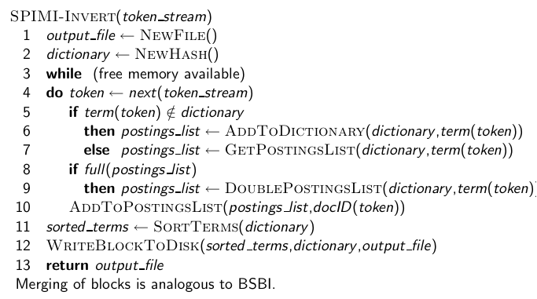
SPIMI-Invert Algorithm
29

Slide 30
SPIMI: Compression
Compression makes SPIMI even more efficient.
  Compression of terms
  Compression of postings
  See next lecture
30

Slide 31
Outline
Recap
Introduction
BSBI algorithm
SPIMI algorithm
Distributed indexing
Dynamic indexing

Slide 32
Distributed Indexing
For web-scale indexing (don’t try this at home!): must use a distributed computer cluster
Individual machines are fault-prone.
  Can unpredictably slow down or fail.
How do we exploit such a pool of machines?
32

Slide 33
Search Engine Data Centers
In order to handle such huge amount of data, search engine companies establish a number of data centers across the globe, see a separate lecture on the subject of data centers
33

Slide 34
Distributed Indexing
Maintain a master machine directing the indexing job – considered “safe”
Break up indexing into sets of parallel tasks
Master machine assigns each task to an idle machine from a pool.
34

Slide 35
Parallel Tasks
We will define two sets of parallel tasks and deploy two types of machines to solve them:
  Parsers
  Inverters
Break the input document collection into splits (corresponding to blocks in BSBI/SPIMI)
Each split is a subset of documents.
35

Slide 36
Parsers
Master assigns a split to an idle parser machine.
Parser reads a document at a time and emits (term,docID)-pairs.
Parser writes pairs into j term-partitions.
Each for a range of terms’ first letters
  E.g., a-f, g-p, q-z (here: j = 3)
36

Slide 37
Inverters
An inverter collects all (term,docID) pairs (= postings) for one term-partition (e.g., for a-f).
Sorts and writes to postings lists
37

Slide 38
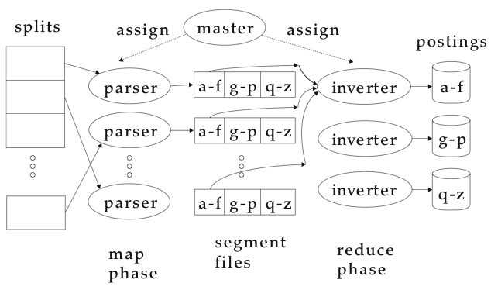
Data Flow
38

Slide 39
MapReduce
The index construction algorithm we just described is an instance of MapReduce.
MapReduce is a robust and conceptually simple framework for distributed computing . . .
. . .without having to write code for the distribution part.
Just like sorting, search algorithms, MapReduce is becoming a critical computation model for distributed computing
39

Slide 40
A Simple Map-Reduce Example
Sum up a sequence of n numbers on k processors
The Map phase:
  Divide the n numbers into k sets
  Each processor adds up n/k numbers and store the partial sum as s_{k}
The Reduce phase:
  Add up the partial sums s_{k} to get the total sum s

Slide 41
MapReduce
The Google indexing system (ca. 2002) consisted of a number of phases, each implemented in MapReduce.
Index construction was just the first phase.
The second phase: transform term-partitioned into document-partitioned index.
41

Slide 42
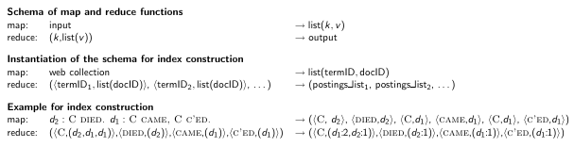
Index Construction in MapReduce
42

Slide 43
Outline
Recap
Introduction
BSBI algorithm
SPIMI algorithm
Distributed indexing
Dynamic indexing

Slide 44
Dynamic Indexing
Up to now, we have assumed that collections are static.
They rarely are: Documents are inserted, deleted and modified.
This means that the dictionary and postings lists have to be dynamically modified.
44

Slide 45
Dynamic Indexing: Simplest Approach
Maintain big main index on disk
New docs go into small auxiliary index in memory.
Search across both, merge results
Periodically, merge auxiliary index into big index
Deletions:
  Invalidation bit-vector for deleted docs
  Filter docs returned by index using this bit-vector
45

Slide 46
Issue with Auxiliary and Main Index
Frequent merges
Poor search performance during index merge
Actually:
  Merging of the auxiliary index into the main index is not that costly if we keep a separate file for each postings list.
  Merge is the same as a simple append.
  But then we would need a lot of files – inefficient.
46

Slide 47
Issue with Auxiliary and Main Index
Assumption for the rest of the lecture: The index is one big file.
In reality: Use a scheme somewhere in between (e.g., split very large postings lists into several files, collect small postings lists in one file etc.)
Time complexity:
  index construction time is O(T²) as each posting is touched in each merge.
  Suppose auxiliary index has size a
47

Slide 48
Logarithmic Merge
Logarithmic merging amortizes the cost of merging indexes over time.
  Users see smaller effect on response times.
Maintain a series of indexes, each twice as large as the previous one.
Keep smallest (Z0) in memory
Larger ones (I0, I1, . . . ) on disk
If Z0 gets too big (> n), write to disk as I0
. . . or merge with I0 (if I0 already exists) and write merger to I1 etc.
48

Slide 49
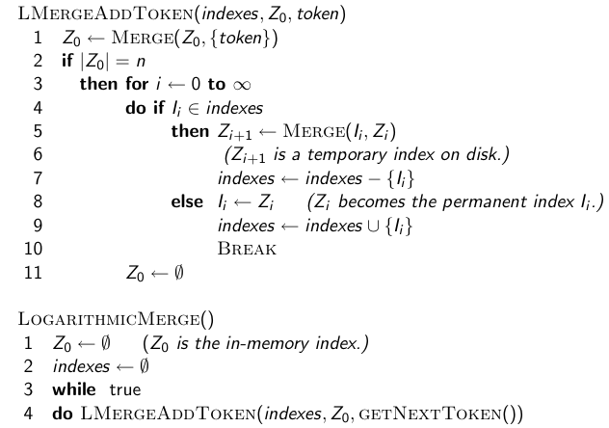
The Algorithm
49

Slide 50
Logarithmic Merge
Number of indexes bounded by O(log T) (T is total number of postings read so far)
So query processing requires the merging of O(log T) indexes
Time complexity of index construction is O(T log T).
. . . because each of T postings is merged O(log T) times.
So logarithmic merging is an order of magnitude more efficient than the simple merge seen earlier.
The price we pay is a bit slower in search operations
50

Slide 51
Dynamic Indexing at Large Search Engines
Often a combination of
  Frequent incremental changes
  Rotation of large parts of the index that can then be swapped in
  Occasional complete rebuild (becomes harder with increasing size – not clear if Google can do a complete rebuild)
51

Slide 52
Building Positional Indexes
Basically the same problem except that the intermediate data structures are much larger.
52

Slide 53
Compression
Index compression and posting lists compression

Slide 54
Compression
Inverted lists are very large
  e.g., index lists occupy 25-50% of the collection for TREC collections using Indri search engine
  Much higher if n-grams are indexed
Compression of indexes saves disk and/or memory space
  Typically have to decompress lists to use them
  Best compression techniques have good compression ratios and are easy to decompress
Lossless compression – no information lost

Slide 55
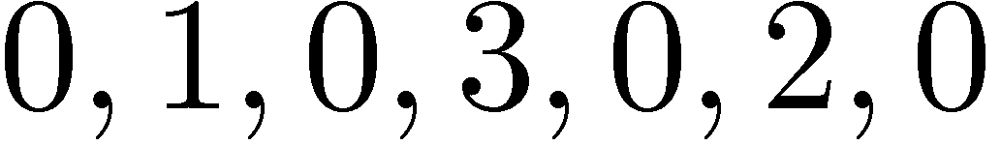
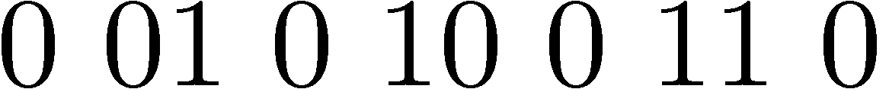
Compression
Basic idea: Common data elements use short codes while uncommon data elements use longer codes
  Example: coding numbers
    number sequence:
    possible encoding (14 bits):
    encode 0 using a single 0:
    only 10 (ten) bits, but...

Slide 56
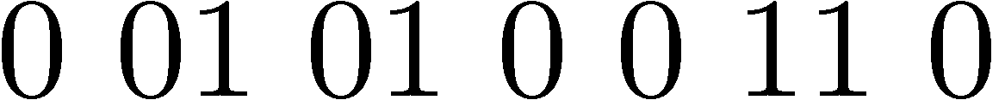
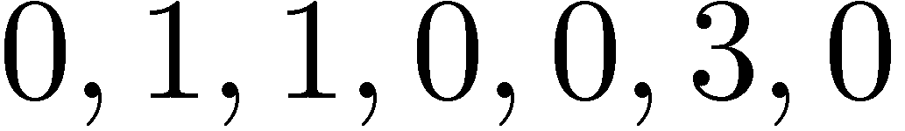
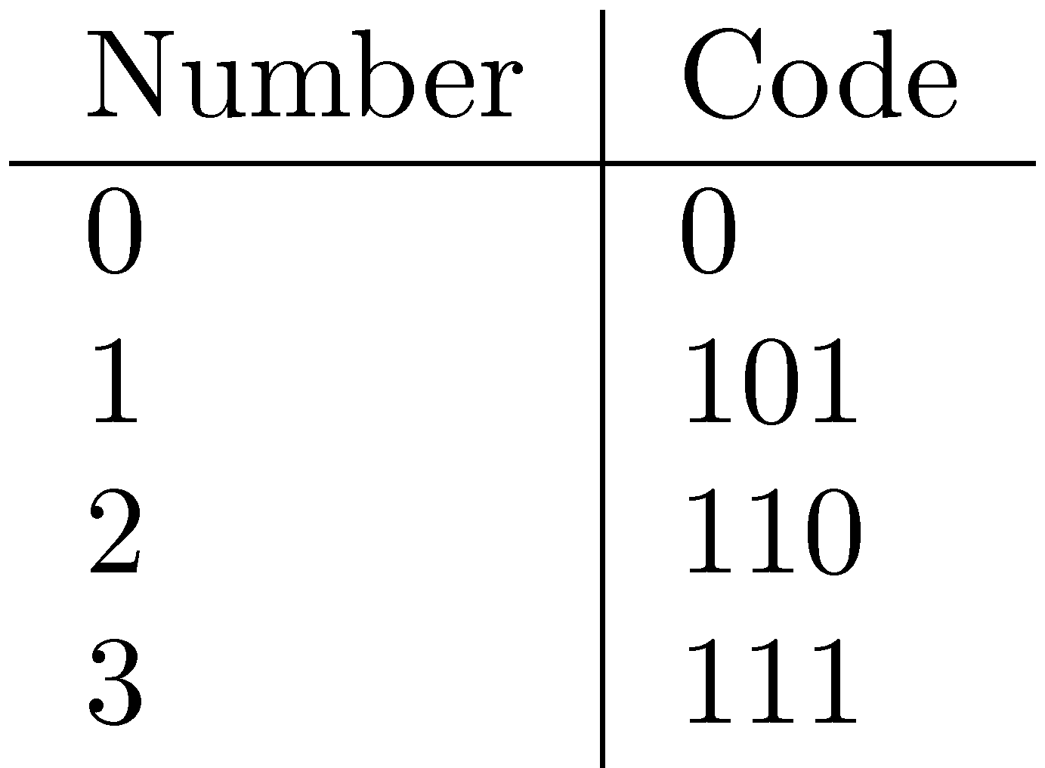
Compression Example
Ambiguous encoding – not clear how to decode
    the same coding:
    which represents:
    use unambiguous code:
      example: prefix codes
    which gives: (13 bits)

Slide 57
Recap
Introduction
BSBI algorithm
SPIMI algorithm
Distributed indexing (MapReduce)
Dynamic indexing

Slide 58
Delta Encoding
Word count data is good candidate for compression
  many small numbers and few larger numbers
  encode small numbers with small codes
Document numbers (docID) are less predictable
  but differences between numbers in an ordered list are smaller and more predictable
Delta encoding:
  encoding differences between document numbers (d-gaps)

Slide 59
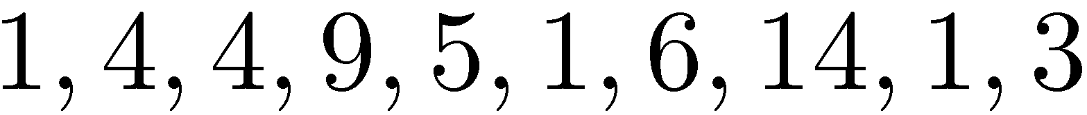
Delta Encoding
  Inverted list
  Differences between adjacent numbers
  Differences for a high-frequency word (thus appearing in consecutive documents) are easier to compress, e.g.,
  Differences for a low-frequency word are large, e.g.,

Slide 60
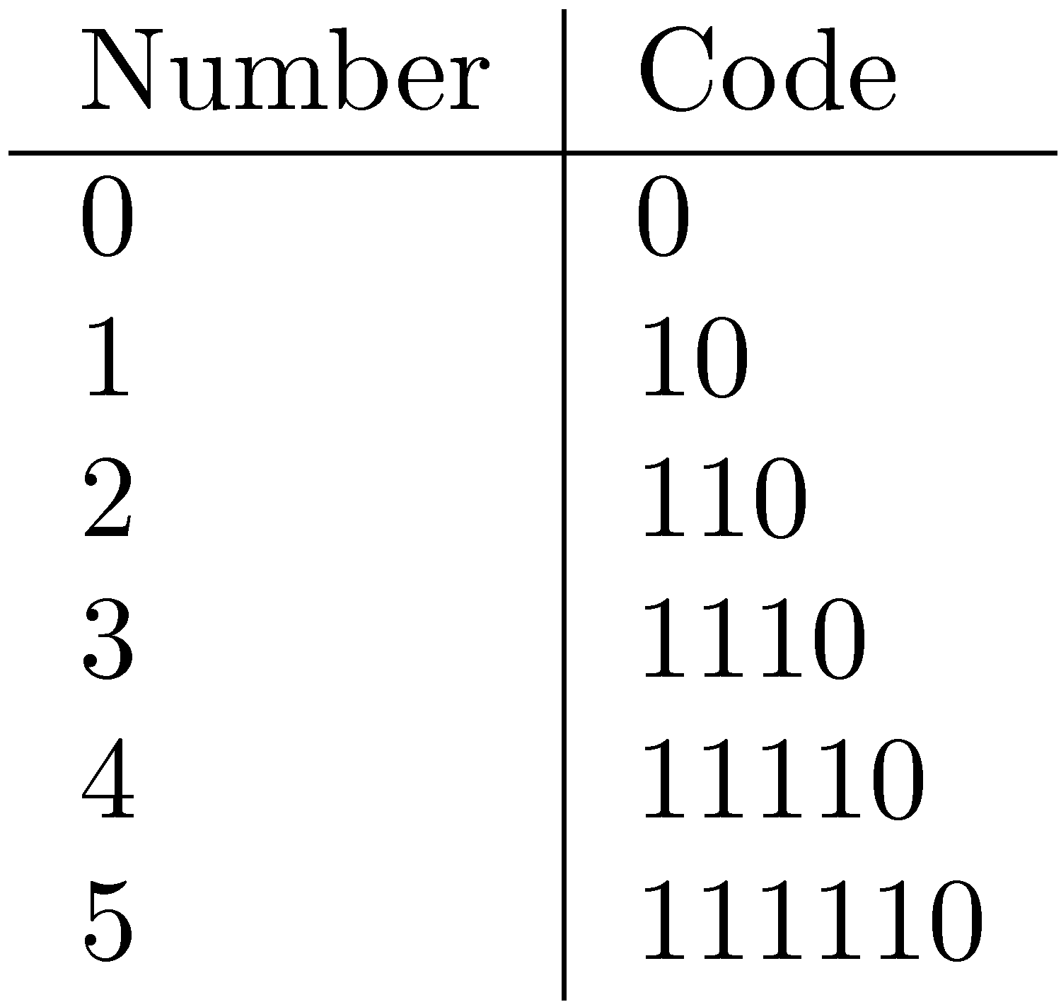
Bit-Aligned Codes
Breaks between encoded numbers can occur after any bit position
Unary code
  Encode k by k 1s followed by 0
  0 at end makes code unambiguous

Slide 61
Unary and Binary Codes
Unary is very efficient for small numbers such as 0 and 1, but quickly becomes very expensive
  1023 can be represented in 10 binary bits, but requires 1024 bits in unary
Binary is more efficient for large numbers, but it may be ambiguous

Slide 62
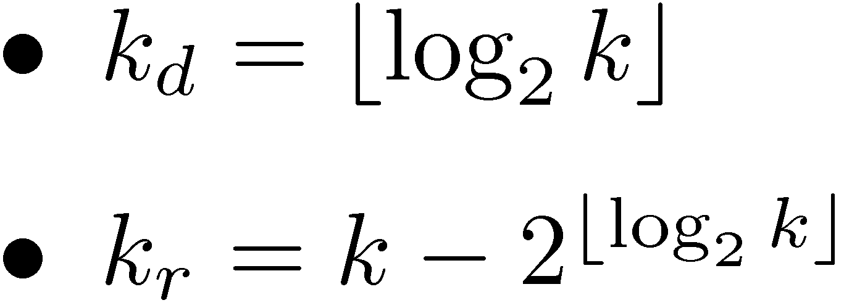
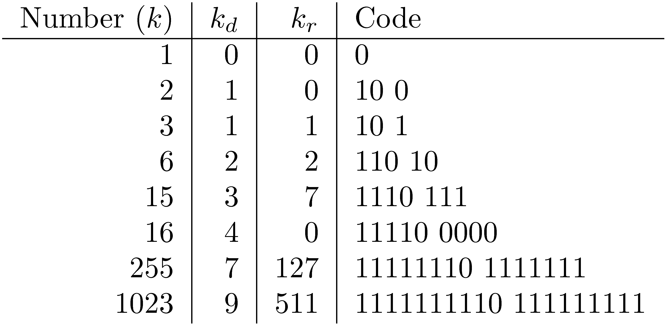
Elias-γ Code
To encode a number k, compute
    k_{d} is number of binary digits, encoded in unary

Slide 63
Elias-γ Code and Decode
For any number k, the Elias-γ code requires
When decoding, k = 2^{kd} + k_{r}
For example, Elias-γ code = 1110110, k_{d}=111, k_{r}=110, thus k = 2³+6 = 14
Compared to binary coding, the saving comes from variable length coding.
bits for k_{d} in unary code and
bits for k_{r} in binary code. A total of
bits are needed.

Slide 64
Elias-δ Code
Elias-γ code uses no more bits than unary, many fewer for k > 2
  1023 takes 19 bits instead of 1024 bits using unary
In general, takes 2⌊log₂k⌋+1 bits
To improve coding of large numbers, use Elias-δ code
  Instead of encoding k_{d} in unary, we encode k_{d} + 1 using Elias-γ
  Takes approximately 2 log₂ log₂ k + log₂ k bits

Slide 65
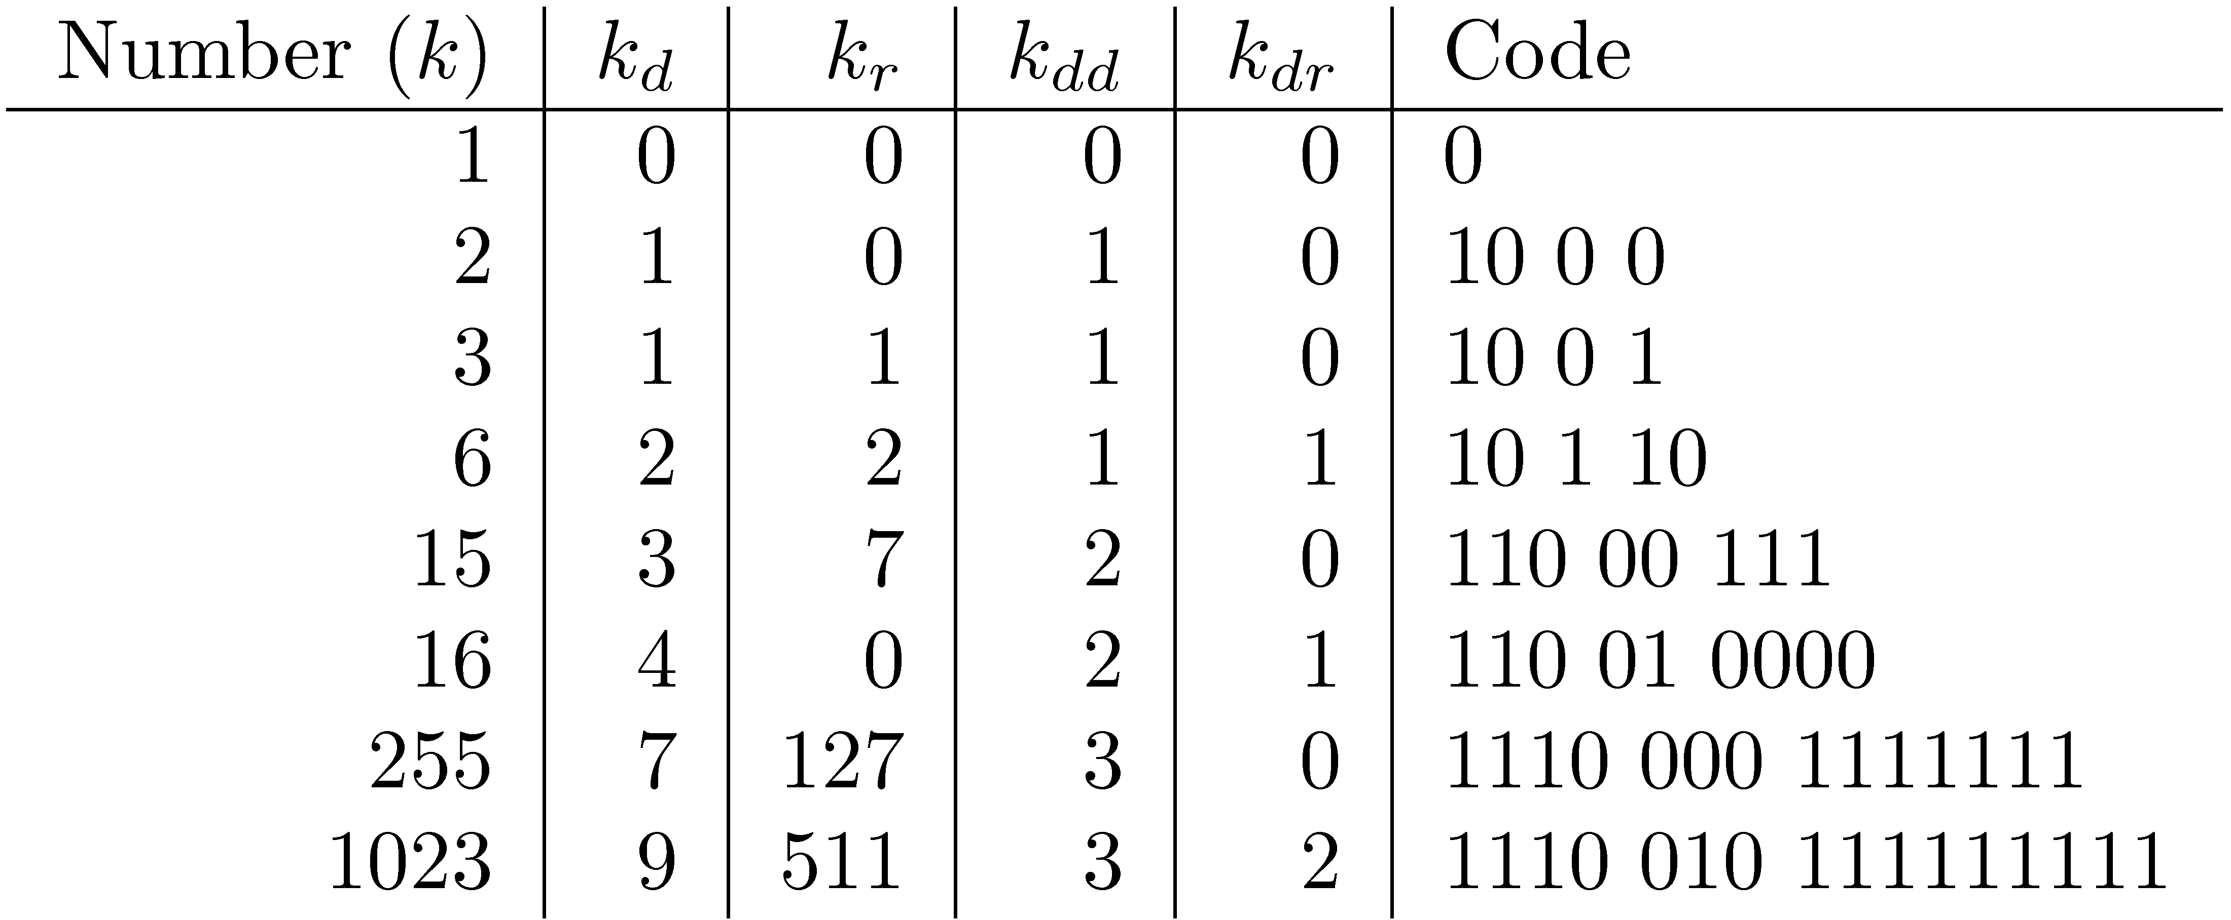
Elias-δ Code
Split k_{d} into:
  encode k_{dd} in unary, k_{dr} in binary, and k_{r} in binary

Slide 66
Example of Elias-δ Code
Code = 11000111
From the code we know k_{dd} =110, k_{dr}=00, k_{r}=111
k = 2^{kd} + k_{r} where k_{d} = k_{dr}+2^{kdd} -1
k = 2⁰⁺⁴⁻¹+7 = 15

Slide 68
Byte-Aligned Codes
Variable-length bit encodings can be a problem on processors that process bytes
v-byte is a popular byte-aligned code
  Similar to Unicode UTF-8
Shortest v-byte code is 1 byte
Numbers are 1 to 4 bytes, with high bit 1 in the last byte, 0 otherwise

Slide 69
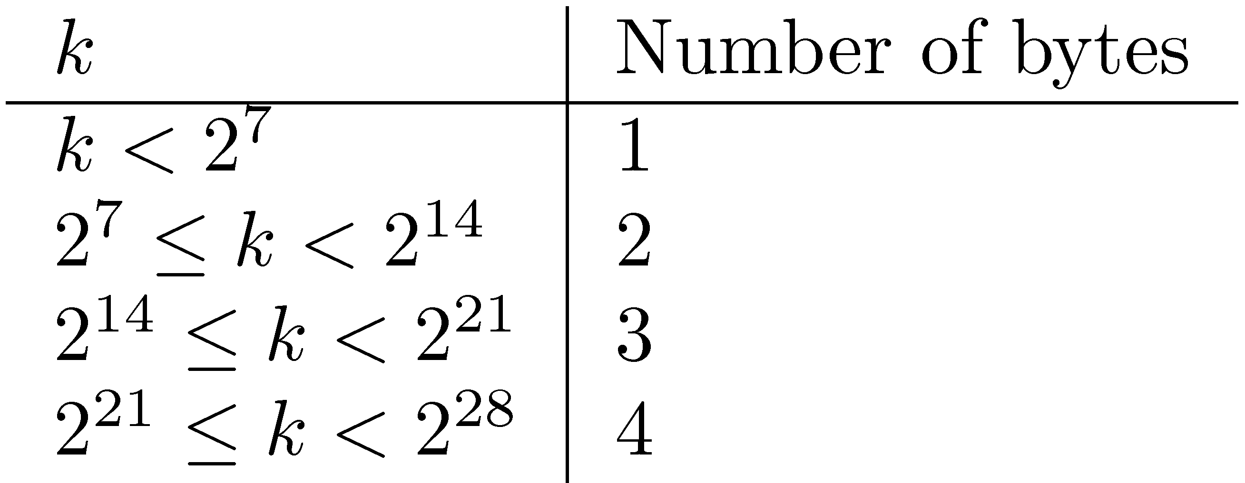
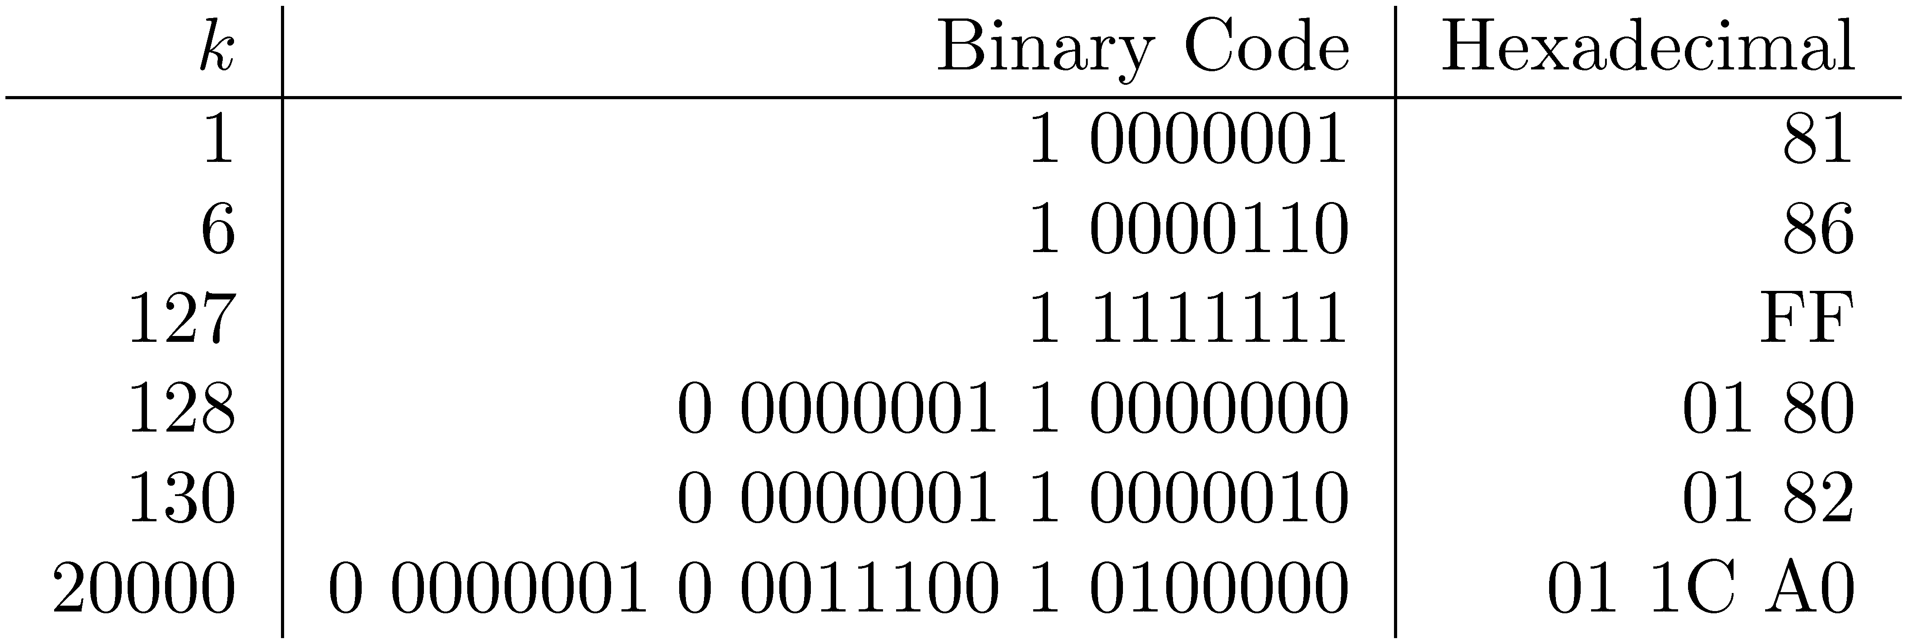
V-Byte Encoding

Slide 70
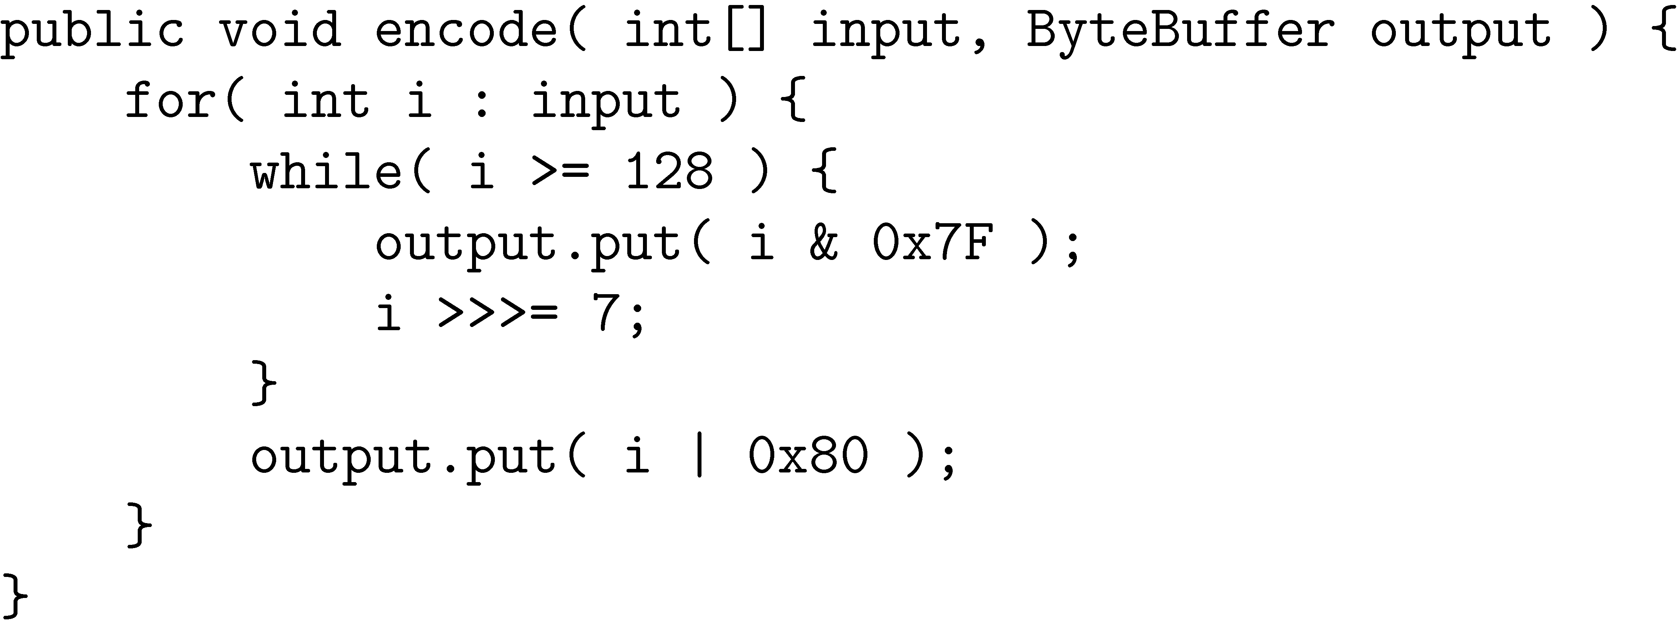
V-Byte Encoder

Slide 71
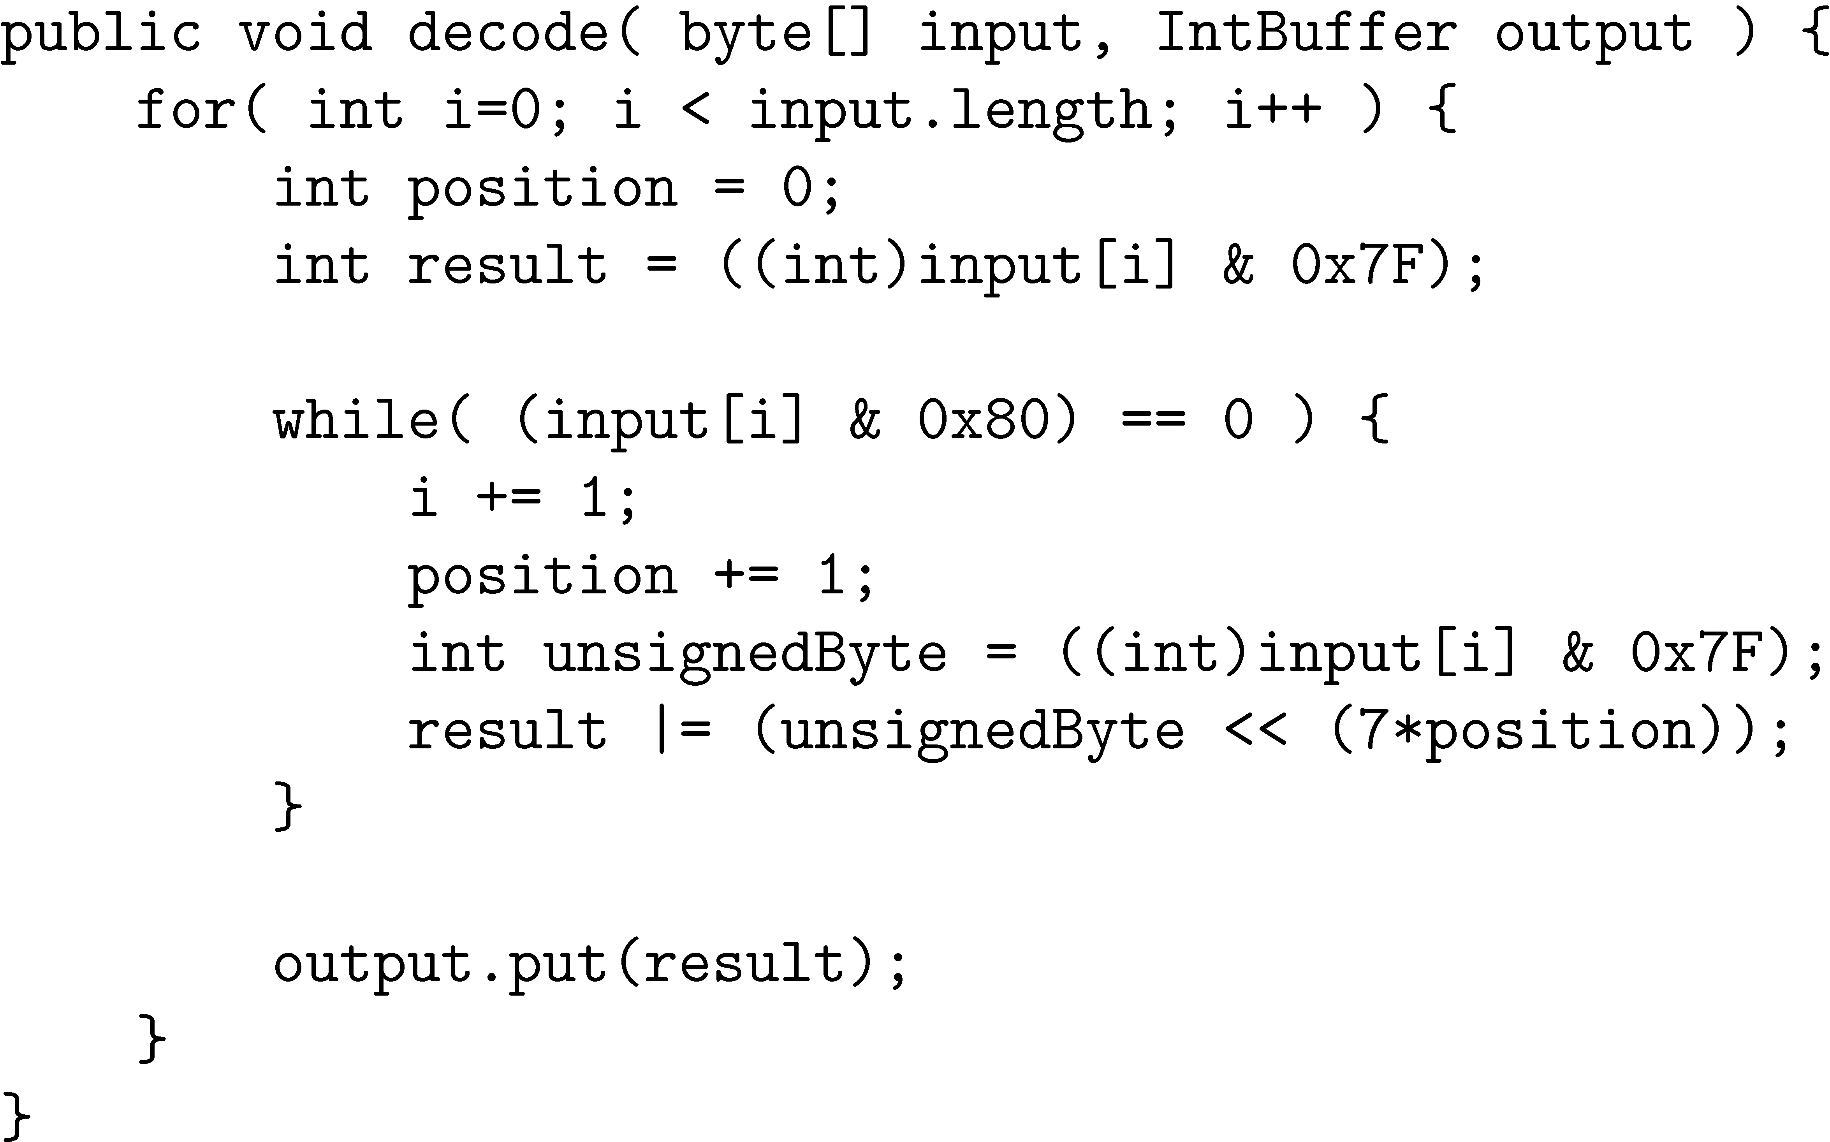
V-Byte Decoder

Slide 72
Compression Example
Consider invert list with positions:
Delta encode document numbers and positions:
Compress using v-byte:

Slide 73
Recap
Index compression:
  Delta coding
  Elias-gamma
  Elias-delta
  Byte-aligned
    V-Byte

Slide 74
Compression of Reuters
data structure | size in MB
dictionary, fixed-width dictionary, term pointers into string ∼, with blocking, k = 4 ∼, with blocking & front coding collection (text, xml markup etc) collection (text) T/D incidence matrix postings, uncompressed (32-bit words) postings, uncompressed (20-bits words) postings, variable byte encoded postings, γ encoded | 11.2 7.6 7.1 5.9 3600.0 960.0 40,000.0 400.0 250.0 116.0 101.0
74

Slide 75
Skipping
Search involves comparison of inverted lists of different lengths
  Can be very inefficient
  “Skipping” ahead to check document numbers is much better
  Compression makes this difficult
    Variable size, only d-gaps stored
Skip pointers are additional data structure to support skipping

Slide 76
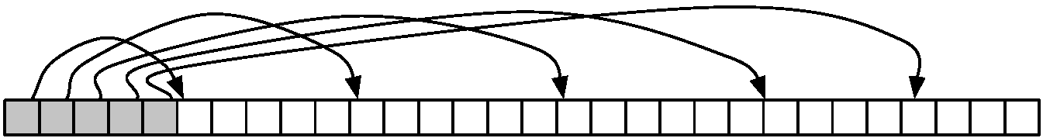
Skip Pointers
A skip pointer (d, p) contains a document number d and a byte (or bit) position p
  Means there is an inverted list posting that starts at position p, and the posting before it was for document d
Inverted list
skip pointers

Slide 77
Skip Pointers
Example
  Inverted list
  D-gaps
  Skip pointers

Slide 78
Auxiliary Structures
Inverted lists usually stored together in a single file for efficiency
  Inverted file
Vocabulary or lexicon
  Contains a lookup table from index terms to the byte offset of the inverted list in the inverted file
  Either hash table in memory or B-tree for larger vocabularies
Term statistics stored at start of inverted lists
Collection statistics stored in separate file

