Slide 1
Google – Architectures and File Systems
Professor Xiannong Meng
A Summary of Four Papers about Google
Spring 2010
Updated Spring 2014 (Data Centers)

Slide 2
Outline Of Presentation
Google history
Overall architecture
File systems
Google cluster
Recent development
Data centers

Slide 3
Brief History
Brin and Page’s classic paper, “The anatomy of a large-scale hypertextual web search engine” was published in April of 1998 at the 7th World Wide Web Conference in Brisbane, Australia.
Though the original goal of building Google was to provide a search engine for academic study, Brin and Page declared the founding of Google as a private commercial company in September 4th, 1998.
Googol: a common spelling of 10¹⁰⁰

Slide 4
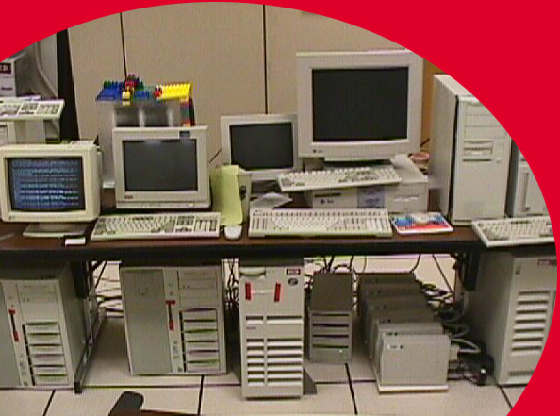
“Google” 1997 (google.stanford.edu)
Photo from Jeff Dean’s WSDM 2009 Presentation

Slide 5
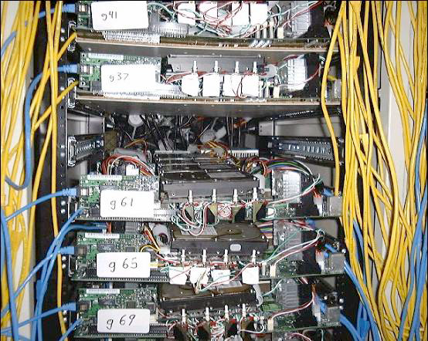
“Corkboards” (1999)
Photo from Jeff Dean’s WSDM 2009 Presentation

Slide 6
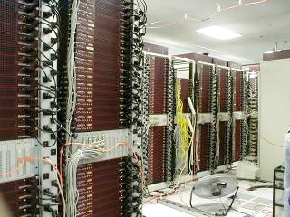
Google Data Center (2000)
Photo from Jeff Dean’s WSDM 2009 Presentation

Slide 7
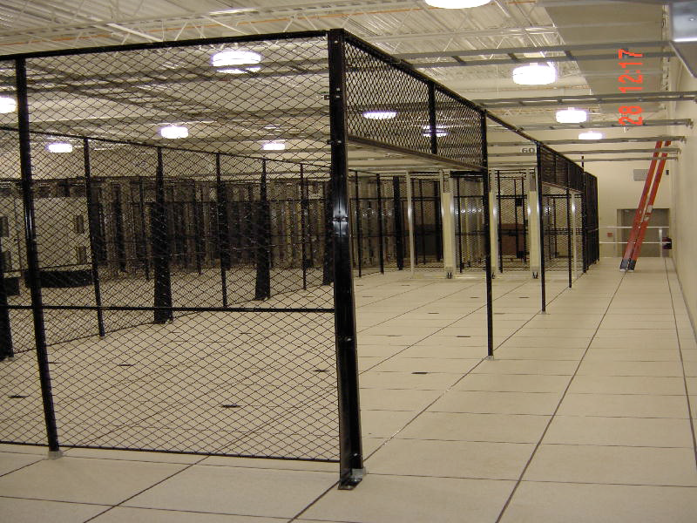
Google (new data center 2001)
Photo from Jeff Dean’s WSDM 2009 Presentation

Slide 8
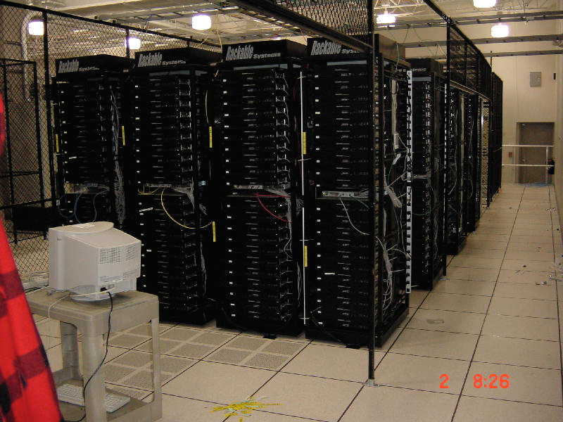
Google Data Center (3 days later)
Photo from Jeff Dean’s WSDM 2009 Presentation

Slide 9
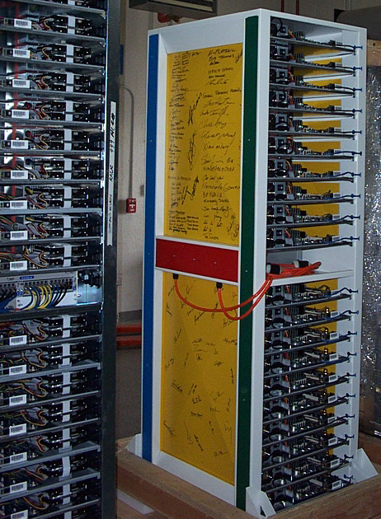
Current (2009) Machines
Photo from Jeff Dean’s WSDM 2009 Presentation

Slide 10
Some Statistics
At the time of the paper (April 1998), Google holds “at least” 24 millions of full web pages and their index.
For historical comparison:
1994 WWW Worm had an index of 110,000 web pages
AltaVista indexed about 30 million web pages in August 1996
1998 AltaVista had about 140 million pages indexed
About 20 million queries per day in November of 1997 to AltaVista

Slide 11
More Statistics
For comparison today (http://www.worldwidewebsize.com/),
Estimated number of web pages indexed by Google today (01/27/2010) is 14 billions.
Estimated number of web pages indexed by Bing is 3.5 billions, Yahoo! 51 billions.
Estimated size of the web is about 51 billion web pages.
Number of web pages indexed is no longer an important statistics (why?)
Google has about 20,000 employees as of 2009, consistently ranked high in employee satisfaction.

Slide 12
Outline Of Presentation
Google history
Overall architecture
File systems
Google cluster
Recent development

Slide 13
Overall System Architecture
Google overall architecture based on their 1998 paper, “The Anatomy of a Large-Scale Hypertextual Web Search Engine,” Sergey Brin and Lawrance Page, 1998 WWW conference, Brisbane, Australia, April 14-28 1998
http://citeseer.ist.psu.edu/brin98anatomy.html

Slide 14
Google Features
PageRank:
Use the frequency of citations to a page and the citations the page used to point to other pages to measure importance
Anchor text:
Provide more accurate description than the page itself
Exist for documents that cannot be indexed by a text-based search engine (e.g., image, database)

Slide 15
Google Architecture

Slide 16
Components of Google
Distributed web crawling
URLserver sends lists of URLs to be fetched to the crawlers
The web pages fetched are sent to the Storeserver which compresses and stores them
A unique docID is assigned for each page
The indexing function is performed by the indexer and the sorter

Slide 17
Components of Google (cont)
Indexer:
Each doc is converted into a set of word occurrences called hits (term frequency + other information)
The hits record the word, its position in the doc, font size, and capitalization
The indexer distributes these hits into a set of “barrels”, creating a partially sorted forward index
The indexer also parses out all the links in every web page and stores important information about them (points to and from, text of the link) in an anchor file

Slide 18
Components of Google (cont)
The URLresolver reads the anchors file and converts relative URLs into absolute URLs, and docIDs
Put the anchor text into the forward index, associated with the docID
Generate a database of links which are pairs of docIDs (the host page, and the page pointed by this host page)
The links database is used to compute PageRanks for all documents

Slide 19
Major Data Structures
BigFiles: virtual files spanning multiple file systems, addressed in 64 bit integers
Repository: full HTML of every web page (then) current size: 150 G
Document Index: information about each doc, it is a fixed width ISAM (index sequential access mode) index, ordered by docID
Hit list: occurrences of a particular word in a particular document including position, font, capitalization
Forward index: from doc to words, in a number of barrels
Inverted index: from word to doc

Slide 20
Outline Of Presentation
Google history
Overall architecture
File systems
Google cluster
Recent development

Slide 21
Google File System
Google file system (GFS,Ghemawat 2003)
64-bit distributed file system
Single master, multiple chunkservers
Chunk size 64 MB
The largest GFS cluster has over 1000 storage nodes and over 300 TB disk storage space

Slide 22
Issues with File Systems
Component failures are the norm rather than the exception
Files are huge in Google by traditional standards
Most files are mutated by appending new data rather than overwriting existing data
Co-design (GFS) with other applications makes it more efficient

Slide 23
Assumptions
Built from many inexpensive commodity components that often fail
Store a modest number of large files, on the order of a few million files, 100 MB or large for each
Workload: large streaming reads and small random reads, e.g. streaming reads involve 100 KB or 1 MB per read

Slide 24
Assumptions (cont)
Workloads may also have many large, sequential writes to append files
Once written, revisions are rare
Multiple clients, concurrent access (append)
High sustained bandwidth is more important than low latency

Slide 25
Architecture
A single master cluster
Multiple chunk-servers
Each accessed by multiple clients
Files are divided into fixed-size chunks (64 Mbytes)
Each chunk is identified by a unique 64-bit chunk-handle
Chunk-servers store chunks on local disks as linux files

Slide 26
Metadata
The master stores three major types of metadata:
File and chunk namespaces
Mapping from files to chunks
Locations of each chunk’s replicas
All metadata have a copy in memory
Namespaces and file-to-chunk mapping are also kept persistent storage (local disk and remote replica)

Slide 27
Consistent Model
What is a consistent model? – How Google (or anyone) guarantees the integrity of the data
Guarantee by GFS
File namespace mutations are atomic
State of a file region after a data mutation depends on the type of operations, success or failure, and whether or not concurrent updates occurred

Slide 28
Consistent Model (cont)
A file region is consistent if all clients will always see the same data
GFS guarantees the consistency by
Applying mutations to a chunk in the same order on all its replicas
Using chunk version number to detect any replica that has become stale because it has missed mutations while its chunkserver was down

Slide 29
System Interactions --- Lease
Lease: when each mutation is performed, the master grants a chunk lease to one of the replicas, primary
The primary picks up a serial order for all mutations to the chunk
A lease has an initial amount of timeout of 60 seconds
As long as the chunk is being updated, the primary can request and will get extension

Slide 30
System Interactions --- Data Flow
Data is pushed linearly along a chain of chunkservers
Each machine’s full outbound bandwidth is used to transfer data
Each machine forwards the data to the “closest” machine that has not received the data
Data transfer is “pipelined” over TCP connection – as soon as a chunkserver starts receiving data, it forwards the data immediately

Slide 31
System Interactions --- Atomic Record Appends
Clients only specify the data
GFS appends the data to the file at least once atomically
Returns the location to the client
If the append would cause the chunk to exceed its size limit (64M), the current chunk is padded, a new chunk starts with the record in operation
If an append fails at any replica, the client retries the operation

Slide 32
System Interactions --- Snapshot
The snapshot operation makes a copy of a file or a directory tree
Copy-on-write is used to implement snapshots
When a request is received, the master revokes any outstanding leases, ensuring data integrity
Subsequent write would have to interact with the master again

Slide 33
Fault Tolerance
High availability
Both master and chunkservers restart in seconds
Each chunk is replicated on multiple chunkservers on different racks
A read-only “shadow” master replica, may lag the primary slightly

Slide 34
Fault Tolerance (cont)
Data integrity
A chunk is broken into 64 K blocks, each of which has a 32 bit checksum
Upon a read request, if checksum fails, the reader may read from another chunk replica
Checksum computation is heavily optimized for appending operation

Slide 35
Fault Tolerance (cont)
Diagnostic tools
Extensive and detailed logs are kept to help in problem isolation, debugging, performance analysis

Slide 36
Outline Of Presentation
Google history
Overall architecture
File systems
Google cluster
Recent development

Slide 37
Hardware Architecture
Very little is published on specific search engines
Google clusters (early 2003 data) (Barroso et.al.)
15,000 Off-the-shelf PCs
Ranging from single-processor 533-MHz Celeron to dual-processor 1.4 GHz PIII
One or more 80G IDE drives on each PC
Giga-bit switches
2-3 years of life cycle (hardware)
Fault-tolerant software

Slide 38
Hardware Architecture (2)
According to NY Times: 450,000 servers across 25 locations (“Hiding in Plain Sight, Google Seeks More Power” By JOHN MARKOFF and SAUL HANSELL Published: June 14, 2006)
http://www.nytimes.com/2006/06/14/technology/14search.html?pagewanted=2&ei=5088\&en=c96a72bbc5f90a47&ex=1307937600&partner=rssnyt&emc=rss
The same source points that Microsoft has about 200,000 servers currently and plans to expand it to 800,000 by 2011
Jeff Dean’s October 2009 presentation anticipates 10 million computers in the next a few years

Slide 39
Some Highlights
On average, a single query reads hundreds of megabytes of data and consumes billions of CPU cycles
Thousands of queries per second at peek time
Index structure is partitioned
Different queries can run on different processors

Slide 40
Design Considerations
Use software to provide functionality, rather than using hardware
Component-off-the-shelf (COTS) approach: commodity PCs are used with faulty tolerant back-bone network
Reliability is achieved through replicating services across many different machines
Price/performance consideration beats peek performance

Slide 41
Serving a Query
When a query is received, it is mapped to a local Google cluster that is close to the user geographically
Google has clusters distributed across the world
Each cluster has a few thousand machines
A DNS-based hardware load-balancing scheme is used

Slide 42
Serving a Query (cont)
Query execution consists of two major phases
Phase one:
The index servers consult an inverted index that map each query word to a hit list
The index servers then determine a set of relevant documents by intersecting the hit lists of each query words
A relevance score is computed for each document
The result of this phase is an ordered list of docIds
The entire index is randomly divided into pieces (index shards)

Slide 43
Serving a Query (cont)
Phase two:
The document servers take the docIds and compute the actual title and URL for each, along with a summary
Documents are randomly distributed into smaller shards
Multiple servers replicas responsible for handling each shard
Routing requests through a load balancer

Slide 44
Document Server Clusters
Each must have access to an online, low-latency copy of the entire web
Google stores dozens of copies of the web across its clusters
Supporting services of a Google web server (GWS) besides doc server and index server:
Spell check
Ad serving (if any)

Slide 45
Commodity Parts
Google’s racks consist of 40 to 80 x86-based servers mounted on either side of a custom made rack
Each side of the rack contains 20 2-u or 40 1-u servers
These servers are mid-range
Several generations of CPU in active use, ranging from 533-MHz single processor to dual 1.4-GHz Pentium III servers (2003)

Slide 46
Commodity Parts (cont)
Each server contains one or more IDE 80 G byte disk drive
The servers on each side of a rack interconnect via a 100-Mbps Ethernet switch
Each switch has one or two gigabit uplinks to a core gigabit switch that connect all racks together
Today (Dean 2009): One server
DRAM: 16GB, 100ns, 20GB/s
Disk: 2TB, 10ms, 200MB/s

Slide 47
Cost Estimate of an Example Rack
Late 2002, a rack of 88 dual-CPU 2-GHz Xeon servers with 2 G bytes Ram and 80 G bytes of disk costs around $278,000
This rack contains 176 2-GHz Xeon CPUs, 176 G bytes of RAM, 7 T bytes of disk
A typical x86-based server contains 8 2-GHz Xeon CPUs, 64 G bytes of RAM, 8 T bytes of disk, costing about $758,000

Slide 48
Outline Of Presentation
Google history
Overall architecture
File systems
Google cluster
Recent development

Slide 49
Search Engine Data Centers
June 2006 New York Times reported that Google’s Dalles, Oregan Data Center would create 60-120 full-time jobs
According to NY Times: 450,000 servers across 25 locations (“Hiding in Plain Sight, Google Seeks More Power” By JOHN MARKOFF and SAUL HANSELL Published: June 14, 2006)
http://www.nytimes.com/2006/06/14/technology/14search.html?pagewanted=1&ei=5088\&en=c96a72bbc5f90a47&ex=1307937600&partner=rssnyt&emc=rss

Slide 50
Rate of Changes at Google
March 2001, serving 70 million web pages with 8,000 computers
In 2003, the number of computers grew to 100,000
The June 2006 estimate was 450,000 scattered over at least 25 locations
Jeff Dean’s presentation (2009 SIGOPS) anticipates 10 million computers in the next a few years

Slide 51
A Few Other Google Data Centers (1)
Belgium Data Center:
341 million dollars
120 long-term jobs
No chillers, just air-cooling, or called “free-cooling”
Scheduled to open early 2008
Lenoir, North Carolina Data Center
600 million dollars
150 acres
200 long-term jobs

Slide 52
A Few Other Google Data Centers (2)
Goose Creek, South Carolina Data Center
600 million dollars
520 acres
200 jobs

Slide 53
Google Data Center Information
Estimated that Google has about 36 data centers world-wide
Google maintains its data center temperature at 80 F
Location map of Google data centers http://www.theregister.co.uk/2008/04/11/google_data_center_map/
Google data center video: http://blogoscoped.com/archive/2009-04-08-n39.html
Google data center FAQ: http://www.datacenterknowledge.com/archives/2008/03/27/google-data-center-faq/

Slide 54
Other Data Centers (Microsoft 1)
The Chicago Data Center:
700,000 square feet – approximately the size of 16 football fields;
Up to 220 shipping containers packed with servers; each container houses 1,800 to 2,500 servers, which makes 396,000 to 550,000 servers at the site! Each container can be wheeled in and out of the center in hours and be connected to the internet.
Another source said a total capacity of 112 containers holding 224,000 servers.
Go live July 20, 2009.

Slide 55
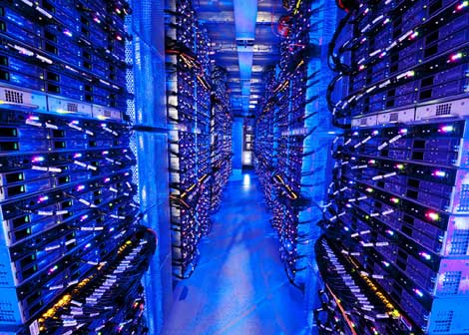
A Photo of Microsoft Chicago Data Center
Inside a 40-ft Microsoft container, Chicago data center

Slide 56
Other Data Centers (Microsoft 2)
The Dublin Data Center (Ireland):
303,000 square feet, first phase, eventually will reach 550,00 square feet
Supported by 5.4 megawatts electricity.
Go live on July 1, 2009. (Started in summer 2007.)
500 million dollar project.
Expected to create 250 jobs.

Slide 57
Other Data Centers (Microsoft 3)
The Quincy Data Center (Washington):
470,000 square feet room on a 75 acre site
A tile floor and a maze of rooms centering around five 12,000-square-foot brain centers that contain tens of thousands of computer servers.
Temperature kept in between 60 and 68 degree Fahrenheit
Collects rainwater from its roof to use in its cooling system.
Row after row of batteries to kick in for 18 seconds if a power failure should occur before the truck-sized backup generators fire up.
Scheduled to go live on March 27, 2007

Slide 58
Other Data Centers (Microsoft 4)
The San Antonio Data Center (Texas):
550 million dollar project
470,000 square foot
Two 10 megawatt utility feeds, each expandable to 30 megawatts each.

Slide 59
Yahoo Data Center
Lockport, NY Data Center
Using Niagara Fall as its power source
150 million dollars
30 acre site
181,000 square feet rooms
First phase : 10 megawatts of hydro-electric power; second phase another 15 megewatts
To be completed by May 2010
Quincy, Washington Yahoo Data Center

Slide 60
References (1)
Barroso, L.A., Dean, J., and Hölzle, U. (2003). “Web Search for a Planet: The Google Cluster Architecture”. IEEE Micro, vol. 23, pp. 22-28.
Brin, S. and Page, L. (1998). “The Anatomy of a Large-Scale Hypertextual Web Search Engine”. In Proceedings of the 1998 WWW Conference, Brisbane, Australia.
Dean, J. (2009). “Designs, Lessons and Advice from Building Large Distributed Systems”, Keynote Speech, The 3rd ACM SIGOPS International Workshop on Large Scale Distributed Systems and Middleware, October 10-11, 2009 Big Sky Resort, Big Sky, MT.
Ghemawat, S., Gobioff, H., & Leung, S.T. (2003). The Google File System. In Proceedings of SOSP'03, pp. 29-43.

Slide 61
References (2)
Markoff, J. & Hansell, S. (2006, June 8). Hiding in Plain Sight, Google Seeks More Power. New York Times Retrieved July 16, 2009 from http://www.nytimes.com/2006/06/14/technology/14search.html?pagewanted=1&ei=5088\&en=c96a72bbc5f90a47&ex=1307937600&partner=rssnyt&emc=rss
Miller, R. (2009, June 29). Microsoft to Open Two Massive Data Centers. Retrieved November 4, 2009, from http://www.datacenterknowledge.com/archives/2009/06/29/microsoft-to-open-two-massive-data-centers/
Miller, R. (2007, March 11). Microsoft Readies Quincy Data Center. Retrieved November 4, 2009, from http://www.datacenterknowledge.com/archives/2007/03/11/microsoft-readies-quincy-data-center/

Slide 62
References (3)
Miller, R. (2007, January 19). Microsoft Confirms Huge San Antonio Center. Retrieved November 4, 2009 from http://www.datacenterknowledge.com/archives/2007/01/19/microsoft-confirms-huge-san-antonio-center/
Microsoft Data Centers: http://www.datacenterknowledge.com/archives/category/microsoft/
Google Data Centers: http://www.datacenterknowledge.com/archives/category/google/
Metz, C. (2008, April 11). Google data centers snub Africa, Oz, and anything near Wyoming. Or do they? http://www.theregister.co.uk/2008/04/11/google_data_center_map/
Miller, R. (2009, June 30). It’s Official: Yahoo Building in Lockport, NY. Retrieved November 4, 2009, from http://www.datacenterknowledge.com/archives/2009/06/30/its-official-yahoo-building-in-lockport-ny/

