Slide 1
Peroneal tendinopathy
“My Painful Ankle!”

Slide 2
Peroneal Tendons: Connect Muscles to bones
Common cause of “outside” ankle pain
Usually result of overuse
Slow to heal!

Slide 3
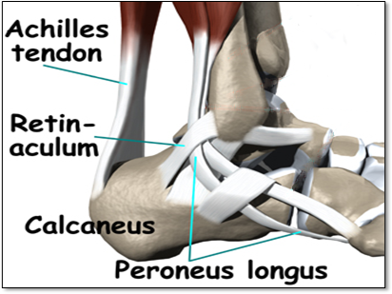
Anatomy
2 Tendons:
Peroneus longus
Peroneus brevis
Location: outside part
of ankle
Function: turn ankle up and out

Slide 4
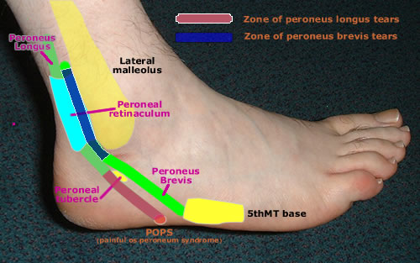
Symptoms
“Burning”pain
Swelling
“Catching”
“Popping”

Slide 5
Symptoms
Stiffness
Worse with…
Prolonged standing
Walking on uneven surfaces

Slide 6
At Risk Population
Athletes
Hikers/skiers
Sedentary
Overweight
Diabetics

Slide 7
Common Causes
Overuse
Running on uneven surfaces ( sides of road)
Tight calf muscles
Excessively flat feet

Slide 8
Traditional Nonoperative Treatment
Rest
Ice
Heel insert
Deep tissue massage
Orthotics
Physical therapy modalities

Slide 9
Immobilization
Walking boot
Usually 2-4 weeks
Often helpful
“Burns no bridges”

Slide 10
Newer Treatment : Shock Wave Therapy
Safe
Noninvasive
In-office procedure
Enhances tendon healing
  “Brings blood to tissue with poor blood supply”

Slide 11
Surgical Options
Debridement of diseased tendon
Removal of swollen “scar tissue” (“synovectomy”)
Repair of tears
Possible tendon transfers
Requires some immobilization

Slide 12
Other Surgical Options
Tendon transfers
Bone realignment procedures

