Slide 1
My Ankle…Posterior Tibial Tendon Insufficiency

Slide 2
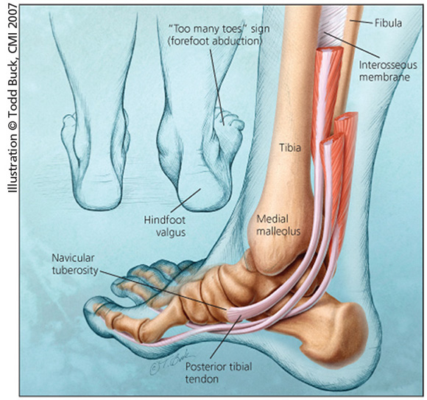
Posterior Tibial Tendon (PTT)
Big tendon
Location: Inside part of ankle
Function:
  Turn foot in
  Maintain the arch

Slide 3
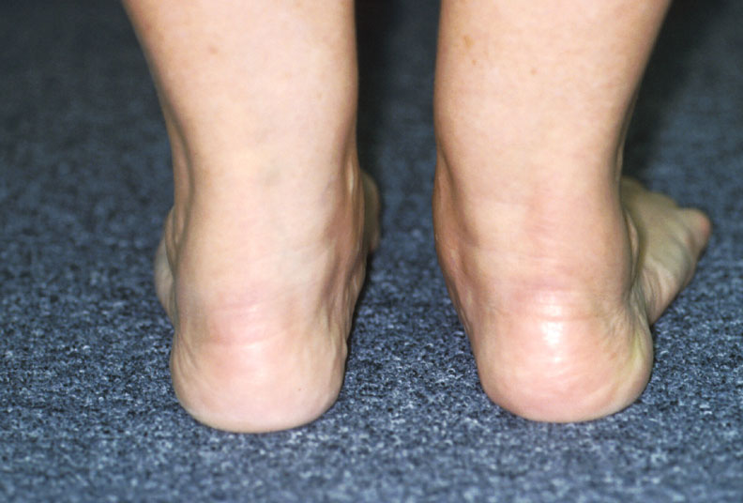
Typical Presentation
Gradual onset
Arch collapses
Foot becomes very flat

Slide 4
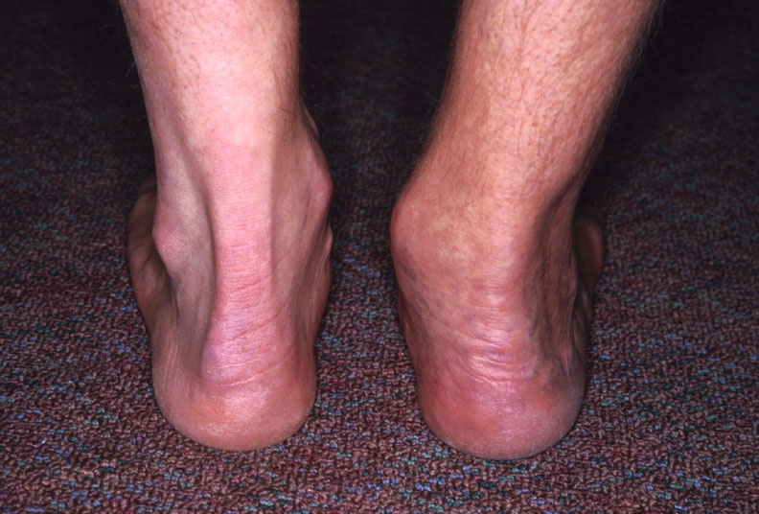
Over Time….
“Foot roles inward”
Progressive pain/deformity

Slide 5
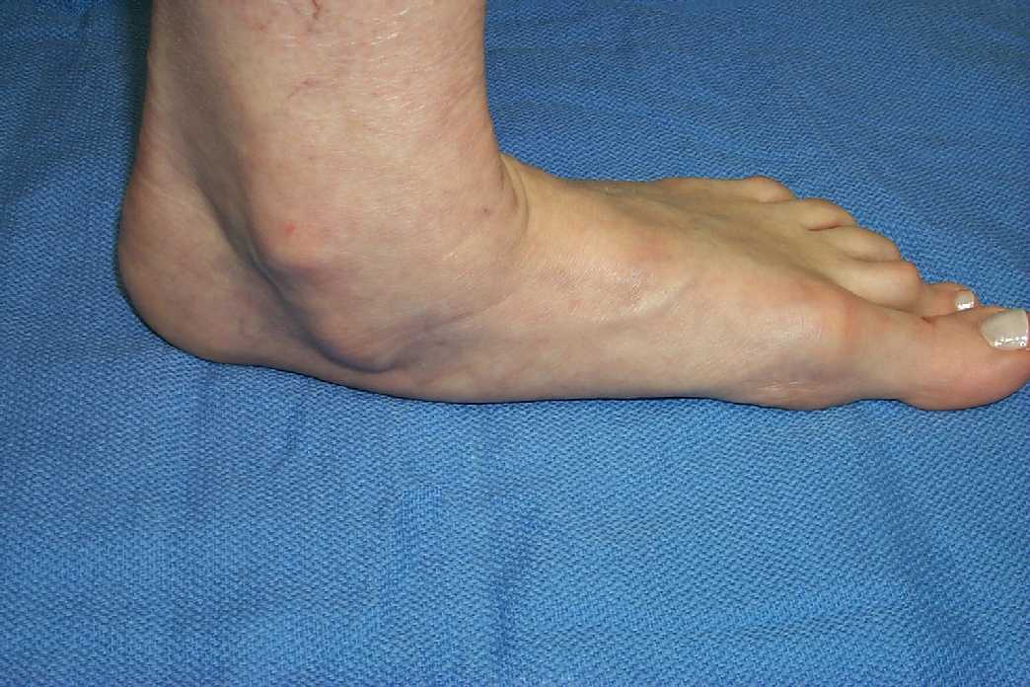
PTT Tendinopathy : Symptoms
Arch pain/swelling
Arch collapses
Acquired flat foot

Slide 6
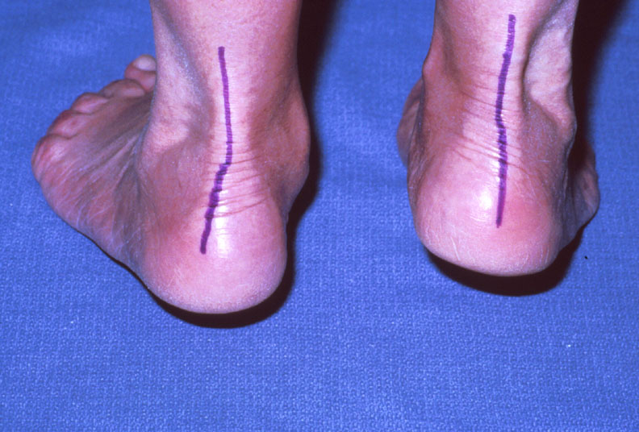
Symptoms
Decreased strength
Cannot rise on one foot

Slide 7

Who is at risk?
Usually middle-aged and older individuals
Females > males
Often sedentary

Slide 8
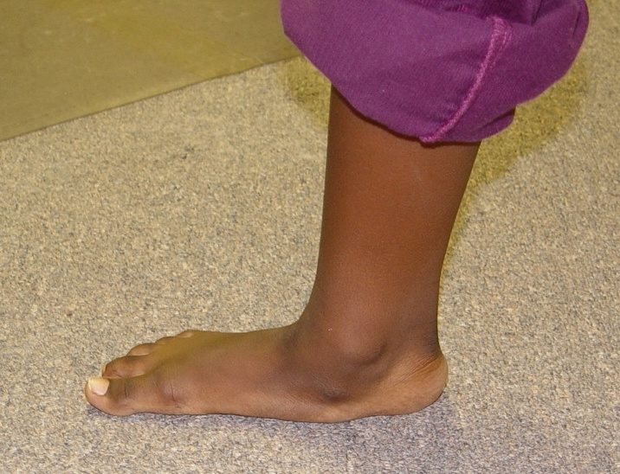
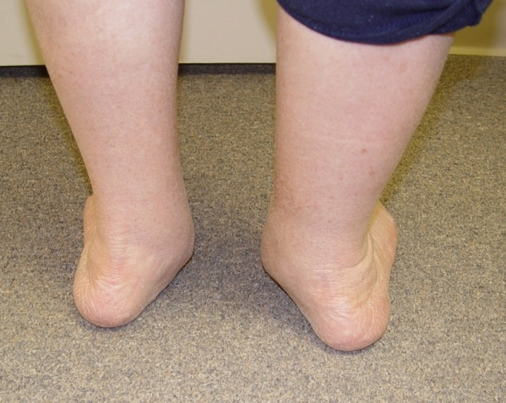
Other Risk Factors
Excessive body weight
Preexisting flat feet
Diabetes

Slide 9
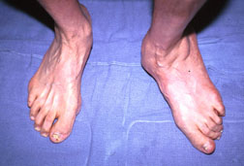
Stages ( Severity of Condition)
Stage I-Early
  no deformity
Stage II-Moderate
  painful, flexible flat foot
Stage III-Advanced
  Stiff/painful flat foot

Slide 10
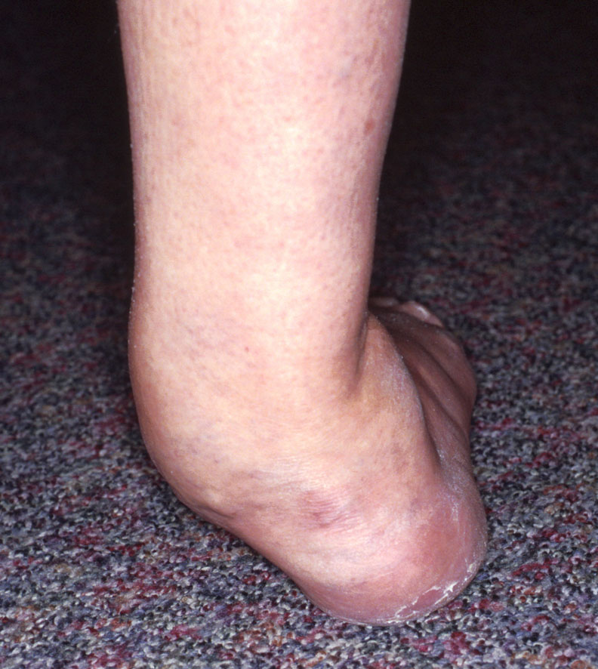
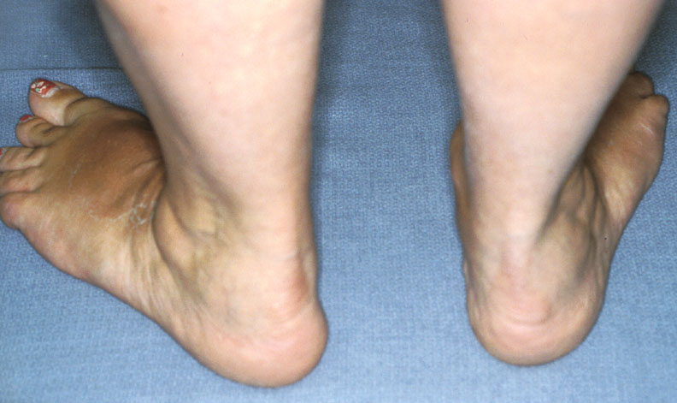
Progression Over Time

Slide 11
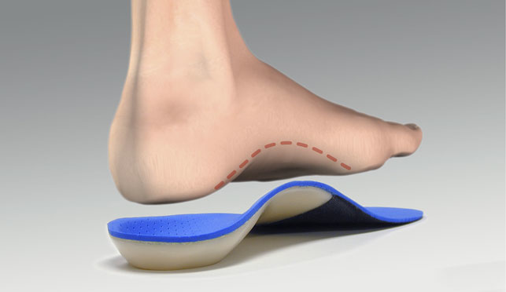
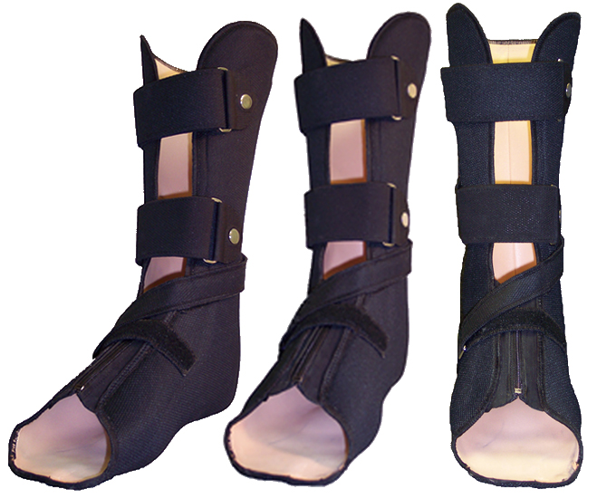
Traditional Nonoperative Treatment
Anti-inflammatory medication
Orthotics
Braces
Immobilization
Physical therapy
  Modalities
  Strengthening

Slide 12
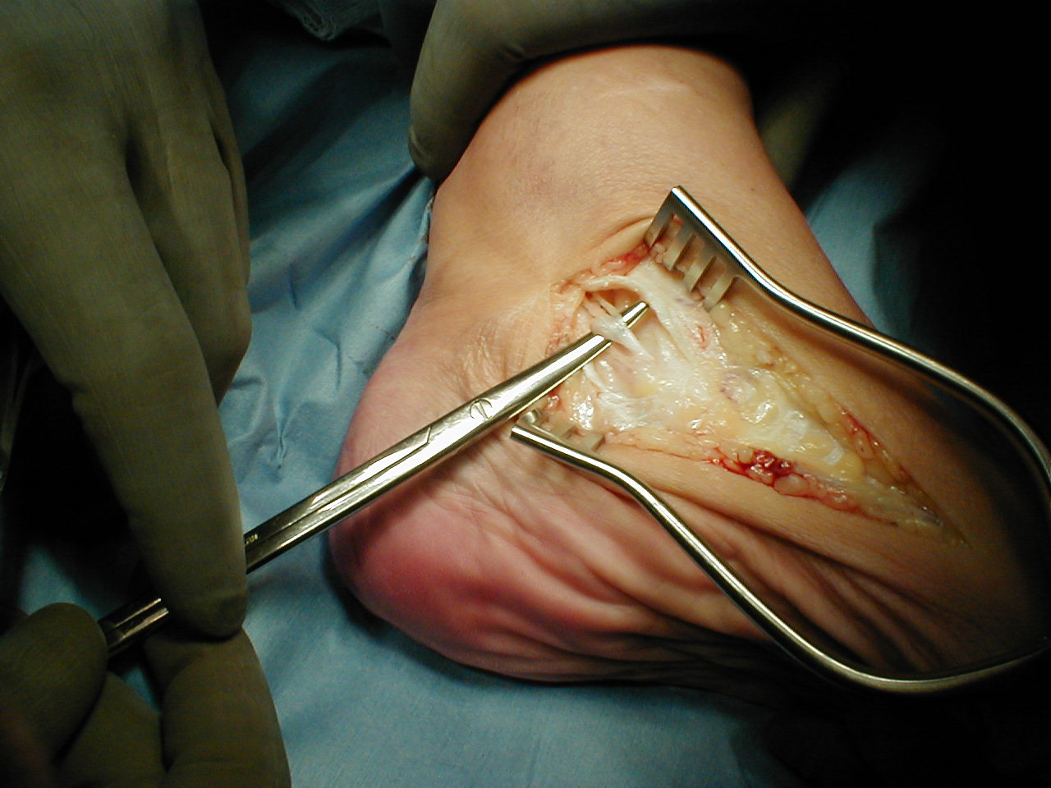
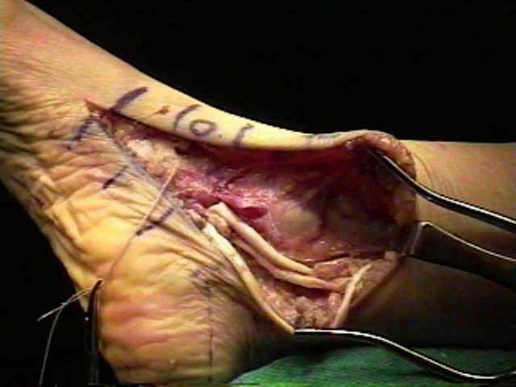
Surgical Options
Many
Depends on stage
Options
  Tendon debridement
  Tendon transfers
  Bone realignments
  Bone Fusions
  Combinations of above

Slide 13
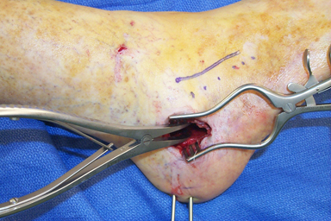
Heel Bone Realignment and Tendon Transfer
Popular surgical option
Usually…..
  Corrects deformity
  Reduces pain
  Improves strength

Slide 14

Prognosis
Nonoperative treatment-fair
Surgical treatment-mostly good/excellent
But….
  Requires immobilization
  Protected weight bearing
  Lengthy recovery

