Slide 1
Intro to Computer Science II
“Every program depends on algorithms and data structures, but few programs depend on the invention of them”
- Kernighan & Pike
Prof. Xiannong Meng
Office Hours: M 2-3, WF 2-4, R 2-3
Office: Dana 212
Email: xmeng@bucknell.edu
Phone: 570-577-1214 (x 71214 on campus)

Slide 2
What will we do in class this semester?
Lecture (but just to get the declarative knowledge down)
PowerPoints
Active Learning
Group activities
Discussion and reflection

Slide 3
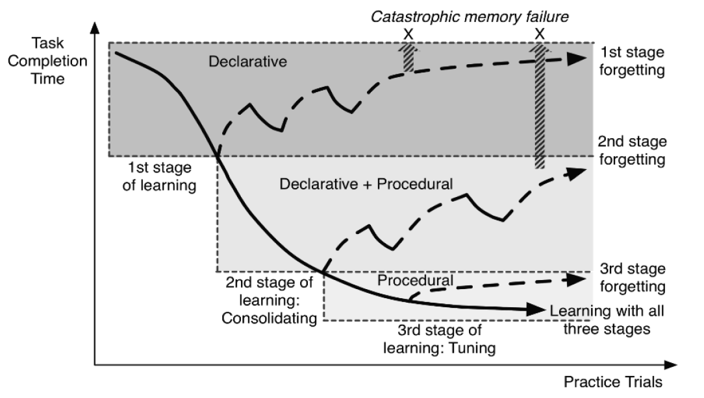
I may repeat things you may have seen before (e.g., in a lab)!

Slide 4
Syllabus
Course website
http://www.eg.bucknell.edu/~csci204/
Syllabus, schedule, lab, projects, …
Course Moodle site
http://moodle.bucknell.edu/course/view.php?id=26802
Submit work, check grades
Prof. Meng’s Moodle site
http://moodle.bucknell.edu/course/view.php?id=25388
Online quizzes
Notes:
4
still before the quiz… (syllabus is in the back of your handout…)

Slide 5
Syllabus
Lectures
MWF: 11 am
Key skills, topics, and their motivation
I’d like to see you! Let me know if you’ll be absent…
Lab
Th: 10-12 pm, 1-3 pm, 3-5 pm
Guided work on the material.
You are required to attend your section.
Let the lab instructor know if you’ll be absent…
Office Hours
M: 2-3 PM, WF: 2-4 PM, Th: 2-3 PM; 212 Dana
Notes:
5
still before the quiz… (syllabus is in the back of your handout…)

Slide 6
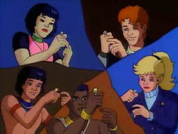
Syllabus
Grading
Projects 16%
Professionalism 8%
Quiz/HW 10%
Labs 16% Mid-term exams 30%
Final Exam 20%
Notes:
6

Slide 7
What will we cover?
Data Structures
Particular way to organize and manipulate data (e.g., list, stack, queue, trees, array
Data Abstraction
Data type properties (independent of implementation)
Algorithms & Algorithm Analysis
Common algorithms, searching, sorting
Advanced Python Programming
OOP, classes, inheritance, exceptions, etc.

Slide 8
What will we cover?
Program design and style will be important!
https://google.github.io/styleguide/pyguide.html
https://www.python.org/dev/peps/pep-0008/#function-names

Slide 9
List Review
Python Lists are Mutable
What does this mean?
test_list = [14, 2, 42, 3, 24]

Slide 10
List Review
Accessing and manipulating Python Lists
Some useful list operators
+ (concat), * (mult), : (slicing)
List methods
append, extend, insert, pop
Comprehensions
Build lists from existing lists
Ex:
my_list = [x*2 for x in range (10) ]

Slide 11
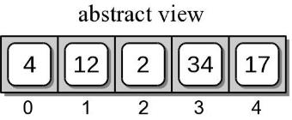
List Review (Examples)
test_list.append(17)
test_list[0:3]
test_list.pop()
>>> [4, 12, 2]

Slide 12
List Review (Examples)
test_list.append([17])
test_list*3
(Abstract view)
test_list[0:4]
(Abstract view of test_list)
(Command Line output)
>>> [4, 12, 2, 34]
What happens when we use * with this version of test_list?

Slide 13
Strings Review
Strings operate in a very similar way to lists, but they are immutable
Lets say test_string = ‘team’
What happens when I execute test_string[1] = ‘l’ ?
Several Methods
split, upper, lower, count, find, … https://docs.python.org/3/library/stdtypes.html#textseq
Notes:
20-Jan-2016: Stopped

Slide 14
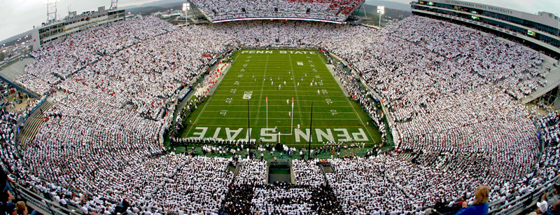
Dictionaries Review
Dictionaries contain a key and a corresponding value
Ex. B10FB = {‘PSU’ : ‘Penn State’, ‘OSU’ : ‘Ohio State’, ‘MSU’ : ‘Michigan State’, ‘Mary’ : ‘Maryland’, ‘Rut’ : ‘Rutgers’, ‘Ind’: ‘Indiana’}
B10FB[‘PSU’] returns…..’Penn State’
What if we didn’t know which B10 teams were in B10FB?
B10FB[‘Umich’] throws an error, BUT B10FB.get(‘Umich’) simply returns None

Slide 15
Classroom exercise
Take as inputs from the user a sequence of nick names, and a sequence of full names, both groups separated by commas. Build a dictionary with the nick names as key and full names as value. Example:
Enter nicknames separated by commas:'bb, cc, dd'
Enter full names separated by commas:'bob barker,chris christie, donny darko’
bob barker or bb for short.
chris christie or cc for short.
donny darko or dd for short.
Retrieve the starting source code from the course website
www.eg.bucknell.edu/~csci204/

