Slide 1
Example: Vehicles
What attributes do objects of Sedan have?
What attributes do objects of Truck have?

Slide 2
Design Exercise
Take out your computer
Write the code for class Vehicle and its subclasses Car and Truck in a file named vehicle.py
Write the code in a separate file named vehicle_app.py for testing the Vehicle class that creates a few Car and Truck objects and prints their information.

Slide 3
Intro to Computer Science II
Modules and Exceptions
Notes:
3

Slide 4
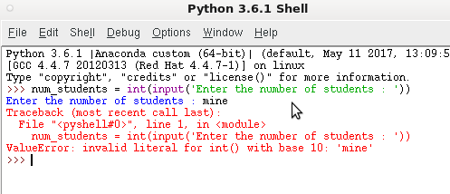
“Exceptions” in Python
Look back the example we had last time.
num_students = int(input(‘Enter the number of students : ‘))
What if we typed a non-numerical input?

Slide 5
When “Exception” Happens
Python will complain and stop execution of the program
What if we want to handle the case(s) ourselves so we can control the program execution?
In the example above, we’d like to ask the user to try again if the input is wrong.
For example, we want the user to input a numerical value, we can also require a specific value range!

Slide 6
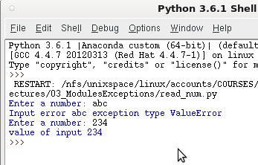
Python Defined Exceptions
num = 0
while True:
try:
v = input("Enter a number: ")
num = int(v)
break
except Exception :
print('Input error ' + v)
print('value of input ' + str(num))

Slide 7
Find the Type of Exceptions
num = 0
while True:
try:
v = input("Enter a number: ")
num = int(v)
break
except Exception as ex:
# if v is a non-numeric string, the type of exception is "ValueError“
print('Input error ' + v + ' exception type ' + type(ex).__name__)
print('value of input ' + str(num))

Slide 8
Catch a Specific Exception
num = 0
while True:
try:
v = input("Enter a number: ")
num = int(v)
break
except ValueError:
# if v is a non-numeric string, the type of exception is "ValueError“
print(‘Value Error’)
print('value of input ' + str(num))

Slide 9
User Defined Exceptions
In the above example, we used Python defined Exception or ValueError exception.
There are many pre-defined exceptions
https://docs.python.org/3/library/exceptions.html
There are occasions in which the programmers want their own exceptions.
For example, we want to control the range of input, in addition to the type being int.

Slide 10
Try 1: use conditions
Get out your computer, write a Python program segment based on the program in the previous example to enforce the range of input values. Let’s try to use conditions first.

Slide 11
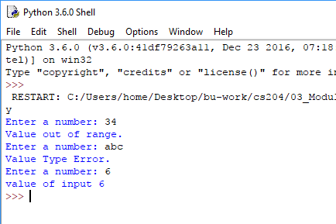
Try 1: use conditions
num = 0
while True:
try:
v = input("Enter a number: ")
num = int(v)
if num >= low_limit and num <= hi_limit:
break
else:
print(‘Value out of range.’)
except ValueError:
# if v is a non-numeric string, the type of exception is "ValueError“
print(‘Value Type Error’)
print('value of input ' + str(num))

Slide 12
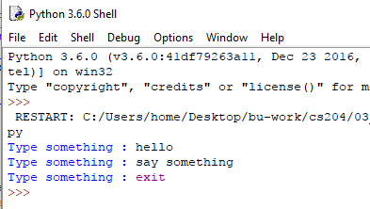
Try 2: define your own exception
class UserException(Exception):
def __init__(self):
self.__name__ = ‘MyException’
def __str__(self):
return ‘Raise ‘ + self.__name__
while True:
try:
value = input('Type something : ')
if value == 'exit':
break
except UserException:
print('Try again ...')

Slide 13
Your Exercise
Define two Python exception classes to handle the cases when a value is out of range.
One is named “ValueTooSmall”
The other is “ValueTooLarge”
Use these two exception classes to enforce that a user must type in an integer in a given range.
Use the two user-defined exceptions in program “limit_range.py”

