Slide 1
Abstract Data Type

Slide 2
Consider the examples …
The Date class we saw in CSCI 203
d = Date()
tomorrow = d.nextDay() gives a new date
d.is_week_day() gives True of False
A GradeBook class
b = GradeBook(student_list, course_list)
print(b.get_grade(‘Sam Brown’, ‘CSCI 204’))

Slide 3
What’s in common?
In both cases, we (the application program) just wanted to use the pre-built class (Date or GradeBook).
We don’t care how Date or GradeBook was implemented.
We are not supposed to visit or change the implementation of Date or GradeBook classes.
Using ADT makes our lives much easier!
We don’t need to re-invent the wheels!

Slide 4
Abstract Data Type
An abstract data type (ADT) is a collection of data and a set of operations on the data.
An ADT has the following features.
Information Hiding: It hides implementation details from the users. That is, it presents what the ADT does, not how it does.
It provides an interface that other programs can use to access the functionality of the ADT.

Slide 5
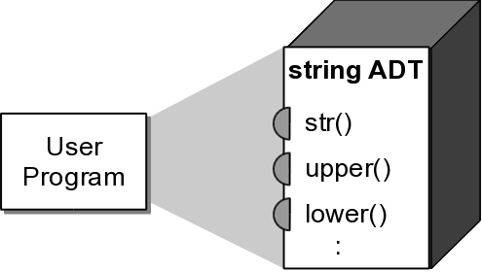
Information Hiding
ADTs can be viewed as black boxes:
functionality is provided through an interface.
Matrix in the coming lab!
implementation details are hidden inside the box.

Slide 6
Types of Operations
ADT operations can be grouped into four categories:
constructors – creates it
accessors – gets information
mutators – changes information
iterators – navigates through it

Slide 7
What does information hiding look like?
Date example
Counter example
Inventory example
You will be working on Matrix in the coming lab

Slide 8
ADT Implementation
Abstractions make problem solving easier.
Programs require concrete implementations in order to execute.
language library ADTs
implemented by the library maintainers, e.g., strings, random numbers.
your own ADTs
implemented by you, e.g., Date, Counter.

Slide 9
Using the ADT
We can use the ADT without knowing how it's implemented.
Reinforces the use of abstraction:
by focusing on what functionality is provided
instead of how that functionality is implemented.

Slide 10
Defining Operations
The ADT definition should specify:
required inputs and resulting outputs.
state of the ADT instance before and after the operation is performed.

Slide 11
Preconditions
Condition or state of the ADT instance and data inputs before the operation is performed.
Assumed to be true.
Error occurs if the condition is not satisfied.
ex: index out of range
Implied conditions
the ADT instance has been created and initialized.
valid input types.

Slide 12
Postcondition
Result or state of the ADT instance after the operation is performed.
Will be true if the preconditions are met.
given: x.pop(i)
the i^{th} item will be removed if i is a valid index.

Slide 13
Postcondition
The specific postcondition depends on the type of operation:
Access methods and iterators
no postcondition.
Constructors
create and initialize ADT instances.
Mutators
the ADT instance is modified in a specific way.

Slide 14
Exceptions
OOP languages raise exceptions when errors occur.
An event that can be triggered by the program.
Optionally handled during execution.
Example:
my_list = [ 12, 50, 5, 17 ]
print( my_list[4] )
Traceback (most recent call last):
File "<stdin>", line 1, in <module>
IndexError: list index out of range

Slide 15
Assertions
Used to state what we assume to be true.
If condition is false, a special exception is automatically raised.
Combines condition testing and raising an exception.
Exception can be caught or let the program abort.
assert value != 0, “Value cannot be zero.”

Slide 16
Evaluating a Data Structure
Evaluate the data structure based on certain criteria.
Does the data structure:
provide for the storage requirements of the ADT?
provide the necessary functionality to fully implement the ADT?
lend itself to an efficient implementation of the operations?

Slide 17
Selecting a Data Structure
Multiple data structures may be suitable for a given ADT.
Select the best possible based on the context in which the ADT will be used.
Common for language libraries to provide multiple implementations of a single ADT.

Slide 18
Build a Bag
Think of this ADT like a shopping cart. Items can be added to it.
Items can also be removed from it. However, there is no specific
order to them.
Operations:
add: which adds an item to the bag
remove: which removes an item from the bag
contains: which checks if an item is in the bag
iterator: which traverses over the items in the bag one at a time

Slide 19
