Slide 1
Singly Linked lists Part 2
Revised based on textbook author’s notes.

Slide 2
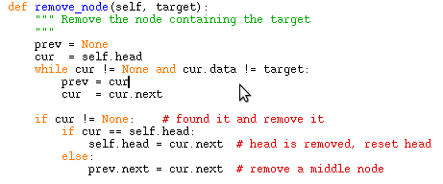
Removing nodes
Last time we discussed removing a node from a singly linked list
In general, removing a node involves a search first.

Slide 3
List search
def search(self, target ):
cur_node = self.head
while cur_node is not None and \
cur_node.data != target :
cur_node= cur_node.next
return cur_node
What are the possible return values?

Slide 4
How to insert a node into a sorted list?

Slide 5
Insert a node to sorted list
head
tail
7
13
19
45
How to insert a value 14 into this list?
Two steps:
Find where it should be inserted
Put the node in place
Be careful in the cases of first and last node.

Slide 6
Find the correct place
Assume sorting the list in ascending order, how to find the proper place for a new node?

Slide 7
Insert the node
Need to consider two cases:
-- Insert in after the head
-- Insert before the head

Slide 8
Swap two nodes
How to swap two nodes in a linked list?
prev1
prev2
7
10
node1
node2
Try to work it out yourself

Slide 9
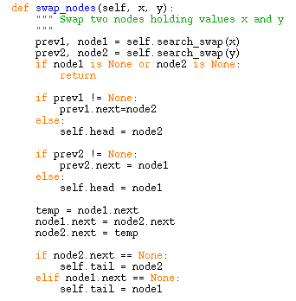
My version of swap()

Slide 10
Sort an existing list
Given a list, how to sort it into a ascending order?
head
tail
7
13
19
45

Slide 11
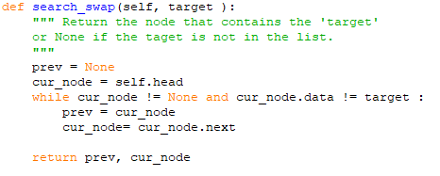
My version of search_swap()

Slide 12
Now we can put them together
Your exercise!

