Slide 1
Advanced Linked lists Doubly Linked and Circular Lists
Revised based on textbook author’s notes.

Slide 2
Doubly linked lists
A linked list in which each node contains a data component(s) and two links:
one pointing the next node and
one pointing to the preceding node.

Slide 3
In Python’s term …
The node storage class is similar to that of a singly linked list.
class DListNode :
def __init__( self, data ):
self.data = data
self.next = None
self.prev = None

Slide 4
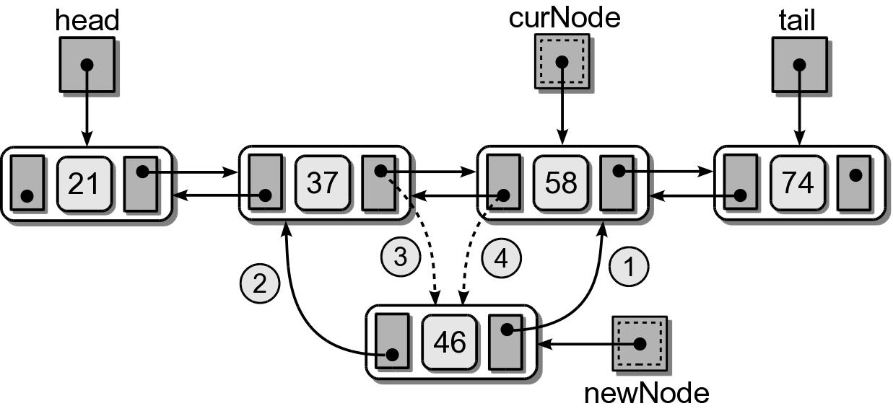
Doubly Linked: Insert
(1) Insert in the middle before a given node.

Slide 5
Doubly Linked: Insert
(1) Insert in the middle before a given node.
node.next = cur
node.prev = cur.prev
node.prev.next = node
cur.prev = node

Slide 6
Doubly Linked: Insert
(2) Insert at the front.

Slide 7
Doubly Linked: Insert
(2) Insert at the front.
node.next = self.head
self.head.prev = node
self.head = node

Slide 8
Doubly Linked: Insert
(3) Insert at the end.

Slide 9
Doubly Linked: Insert
(3) Insert at the end.
node.next = self.head
self.head.prev = node
self.head = node

Slide 10
Exercise
How to find a node with a particular value?
How to remove a node with a particular value in a doubly linked list?
How to insert node into a sorted doubly linked list?

Slide 11
Circular Linked List
Another variation of the linked list in which the nodes form a continuous circle.
Allows for a complete traversal from any initial node.
Used with round-robin type applications.
The external reference can point to any node in the list. Common to reference “end” of the list.

Slide 12
Circular Linked List
A circular linked list can also be doubly linked.

Slide 13
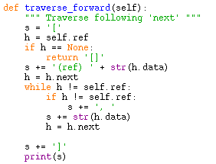
Circular Linked: Traverse
Traverse forward following the next link

Slide 14
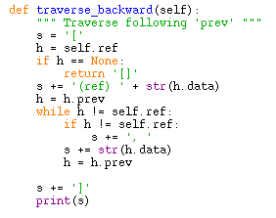
Circular Linked: Traverse
Traverse backward following the prev link

Slide 15
Circular Linked: Inserting
Adding nodes is very similar to that of the sorted singly linked list.
Sorted list – new node is placed in proper position.
Can be divided into four cases.

Slide 16
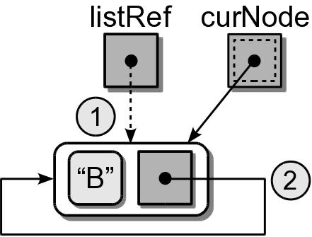
Circular Linked: Inserting
(1) Insert into an empty list.
...
if listRef is None :
listRef = newNode
newNode.next = newNode

Slide 17
Circular Linked: Inserting
(2) Insert at the “front” (one node past listRef)
...
if value < listRef.next.data :
newNode.next = listRef.next
listRef.next = newNode

Slide 18
Circular Linked: Inserting
(3) Insert at the “end” (adjust listRef)
...
if value > listRef.next.data :
newNode.next = listRef.next
listRef.next = newNode
listRef = newNode

Slide 19
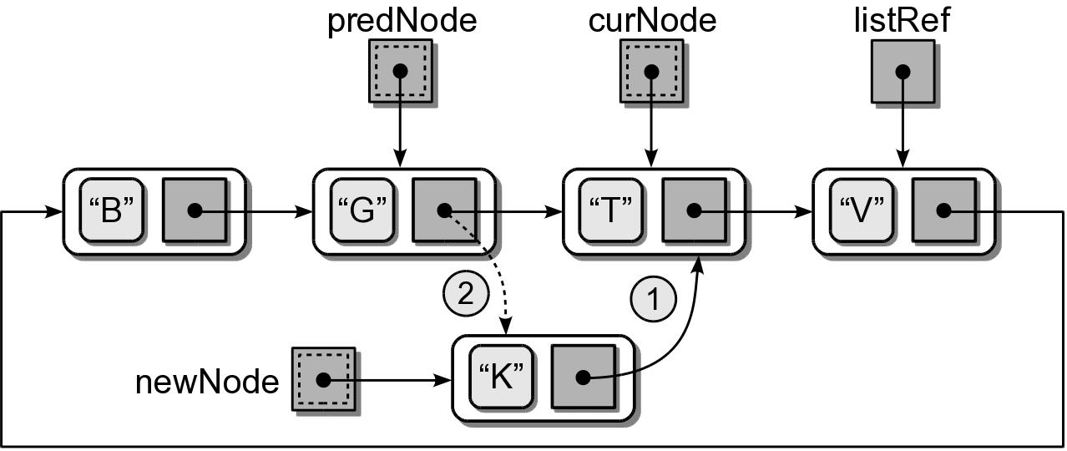
Circular Linked: Inserting
(4) Insert in the middle.

Slide 20
Circular Linked: Inserting
newnode = ListNode( value )
if listRef is None : # empty list
listRef = newNode
newNode.next = newNode
elif value < listRef.next.data : # insert in front
newNode.next = listRef.next
listRef.next = newNode
elif value > listRef.data : # insert in back
newNode.next = listRef.next
listRef.next = newNode
listRef = newNode
else : # insert in the middle
# Position the two pointers.
predNode= None
curNode = listRef
done = listRef is None
while not done :
predNode = curNode
predNode = curNode.next
done = curNode is listRef or curNode.data > target
# Adjust links to insert the node.
newNode.next = curNode
predNode.next = newNode

