Slide 1
Advanced Linked lists Circular Lists
Revised based on textbook author’s notes.

Slide 2
Circular Linked List
Another variation of the linked list in which the nodes form a continuous circle.
Allows for a complete traversal from any initial node.
Used with round-robin type applications.
The external reference can point to any node in the list. Common to reference “end” of the list.

Slide 3
Circular Linked List
A circular linked list can also be doubly linked.

Slide 4
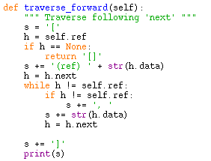
Circular Linked: Traverse
Traverse forward following the next link

Slide 5
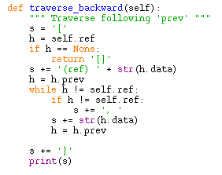
Circular Linked: Traverse
Traverse backward following the prev link

Slide 6
Circular Linked: Inserting
Adding nodes is very similar to that of the sorted singly linked list.
Sorted list – new node is placed in proper position.
Can be divided into four cases.

Slide 7
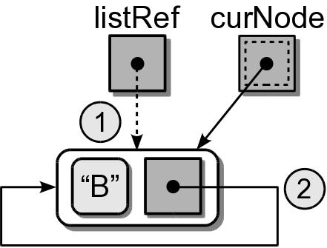
Circular Linked: Inserting
(1) Insert into an empty list.
...
if listRef is None :
listRef = newNode
newNode.next = newNode

Slide 8
Circular Linked: Inserting
(2) Insert at the “front” (one node past listRef)
...
if value < listRef.next.data :
newNode.next = listRef.next
listRef.next = newNode

Slide 9
Circular Linked: Inserting
(3) Insert at the “end” (adjust listRef)
...
if value > listRef.next.data :
newNode.next = listRef.next
listRef.next = newNode
listRef = newNode

Slide 10
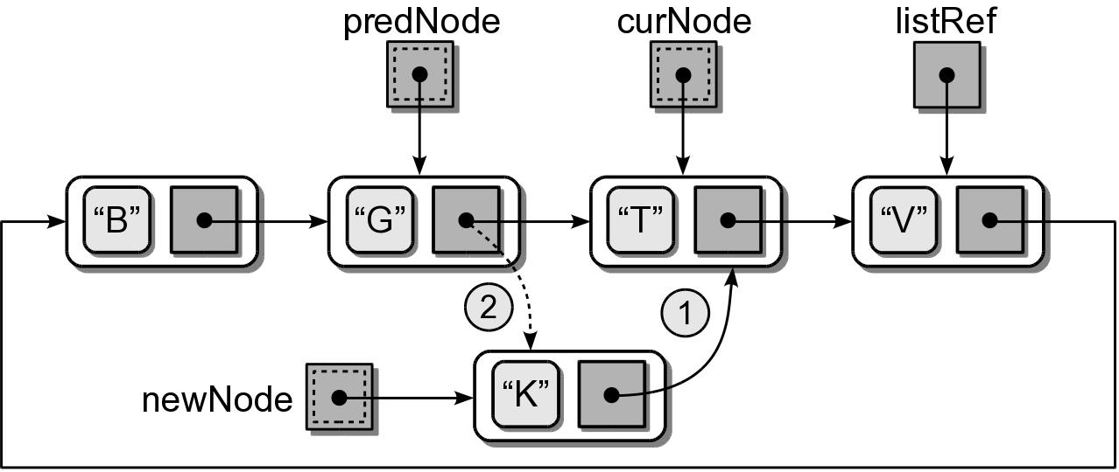
Circular Linked: Inserting
(4) Insert in the middle.

Slide 11
Circular Singly Linked: Inserting
newnode = ListNode( value )
if listRef is None : # empty list
listRef = newNode
newNode.next = newNode
elif value < listRef.next.data : # insert in front
newNode.next = listRef.next
listRef.next = newNode
elif value > listRef.data : # insert in back
newNode.next = listRef.next
listRef.next = newNode
listRef = newNode
else : # insert in the middle
# Position the two pointers.
predNode= None
curNode = listRef
done = listRef is None
while not done :
predNode = curNode
predNode = curNode.next
done = curNode is listRef or curNode.data > target
# Adjust links to insert the node.
newNode.next = curNode
predNode.next = newNode

