Slide 1
Queue ADT
Revised based on textbook author’s notes.

Slide 2
Queue
A restricted access container that stores a linear collection.
Very common for solving problems in computer science that require data to be processed in the order in which it was received.
Provides a first-in first-out (FIFO) protocol.
New items are added at the back while existing items are removed from the front of the queue.

Slide 3
The Queue ADT
A queue stores a linear collection of items with access limited to a first-in first-out order.
New items are added to the back.
Existing items are removed from the front.
Queue() is_empty() len() enqueue( item ) dequeue()

Slide 4
Queue Example
The following code creates the queue from earlier.
Q = Queue()
Q.enqueue( 28 )
Q.enqueue( 19 )
Q.enqueue( 45 )
Q.enqueue( 13 )
Q.enqueue( 7 )

Slide 5
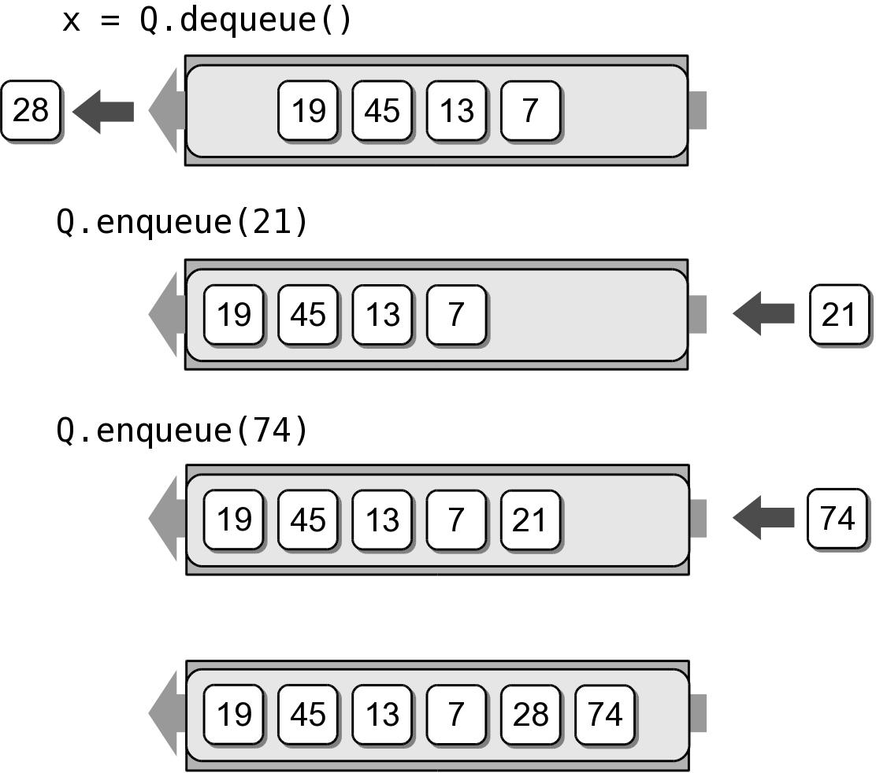
Queue Example
We can remove items from the queue and add more items.
x = Q.dequeue()
Q.enqueue( 21 )
Q.enqueue( 74 )

Slide 6
Queue Implementation
Several common ways to implement a queue:
Python list
easiest to implement
Linked list
reduces memory wastes by eliminating the extra capacity created with an array.
Circular array
fast operations with a fixed size queue.

Slide 7
Queue: Python List
How is the data organized within the Python list?
Add new items to the end of the list.
Remove items from the front of the list.

Slide 8
Queue: Python List
pylistqueue.py
# Implementation of the Queue ADT using a Python list.
class Queue :
def __init__( self ):
self._qlist = list()
def is_empty( self ):
return len( self ) == 0
def __len__( self ):
return len( self._qlist )
def enqueue( self, item ):
self._qlist.append( item )
def dequeue( self ):
assert not self.is_empty(), "Cannot dequeue from an empty queue."
return self._qlist.pop( 0 )

Slide 9
Queue Analysis: Python List
Queue Operation | Worst Case
q = Queue() | O(1)
len(q) | O(1)
q.is_empty() | O(1)
q.enqueue(x) | O(n)
x = q.dequeue() | O(n)

Slide 10
Queue: Linked List
How should the data be organized?
Use both head and tail references.
Let the head of the list represent the front of the queue and the tail the back.

Slide 11
Your in-class work
Implement a linked list queue
Test your implementation with test_linkedlist_queue.py

