Slide 1
Binary Tree Implementation
Revised based on textbook author’s notes.

Slide 2
Binary Tree Properties
There are several properties associated with binary trees that depend on the node organization.
depth – the distance of a node from the root.
level – all nodes at a given depth share a level.
height – number of levels in the tree.
width – number of nodes on the level containing the most nodes.
size – number of nodes in the tree.

Slide 3
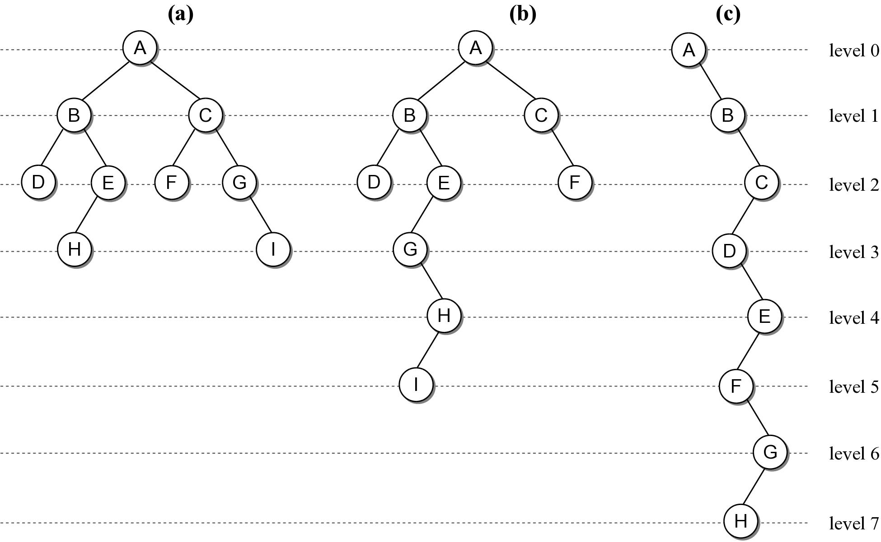
Binary Tree Properties

Slide 4
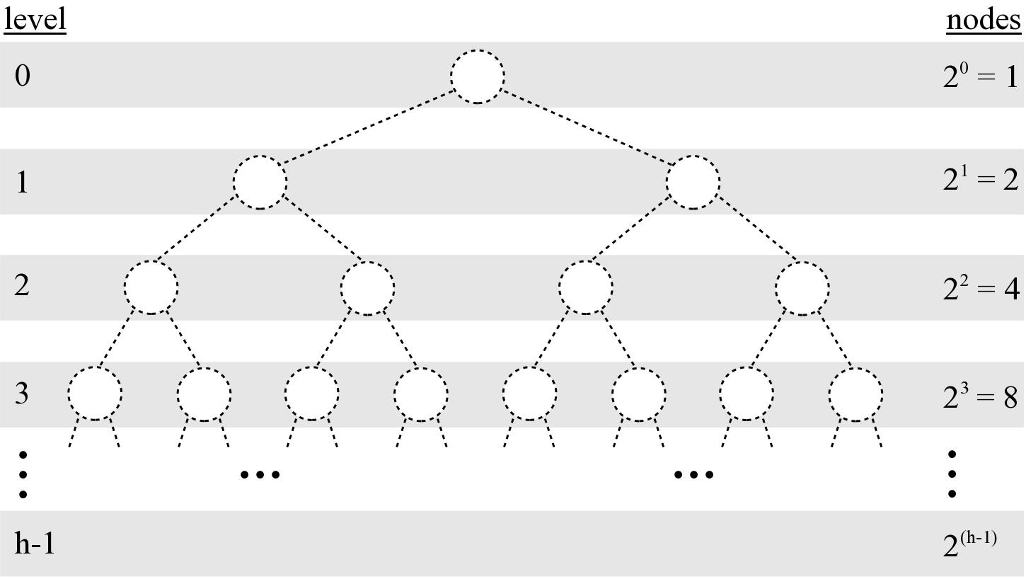
Binary Tree Properties
Given a tree of size n:
max height = n
min height =

Slide 5
Binary Tree Structure
Height of a tree will be important in analyzing the efficiency of binary tree algorithms.
Structural properties can play a role in the efficiency of an algorithm.

Slide 6
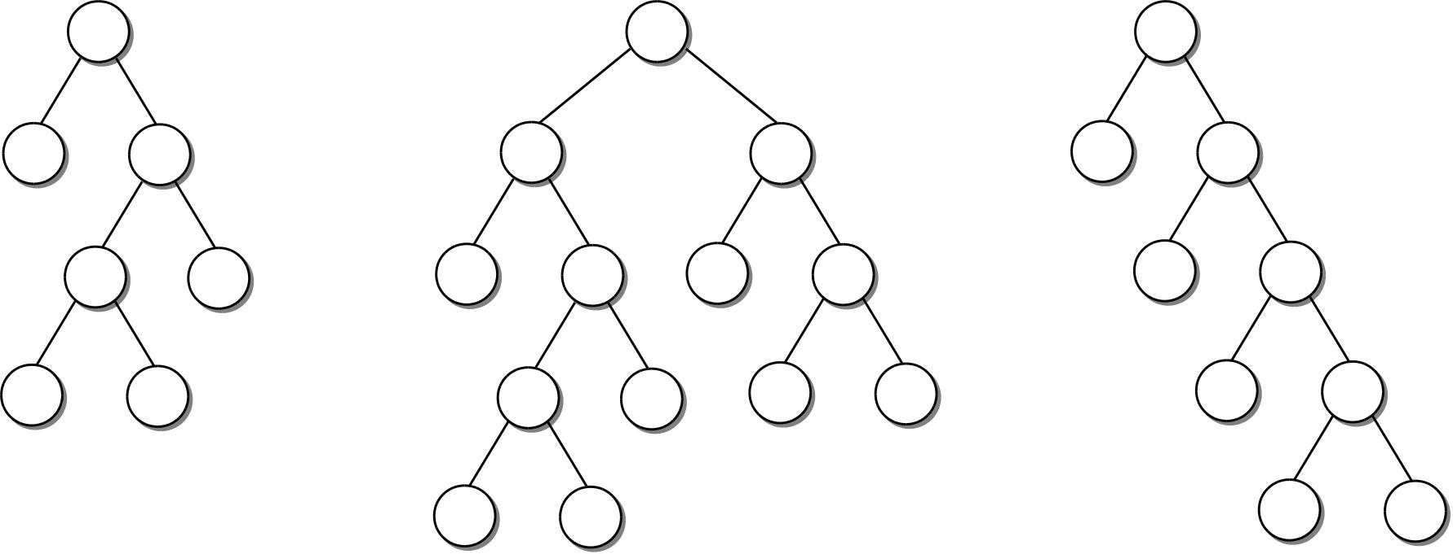
Full Binary Tree
A binary tree in which each interior node contains two children.

Slide 7
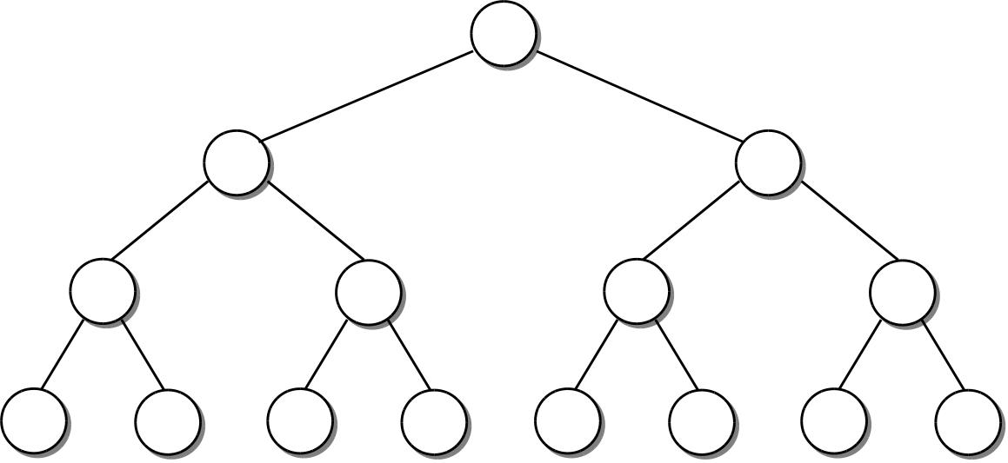
Perfect Binary Tree
A full binary tree in which all leaf nodes are at the same level.

Slide 8
Complete Binary Tree
A binary tree of height h, is a perfect binary tree down to height h – 1 and the nodes at the lowest level are filled from left to right (no gaps).

Slide 9
Binary Tree Implementation
Many different implementations. We’ll discuss two.
Linked node based
Array based

Slide 10
Linked node based
# The storage class for creating binary tree nodes.
class BinTreeNode :
def __init__( self, data ):
self.data = data
self.left = None
self.right = None
def set_left(self, leftnode):
”””Set the incoming node as the left child”””
self.left = leftnode
”””similar functions follow”””
def set_right(self, rightnode):
def set_data(self, new_data):
def get_data(self):
def get_left(self):
def get_right(self):
bintreenode.py

Slide 11
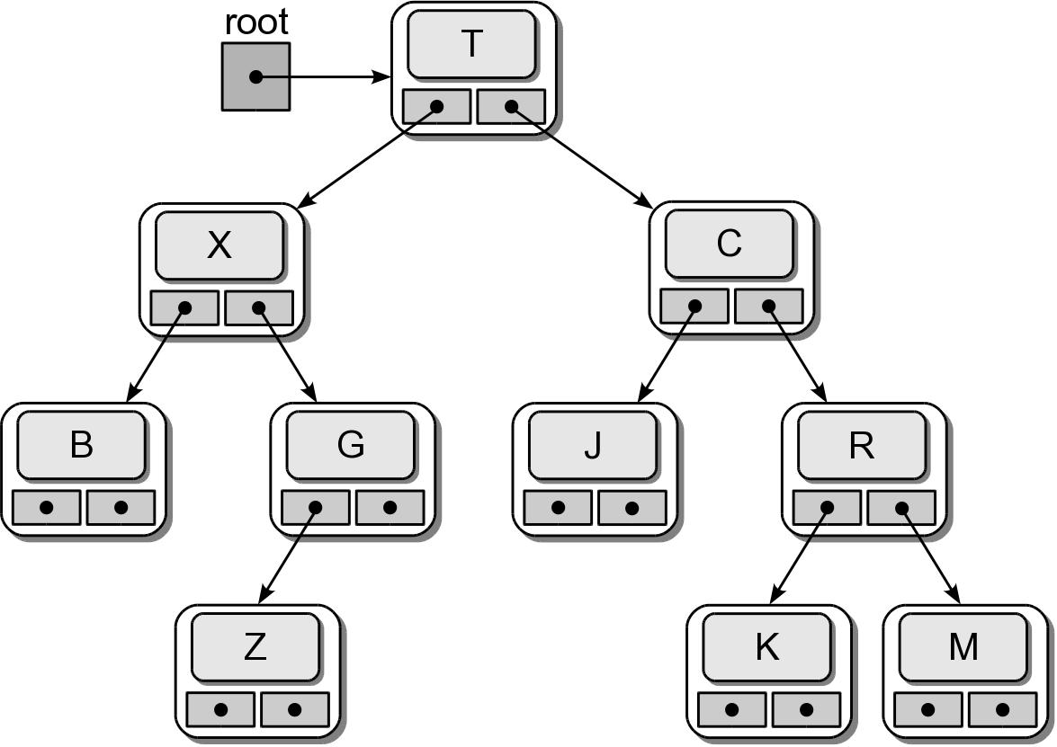
Physical Implementation
testbintree.py

Slide 12
Tree Traversals
Iterates through the nodes of a tree, one node at a time in order to visit every node.
With a linear structure this was simple.
How is this done with a hierarchical structure?
Must begin at the root node.
Every node must be visited.
Results in a recursive solution.

Slide 13
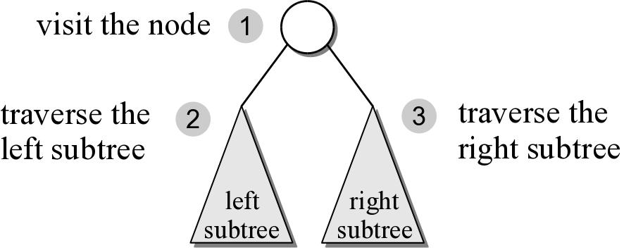
Preorder Traversal
After visiting the root,
traverse the nodes in the left subtree
then traverse the nodes in the right subtree.

Slide 14
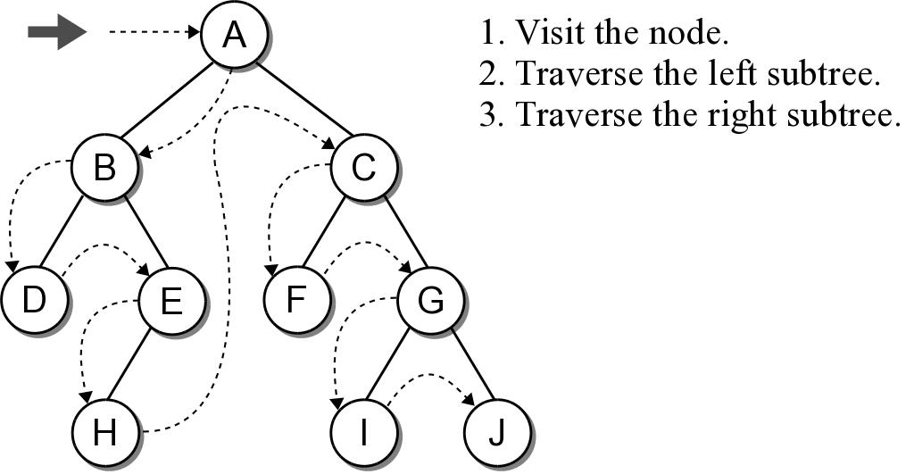
Preorder Traversal

Slide 15
Preorder Traversal
The implementation is rather simple.
Given a binary tree of size n, a complete traversal requires O(n) to visit every node.
def preorderTrav( subtree ):
if subtree is not None :
print( subtree.data )
preorderTrav( subtree.left )
preorderTrav( subtree.right )

Slide 16
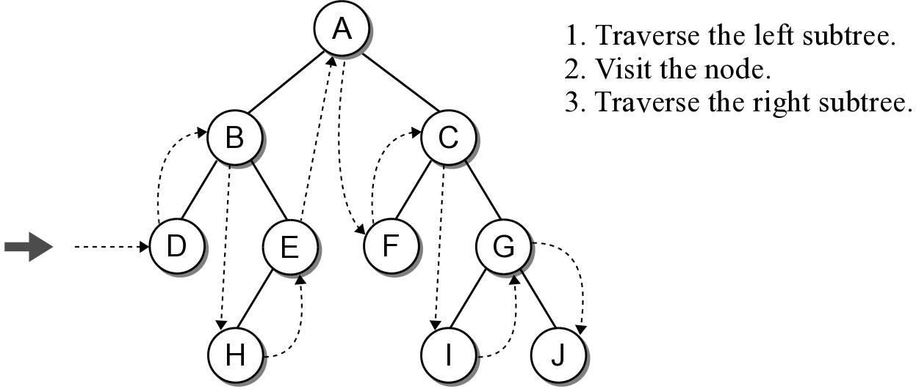
Inorder Traversal
Similar to the preorder traversal, but we traverse the left subtree before visiting the node.

Slide 17
Inorder Traversal
The implementation swaps the order of the visit operation and the recursive calls.
def inorderTrav( subtree ):
if subtree is not None :
inorderTrav( subtree.left )
print( subtree.data )
inorderTrav( subtree.right )

Slide 18
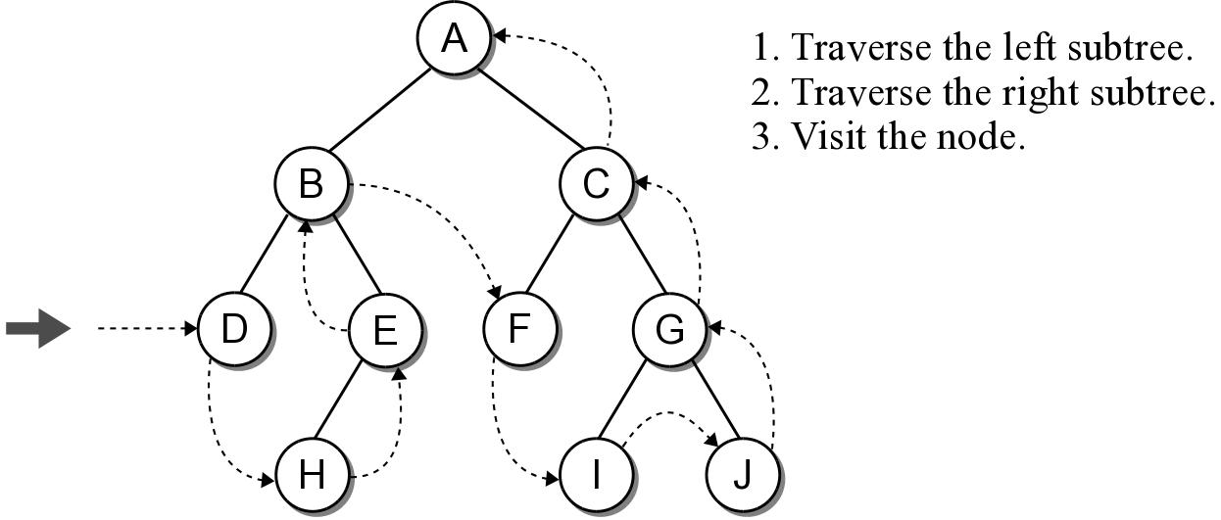
Postorder Traversal
Is the opposite of the preorder traversal.
Traverse both the left and right subtrees before visiting the node.

Slide 19
Postorder Traversal
The implementation swaps the order of the visit operation and the recursive calls.
def postorderTrav( subtree ):
if subtree is not None :
postorderTrav( subtree.left )
postorderTrav( subtree.right )
print( subtree.data )

Slide 20
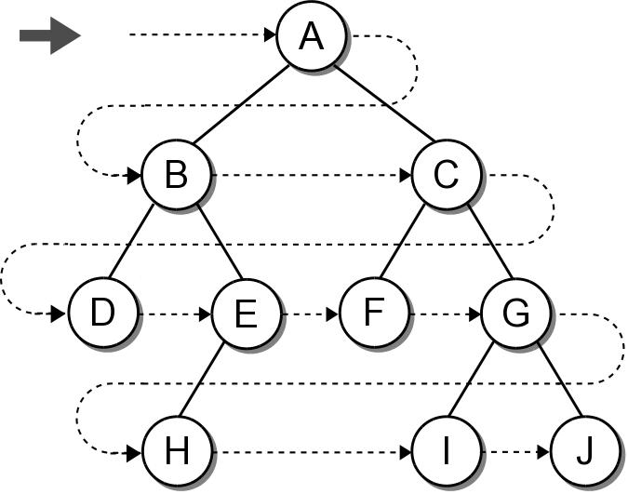
Breadth-First (level order) Traversal
The nodes are visited by level, from left to right.
The previous traversals are all depth-first traversals.

Slide 21
Breadth-First Traversal
Recursion can not be used with this traversal.
We can use a queue and an iterative loop.
def breadthFirstTrav( bintree ):
Queue q
q.enqueue( bintree )
while not q.isEmpty() :
# Remove the next node from the queue and visit it.
node = q.dequeue()
print( node.data )
# Add the two children to the queue.
if node.left is not None :
q.enqueue( node.left )
if node.right is not None :
q.enqueue( node.right )

Slide 22
Array based binary trees
It is very nature to implement binary trees using linked nodes.
For binary tree that has “many” nodes, it may be more effective and efficient to implement it using an array!

