Slide 1
Binary Tree Implementation And Applications
Revised based on textbook author’s notes.

Slide 2
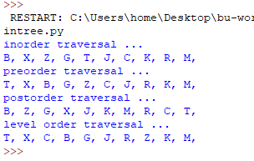
Re-build the tree from traversals
From these traversals, can we rebuild the tree?
The answer is ‘Yes.’

Slide 3
Re-build the tree from traversals
inorder traversal ...
B, X, Z, G, T, J, C, K, R, M,
preorder traversal ...
T, X, B, G, Z, C, J, R, K, M,
From pre-order, we know T is the root.
From in-order, we know T has left child(ren)
From pre-order, we know X is the root of left branch
From in-order, we know X has left child(ren)
From pre-oder, we know B is the root of left branch of X
Because B doesn’t have child, from pre-order, we know G is the root
of the right subtree of X
…

Slide 4
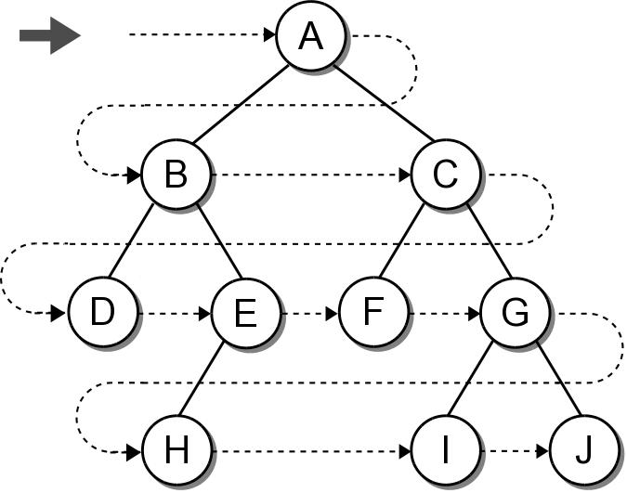
Breadth-First (level order) Traversal
The nodes are visited by level, from left to right.
The previous traversals are all depth-first traversals.

Slide 5
Breadth-First Traversal
Recursion can not be used with this traversal.
We can use a queue and an iterative loop.
def breadth_first_trav( bintree ):
q = Queue()
q.enqueue( bintree )
while not q.is_empty() :
# Remove the next node from the queue and visit it.
node = q.dequeue()
print( node.data )
# Add the two children to the queue.
if node.left is not None :
q.enqueue( node.left )
if node.right is not None :
q.enqueue( node.right )
Try testbintree.py

Slide 6
Array based binary trees
It is very natural to implement binary trees using linked nodes.
For binary tree that has “many” nodes, it may be more effective and efficient to implement it using an array!

Slide 7
Relation among nodes
If the root is at index n, its left child will be at index 2*n+1, its right child will be at index 2*n+2
If a node is at index k, its parent is at index (k-1) // 2

Slide 8
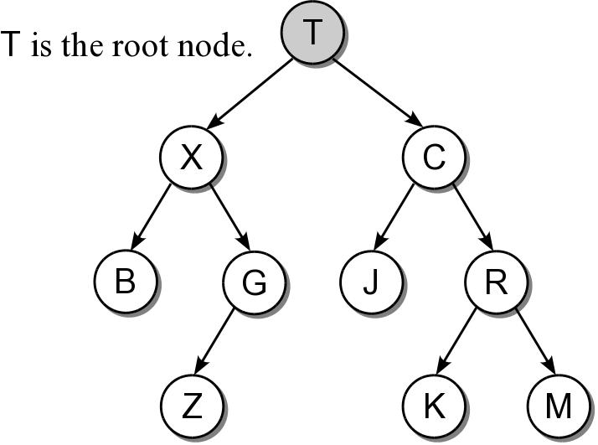
An array-based tree example
T
X
C
B
G
J
R
Z
K
M
0
1
2
3
4
5
6
7
8
9
0
1
2
3
4
5

Slide 9
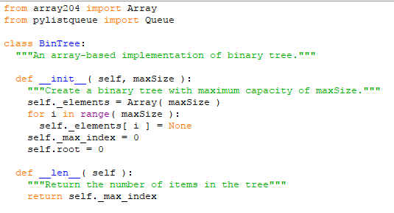
Implementation: constructor

Slide 10
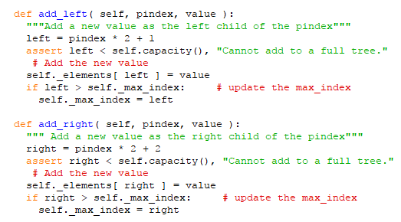
Implementation: adding node

Slide 11
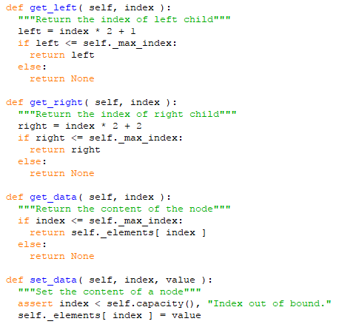
Implementation: accessors

Slide 12
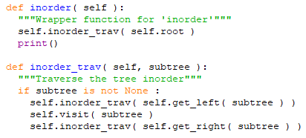
Traversals: in-order

Slide 13
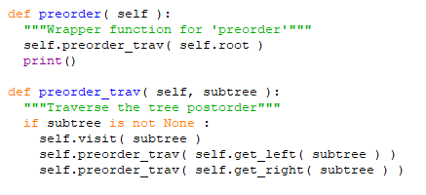
Traversals: pre-order

Slide 14
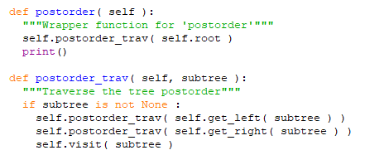
Traversals: post-order

Slide 15
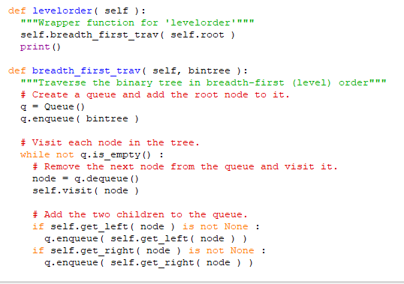
Traversals: level-order

