Slide 1
Binary Tree Application
Expression Tree
Revised based on textbook author’s notes.

Slide 2
Expression Trees
A binary tree in which the operators are stored in the interior nodes and the operands are sored in the leaves.
  Used to evaluate an expression.
  Used to convert an infix expression to either prefix or postfix notation.

Slide 3
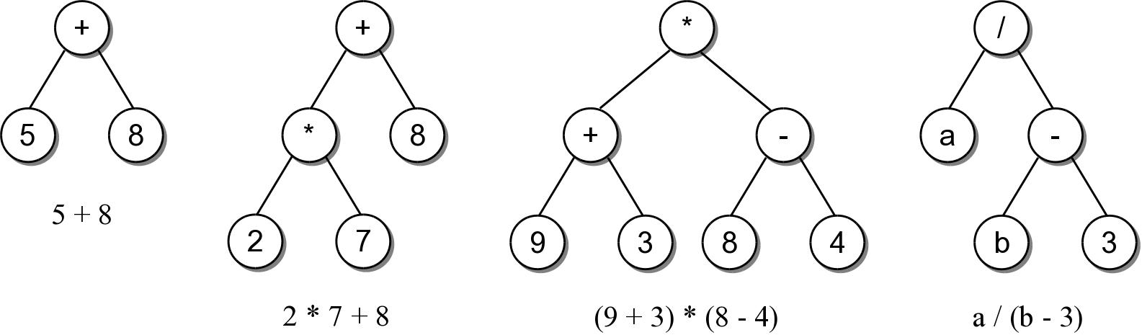
Expression Trees
The tree structure is based on the order in which the operators are evaluated.
  Operators in lower-level nodes are evaluated first.
  The last operator evaluated is in the root node.

Slide 4
Expression Tree ADT
An expression tree is a binary tree representation of an arithmetic expression.
  Contains various operators (+, -, *, /, %)
  Contains operands comprised of single integer digits and single-letter variables.
ExpressionTree( exp_str ) evaluate( var_dict ) __str__()

Slide 5
Expression Tree Example
We can use the ADT to evaluate basic arithmetic expressions of any size.
# Create a dictionary containing values for the variables.
vars = { 'a' : 5, 'b' : 12 }
# Build the tree for a sample expression and evaluate it.
exp_tree = ExpressionTree( "(a/(b-3))" )
print( "The result = ", exp_tree.evaluate(vars) )
# We can change the value assigned to a variable
# and reevaluate.
vars['a'] = 22
print( "The result = ", exp_tree.evaluate(vars) )
Try ex1.py

Slide 6
Expression Tree Implementation
exptree.py
class ExpressionTree :
def __init__( self, exp_str ):
self._exp_tree = None
self._build_tree( exp_str ) # recursion
def evaluate( self, var_map ):
return self._eval_tree( self._exp_tree, var_map ) # recursion
def __str__( self ):
return self._build_string( self._exp_tree )
# ...
# Storage class for creating the tree nodes.
class _ExpTreeNode :
def __init__( self, data ):
self.element = data
self.left = None
self.right = None

Slide 7
Expression Tree Evaluation
We can develop an algorithm to evaluate the expression.
  Each subtree represents a valid subexpression.
  Lower-level subtrees have higher precedence.
  For each node, the two subtrees must be evaluated first.
How does it work?

Slide 8
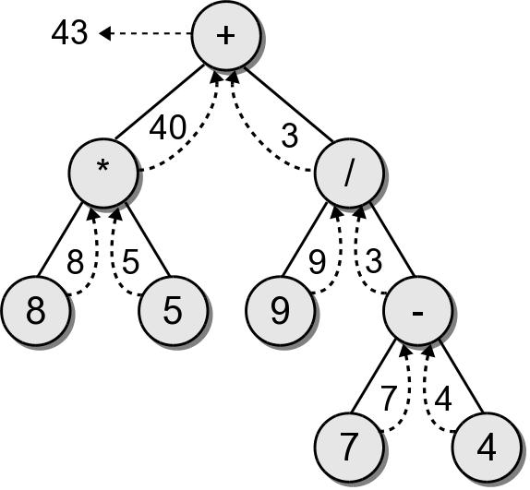
Evaluation Call Tree

Slide 9
Expression Tree Implementation
exptree.py
class ExpressionTree :
# ...
def _eval_tree( self, subtree, var_dict ):
# See if the node is a leaf node
if subtree.left is None and subtree.right is None :
# Is the operand a literal digit?
if subtree.element >= '0' and subtree.element <= '9' :
return int(subtree.element)
else : # Or is it a variable?
assert subtree.element in var_dict, "Invalid variable."
return var_dict[subtree.element]
# Otherwise, it's an operator that needs to be computed.
else :
# Evaluate the expression in the subtrees.
lvalue = _eval_tree( subtree.left, var_dict )
rvalue = _eval_tree( subtree.right, var_dict )
# Evaluate the operator using a helper method.
return compute_op( lvalue, subtree.element, rvalue )

Slide 10
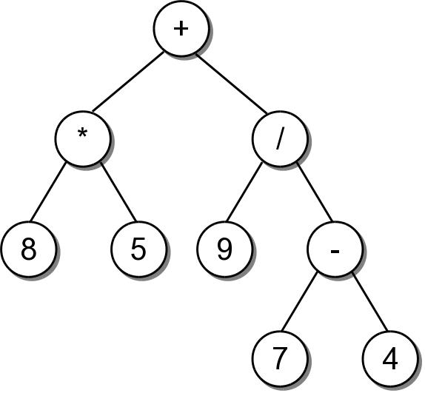
String Representation
To convert an expression tree to a string, we must perform an infix traversal.
8 * 5 + 9 / 7 - 4

Slide 11
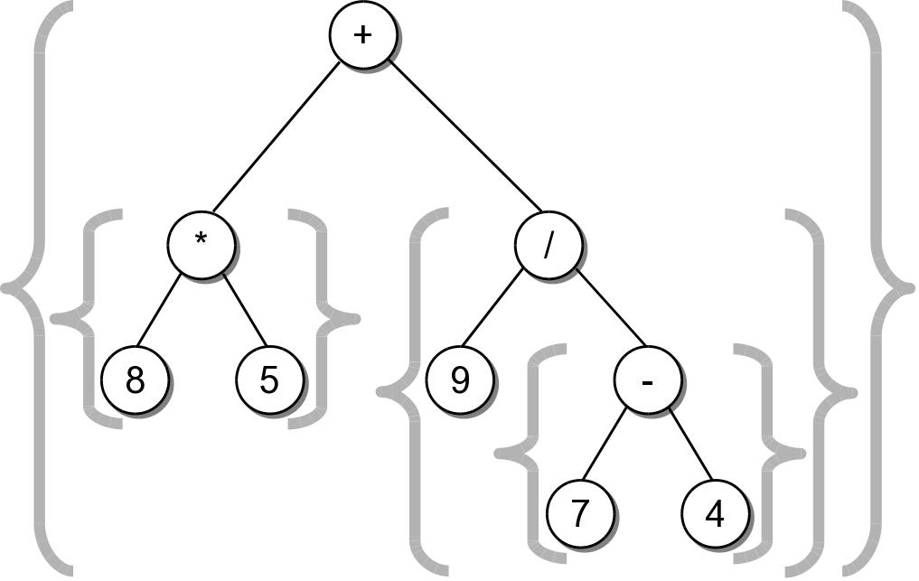
String Representation
The result was not correct because required parentheses were missing.
  Can easily create a fully parenthesized expression.
((8 * 5) + (9 / (7 - 4)))
Class activity to implement this __str__() method.

Slide 12
Expression Tree Implementation
exptree.py
class ExpressionTree :
# ...
def _build_string( self, tree_node ):
# If the node is a leaf, it's an operand.
if tree_node.left is None and tree_node.right is None :
return str( tree_node.element )
# Otherwise, it's an operator.
else :
exp_str = '('
exp_str += self._build_string( tree_node.left )
exp_str += str( tree_node.element )
exp_str += self._build_string( tree_node.right )
exp_str += ')'
return exp_str

Slide 13
Expression Tree Construction
An expression tree is constructed by parsing the expression and examining the tokens.
  New nodes are inserted as the tokens are examined.
  Each set of parentheses will consist of:
    an interior node for the operator
    two children either single valued or a subexperssion.

Slide 14
Expression Tree Construction
For simplicity, we assume:
  the expression is stored in a string with no white space.
  the expression is valid and fully parenthesized.
  each operand will be a single-digit or single-letter variable.
  the operators will consist of +, -, *, /, %

Slide 15
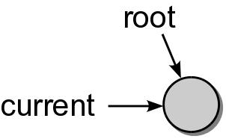
Expression Tree Construction
Consider the expression (8*5)
The process starts with an empty root node set as the current node:
The action at each step depends on the current token.

Slide 16
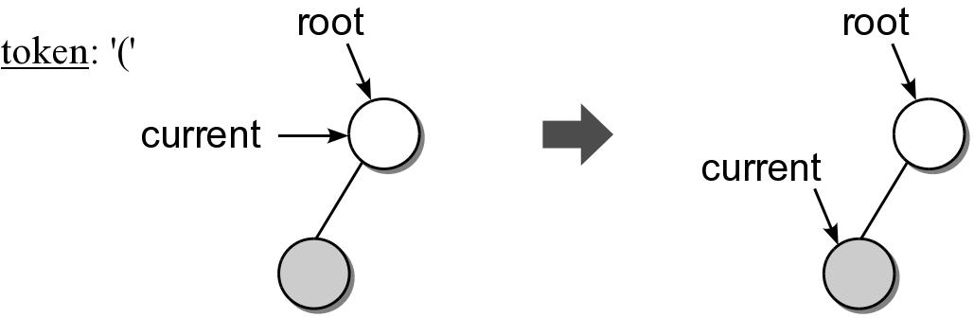
Expression Tree Construction
When a left parenthesis is encountered: (8*5)
  a new node is created and linked as the left child of the current node.
  descend down to the new node.

Slide 17
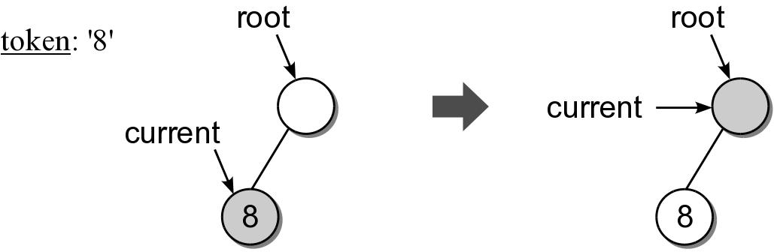
Expression Tree Construction
When an operand is encountered: (8*5)
  the data field of the current node is set to contain the operand.
  move up to the parent of current node.

Slide 18
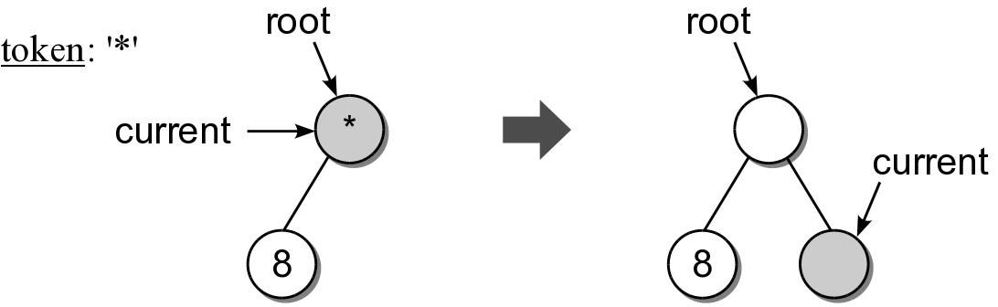
Expression Tree Construction
When an operator is encountered: (8*5)
  the data field of the current node is set to the operator.
  a new node is created and linked as the right child of the current node.
  descend down to the new node.

Slide 19
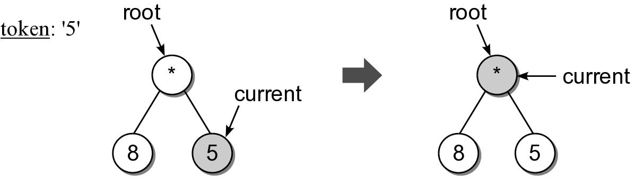
Expression Tree Construction
Another operand is encountered: (8*5)

Slide 20
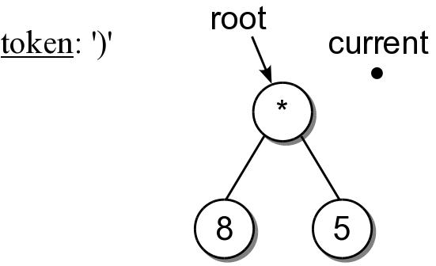
Expression Tree Construction
When a right parenthesis: (8*5)
  move up to the parent of the current node.

Slide 21
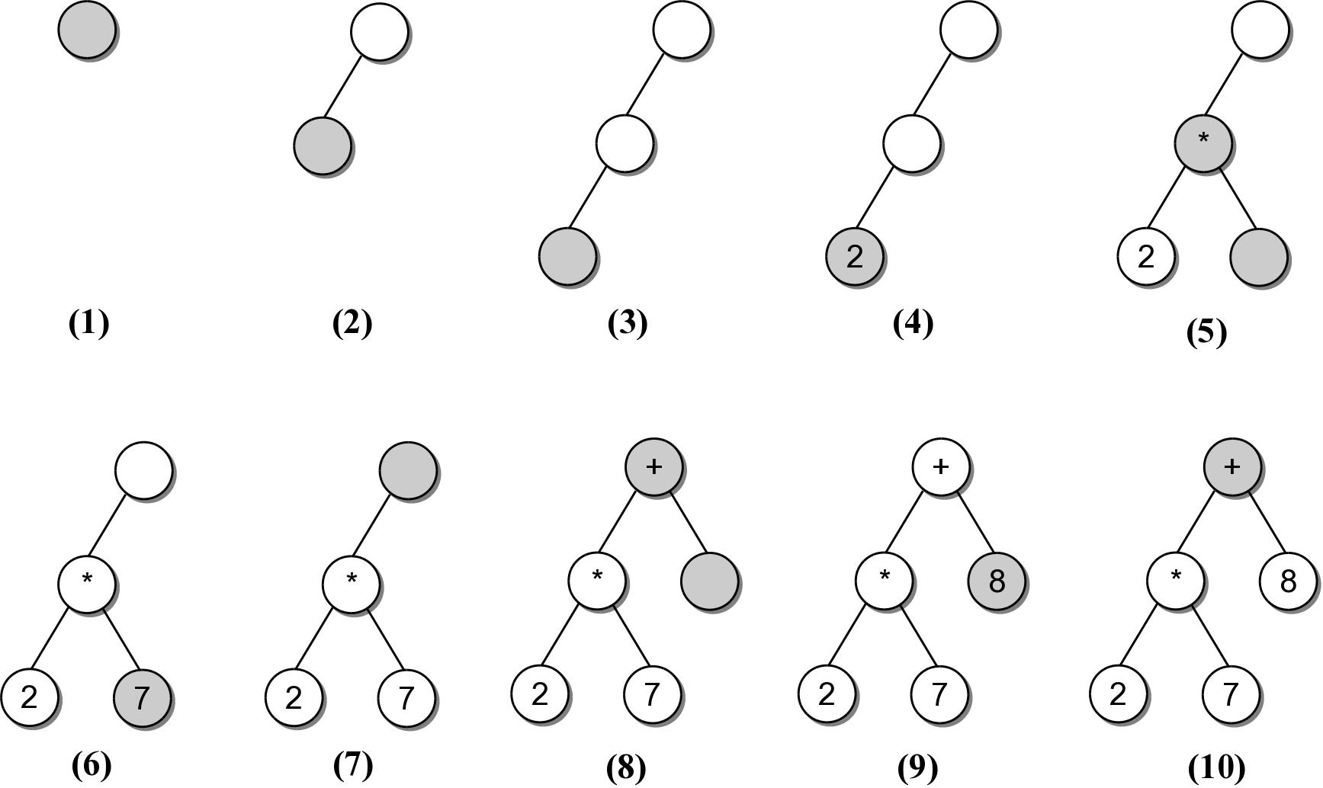
Expression Example #2
((2*7)+8)
Consider another expression:

Slide 22
Expression Tree Implementation
exptree.py
class ExpressionTree :
# ...
def _build_tree( self, exp_str ):
# Build a queue containing the tokens from the expression.
expQ = Queue()
for token in exp_str :
expQ.enqueue( token )
# Create an empty root node.
self._exp_tree = _ExpTreeNode( None )
# Call the recursive function to build the tree.
self._rec_build_tree( self._exp_tree, expQ )

Slide 23
Expression Tree Implementation
exptree.py
class ExpressionTree :
# ...
def _rec_build_tree( self, cur_node, expQ ):
# Extract the next token from the queue.
token = expQ.dequeue()
# See if the token is a left paren: '('
if token == '(' :
cur_node.left = _ExpTreeNode( None )
build_treeRec( cur_node.left, expQ )
# The next token will be an operator: + - / * %
cur_node.data = expQ.dequeue()
cur_node.right = _ExpTreeNode( None )
self._build_tree_rec( cur_node.right, expQ )
# The next token will be a ), remove it.
expQ.dequeue()
# Otherwise, the token is a digit.
else :
cur_node.element = token

