Slide 1
Binary Tree Application Build Expression Tree Heaps
Revised based on textbook author’s notes.

Slide 2
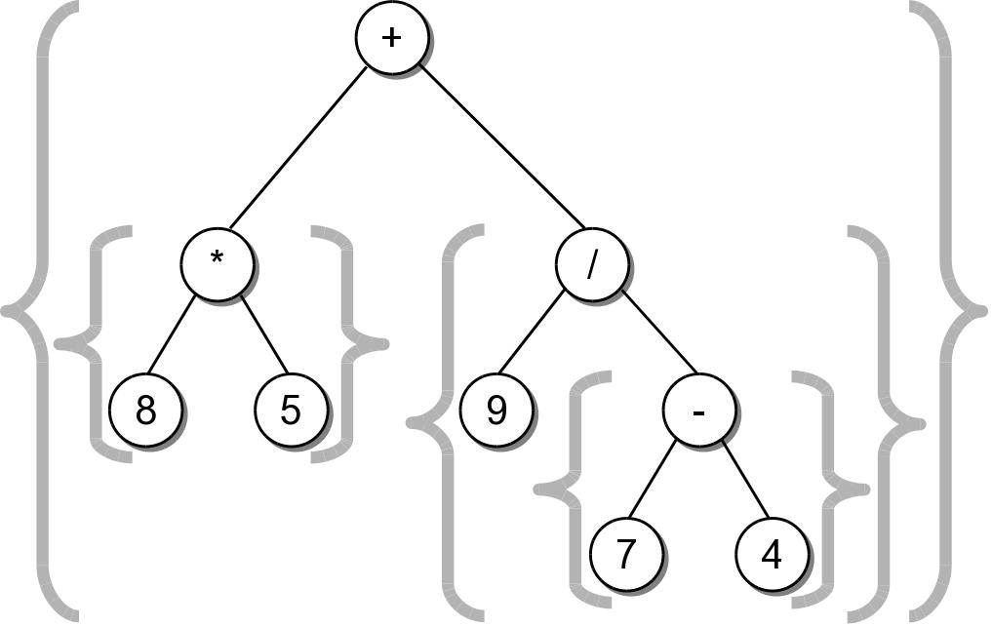
String Representation
The result was not correct because required parentheses were missing.
Can easily create a fully parenthesized expression.
((8 * 5) + (9 / (7 - 4)))
Class activity to implement this __str__() method.

Slide 3
Expression Tree Implementation
exptree.py
class ExpressionTree :
# ...
def _build_string( self, tree_node ):
# If the node is a leaf, it's an operand.
if tree_node.left is None and tree_node.right is None :
return str( tree_node.element )
# Otherwise, it's an operator.
else :
exp_str = '('
exp_str += self._build_string( tree_node.left )
exp_str += str( tree_node.element )
exp_str += self._build_string( tree_node.right )
exp_str += ')'
return exp_str

Slide 4
Expression Tree Construction
An expression tree is constructed by parsing the expression and examining the tokens.
New nodes are inserted as the tokens are examined.
Each set of parentheses will consist of:
an interior node for the operator
two children either single valued or a subexperssion.

Slide 5
Expression Tree Construction
For simplicity, we assume:
the expression is stored in a string with no white space.
the expression is valid and fully parenthesized.
each operand will be a single-digit or single-letter variable.
the operators will consist of +, -, *, /, %

Slide 6
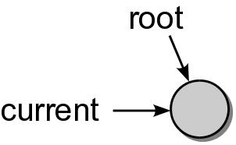
Expression Tree Construction
Consider the expression (8*5)
The process starts with an empty root node set as the current node:
The action at each step depends on the current token.

Slide 7
Expression Tree Construction
When a left parenthesis is encountered: (8*5)
a new node is created and linked as the left child of the current node.
descend down to the new node.

Slide 8
Expression Tree Construction
When an operand is encountered: (8*5)
the data field of the current node is set to contain the operand.
move up to the parent of current node.

Slide 9
Expression Tree Construction
When an operator is encountered: (8*5)
the data field of the current node is set to the operator.
a new node is created and linked as the right child of the current node.
descend down to the new node.

Slide 10
Expression Tree Construction
Another operand is encountered: (8*5)

Slide 11
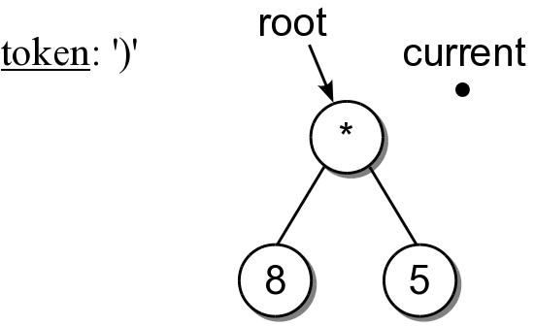
Expression Tree Construction
When a right parenthesis: (8*5)
move up to the parent of the current node.

Slide 12
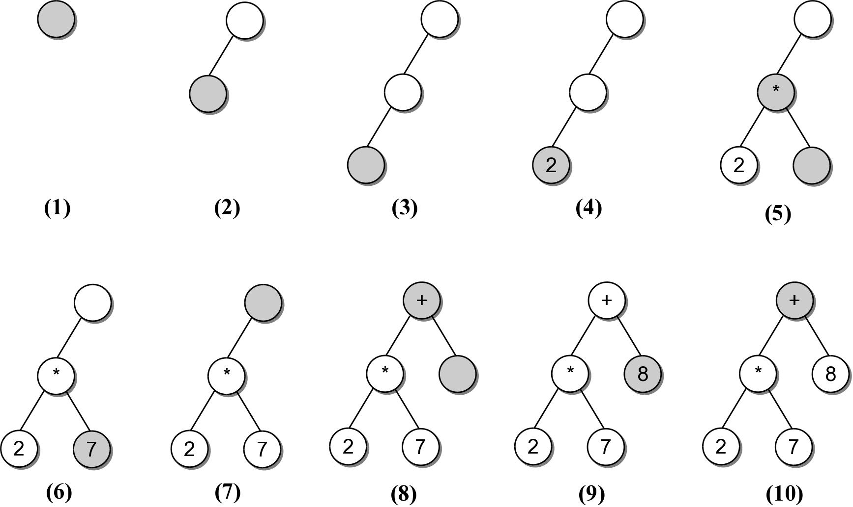
Expression Example #2
((2*7)+8)
Consider another expression:

Slide 13
Expression Tree Implementation
exptree.py
class ExpressionTree :
# ...
def _build_tree( self, exp_str ):
# Build a queue containing the tokens from the expression.
expQ = Queue()
for token in exp_str :
expQ.enqueue( token )
# Create an empty root node.
self._exp_tree = _ExpTreeNode( None )
# Call the recursive function to build the tree.
self._rec_build_tree( self._exp_tree, expQ )

Slide 14
Expression Tree Implementation
exptree.py
class ExpressionTree :
# ...
def _rec_build_tree( self, cur_node, expQ ):
# Extract the next token from the queue.
token = expQ.dequeue()
# See if the token is a left paren: '('
if token == '(' :
cur_node.left = _ExpTreeNode( None )
build_treeRec( cur_node.left, expQ )
# The next token will be an operator: + - / * %
cur_node.data = expQ.dequeue()
cur_node.right = _ExpTreeNode( None )
self._build_tree_rec( cur_node.right, expQ )
# The next token will be a ), remove it.
expQ.dequeue()
# Otherwise, the token is a digit.
else :
cur_node.element = token
Run testexptree.py in 28_ExpressionTree/

Slide 15
Heaps
A heap is a complete binary tree in which the nodes are organized based on their data values.
heap order property – how the nodes in a heap or arranged.
heap shape property – as a complete binary tree.

Slide 16
Heap property, examples
For each non-leaf node V,
max-heap: the value in V is greater than the value of its two children.
min-heap: the value in V is smaller than the value of its two children.

Slide 17
Heap Operations
The heap is a specialized structure with limited operations.
Insert an element into the heap.
Remove the element from root node.

