Slide 1
Binary Tree Application
Heap Sorting
Revised based on textbook author’s notes.

Slide 2
The Heapsort
The simplicity and efficiency of the heap structure can be applied to the sorting problem.
  Build a heap from a sequence of unsorted keys.
  Extract the keys from the heap to create a sorted sequence.
Very efficient: O(n log n)

Slide 3
Heapsort Implementation
A simple implementation is provided below.
def simple_heap_sort( the_seq ):
# Create an array-based max-heap.
n = len(the_seq)
heap = MaxHeap( n )
# Build a max-heap from the list of values.
for item in the_seq :
heap.add( item )
# Extract each value from the heap and store
# them back into the list.
for i in range( n-1, -1, -1 ) : # small to large
# for I in range( n ) : # large to small
theSeq[i] = heap.extract()

Slide 4
In-Place Heapsort
The previous version required additional storage for the heap.
The entire process can be done in-place within the original sequence.
  Suppose we are given the following array

Slide 5
In-Place Heapsort
The first step is to construct a max-heap.
  The heap nodes occupy the array from front to back.
  We can keep the heap elements in the front and those yet to be added at the back.
  Keep track of where the heap ends.

Slide 6
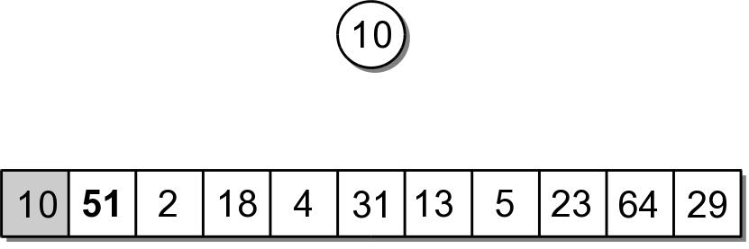
In-Place Heapsort
The first value in the array represents a max-heap of one element.

Slide 7
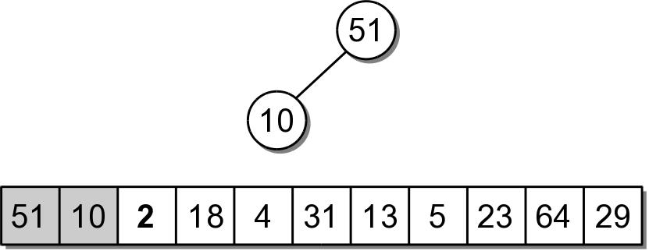
In-Place Heapsort
The next value to be added, is the next in the array.
  The value is copied to the root node (position 0).
  Then sifted down.

Slide 8
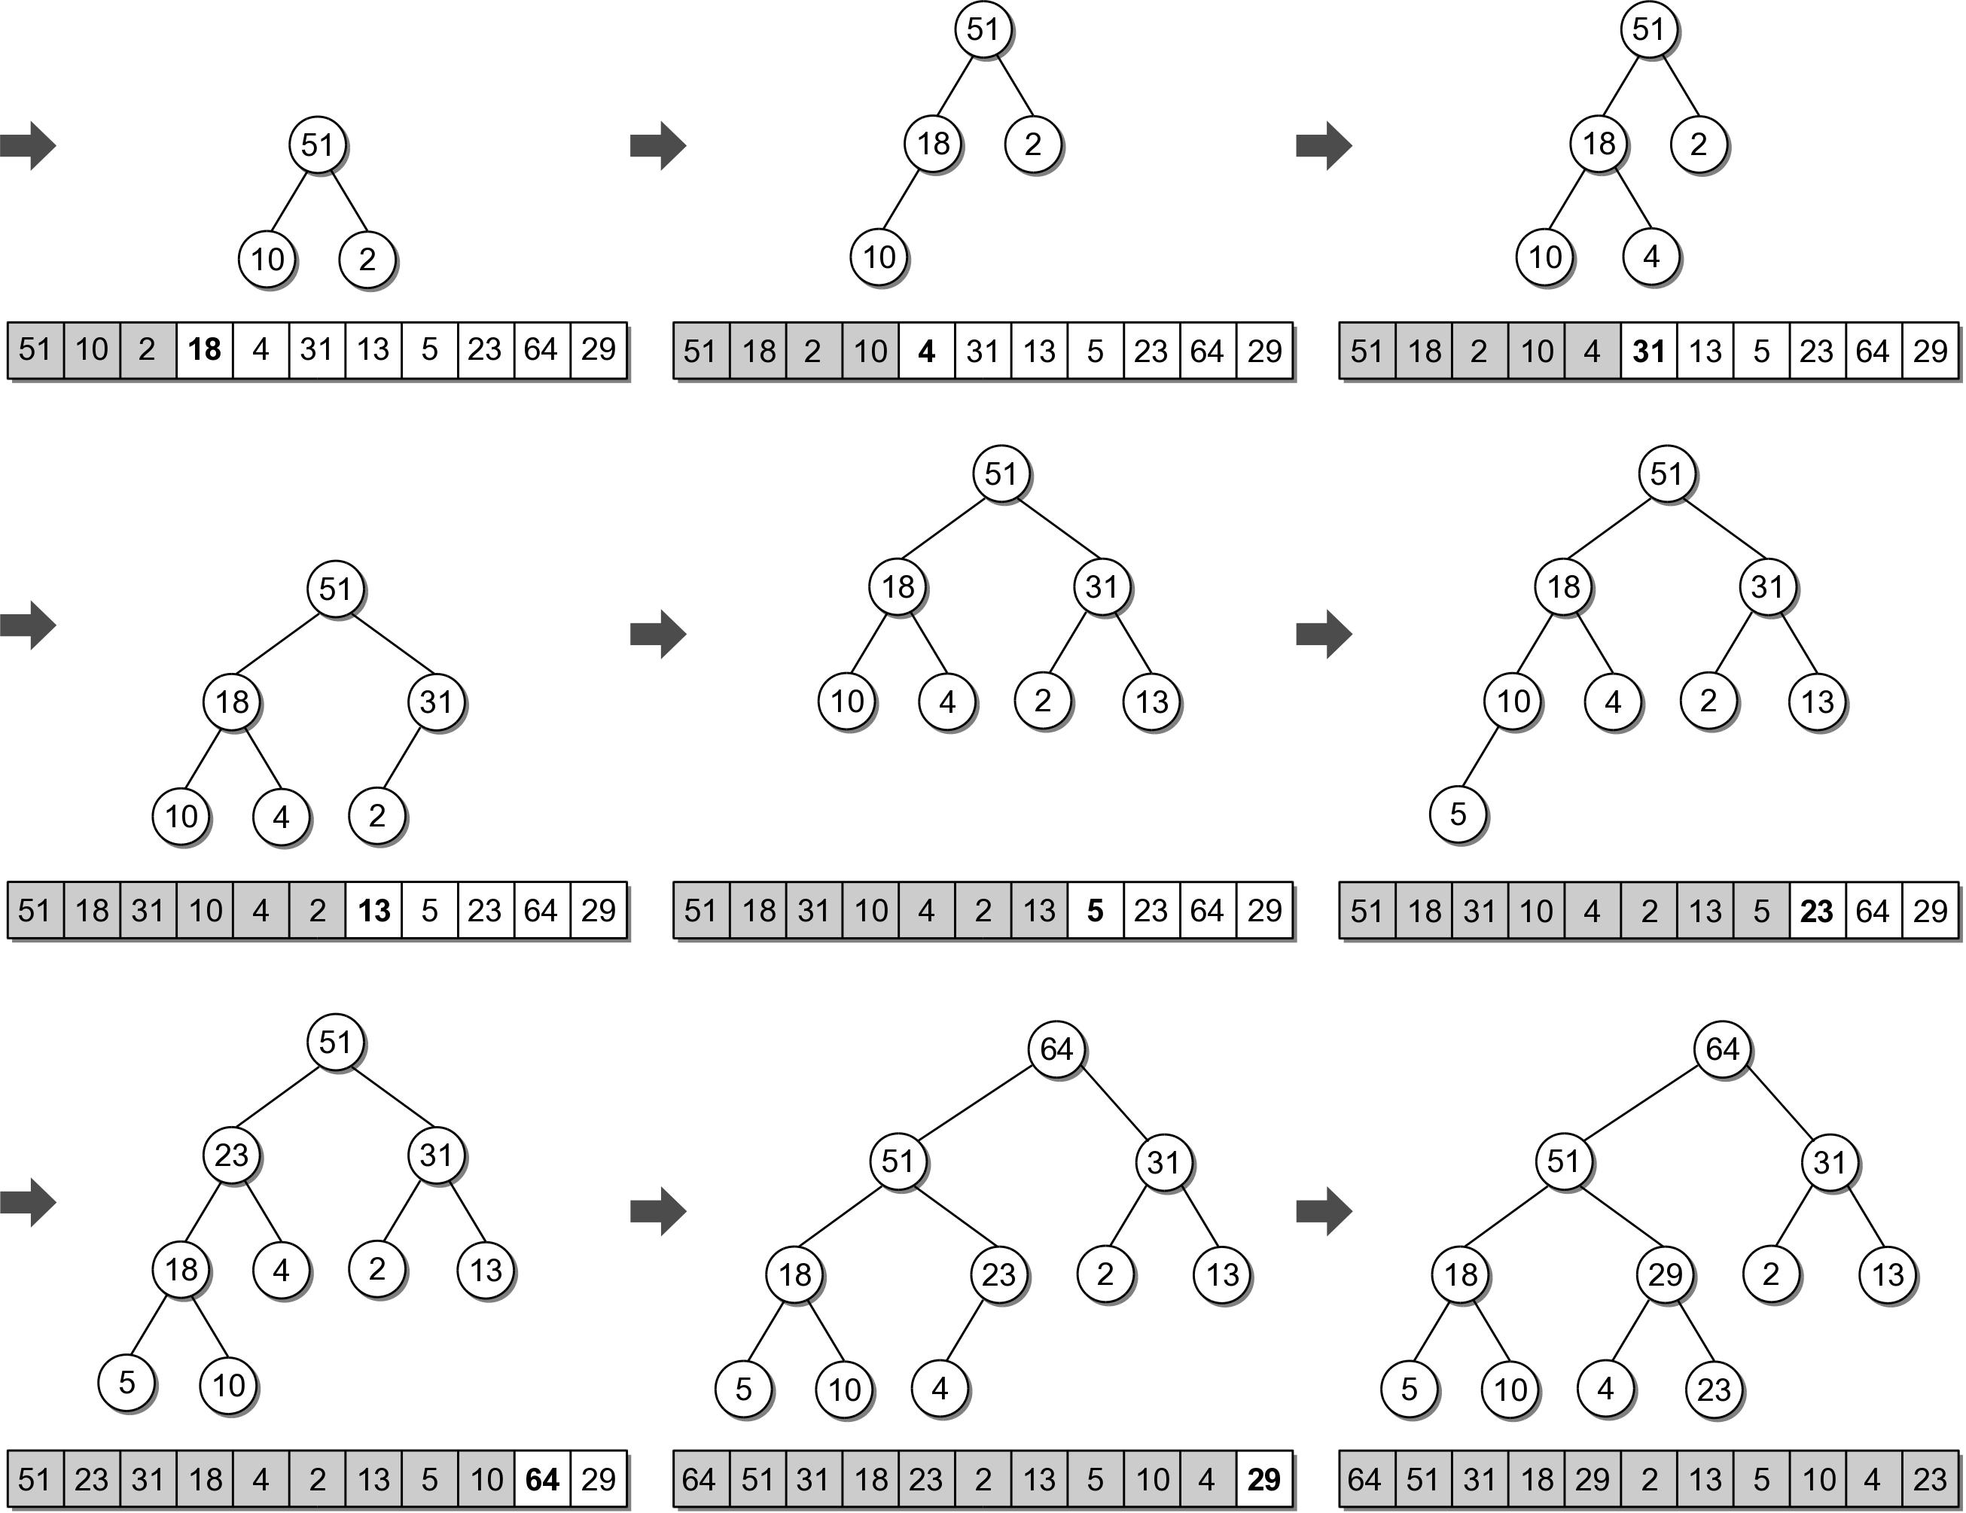
In-Place Heapsort

Slide 9
In-Place Heapsort
The next step is to extract the values from the heap and build the sorted sequence.
  When the root is extracted, the last child node is copied to the root.
  The last child node is stored in the last element of the heap.
  We can simply swap the two values.

Slide 10
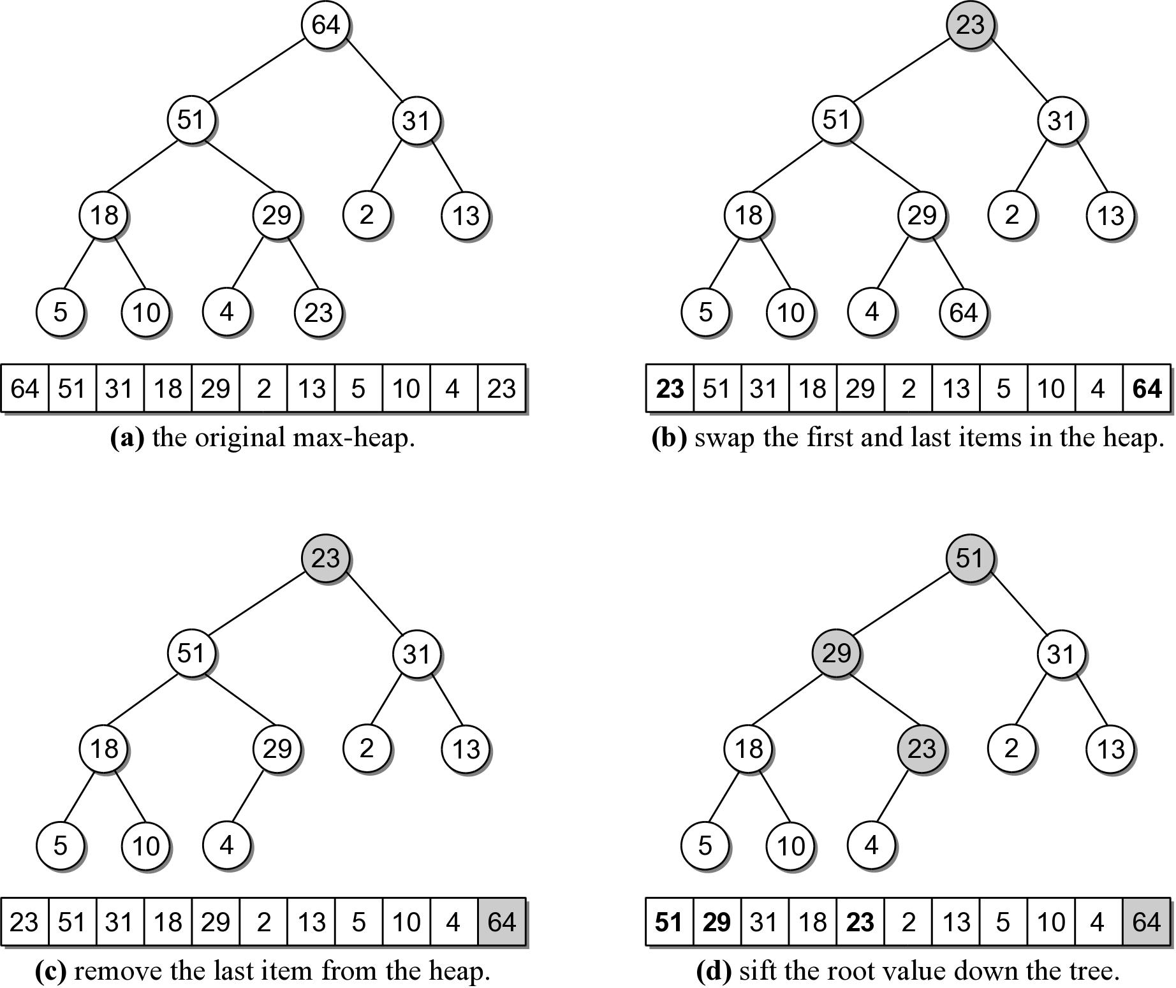
In-Place Heapsort

Slide 11
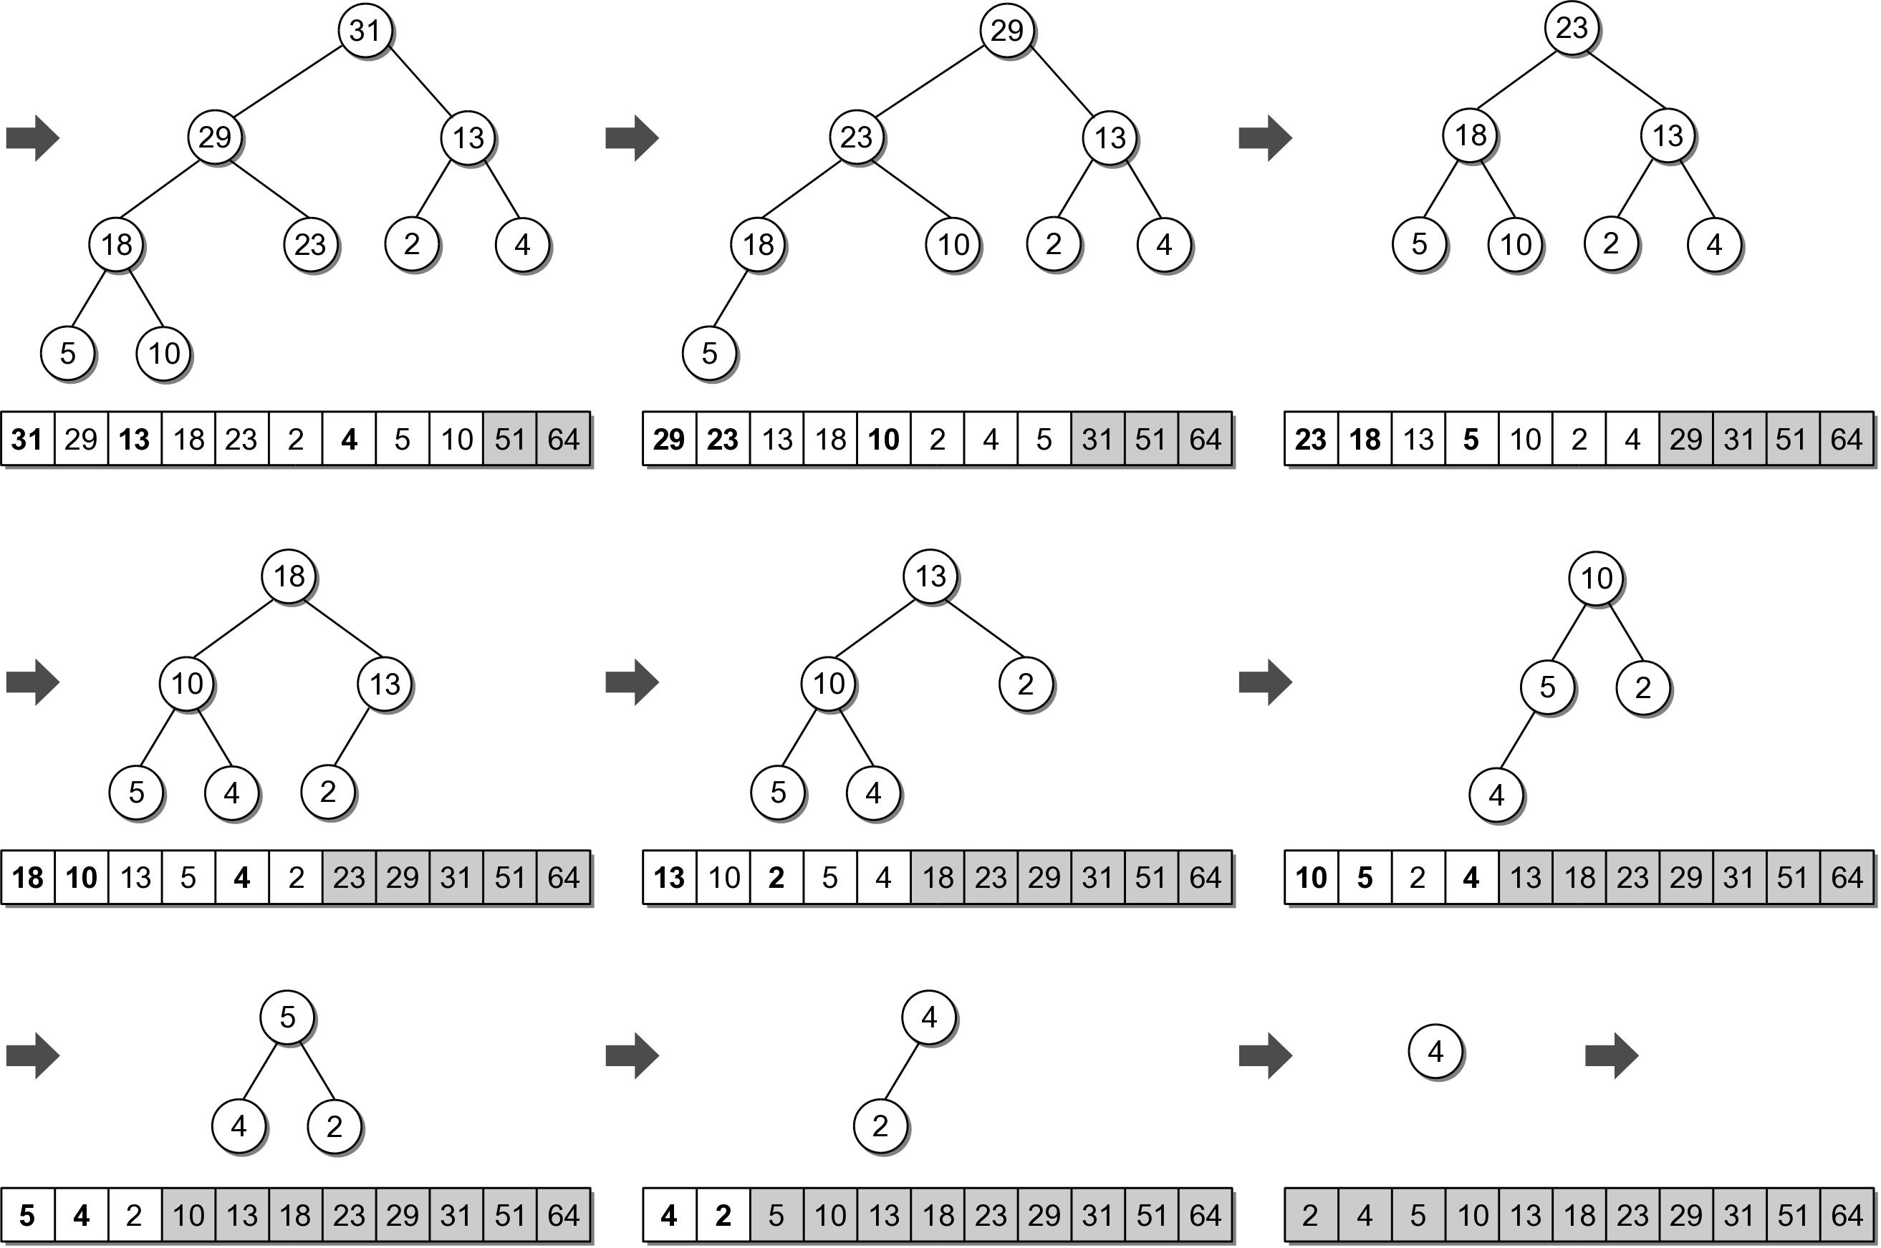
In-Place Heapsort

Slide 12
In-Place Heapsort Implementation
sift_up() and sift_down() are helper functions based on those used in the heap class.
def heapsort( the_seq ):
n = len(the_seq)
# Build a max-heap within the same array.
for i in range( n ) :
siftUp( the_seq, i )
# Extract each value and rebuild the heap.
for j in range( n-1, 0, -1) :
tmp = the_seq[j]
the_seq[j] = the_seq[0]
the_seq[0] = tmp
siftDown( the_seq, j-1, 0 )
Try heapsort.py

