Slide 1
Linear Search Binary Search Tree
Revised based on textbook author’s notes.

Slide 2
Searching
The process of selecting particular information from a collection of data based on specific criteria.
Can be performed on different data structures.
sequence search – search within a sequence.
search key (or key) – identifies a specific item.
compound key – consists of multiple parts.

Slide 3
Linear Search
Iterates over the sequence, item by item, until the specific item is found or the list is exhausted.
The simplest solution to sequence search problem.
Python's in operator: find a specific item.
if key in theArray :
print( 'The key is in the array.' )
else :
print( 'The key is not in the array.' )

Slide 4
Linear Search Examples
Searching for 31
Searching for 8

Slide 5
Linear Search Code
def linear_search( the_values, target ) :
n = len( the_values )
for i in range( n ) :
if the_values[i] == target
return True # or return I
return False # or return -1

Slide 6
Linear Search: Sorted Sequence
A linear search can be performed on a sorted sequence.
Example: searching for 8.

Slide 7
Linear Search: Sorted Sequence
Similar to the unsorted sequence, with one major difference.
def sorted_linear_search( the_values, target ) :
n = len( the_values )
for i in range( n ) :
if the_values[i] == target :
return True
elif the_values[i] > target :
return False
return False

Slide 8
Linear Search: Smallest Value
We can search for an item based on certain criteria.
Example: find the smallest value.
def find_smallest( the_values ):
n = len( the_values )
smallest = the_values[0]
for i in range( 1, n ) :
if the_values[i] < smallest :
smallest = the_values[i]
return smallest

Slide 9
Binary Search
The linear search has a linear time-complexity.
We can improve the search time if we modify the search technique itself.
Use a divide and conquer strategy.
Requires a sorted sequence.

Slide 10
Binary Search Algorithm
Examine the middle item (searching for 10):
One of three possible conditions:
target is found in the middle item.
target is less than the middle item.
target is greater than the middle item.

Slide 11
Binary Search Algorithm
Since the sequence is sorted, we can eliminate half the values from further consideration.

Slide 12
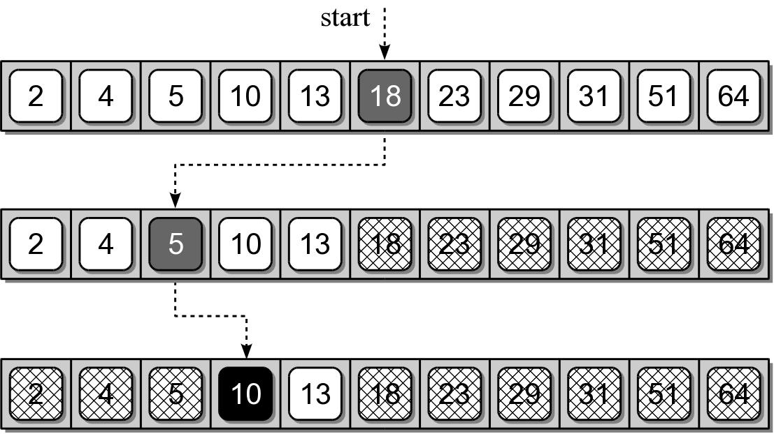
Binary Search Algorithm
Repeat the process until either the target is found or all items have been eliminated.

Slide 13
Binary Search Implementation
def binary_search( the_values, target ) :
low = 0
high = len(the_values) - 1
while low <= high :
mid = low + (high - low) // 2
if the_values[mid] == target :
return True # or return mid
elif target < the_values[mid] :
high = mid - 1
else :
low = mid + 1
return False # or return -1

Slide 14
Binary Search Implementation

Slide 15
Your Exercise
Implement binary search in recursion

Slide 16
Suggested solution
def binary_search( the_list, key, low, high ) :
if low > high:
return False # or return -1
mid = low + (high – low) // 2
if the_list[mid] == key :
return True # or return mid
elif key < the_values[mid] :
return binary_search( the_list, key, low, mid-1 )
else :
return binary_search( the_list, key, mid+1, high )

